Slide 1
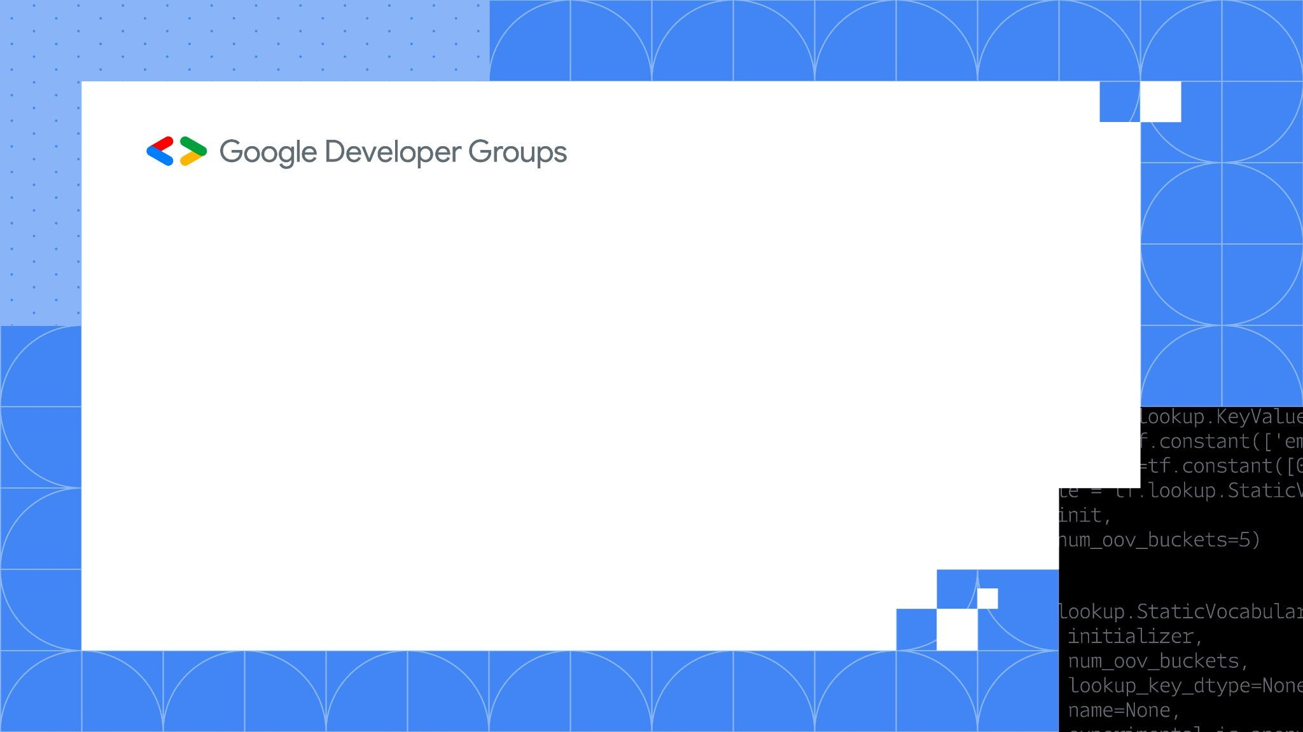
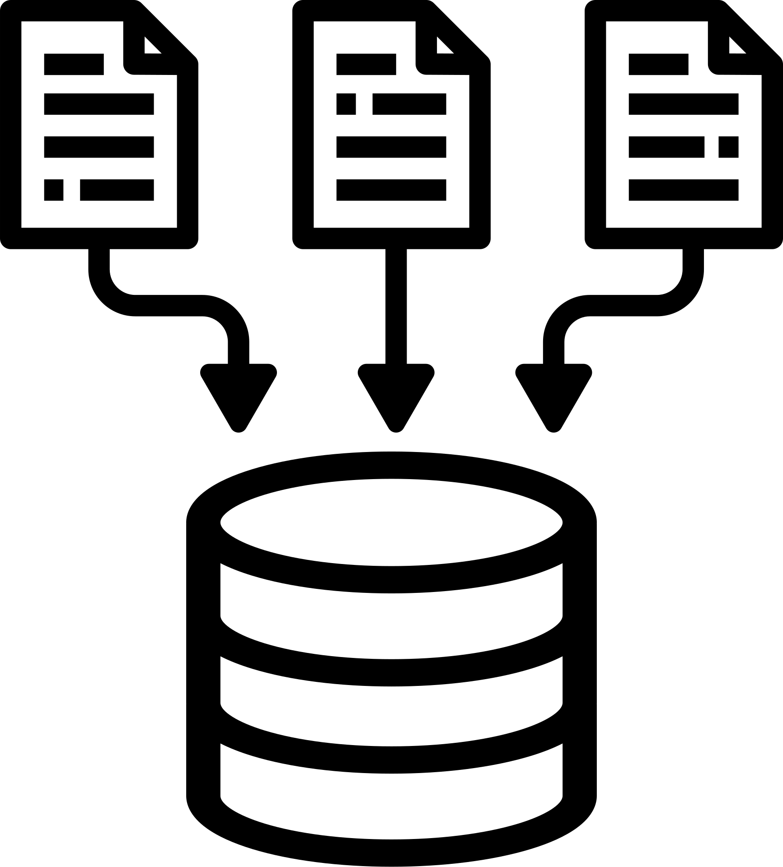
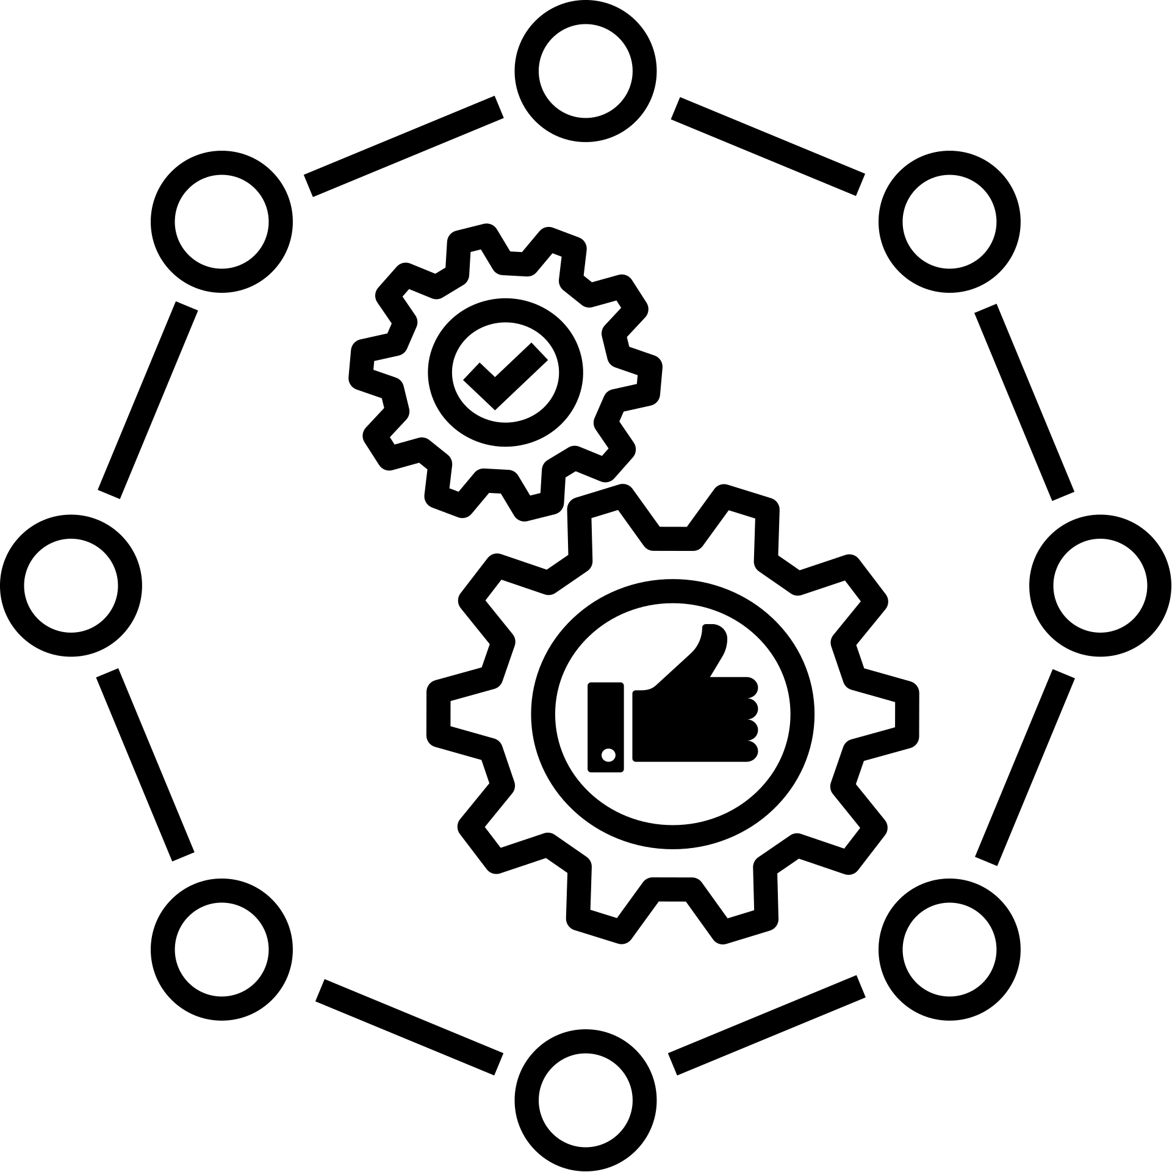
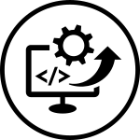
on campus CVR
WEB OFFLINE SESSIONS
Week-1

Slide 2
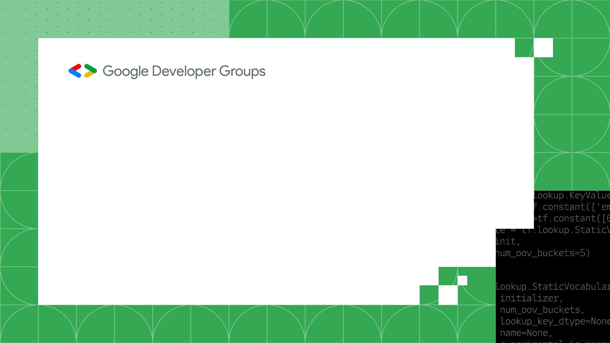
What is Git?
Git is a popular version control system
It is used for:
Tracking code changes
Tracking who made changes
Coding collaboration

Slide 3
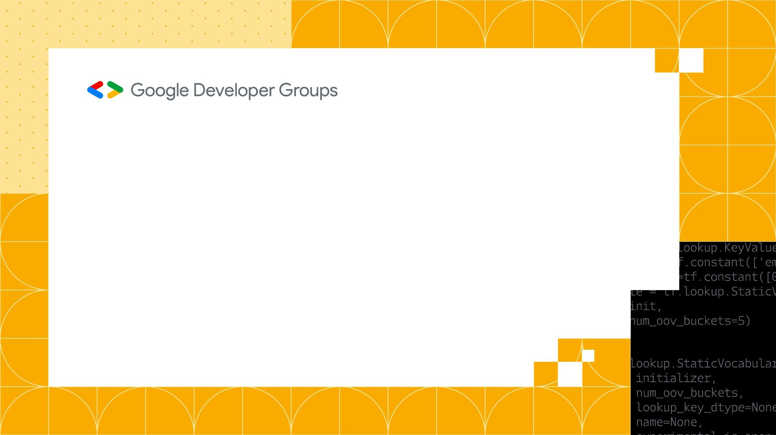
Git Commands
So in order to know got version or whether git installedwe use the following command :
git --version
Configure git
git config --global user.name "Your Name"
git config --global user.email "youremail@example.com"

Slide 4
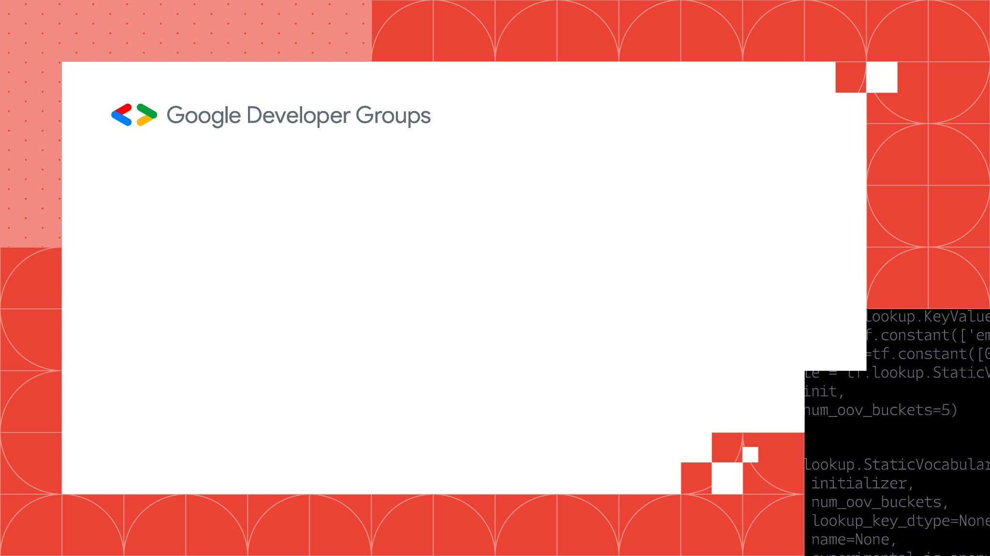
Git Adding New File
git status
git status helps us to get rid of tracked and untracked file
git add <file> – Adds files to the staging area.
Ex: git add index.html

Slide 5
Git Commit
The git commit command is used to save the changes made in the staging area to the Git repository's history
git commit -m “message”
Git branch
A branch is a new/separate version of the main repository
git branch branch_name

Slide 6
git checkout -b branch_name
git branch
git checkout branch_name
Git Merge
The git merge command is used to combine changes from one branch into the current branch, integrating the histories of both branches.
git merge branch_name

Slide 7
Git Pull
pull is a combination of fetch and merge. It is used to pull all changes from a remote repository into the branch you are working on.
Push Changes to GitHub
git push origin branch_name

Slide 8
Introduction to the MERN Stack
MongoDB: A NoSQL database to store and manage application data.
Express.js: A lightweight web application framework for building robust APIs.
React.js: A powerful library for building dynamic user interfaces.
Node.js: A runtime environment to run JavaScript on the server side.

Slide 9
Creating your first react app
> npx create-react-app appname
> Delete “reportWebVitals.js” and remove imports related to this from “index.js” in src directory
> npm start
> access your app at http://localhost:3000

Slide 10
explore the below links for additional knowledge:
https://docs.github.com/en
https://www.geeksforgeeks.org/difference-between-git-and-github/
https://www.geeksforgeeks.org/why-is-react-considered-a-library-and-not-a-framework/
https://react.dev/learn

