Slide 1
JSS ACADEMY OF HIGHER EDUCATION AND RESEARCH
Department of Biotechnology and Bioinformatics
IMMUNOINFORMATICS
Course Co-ordinator: Kiran Kumar M N
Presented by: Sandhya Elumalai

Slide 2
Neuroprotective Peptides: A Computational Approach
- Using Bioinformatics to shield the Brain from Immune stress.

Slide 3
What’s Ahead :
Introduction to Neuroprotective peptides
Mechanism
Neuroprotective peptides : Tools and Advantages
Case study of Parkinson’s Disease : Mechanism , Tools and Benefits of peptide therapy
Future Directions and Challenges

Slide 4
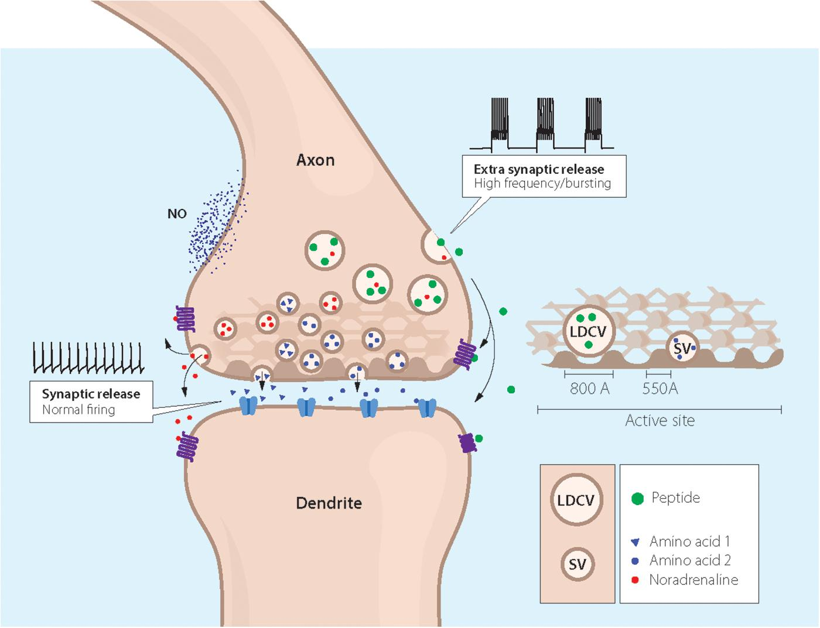
Introduction
Neuroprotective peptides are short amino acids that help protect neurons against injury, degeneration and cell death.
Caused by neurological diseases and events such as ischemic stroke or neurodegenerative disorders.
Targets processes such as oxidative stress, protein aggregation, inflammation, mitochondrial dysfunction and excitotoxicity.
Due to its small size and membrane permeability, they can efficiently cross BBB making it a potential therapeutics in treatment of neurodegenerative diseases.

Slide 5
Types
Cationic Arginine-Rich Peptides (CARP’s): These peptides combine multiple neuroprotective peptides and act through anti-inflammatory and antioxidant effects.
Interfering Peptides (IPs): It is engineered to block specific protein - protein interactions.
Shuttle Peptides: These are synthetic peptides designed to facilitate drug or peptide transport across the blood-brain barrier.
Brain- gut peptide: Includes molecules such as PACAP, nesfatin-1 which participate in neuroprotective pathways and neurodegenerative disease models.
Peptide fragments: Small fragments of peptides that are designed to mimic the activity of larger proteins .

Slide 6


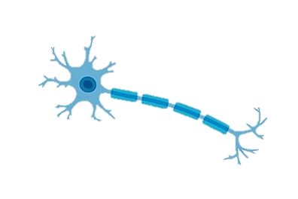
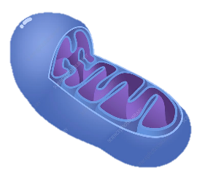

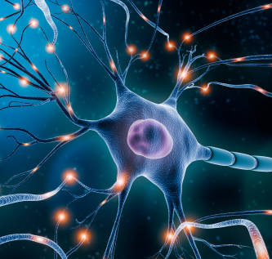
Mechanism
Anti-aggregation: Binds to misfolded proteins and prevents toxic aggregation formation.
Antioxidant action: It reduces ROS and oxidative stress as neurons are highly sensitive to them.
Mitochondrial Protection: Stabilizes mitochondrial function and prevents apoptosis.
Anti- Inflammatory Effects: Suppress microglial activation and inflammatory cytokines.
Neurotrophic support: Promotes neuronal survival, repair and synaptic function.

Slide 7
Neuroprotective peptides: Tools
Alpha Fold / Rosetta Fold: Predicts 3D structure of peptides.
Auto Dock / Swiss Dock: Dock peptides with neurotoxic targets.
GROMACS: Molecular dynamics to test stability and binding.
ToxinPred / PepCalc: Predict toxicity and stability.
STRING / KEGG: Pathway and interaction analysis.

Slide 8
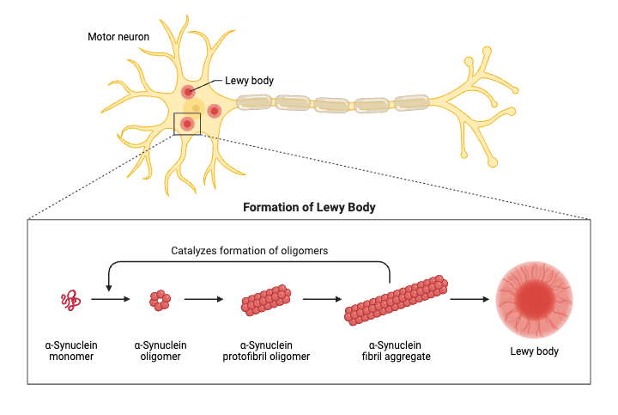
Case Study: Parkinson’s Disease
Parkinson’s disease is largely driven by α-synuclein misfolding and aggregation.
Toxic α-synuclein oligomers damage neurons leading to Lewy body formation.
Peptides are emerging as effective therapeutics as they target protein-protein interaction surfaces.

Slide 9
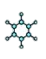




Case Study: Parkinson’s Disease Tools.
Peptide Design and Structure Prediction Tools:
PepFols, Rosetta and AlphaFold – Structure prediction and peptide - protein interaction modeling.
Molecular Docking and Dynamics:
Auto Dock, Schrodinger, GROMACS – Tests peptide binding to α-synuclein, membranes, enzymes and mitochondria.
Toxicity and Stability Prediction:
ToxinPred, AllerTOP, HLP – Evaluate safety, solubility, charge.
Bioinformatics Database:
APD3, CAMP, UniProt – Retrieve known neuroprotective peptides and structural templates.
In-vitro/ Cell Tools:
SH- SY5Y cell assay, ROS assay – Confirms antioxidant and anti-aggregation effects .

Slide 10
Case Study: Parkinson’s Disease
Neuroprotective Peptide- Exendin-4
Exendin-4 is an GLP-1 ( Glucagon- Like Peptide) analog.
It was initially used in type 2 diabetes which is now repurposed for neuroprotection in PD.
Mechanism:
Exendin-4 activates GLP-1 receptors in dopaminergic neurons.
Leads to reduction in inflammation and oxidative stress.
Which enhances mitochondrial function and neuronal survival.
That improves dopamine signaling and motor function in PD.

Slide 11
Case Study: Parkinson’s Disease
Neuroprotective Peptide- Exendin-4 Tools
In Vitro: SH-SY5Y dopaminergic neuron assays for cell survival, ROS reduction.
In Vivo: Rodent PD models are used to asses motor function and neuron preservation.
Clinical Relevance:
Early clinical trials indicates improved motor scores and potential disease modifying effects.

Slide 12
Case Study: Parkinson’s Disease
Benefits of neuroprotective peptides:
Targets multiple disease pathways all at once.
Has high specifity and low toxicity compared to other therapeutics.
Cell membrane permeability, so can cross BBB.
Promotes neuronal recovery as protein aggregation is blocked.
Potential for disease modification and therapeutics

Slide 13
Future Directions and challenges
Improves Brain delivery of drugs.
Enhances stability of the peptide or drug when bound with these peptides.
Designing highly specific peptides reduces experimental trials.
Large scale clinical testing reduces time and cost.
Combining peptides with existing PD therapies.

Slide 14
Thank You

