Slide 1
Designing De Novo Protein Candidates to Mimic the 6S RNA Regulatory Interface of σ70
A computational proof- of concept for protein mimicry of an RNA mediated regulatory interface.
Hackathon: Boltzmann AI Research Agent Hackathon
By, Date: 31-08-2026
Sandhya Elumalai

Slide 2
Introduction
6S RNA: A natural Regulatory RNA –Protein Interaction
6S RNA is a bacterial regulatory RNA that binds the σ70- containing RNA polymerase holoenzyme.
It interacts with σ70 and interferes with promoter recognition and modulates transcription.
The experimentally solved 5VT0 structure provides a structural reference for this native 6S RNA-σ70 interaction.
This native RNA- protein interaction provides a template for exploring whether a de novo protein can reproduce part of the same σ70 interaction surface.

Slide 3
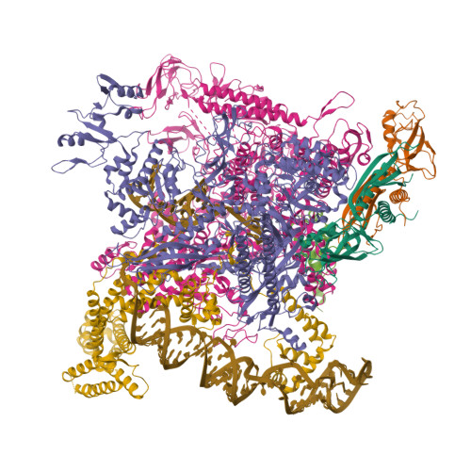
Introduction
6S RNA–σ70/RNAP complex
Structure: From RCSB PDB
Entry ID (PDB): 5VT0
Chain L:σ70 (RpoD), 523 aa
Chain R: 6S RNA, 112 mer

Slide 4
Aim
Screen computationally generated proteins for overlap with experimentally defined 6S RNA–σ70 interface residues.
Native system
Computational concept
6S RNA
De Novo protein
σ70/RNAP
6S RNA–σ70
/RNAP

Slide 5
Computational Workflow
5VT0 Native complex
Define design target
Unconditional sampling
8 de novo protein candidates
Candidate prioritization
Interface analysis
MegaDock

Slide 6
Tools used
Structural reference – 5VT0, obtained by RCSB PDB
Unconditional Sampling – De novo protein generation
MegaDock – protein-protein docking
Prodigy – predicted binding affinity

Slide 7
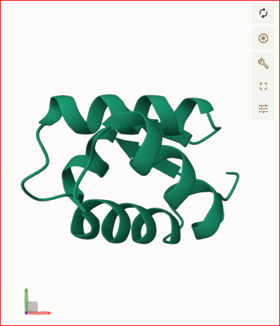
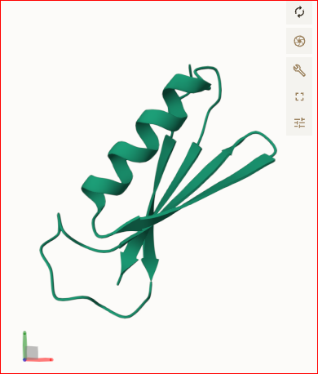
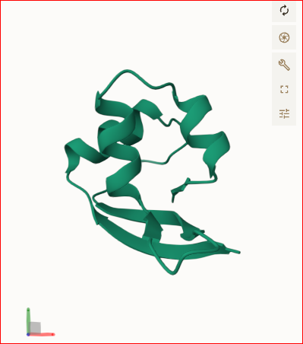
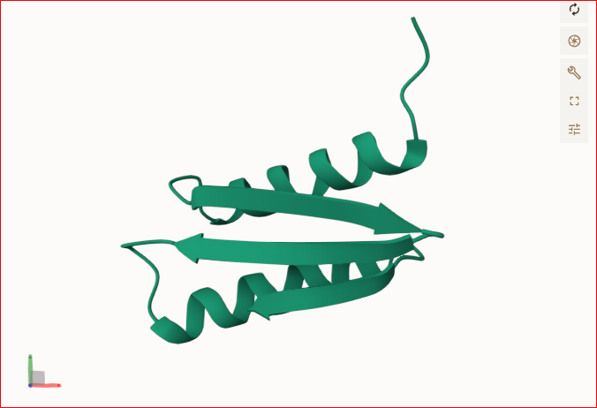
De Novo Protein Generation
Unconditional sampling:
Eight compact de novo protein candidates were generated as potential mimics of the native 6S RNA- σ70 interaction.
Candidate_01
Candidate_02
Candidate_03
Candidate_04

Slide 8
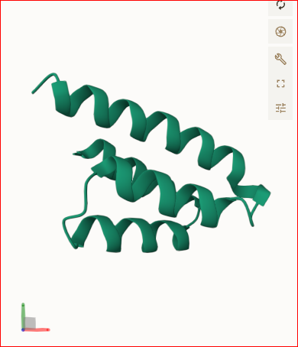
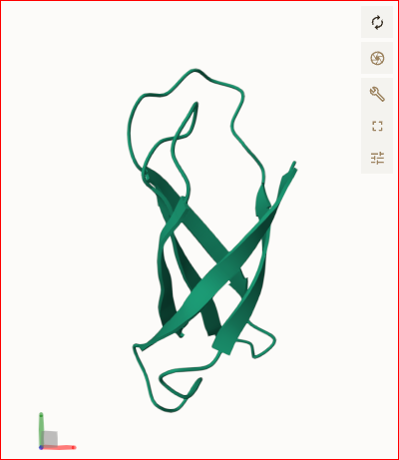
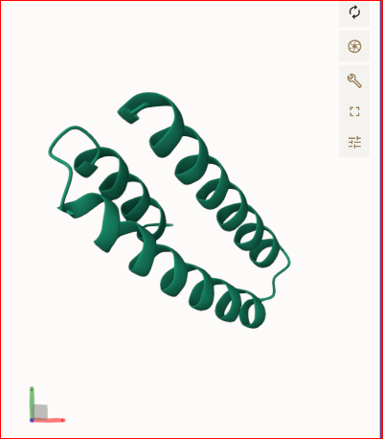
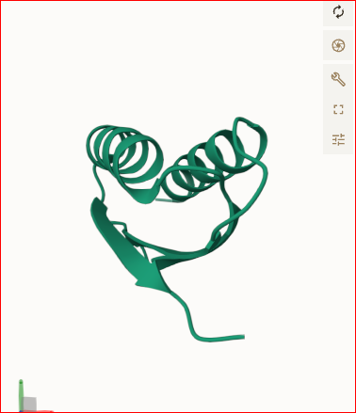
De Novo Protein Generation
Candidate_05
Candidate_06
Candidate_07
Candidate_08

Slide 9
Prompt Used
Biological design challenge
We want to investigate the recently discovered conformational RNA switch in the human RORC 3′UTR.
Experimental structural references:
EMD-42275 = WT Class A / Conformation 1
EMD-42276 = WT Class B / Conformation 2
These are experimentally determined cryo-EM maps deposited in EMDB. Do not assume they are atomic PDB structures.
WT RORC switch sequence:
GGTGCTCCAGTCCACTGATCTTGGGTCTGGGGTGATCCAAATACCACCCCAGCTCCAGCTGTCTTCTACCACTAGAAGACCCAAGAGAAGCAGAAGTCGCTCGCACTGGTCAGTCGGAAGGCAAGATCAGATCCTGGAGGACTTTCCTGGCCTGCCCGCCAGCCCTGCTCTTGTTGTGGAGAAGGA
Hypothesis:
Can we computationally design a de novo protein that creates a new protein–RNA interaction by selectively recognizing a cryptic/state-specific surface exposed in one conformation of the RORC RNA switch, potentially stabilizing that RNA state?
Task:
Design and execute the complete workflow yourself using ONLY the tools available in Boltzmann Lab. Do not use external computational tools.
Starting from the sequence and the experimental structural references above:

Slide 10
Prompt Used
Determine how the two experimentally characterized WT conformations can be represented using the available Boltzmann tools.
Identify a potentially conformation-specific/cryptic RNA surface.
Design or generate suitable de novo protein candidates.
Predict protein–RNA interactions/complexes using the available tools.
Test the same candidate proteins against both RORC conformations.
Compare the predicted interactions and identify candidates showing preferential recognition of one conformation.
Assess whether the resulting design supports our biological hypothesis.
Important constraints:
Use ONLY Boltzmann Lab tools available to you.
Do not use external docking, structure prediction, molecular dynamics, or custom computational analysis.
You decide the tool order and workflow.
Do not stop merely because one particular tool is unavailable; use the best available Boltzmann-only alternative where scientifically appropriate.
Clearly distinguish experimentally established information from computational predictions.
Do not claim experimental validation where none exists.
If a required step genuinely cannot be performed with the available tools, explain exactly what is missing and proceed as far as possible with the remaining workflow.
Goal: produce a computational proof-of-concept for a conformation-selective de novo protein binder of the RORC RNA switch, rather than simply predicting a generic RNA-binding protein.

Slide 11
Docking the 8 candidates
MegaDock:
The 8 generated protein candidates were docked against σ70- containing RNAP target stricture to identify protein–σ70 interaction poses.
8 protein candidates
Megadock
Docking poses

Slide 12
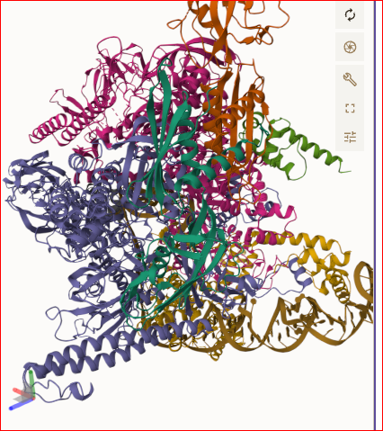
Docking result
Out of all the 8 protein candidates, 3 candidates showed interaction with the reference RNA

Slide 13
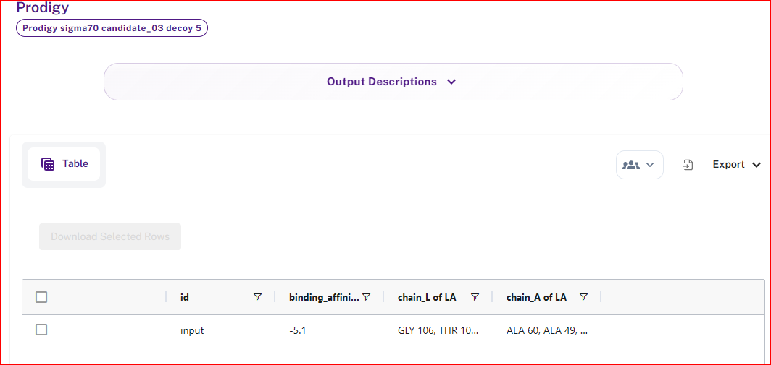
Prodigy
Candidate_ 03 :

Slide 14
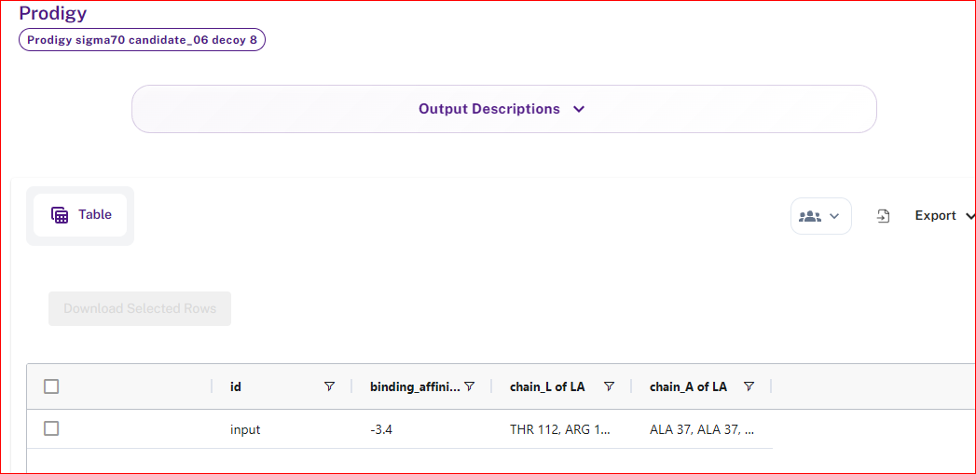
Prodigy
Candidate_ 06 :

Slide 15
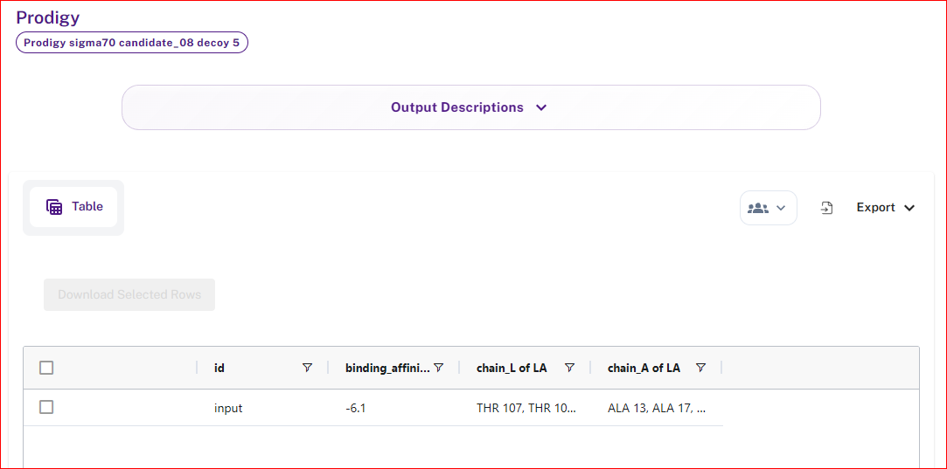
Prodigy
Candidate_ 08 :

Slide 16
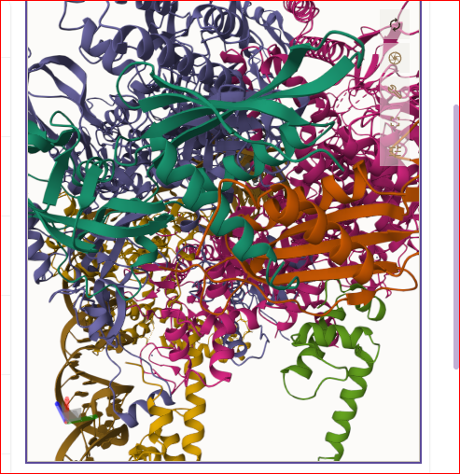
What we achieved
Candidate_ 08 interaction with a region of σ70 that is also contacted by 6S RNA.
This indicates partial structure and interface mimicry of the native 6S RNA - σ70 interactions. The current design doesn’t reproduce the complete 6S RNA interface

Slide 17
Limitations
Only partial interface overlap was observed.
Computational docking and Prodigy doesn’t establish biological function.
Experimental binding remains to be tested.
A future target conditioned design could aim for boarder native interface coverage.

Slide 18
Conclusion
8 de novo protein candidates were generated and computationally screened against the σ70/RNAP target.
The candidate_08 emerged as the lead candidate, contacting R385 within the native 6S RNA–σ70 interaction region and showing a predicted ΔG of −6.1 kcal/mol.
Together, these results provide a computational proof-of concept for designing protein candidates that are partially mimicking an RNA- mediated regulatory interface.

