Slide 1


DEPLOY-STATIC-WEBSITE-ON-S3-BUCKET-AND-CONFIGURE-CLOUDFRONT-DISTRIBUTION
PROJECT TITLE
NAME: SANDHYA CERTIFICATION: AWS SOLUTIONS ARCHITECT: SAA C03
VALIDATION NUMBER:BB8SQRWBQJR11193

Slide 2
INTRODUCTION
Hello, I’m Sandhya, a certified Solutions Architect with hands-on experience in AWS foundational services and Infrastructure Management. I’ve successfully completed certifications in AWS (SAA-C03), Azure (AZ-104), and DevOps (AZ-400), which have equipped me with a robust understanding of cloud technologies and best practices.
During my certification labs, I’ve honed my skills in deploying and managing scalable, secure, and resilient infrastructure. One of my capstone projects involved creating a static website hosted on an Amazon S3 bucket, which I integrated with Amazon CloudFront. This setup ensured low latency access, high availability, and enhanced security for the website. Additionally, I implemented AWS WAF to protect the web application from common web exploits, demonstrating my commitment to building secure cloud solutions.
As a Solutions Architect, I’m passionate about leveraging cloud technologies to solve complex business challenges and drive innovation. I’m looking forward to discussing how my skills and experiences align with the needs of your organization.

Slide 3



PROBLEM STATEMENT & PROPOSED SOLUTION
An organization requires a solution for hosting a static web page that ensures firewall protection, failover capabilities, geographical restrictions, and low latency access. The current infrastructure lacks the necessary security measures, redundancy, and global accessibility, leading to potential security breaches, downtime, and slow website performance. To address these concerns, the organization needs a comprehensive hosting solution that can provide robust firewall protection, automatic failover mechanisms, the ability to enforce geographical restrictions for access, and ensure low latency access to the web page for users worldwide.
To address the challenges outlined in the problem statement, the following AWS services can be used to create a secure, resilient, and globally accessible hosting solution for a static web page:
Amazon S3: Hosts the static content of the web page and provides high durability and availability.
AWS WAF (Web Application Firewall): To protect the web page from common web exploits. Protects against common web attacks by controlling incoming and outgoing traffic
Amazon CloudFront: To distribute the content globally, ensuring low latency and implementing geographical restrictions. A content delivery network (CDN) that caches content at edge locations, ensuring low latency access globally.
Benefits: Enhanced Security, Improved Performance, Increased Reliability, Reduced Bandwidth Costs.

Slide 4
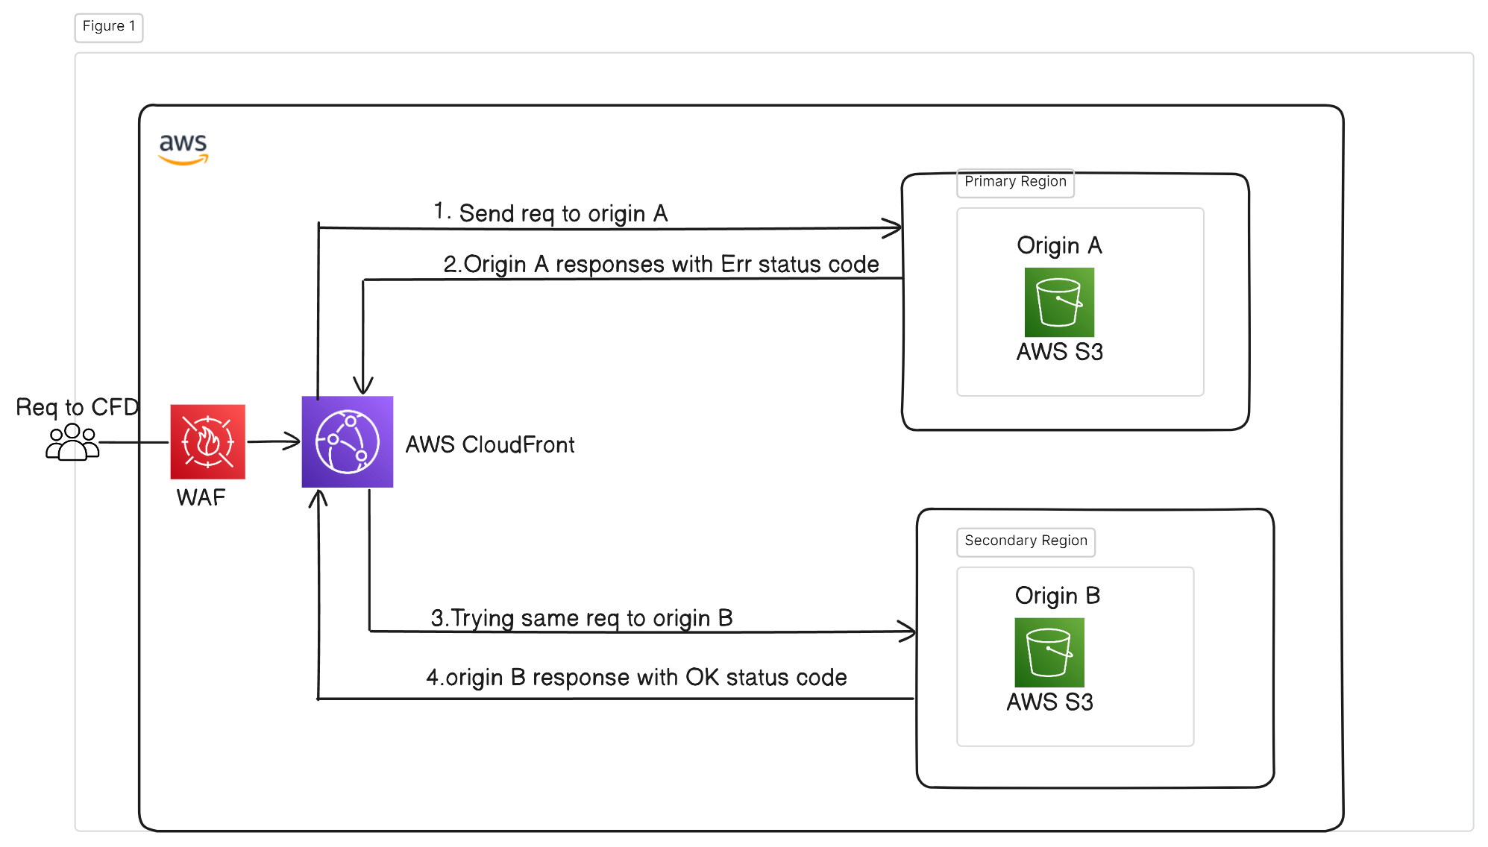
ARCHITECTURAL DIAGRAM

Slide 5
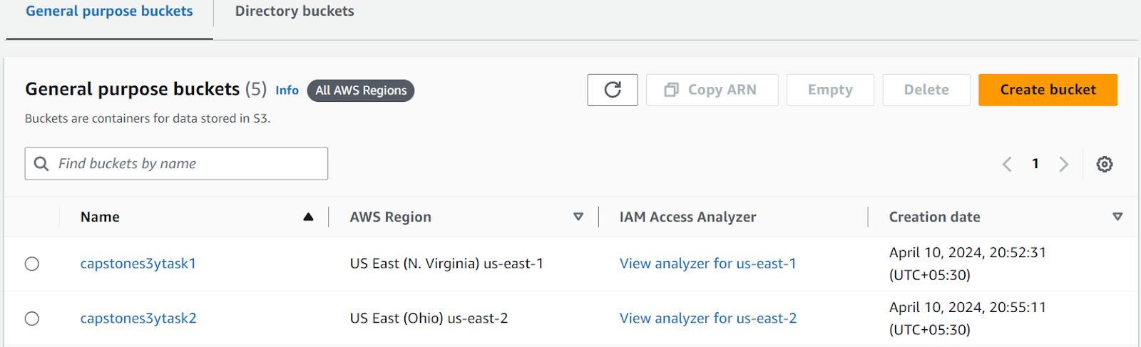
CREATING S3 BUCKETS & UPLOADED INDEX.HTML

Slide 6
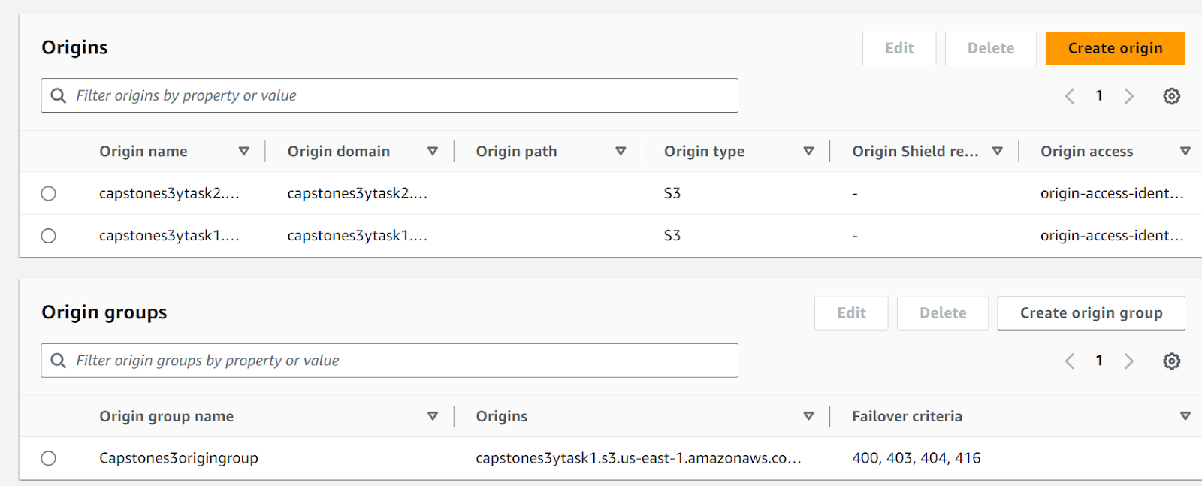
CREATE A CLOUDFRONT DISTRIBUTION
Create 2 Origin access Identities & origin group name. One for Primary bucket and the other one for secondary bucket.

Slide 7
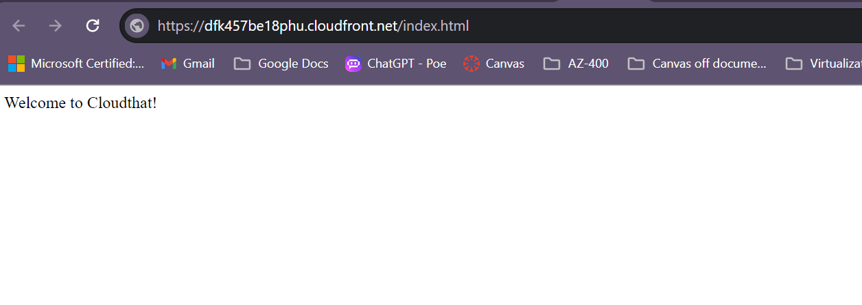
TEST THE FAILOVER
Paste domain name in browser and add /index.html in front of domain name.
You will observe website
Delete index.html in the primary bucket. Try accessing the website and see the results.

Slide 8
CONTENT SERVED FROM CACHE
Notes:
Cache Persistence: Even if you remove a file from the primary S3 bucket, CloudFront may still serve it from its cache. TTL (Time to Live): Cached content remains valid until the TTL expires or you manually invalidate the cache. Immediate Update: To reflect changes instantly, create a CloudFront invalidation for the specific file.

Slide 9
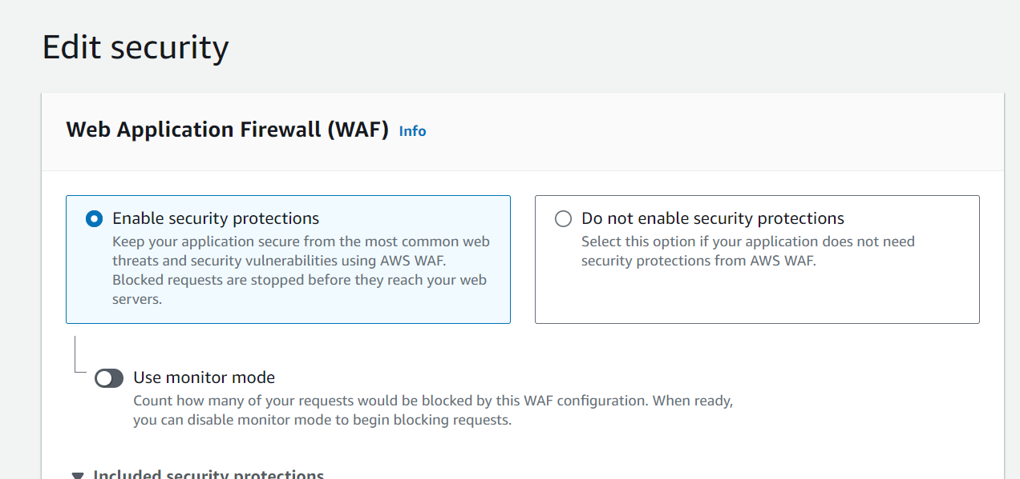
ADDING WAF TO CLOUDFRONT

Slide 10
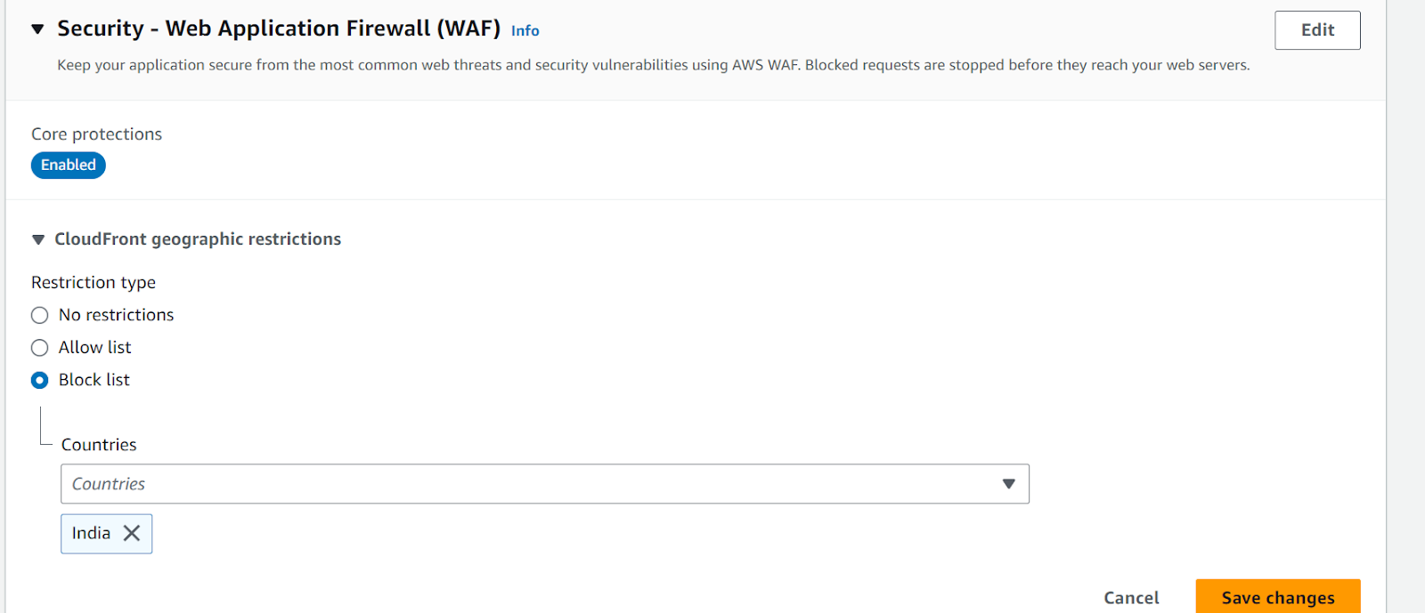
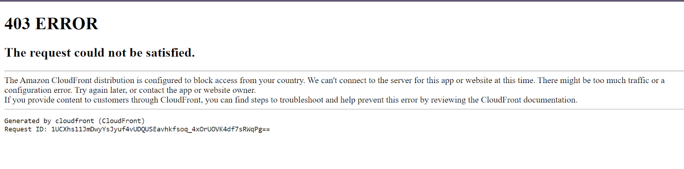
IMPLEMENTING GEO RESTRICTION
Notes:
Copy the distribution domain name and try to access it from a blocked location (You will get 403
error message)

Slide 11
CONCLUSION & BEST PRACTICES
Key Takeaways:
Successfully deployed a static website on AWS with high availability, low latency, and enhanced security.
Utilized AWS S3 for hosting, CloudFront for content delivery, and WAF for web application security.
Best Practices:
Resource Cleanup: Post-deployment, ensure to remove unused resources to prevent incurring extra costs.
Security: Maintain strong security practices by regularly updating IAM policies and using services like AWS WAF.
Documentation: Keep your project documentation up-to-date for clarity and future reference.
Final Thoughts: This project has been a valuable opportunity to apply my knowledge of AWS services to create a secure, efficient, and user-friendly web hosting solution. It demonstrates my ability to address key web application requirements and my readiness to take on the role of a Solutions Architect.
I appreciate your time and consideration. I’m happy to answer any questions you may have.

Slide 12
Thank you!

