Slide 1

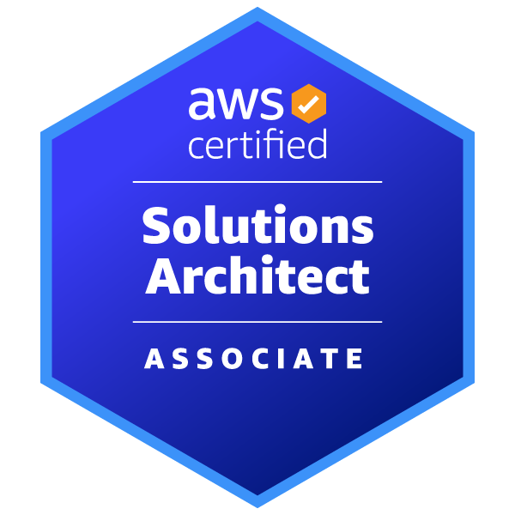
SHARED FILE SYSTEM USING AWS
PROJECT TITLE
NAME: SANDHYA CERTIFICATION: AWS SOLUTIONS ARCHITECT: SAA C03
VALIDATION NUMBER:BB8SQRWBQJR11193

Slide 2
INTRODUCTION
Hello, I’m Sandhya, a certified Solutions Architect with hands-on experience in AWS foundational services and Infrastructure Management. I’ve successfully completed certifications in AWS (SAA-C03), Azure (AZ-104), and DevOps (AZ-400), which have equipped me with a robust understanding of cloud technologies and best practices.
In this project, we embarked on a journey to design and implement a highly available, secure, and scalable cloud architecture. Our objectives were clear: to ensure data integrity, facilitate seamless collaboration, and maintain stringent security standards.
As a Solutions Architect, I’m passionate about leveraging cloud technologies to solve complex business challenges and drive innovation. I’m looking forward to discussing how my skills and experiences align with the needs of your organization.

Slide 3
PROBLEM STATEMENT
ABC, an India-based entertainment production company focusing on Northeast and East Indian cinema, requires a highly available and reliable storage solution for their on-premises data.
Challenges with Existing Infrastructure:
Limited scalability of NAS storage.
Desire for centralized storage with AWS cloud application integration.
Security vulnerabilities with lack of encryption
Manual intervention was needed to change the storage type and transfer files to infrequent storage.
The client is unable to scale up the infrastructure due to high capital costs for new
hardware.
Need for low-cost storage options for both frequent and infrequent data.
Highly available, secure, and persistent shared File system in AWS cloud with EFS

Slide 4



CHALLENGES & SOLUTION
Challenge Overview: ABC found itself constrained by a legacy NAS storage system, which lacked the necessary scalability and posed significant security vulnerabilities. The company’s vision to migrate to a cloud-based application with centralized data synchronization was hindered by the existing infrastructure’s limitations.
Strategic Solution:
We created a highly available, reliable, and secure storage distributed file system using Amazon Elastic File System (EFS), which allows multiple EC2 instances to share data efficiently and securely.
Security and Reliability:
We secured data in Amazon EFS with AWS KMS encryption, addressing encryption concerns at rest and in transit
Infrastructure Setup:
Configured EC2 instances with custom security groups in a VPC for EFS, ensuring secure data transfer.
Cost-Effective Scaling: Leveraged AWS cloud for cost-effective storage scaling without hardware investments.
Resiliency:
Deployed EC2 instances across zones for system robustness.
Hands-On Execution:
Connected to instances, installed utilities, and mounted EFS for real-time data sync.

Slide 5
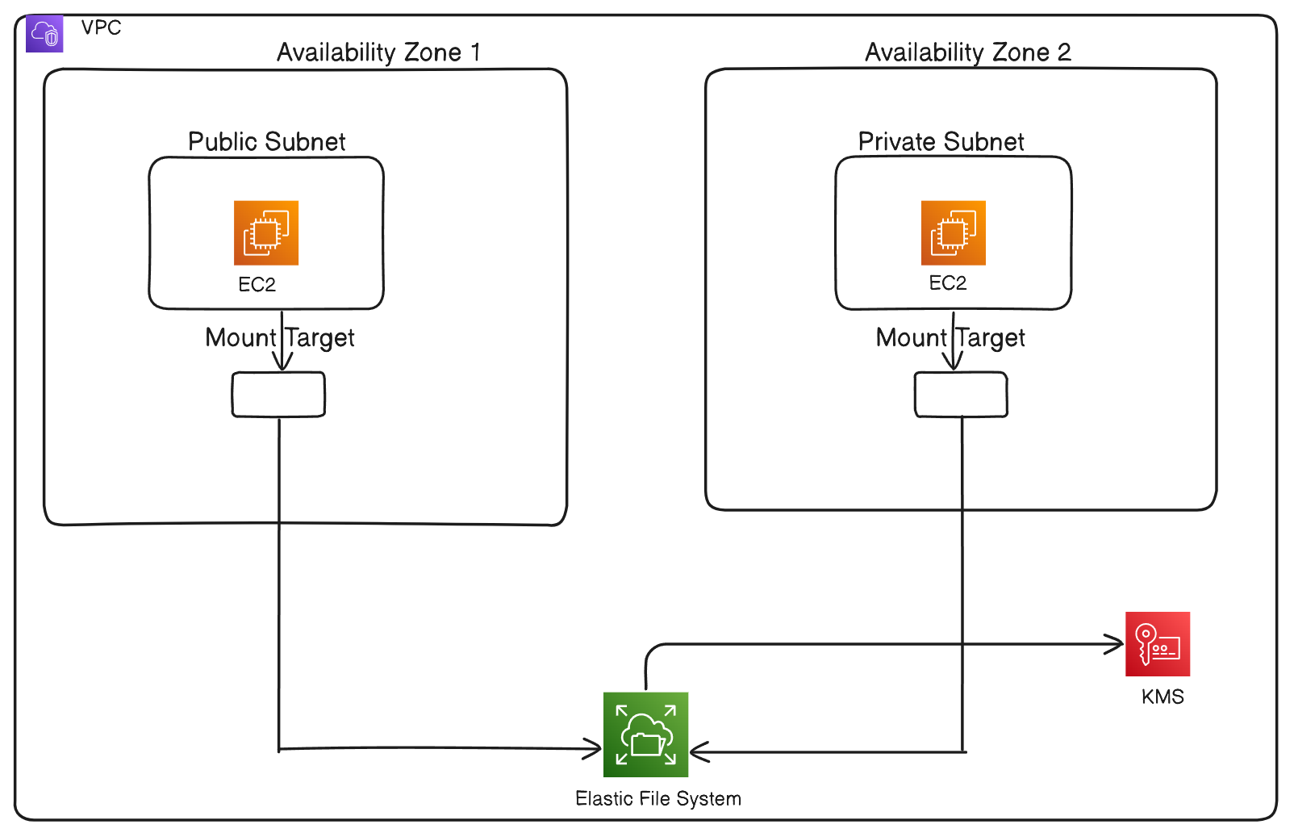
ARCHITECTURAL DIAGRAM

Slide 6
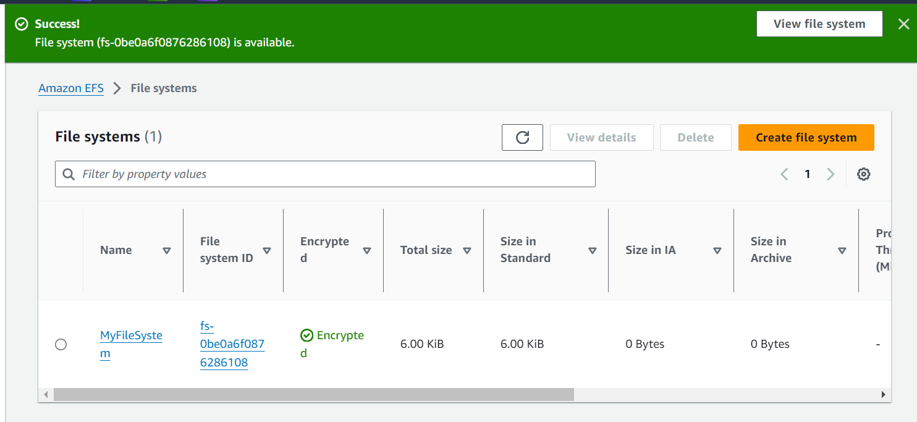
CREATING ELASTIC FILE SYSTEM WITH KMS

Slide 7
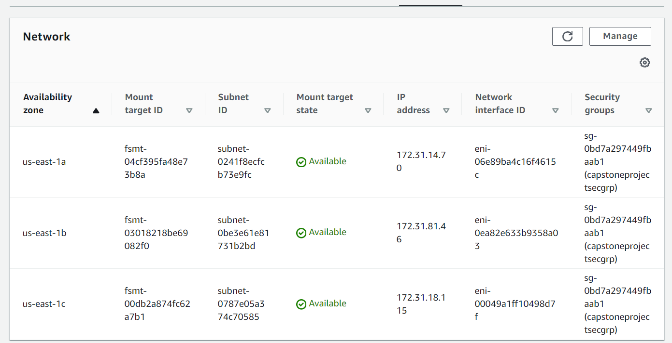
CONFIGURED AN INBOUND RULE FOR NFS (NETWORK FILE SYSTEM) THAT ALLOWS ACCESS FROM ANY IP ADDRESS (REPLACED A NEW SG)

Slide 8
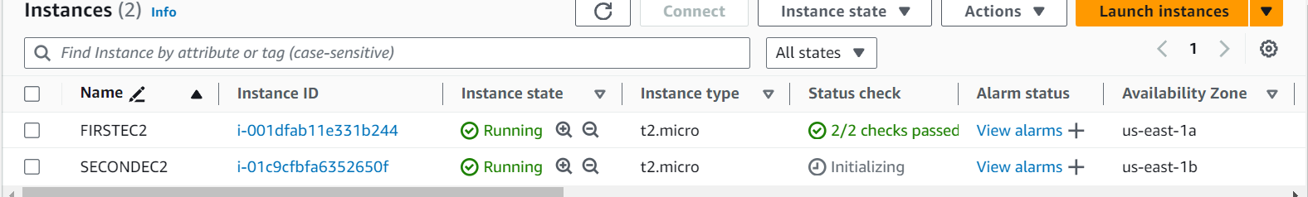
CREATED 2 INSTANCES IN 2 DIFF AZ
Detailing the steps to set up and verify a shared file system using Amazon EFS across two EC2 instances.
Install EFS utilities: sudo yum install amazon-efs-utils
Mount the EFS File System: sudo mount -t efs -o tls fs-0be0a6f0876286108:/ efs
Verify the Mount: df –k
Check mount details: mount | column -t

Slide 9
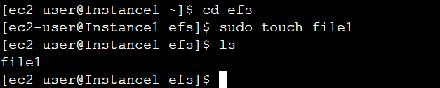
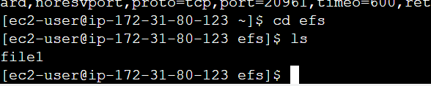
TESTING EFS ACROSS INSTANCES
You can access file 1 created by FIRSTEC2 through SECONDEC2. Hence, shared file
the system is working with both EC2.

Slide 10
BEST PRACTICES
Amazon EFS Best Practices:
Performance Mode: Choose the right performance mode (General Purpose or Max I/O) based on your workload requirements.
Lifecycle Management: Implement EFS Lifecycle Management to automatically move infrequently accessed files to a cost-effective storage class.
Monitoring: Use Amazon CloudWatch to monitor file system performance and set up alarms for unusual activity.
AWS KMS Best Practices:
Key Rotation: Enable automatic key rotation for your customer master keys (CMKs) to enhance security.
Least Privilege: Apply the principle of least privilege by granting only necessary permissions to IAM roles and users for KMS operations.
Audit and Compliance: Regularly audit your KMS usage with AWS CloudTrail to ensure compliance with security policies.

Slide 11
BEST PRACTICES
Amazon EC2 Best Practices:
Security Groups: Restrict security group rules to allow only necessary traffic. Avoid using 0.0.0.0/0 (open to the world) unless absolutely necessary.
Instance Types: Choose the right EC2 instance type that matches your performance and cost requirements.
Elastic IP (EIP): Use EIPs judiciously and release them when not in use to avoid unnecessary charges.
Backup and Recovery: Regularly create snapshots of your EC2 instances to facilitate quick recovery in case of failure.
General AWS Best Practices:
Multi-AZ Deployment: Deploy resources across multiple Availability Zones for high availability.
IAM Roles: Use IAM roles for EC2 instances to securely access other AWS services without the need to manage credentials.
Encryption: Encrypt data at rest and in transit to ensure data security and privacy.
Cost Management: Utilize AWS Budgets and Cost Explorer to monitor and manage your AWS spending.

Slide 12
Challenges: Encountered a mounting issue with EFS due to an incorrect directory path. Initially attempted to set the mount point within a newly created directory, which was not effective. After troubleshooting, I realized the command needed to be executed from the parent directory. This adjustment resolved the mounting problem, allowing for successful attachment of the mount point to EFS
Thank you!

