Slide 1


Government of Karnataka
Department of Collegiate and Technical Education
GOVT. C.P.C. POLYTECHNIC
Ashoka Road, Mysore – 570007
DEPARTMENT OF COMPUTER SCIENCE AND ENGG.
Project Presentation on
Confidential And Transparent E-tender System: Protecting Bids And Data
Presented By
Sanjana M
Sandhya R
Ravi Kumar
Chirag G M
Under The Guidance Of
ANUSUYA D (M.Tech)
(Senior Grade Lecturer)

Slide 2
GROUP MEMBERS
Sanjana M | Project Lead
Ravikumar | Document Lead
Sandhya R | Development Lead
Chirag G M | Development Lead

Slide 3

Abstract
Organizations are continuously working to bring fairness in this process.
Problems with the traditional tendering system paper works, increasing the risk of fraud, collusion, and manipulation.
To avoid bidder fraud and suspicion, the highly competitive contract selection process must be supported by effective and transparent technology.
E-tendering reduces sources of fraud and manipulation

Slide 4
Content
Introduction
Objectives
Existing System
Limitation of Existing System
Proposed System
Advantages
System Requirements
Conclusion

Slide 5
Confidential and Transparent E-Tender System
Introduction
E-tendering is a network platform that is built based on bidding in new ways, which can release information, submit tenders, evaluate bids and so on
In its development the e-tendering system has also developed progressively over the years, the evolution of
E-tendering websites
Integrates strategic security mechanisms for desired security and efficiency services
The organization uses E-tenders to ensure fairness and transparency in business dealings
Tendering is a complex business process with legal obligations associated with corporate contracts. E-tendering systems aim to bring fairness and efficiency to this process by facilitating procurement with linked parties, promoting productivity, effectiveness, and transparency. Traditional tendering systems rely on transparency to achieve equality, while e-tendering systems can strategically integrate security mechanisms to provide the desired security and efficiency services.

Slide 6
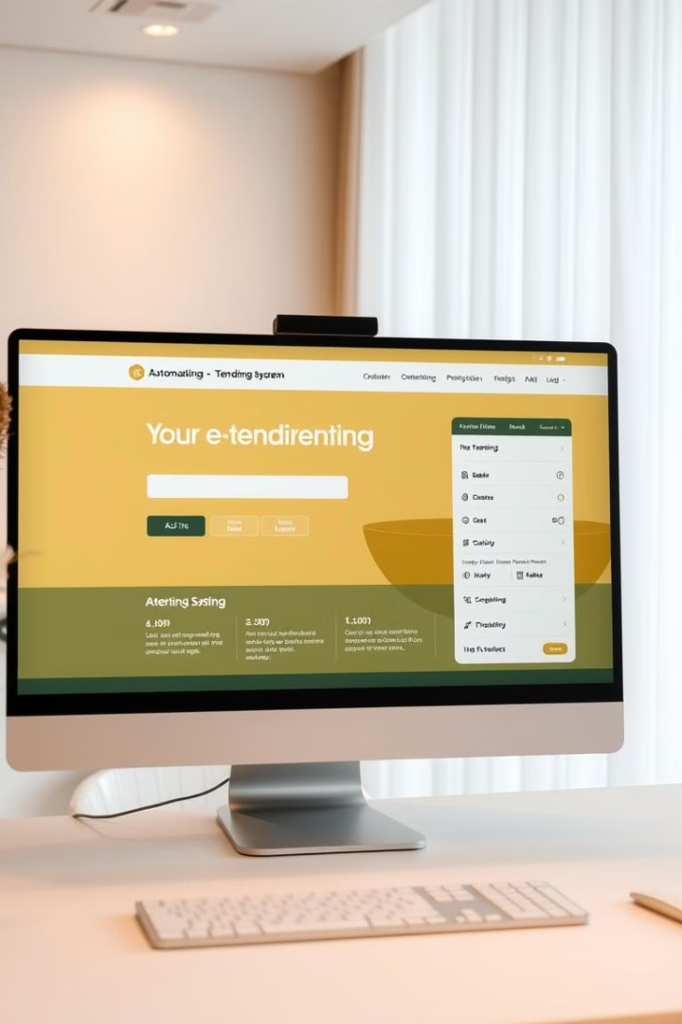
Objectives
Security
Transparency
Fraud Prevention
Efficiency

Slide 7
Z```````````
Existing System
Manual tendering processes with electronic submission
Limited online functionality
Mostly PDF-based tender documents
No real-time tracking or updates
Limited accessibility and usability

Slide 8
Limitations of Existing System
Transparency
Lack of transparency can lead to
unfair bidding practices and favoritism.
Security
Security vulnerabilities can expose
sensitive data to hackers, leading to
financial and strategic losses.
Tedious Data Management
Managing large volumes of paper documents
is tedious and time-consuming
Time Consuming
The manual process can be time-consuming, delaying the tender process and impacting efficiency.

Slide 9
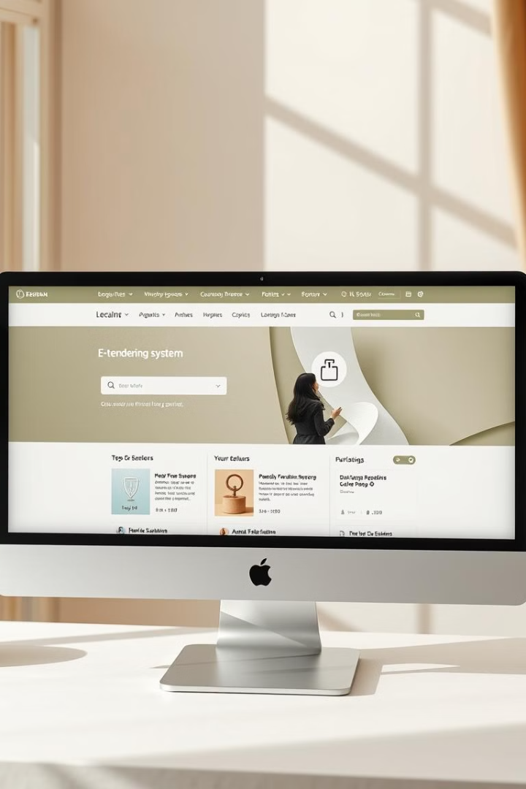
Proposed System
Tender Creation
Bidding Process
Evaluation and Review
Client Feedback

Slide 10
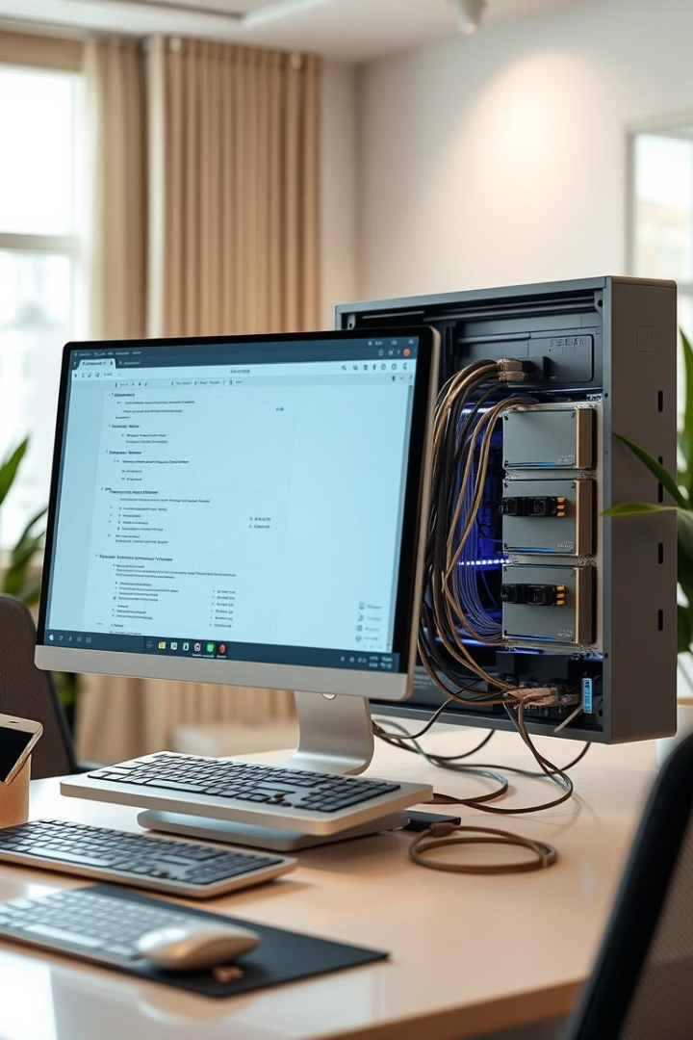
Advantages
Enhanced Security
Transparency
Efficiency
Improved Accountability
Data Integrity
Scalability

Slide 11
System Requirements
Hardware Requirements
Software Requirements
Processor : i3+
Operating System : Windows 10 +
RAM : 4GB
IDE : Visual Studio Code
Hard Disk : 80GB
Back End Technology : JAVA Spring Boot
Speed : 1.2 GHz+
Front End Technology : HTML, CSS, Bootstrap, React JS
Database : My SQL

Slide 12
Conclusion
Enhanced security and transparency in tendering through modern technology.
Web-based platform for secure tender data storage and bidding.
Protection against fraud, document tampering, and manipulation.
Automated processes streamline operations and reduce administrative overhead.
Clear, traceable records build trust between parties.
Mitigates vulnerabilities of traditional tendering systems

Slide 13
Thank you

