Slide 1
U2A Use Case Presentation 2026
Unified Rewards Platform
Enterprise Employee Benefits & Compensation Management Platform
266319 – Sandhya S

Slide 2
Agenda
01 Use Case Details
08 AI Usage and Metrics
02 Scope Definition
09 Advantages
03 Assumptions
10 Estimations and Implementation Plan
04 Business Requirements
11 Risks and Mitigations
05 NFRs
12 Link to LLD and HLD
06 Architecture Diagrams
13 Case Studies
07 Tech Stack
All 13 agenda items as per the U2A Use Case Presentation 2026 template

Slide 3
01 Use Case Details
Problem Statement · Proposed Solution · System Context · Use Cases
© 2025–2027 Cognizant | Private

Slide 4
Use Case Details — Problem Statement & Proposed Solution
Problem Statement
Proposed Solution
"A configurable platform for enterprises to manage employee benefits, reimbursements, bonuses, and flexible compensation structures."
7 Backend Microservices (as mandated by requirement doc)
▸ Employee Profile Service
▸ Benefits Catalogue Service
Business Domain & Scale
▸ Domain: HR Tech / Enterprise SaaS
▸ Scale: Large enterprise
▸ Cloud: Microsoft Azure (selected from AWS or Azure)
▸ Compensation Rules Engine
▸ Reimbursement Workflow Service
▸ Document & Receipt Processing Service
Key Capabilities Required
▸ Payroll Integration Service
▸ Benefits catalogue — insurance, LTA, food cards
▸ Flexible pay / compensation configuration
▸ Reimbursement workflow — claims and approvals
▸ Payroll system integration
▸ Analytics & compliance reporting
▸ Reporting & Compliance Service
4 Micro-Frontend Portals (as mandated by requirement doc)
▸ Employee Self-Service Portal
▸ Manager Approval Portal
▸ HR Admin Console
▸ Finance & Audit Dashboard
Source: Requirement_Document.docx — Problem Statement section
Source: Requirement_Document.docx — Architecture Scope section
Notes:
Opening:
This slide lays out the use case we're solving for — on the left, the problem we were given, and on the right, the solution we're proposing to address it.
Problem Statement (left panel):
the requirement is to build a configurable platform that lets large enterprises manage employee benefits, reimbursements, bonuses, and flexible compensation structures — all in one place.
In terms of business context, this sits in the HR Tech and Enterprise SaaS domain, it's designed for large enterprise scale, and we've chosen Microsoft Azure as the cloud platform
The platform needs to deliver five key capabilities: a benefits catalogue covering things like insurance, leave travel allowance, and food cards; flexible pay and compensation configuration; a reimbursement workflow that handles claims and approvals end-to-end; integration with the payroll system; and analytics and compliance reporting.
Proposed Solution (right panel):
To deliver this, our architecture is broken into two layers — backend services and frontend portals — and the counts here are mandated directly by the requirement document.
On the backend, we have seven microservices, each owning a clear slice of the domain: an Employee Profile Service for workforce data, a Benefits Catalogue Service for the available benefit options, a Compensation Rules Engine for the flexible pay logic, a Reimbursement Workflow Service to manage claims and approvals, a Document and Receipt Processing Service for handling supporting paperwork, a Payroll Integration Service that connects to the downstream payroll system, and a Reporting and Compliance Service for analytics and audit needs.
On the frontend, we have four micro-frontend portals, each tailored to a different user persona: an Employee Self-Service Portal where staff submit claims and view benefits, a Manager Approval Portal for sign-offs, an HR Admin Console for configuration and administration, and a Finance and Audit Dashboard for the finance team and auditors.

Slide 5
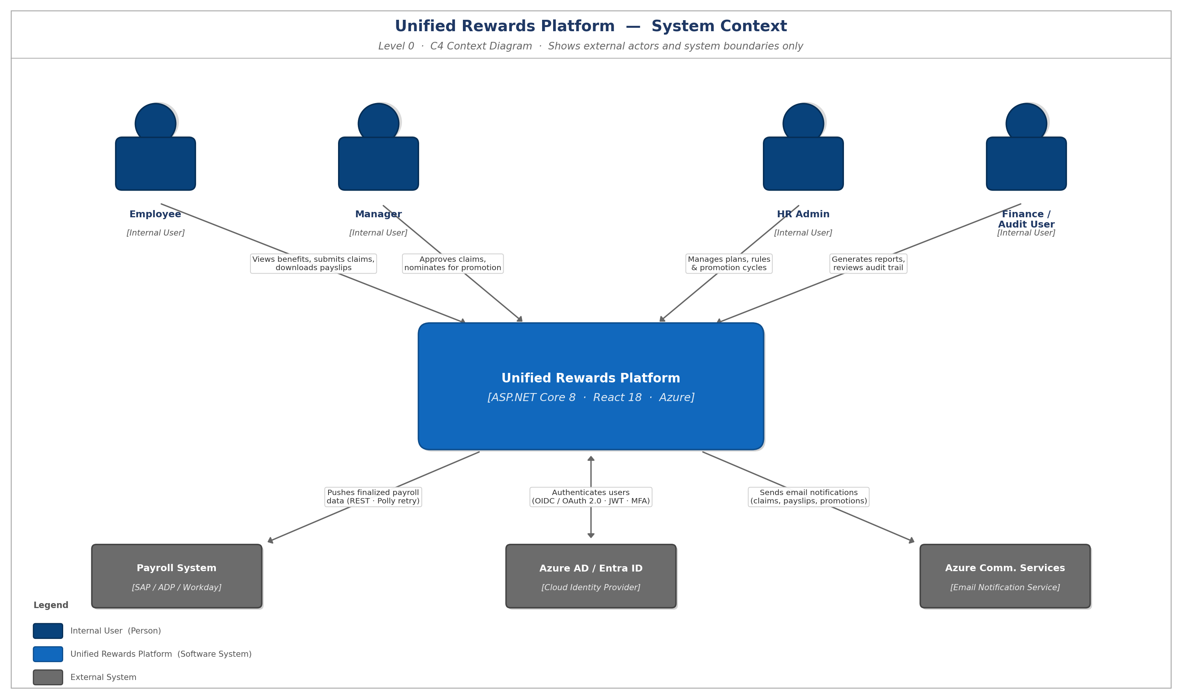
Use Case Details — System Context (C4 Level 0)
Black-box view: 4 actors + system boundary + external systems | Source: HLD Section 2.1.1.3
Notes:
"What you're looking at is a C4 Level 0 System Context diagram for the Unified Rewards Platform. At this level, we treat the platform itself as a single black box. We're not showing what's inside it yet; we're only showing who uses it and what external systems it talks to. The point of this slide is to agree on the boundary of the system before we go deeper."
The actors are in the top row (40 seconds)
"Across the top we have the four human actor types — the people who interact with the platform. All four are internal users, meaning employees of the organization, not customers.
Employee — the everyday user. They view their benefits, submit claims, and download payslips.
Manager — has elevated permissions. They approve claims their reports submit and nominate people for promotions.
HR Admin — the operational backbone. They configure the benefit plans, set the business rules, and run the promotion cycles.
Finance / Audit User — read-only oversight. They pull reports and review the audit trail to confirm everything is compliant.
Each arrow from an actor into the platform is labeled with what that actor does — that's the use case in plain English."
The system itself is in the center (15 seconds)
"In the middle is the platform itself. ASP.NET Core 8, React 18, Azure are the tech stack. "
External systems are in the bottom row (45 seconds)
"bottom are the three external systems that the platform integrates with.
Payroll System (SAP / ADP / Workday) — once a claim is approved and a payout is finalized, we push that data to payroll over REST, with retry logic so nothing is lost if payroll is temporarily down.
Azure AD / Entra ID — this is our identity provider. Users don't log in to our platform directly with a password; they authenticate against Azure AD using OIDC and OAuth 2.0, and we receive a JWT token. Multi-factor authentication is enforced there, not by us.
Azure Communication Services — handles all outbound email — claim status updates, payslip notifications, promotion announcements. We don't run our own mail server.
The direction of the arrow matters: arrows pointing out of the platform mean we initiate the call. Arrows would point in if the external system called us — at this level, none do."

Slide 6
Use Case Catalog — Modules, Use Cases & Actors
Module-by-module breakdown of key use cases and their actors | Source: HLD Section 2.2
MODULE
KEY USE CASES
ACTOR(S)
User Management
Login via SSO (Azure AD / OIDC / MFA)
Manage accounts & roles
Assign roles
Validate JWT & RBAC (JWT RS256)
Employee
HR Admin
Azure AD (System)
Benefits Management
Enroll / Opt-Out of benefit plan
Browse benefits catalog
Configure plans & eligibility criteria
Trigger deduction in payroll
Employee
HR Admin
Payroll Service (System)
Claims & Documents
Submit + upload receipt (Tesseract.Net / Azure Fn)
Track DRAFT->SETTLED (State Machine)
Approve / Reject claim (7-day SLA)
Manual review fallback (Confidence Scoring)
Employee
Manager
OCR Engine (System)
Compensation Management
View CTC breakdown
Compensation rules (NRules Engine)
Calculate CTC at runtime
Cache compiled rules (Redis)
Employee
HR Admin
NRules Engine (System)
Payroll Management
Download payslip (ClosedXML -> PDF)
Trigger settlement (Azure Service Bus)
External API integration (SAP / ADP / Workday)
Polly retry (3x) + Dead Letter Queue (DLQ)
Employee
Finance User
Ext. Payroll System
Promotions Management
View promotion eligibility & history
Nominate employee for promotion
Configure promotion cycle & eligibility bands
Approve / Reject promotion
Trigger CTC update on approval
Employee
Manager
HR Admin
Reporting & Audit
Generate compliance reports (ClosedXML)
View & export audit trail
View analytics dashboard
Schedule nightly report
Ingest & persist audit events (Azure Event Hub -> 7-yr SQL)
Finance User
HR Admin
Reporting Service (System)
Notes:
"This slide shows the Module-by-module breakdown of key use cases and their actors . there are Module — a logical area of the system; its Key Use Cases — what users can actually do there; and the Actors — who is involved, including external systems shown as (System). There are seven modules; let me walk through them quickly along with the use cases"
The modules (60 sec — one line each)
User Management — how people get into the platform. Single sign-on via Azure AD with MFA, role assignment, and JWT-based authorization. The identity provider itself is external.
Benefits Management — employees enroll in or opt out of benefit plans; HR Admin configures the plans and eligibility rules; approved enrollments trigger a payroll deduction.
Claims & Documents — employees submit receipts which an OCR engine reads; claims flow through a state machine from draft to settled with a 7-day SLA; low-confidence OCR results fall back to manual review.
Compensation Management — calculates total cost-to-company at runtime using a rules engine (NRules), with compiled rules cached in Redis for performance.
Payroll Management — generates payslips as PDFs, triggers settlement asynchronously over a service bus, and pushes results to the external payroll system (SAP / ADP / Workday) with a 3-attempt retry plus dead-letter queue for failures.
Promotions Management — managers nominate, HR configures the cycle and eligibility bands, approvals flow through, and on approval the compensation values are automatically updated.
Reporting & Audit — read-only views: compliance reports, audit trail export, dashboards, and a 7-year retention pipeline through Azure Event Hub into SQL."

Slide 7
02 Scope Definition
Source: Requirement Analysis & Clarification Document — Section 6 (Constraints)
IN SCOPE
OUT OF SCOPE
▸ 7 backend microservices (mandated in requirement doc)
▸ 4 micro-frontend portals (mandated in requirement doc)
▸ Benefits catalogue, claims & approval workflow
▸ Compensation rules engine (rule-based, NOT hardcoded)
▸ Payroll system integration (SAP / ADP / Workday)
▸ Analytics & compliance reporting
▸ RBAC — 4 defined user roles
▸ Multi-country compliance rules support
▸ Cloud-native deployment on Microsoft Azure
▸ Gen AI code companion tools (Claude Code)
▸ Mobile native applications (iOS / Android) — not in requirement
▸ On-premises or hybrid cloud deployment
▸ Internal logic of external payroll systems (SAP/ADP/Workday)
▸ Legacy system data migration
▸ Multi-tenancy — single-tenant deployment
▸ Custom hardware provisioning
▸ Budget / cost constraints — not specified in requirement
Requirement Constraints: Compensation logic MUST use Rule Engine approach — NOT hardcoded. Gen AI code companion tools MUST be leveraged throughout delivery.
Source: Requirement Analysis & Clarification Document — Section 6
Notes:
This is the scope definition slide — it locks down what the project will and will not deliver. In scope is what we're building. Out of scope is what we're explicitly not building.
Under In-scope,
seven backend microservices and four micro-frontend portals are the structural ones are mandated by the requirement doc.
The functional pieces cover the core flows: benefits catalogue, claims, approvals, compensation, payroll integration with SAP / ADP / Workday, and analytics. Access is governed by RBAC with four roles — the same four actors from the context diagram. Multi-country compliance is in scope, meaning the rules engine handles jurisdictional variations. Everything will run cloud-native on Azure, and Claude Code is the Gen AI code companion that is used."
Out of Scope functionalities are
No native mobile apps — web only. No on-premises or hybrid deployment — pure cloud. We integrate with payroll systems but we don't touch their internal logic. No legacy data migration, no multi-tenancy — this is single-tenant. And no custom hardware or budget constraints were specified, so we're not designing around either."
The constraint callouts are,
compensation logic must use a rules engine — explicitly not hardcoded, which is why NRules is in the architecture — and Gen AI tooling must be used throughout delivery. These aren't preferences, they're contractual."
If asked:
"Why no mobile?" → Not in the requirement; web portals were specified. Mobile would be a Phase 2 conversation.
"Why single-tenant?" → Each customer gets an isolated deployment per the requirement — likely driven by data residency for multi-country compliance.
"What if scope changes mid-delivery?" → Any addition needs a change request against Section 6 of the requirement doc.

Slide 8
03 Assumptions
Architectural decisions made where the requirement document does not specify — clearly labelled
NOTE: The Requirement Document do NOT specify: performance targets, availability SLA, authentication protocol, encryption standards, or DR targets. The following are ARCHITECTURAL ASSUMPTIONS made during design.
Cloud Platform
Authentication
Security
Microsoft Azure selected (requirement allows AWS or Azure)
Azure AD / Entra ID — OIDC / OAuth 2.0 + MFA for all users
TLS 1.3 in transit, AES-256 at rest, JWT RS256 signing, Private VNet
Availability
Disaster Recovery
Performance
99.9%+ uptime target — zone-redundant across 3 Azure Availability Zones
Active-Passive DR: East US 2 (Primary) → West US 2 (DR) | RTO < 30 min
API P95 < 500ms | OCR < 5s | NRules CTC calc < 100ms
Compliance
Microservices
CI/CD
7-year audit retention | GDPR-ready | PII masked in audit logs
No shared databases — each service owns its own data domain
GitHub Actions per-service pipelines | Docker + Helm on AKS
Notes:
let me walk thru the assumptions
Cloud Platform — The requirement allowed AWS or Azure. We chose Azure for tighter integration with Entra ID and Communication Services.
Authentication — Azure AD / Entra ID with OIDC, OAuth 2.0, and MFA enforced for all users.
Security — TLS 1.3 in transit, AES-256 at rest, JWT RS256 signing, and the workloads sit in a private VNet.
Availability — Targeting 99.9%+ uptime, achieved by spreading workloads across three Azure Availability Zones in the primary region.
Disaster Recovery — Active-passive between East US 2 and West US 2, with a recovery time objective under 30 minutes.
Performance — Concrete latency budgets: API P95 under 500ms, OCR under 5 seconds, rules-engine CTC calculation under 100ms.
Compliance — 7-year audit retention, GDPR-ready, and PII masked in audit logs.
Microservices — Strict rule: no shared databases. Each service owns its own data domain. This is what makes them independently deployable.
CI/CD — GitHub Actions with per-service pipelines, Docker containers, and Helm charts deploying onto AKS (Azure Kubernetes Service)."
Closing (15 sec)
"Every one of these is a decision we made — not one we were given. If the reviewer disagrees with any number, any protocol, or any region pairing, this is the slide to push back on. Anything that survives this review becomes a binding constraint for the rest of the design."
Likely questions:
"Why 99.9% and not 99.99%?" → Three nines is achievable in a single region with AZ redundancy; four nines requires active-active multi-region, which would increase cost significantly. Happy to revisit if the SLA is firmed up.
"Why active-passive instead of active-active for DR?" → Cost and complexity. Active-passive meets a 30-minute RTO at a fraction of the cost, and the requirement doesn't demand zero-downtime failover.
"Why East US 2 / West US 2 specifically?" → Both are paired Azure regions with full service parity, geographically separated for fault isolation.
Cloud Platform — Azure → Our identity, email, and messaging dependencies are all native Azure services; staying on Azure avoids cross-cloud latency and credentials.
Authentication — Entra ID + OIDC/OAuth 2.0 + MFA → We don't store passwords ourselves; Entra ID owns the credentials and we just verify the signed tokens it issues.
Security — TLS 1.3, AES-256, JWT RS256, Private VNet → Current encryption standards in transit and at rest, signed tokens that can't be forged, and backend services with no public internet exposure.
Availability — 99.9%+, 3 AZs → Three nines (~43 min/month downtime) is achievable with three Availability Zones in one region; four nines would need active-active multi-region and double the cost.
DR — Active-Passive, RTO < 30 min → Warm standby in West US 2 fails over within 30 minutes if East US 2 goes down — much cheaper than active-active and meets a realistic recovery target.
Performance — API P95 < 500ms, OCR < 5s, Rules < 100ms → Concrete SLOs we'll measure in production; P95 (not average) so tail latency can't hide.
Compliance — 7-yr retention, GDPR-ready, PII masked → 7 years covers the strictest payroll/tax regulations; GDPR rights are honored; logs never contain raw PII.
Microservices — No shared databases → Each service owns its data and talks via APIs or events — the rule that keeps microservices independent instead of turning into a distributed monolith.
CI/CD — GitHub Actions + Docker + Helm + AKS → Every commit auto-builds a container and deploys via Helm to managed Kubernetes; any single service ships to prod in under 15 minutes.

Slide 9
04 Business Requirements — Functional Requirements
Source: Requirement Analysis & Clarification Document — Section 1 (all 13 FRs verbatim)
FR-01
Employees view and manage benefits catalogue (Health, LTA, Meal Cards)
FR-08
Multi-step workflow: Submit → Review → Approve/Reject → Settle
FR-02
Employees submit reimbursement claims with supporting receipt uploads
FR-09
Integration with external payroll systems for settlement
FR-03
Employees track claim status in real time
FR-10
Document and receipt processing, validation, and storage
FR-04
Managers review, approve, or reject submitted claims
FR-11
Analytics, compliance, and audit reporting for Finance teams
FR-05
HR Admin configures benefit plans, coverage limits, and eligibility criteria
FR-12
RBAC and data privacy across all 4 user types
FR-06
HR Admin manages active promotions and bonus schemes
FR-13
Multi-country compliance rules for benefits and compensation
FR-07
Flexible rule-based compensation engine (Basic Pay, HRA, Bonus, Total CTC)
System Flow (from Requirement Analysis Doc Section 7): Employee logs in → Views Benefits / CTC → Submits Claim (type, amount, receipt) → Workflow Service receives → Document & OCR component validates → Claim set to In Review → Manager notified → Approves: Payroll settles (Settled) | Rejects: Employee notified → Finance Dashboard + Audit Trail updated
Notes:
This slide defines end-to-end business functionality of the platform.
Employee self-service (FR-01 to FR-03) — view benefits, submit claims, track status in real time.
Approvals (FR-04, FR-08) — managers approve or reject claims through a multi-step workflow: Submit → Review → Approve/Reject → Settle.
HR configuration (FR-05, FR-06) — HR Admin sets up the benefit plans and promotion schemes that everything else operates on.
Compensation & Payroll (FR-07, FR-09) — a rules-based engine calculates total CTC, and approved claims integrate with external payroll for settlement.
Documents (FR-10) — receipts are processed, validated, and stored — this is where OCR plugs in.
Reporting & Compliance (FR-11, FR-12, FR-13) — analytics and audit reporting for Finance, role-based access across the four user types, and country-specific compliance rules."
Closing — point at the flow bar (15 sec)
"The bottom strip ties it all together with one concrete scenario: employee logs in, views benefits, submits a claim, the workflow service receives it, documents are validated, claim moves to In Review, manager is notified, approves it — payroll settles. If rejected, the employee is notified and audit trail is updated. That single path touches roughly half the FRs on this slide, which is why we use it as the reference scenario for design."
If asked:
"Are any of these out of scope?" → No — all 13 are in scope. Out-of-scope items are on slide 7.
"Why call out FR-12 separately?" → RBAC is cross-cutting; every other requirement depends on it working correctly.

Slide 10
05 NFRs — Non-Functional Requirements
Source: Req Analysis Doc (Section 2) — Performance/Availability not specified; values are architectural decisions
NOTE: Requirement Analysis Doc states: Performance and Availability are 'Not Specified — to be defined during Architecture Design phase.' The values below are the architectural design decisions made for this platform.
Performance
Scalability
Security
• API response P95: < 500 ms
• OCR processing: < 5 seconds
• NRules CTC: < 100 ms
• Report generation: < 2 seconds
• 10,000+ concurrent users
• AKS HPA: 2–10 pods per service
• Cosmos DB auto-scale: 400–4,000 RU/s
• No re-architecture to scale
• RBAC — 4 roles (from req doc Section 2)
• TLS 1.3 + AES-256 + JWT RS256
• MFA — all users (Assumptions)
• Private Endpoints — zero public data access
Availability
Disaster Recovery
Compliance
• 99.9%+ uptime (architectural decision)
• Zone-redundant — 3 Azure AZs
• Azure SQL auto-failover < 30 sec
• Cosmos DB multi-region write (0 RPO)
• RTO: < 30 minutes (app tier)
• RPO: < 5 min (SQL) | 0 (Cosmos)
• DR Region: West US 2 (standby)
• Quarterly validated DR drills
• 7-year audit retention (Clarification Q 8.7)
• GDPR-ready — PII masked in logs
• Region-pinned storage (East US 2)
• Multi-country extensible design (FR-13)
Notes:
NFRs define how well the system works. These define the system quality and performance expectations.
Key points:
Performance: APIs < 500ms, OCR < 5s
Scalability: supports 10,000+ users
Security: RBAC + encryption + MFA
Availability: 99.9% uptime
DR: recovery within 30 min
Compliance: 7-year data retention
These ensure the system is fast, secure, scalable, and reliable.

Slide 11
06 Architecture Diagrams
11 diagrams from HLD and project deliverables
© 2025–2027 Cognizant | Private

Slide 12
Architecture Overview — 5-Layer Cloud-Native Design
Source: HLD Section 2.1.3 Logical View + Section 2.1.4 Functional Architecture View
L1 Edge
Azure Front Door · WAF (OWASP CRS) · CDN · DDoS Standard Protection · SSL/TLS 1.3 Termination
L2 Frontend
React 18 + Webpack 5 Module Federation · 4 Role-Based Portals · Azure AD MSAL.js · Azure Static Web Apps
L3 API Gateway
Azure APIM · JWT Signature Validation · Rate Limiting 100 req/min · CORS · Versioning /api/v1/
L4 Application
7 ASP.NET Core 8 Microservices on AKS · MediatR CQRS · HPA 2–10 pods · Private VNet
L5 Data
Azure SQL · Cosmos DB · Redis Cache · Blob Storage · Key Vault · No Public Internet Access
Events
Azure Service Bus (claim lifecycle events) · Azure Event Hub (audit stream) · Azure Functions (OCR, reports, payroll batch)
Notes:
This slide shows the overall architecture divided into five layers to separate responsibilities.
The edge layer handles security, routing, and protects against external threats using tools like Azure Front Door and WAF.
The frontend layer consists of micro-frontend portals built using React, which provide user-specific interfaces.
The API gateway acts as a single entry point for all requests and handles tasks like authentication validation, rate limiting, and routing.
The application layer contains microservices where all business logic is implemented.
The data layer stores information using different storage technologies optimized for various use cases.
Additionally, background processing is handled through event-driven components like Service Bus and Event Hub.
This layered architecture improves scalability, security, and maintainability.”

Slide 13
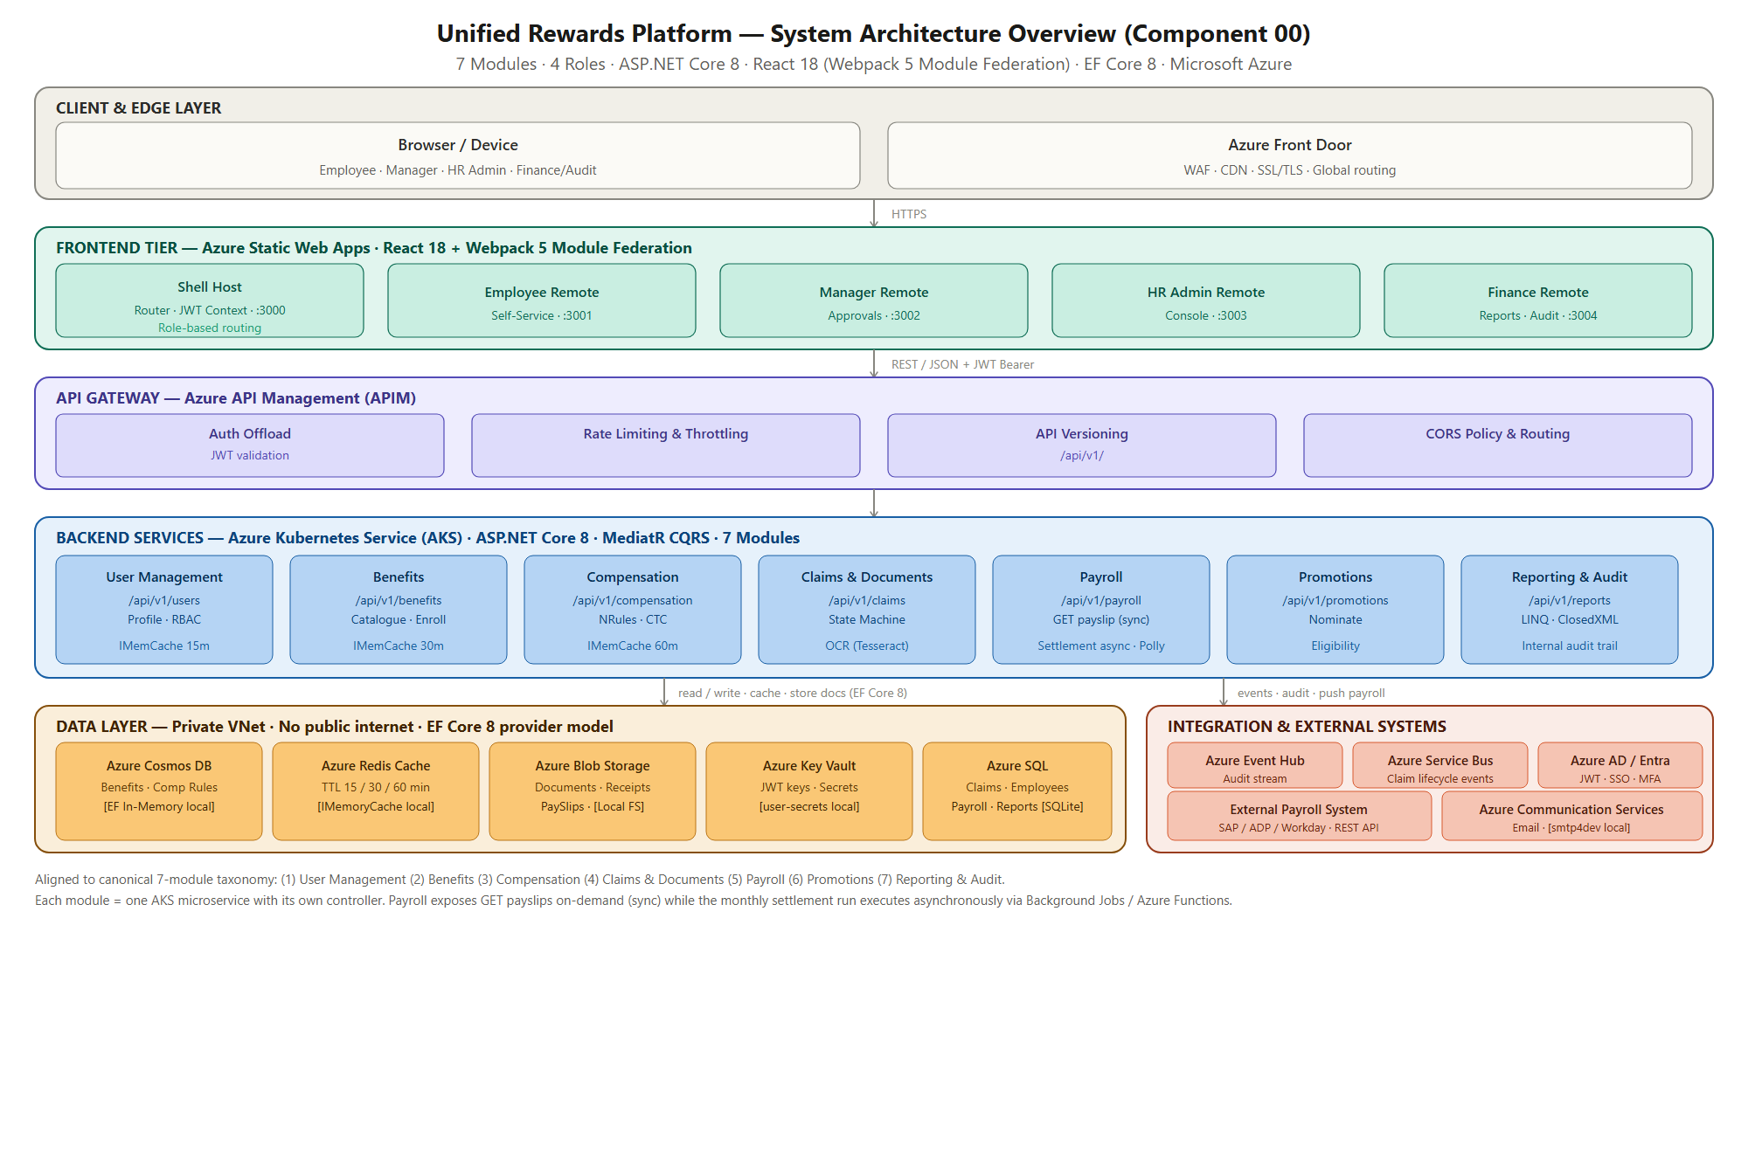
Architecture Diagrams — System Architecture Overview
Source: HLD Section 2.1.2 Conceptual View | comp_00_SystemOverview.png
Notes:
This diagram shows the complete end-to-end flow of the system.
Users such as employees, managers, and admins interact with the system through frontend portals.
Requests from the frontend go to the API gateway, which validates and routes them to the appropriate microservices.
These microservices handle business logic such as claims processing, compensation calculation, and reporting.
The system also interacts with external systems like Azure AD for authentication, payroll services for settlement, and communication services for notifications.
All arrows in the diagram show how data flows between components, starting from user interaction to backend processing and external integrations.
We use SQL for structured transactional data and Cosmos DB for unstructured, scalable and flexible data. This improves performance and scalability.
Why not only SQL? - Using only SQL would limit scalability and flexibility for high-volume or schema-less data, which Cosmos DB handles better.

Slide 14
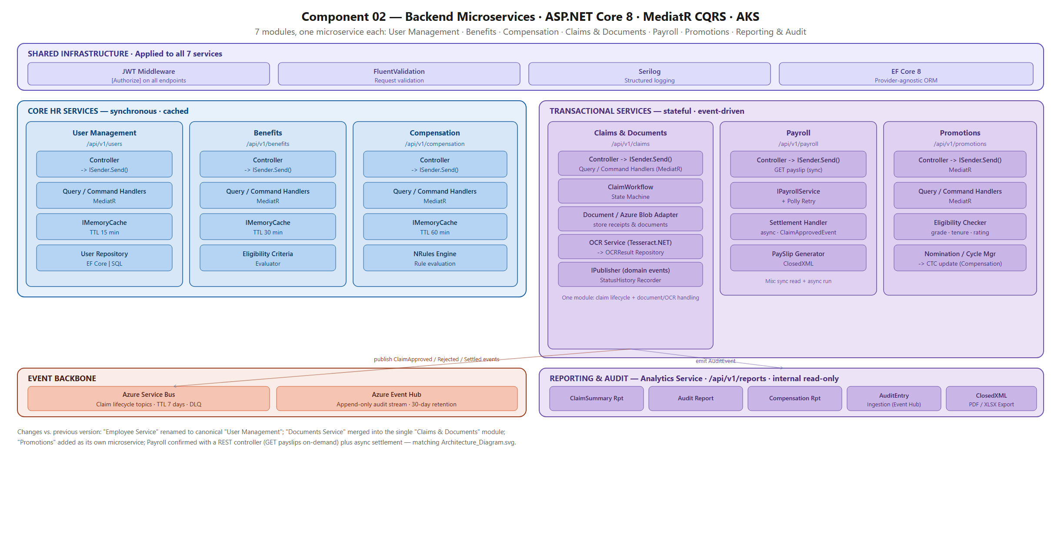
Architecture Diagrams — Backend Services
Source: HLD Section 2.1.7 comp_02_BackendServices.png
Backend: 7 microservices with shared infrastructure (JWT · FluentValidation · Serilog · EF Core 8) + internal CQRS + Service Bus events
Notes:
This slide focuses on the internal structure of backend services.
The system is divided into seven microservices, each responsible for a specific business function, such as claims, payroll, or reporting.
Common functionalities like authentication, logging, and validation are shared across all services to maintain consistency.
The architecture follows the CQRS pattern, separating read and write operations, which improves performance and scalability.
Services communicate using both REST APIs and asynchronous messaging through Service Bus, which enables loose coupling and better fault tolerance.
This design ensures that each service can scale independently and reduces system dependencies.
Inside each microservice, the architecture follows a standard layered pattern, where each component handles a specific responsibility such as request handling, business logic, caching, and data access.
We use controllers to separate API handling from business logic, which makes the system more maintainable and easier to test.
The command and query layer implements the CQRS pattern, where commands are used for operations that modify data, such as creating or updating a claim, and queries are used for read-only operations, such as fetching claim details.
The memory cache is used to temporarily store frequently accessed data, so that the system does not need to repeatedly fetch it from the database. This significantly reduces response time and improves performance.
The repository layer is responsible for interacting with the database. It handles all data access operations such as saving, updating, and retrieving data

Slide 15
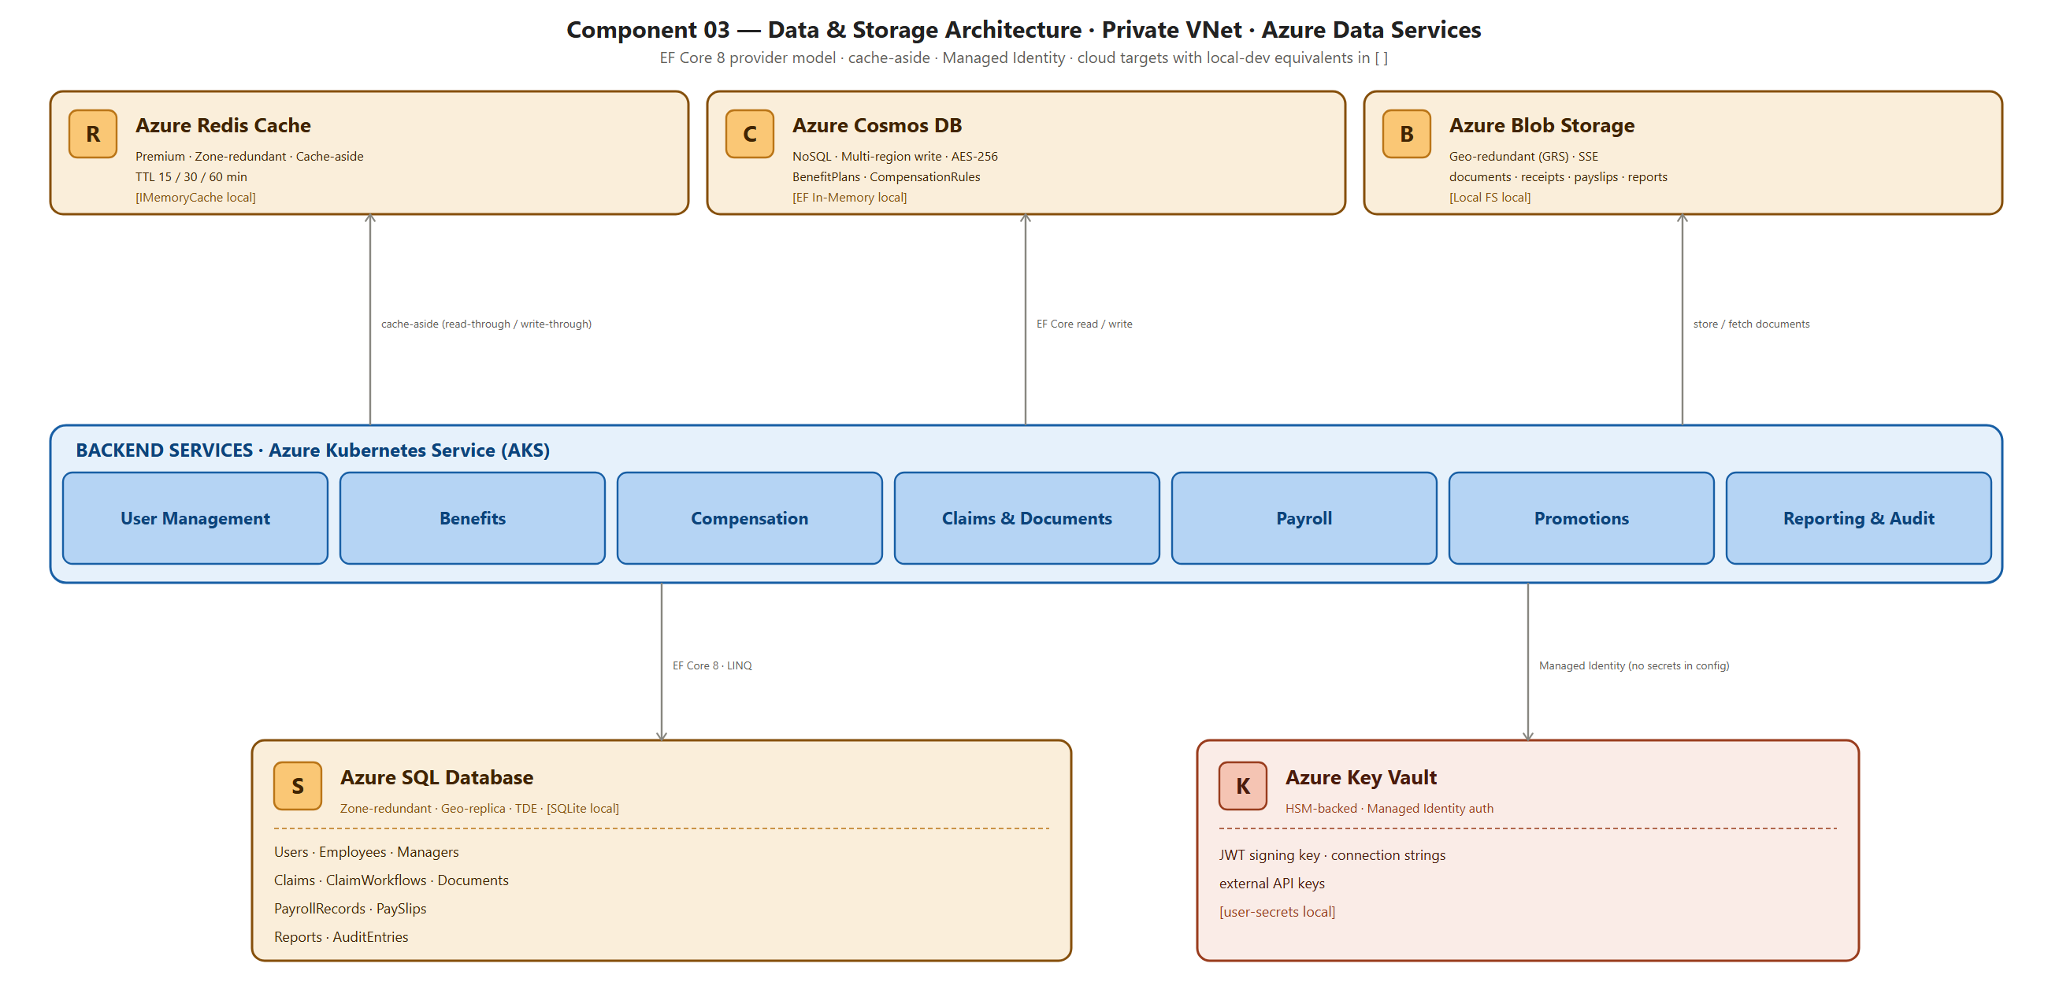
Architecture Diagrams — Data Architecture
Source: HLD Section 2.1.7 comp_03_DataStorage.png
Data Architecture: Polyglot persistence — Azure SQL (transactional) + Cosmos DB (flexible schema) + Redis (cache-aside) + Blob (files)
Notes:
This slide explains the data architecture of the system, where we use different types of storage technologies to handle different kinds of data efficiently. This approach is called polyglot persistence.
What is Polyglot Persistence - Instead of using a single database for all data, we use multiple databases, each chosen based on the type of data and its usage. This improves performance, scalability, and flexibility of the system.
Azure SQL is used to store structured and transactional data such as employee details, claims, approvals, and payroll data. This type of data requires strong consistency and relationships between tables.
Zone-redundant means the database is replicated across multiple physical data centers, called availability zones, within the same region. If one zone fails, the data is still available from another zone. This improves availability and fault tolerance
Azure Cosmos DB is used for storing flexible and high-volume data where the structure may vary, such as audit logs, configuration data, and event-based data.
It also supports schema flexibility, which allows storing unstructured or semi-structured data without rigid table structures.
Azure Redis Cache is used to store frequently accessed data in memory so that it can be retrieved quickly without querying the database every time.
ex-:- For example, configuration data or frequently accessed employee details can be cached for faster access.
Azure Blob Storage is used to store large unstructured data like files, such as receipts, documents, and reports uploaded by users.
Ex:- claim receipts uploaded by employees are stored in blob storage.
Azure Key Vault is used to securely store sensitive information such as encryption keys, secrets, and certificates.
How these components work together :- When a user submits a claim, the structured claim data is stored in Azure SQL, the uploaded receipt is stored in Blob storage, and any frequently accessed data is cached in Redis for faster retrieval. Audit logs or event data may be stored in Cosmos DB. All sensitive credentials used in these operations are securely managed in Azure Key Vault.
Zone-Redundant - Data is replicated across multiple availability zones to ensure high availability.
Why not use only SQL - SQL cannot efficiently handle high-volume or flexible data, so Cosmos DB is used for scalability.
Why Redis? - To improve performance by caching frequently used data.
Why Blob Storage? - To store large files like receipts efficiently.
Geo-Redundant - Data is replicated across different regions (different locations/cities/countries)
Multi-Region Write - Multi-region write means data can be written (updated/inserted) from multiple regions at the same time, not just one primary region.
Improves availability, Supports global applications

Slide 16
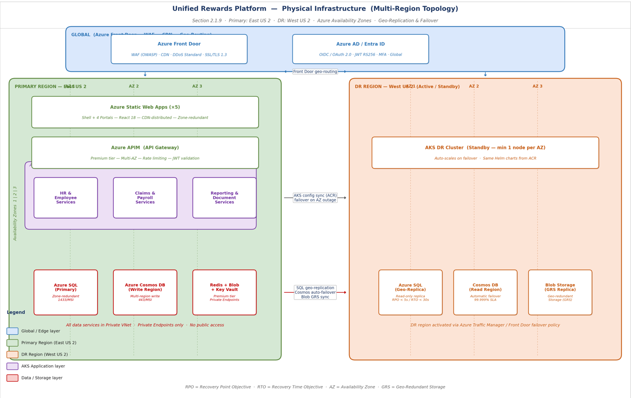
Architecture Diagrams —Deployment Architecture
Deployment: East US 2 (Primary) + West US 2 (DR) — 3 Availability Zones, geo-replication, Azure Front Door geo-routing
Notes:
This slide shows the physical deployment architecture of the system across multiple regions, including the global entry layer, the primary region where the system actively runs, and the disaster recovery region which acts as backup.
When a user accesses the system, the request first goes to Azure Front Door, which routes it to the primary region. The frontend communicates with backend services through API Management, and all processing happens within the AKS cluster. Data is stored in SQL, Cosmos DB, and Blob storage. At the same time, all data is replicated to the disaster recovery region. If the primary region fails, traffic is automatically redirected to the DR region, where the standby system becomes active.
top layer is the GLOBAL LAYER, where Azure Front Door acts as the global entry point for all user requests. It routes traffic to the nearest and healthiest backend region.
Azure AD is used for authentication and identity management. All users log in through this service using OIDC and OAuth protocols
Primary region is East US 2 and DR Region is West US 2). The system is deployed in a primary region, East US 2, and a disaster recovery region, West US 2. If the primary region becomes unavailable due to a failure, the system can switch to the secondary region. This ensures business continuity and avoids downtime in case of regional failures.
Azure Static Web Apps (Frontend Layer) - The frontend applications are hosted using Azure Static Web Apps, which include the main shell and four portals built using React.
CDN distributed → served globally for speed
Zone-redundant → deployed across multiple zones
Why:
“This ensures fast loading for users and high availability even if one zone fails.”
Azure API Management acts as the API gateway, which receives all frontend calls and routes them to backend services.
AKS Application Layer (Microservices) - The backend microservices are deployed on Azure Kubernetes Service, where each service handles a specific business function.
Availability Zones - Within the primary region, the system is deployed across three availability zones, which are separate physical data centers.
PRIMARY DATA LAYER - Azure SQL stores structured transactional data such as claims, employee records, and payroll details.
Zone-redundant → replicated across zones
Cosmos DB is used for high-volume and flexible data, and this region acts as the write region where data is actively written
Redis is used for caching frequently accessed data, Blob storage is used for storing files like receipts, and Key Vault securely stores secrets and encryption keys
Redis → performance
Blob → cost-effective file storage
Key Vault → security
DR REGION – WEST US 2 (Backup System)
A standby AKS cluster is maintained in the disaster recovery region, with minimal resources running
Azure SQL data is replicated to this region as a read-only geo-replica.. RPO < 5 min → max data loss. RTO < 30 sec → recovery time
Cosmos DB automatically replicates data to this region and can act as a read region or failover write region.
Blob storage uses geo-redundant storage, meaning data is replicated to another region automatically.

Slide 17
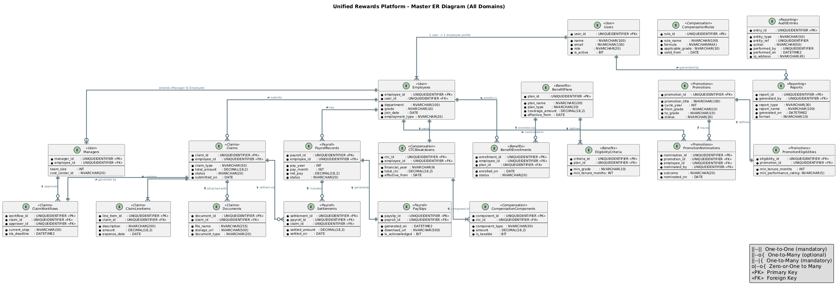
Architecture Diagrams — Entity Relationship Diagram (All Domains)
Source: HLD Section 2.1.8 Data View | er_00_master.png | 22 entities across 7 domains
Notes:
This diagram represents the data model of the system.
It shows all key entities such as employees, claims, benefits, payroll, and their relationships.
For example, an employee can have multiple claims, and each claim is linked to documents and approvals.
This diagram helps in understanding how data is structured and how different parts of the system are connected.
It is used for designing databases and ensuring data consistency.

Slide 18
07 Tech Stack
Source: HLD Section 2.1.5 + LLD Sections 1.1 Trademarks & 4.8 Software Prerequisites
© 2025–2027 Cognizant | Private

Slide 19
Tech Stack
Source: HLD Section 2.1.5 Technology View + LLD Section 4.8 Software Prerequisites
FRONTEND
BACKEND
AZURE CLOUD
DEVOPS & TESTING
• React 18.3 + TypeScript
• Webpack 5 Module Federation
• Material-UI v5 (Cognizant theme)
• Axios 1.x — Bearer token interceptor
• MSAL.js — Azure AD OIDC/OAuth 2.0
• Azure Static Web Apps + CDN
• Jest + React Testing Library
• Playwright (E2E testing)
• ASP.NET Core 8 + C# 12 (.NET 8 LTS)
• MediatR v12 — CQRS pattern
• NRules v0.15 — compensation rules engine
• FluentValidation v11
• Entity Framework Core 8 (code-first)
• Polly v8 — retry + circuit breaker
• Tesseract.Net 2024 (receipt OCR)
• ClosedXML v0.102 — XLSX/PDF reports
• Serilog v3 — structured logging
• AKS v1.28+ (HPA 2–10 pods per service)
• Azure APIM Premium
• Azure Front Door v2 + WAF (OWASP CRS)
• Azure SQL GP_Gen5_4 (zone-redundant)
• Azure Cosmos DB (auto-scale, multi-region)
• Azure Redis Cache P1 (zone-redundant)
• Azure Blob Storage (GRS)
• Azure Service Bus Premium
• Azure Event Hub Standard
• Azure Functions v4 (.NET 8 isolated)
• Azure Key Vault (HSM) + Managed Identity
• Azure AD / Entra ID + MFA
• GitHub Actions — per-service CI/CD
• Docker 26 — container builds
• Helm 3 — Kubernetes deployments
• Azure Monitor + Application Insights
• OpenTelemetry (distributed tracing)
• xUnit + Moq — unit testing
• WireMock.NET — payroll API mock (dev)
• smtp4dev — email mock (dev)
• Azure Container Registry (ACR)
• GitHub Copilot + Claude Code (AI)
Notes:
This slide shows the complete technology stack used to build the system. On the frontend, we use React with TypeScript for building modular and scalable UI components. On the backend, we use ASP.NET Core with microservices architecture for handling business logic. Azure services like AKS, SQL, Cosmos DB, and Service Bus are used for cloud infrastructure, ensuring scalability and reliability. DevOps tools like GitHub Actions, Docker, and monitoring tools are used for deployment and observability.

Slide 20
08 AI Usage and Metrics
GitHub Copilot (code generation) + Claude Code (architecture & docs) — mandatory requirement from spec
AI Used to BUILD This Platform
AI Features Built Into the Product
GitHub Copilot — ~40% of code auto-generated
ASP.NET Core controllers + EF Core entities
MediatR handlers + FluentValidation rules
React components + Axios clients
xUnit tests — >60% test methods generated
Helm charts + GitHub Actions YAML
Claude Code — architecture & documentation
HLD (60+ pages, 11 views) in < 1 day
LLD (full technical specs) in < 1 day
API Specification — 9 endpoints, OpenAPI 3.0
Architecture Decision Records (AD-01–AD-10)
This presentation — structured & formatted
Tesseract.Net Receipt Processing:
Extracts: vendor, date, amount, currency, category
Score ≥ 0.95 → auto-accept (form pre-filled)
Score 0.80–0.94 → flag for spot-check
Score < 0.80 → re-upload prompt
NRules Compensation Engine:
HR Admin edits rules in browser in 5 minutes
NRules Rete algorithm: < 100 ms per CTC calc
Live update — zero code redeployment
Azure Monitor ML Anomaly Detection:
Dynamic thresholds on 7-day baseline
PagerDuty P1 alert < 5 minutes
Delivery Metrics: Without AI = 34 weeks (~8.5 months) | With AI = 21 weeks (~5.25 months) | 13 weeks saved | 38% faster
Notes:
This slide explains how AI is used both during development and within the product. During development, tools like Copilot and Claude help generate code, documentation, and tests, improving productivity. Inside the product, AI is used for OCR to extract data from receipts, rules engine optimization, and anomaly detection for monitoring. Overall, AI reduces manual effort and speeds up delivery by around 38%.

Slide 21
09 Advantages
Architecture, Security, Delivery & Operational benefits of the chosen design
Independent Scalability
Rule-Based Compensation
Event-Driven Resilience
Zero-Credential Security
Each of 7 services scales autonomously on AKS. Payroll Service scales 10x at month-end without touching other services.
NRules engine: HR Admin changes salary formulas in browser in 5 minutes — replaces 3–6 week IT deployment cycle.
Service Bus decouples services. DLQ guarantees zero payroll data loss. Circuit breaker prevents cascade failures.
Managed Identity everywhere. No passwords in code, config files, pipelines, or databases.
Module Federation Portals
AI-Accelerated Delivery
Compliance by Design
Multi-Region DR
Each of 4 portals deploys independently. Bug fix in Manager portal does NOT redeploy Employee portal.
38% faster: 34 weeks → 21 weeks. ~40% boilerplate auto-generated. Full architecture docs in days.
7-year immutable audit trail from Day 1. GDPR-ready. PII masked in logs. Region-pinned East US 2.
RTO < 30 min (app). RPO < 5 min (SQL). Cosmos DB zero RPO. Quarterly validated DR failover drills.
Notes:
This slide highlights the key benefits of the architecture. Microservices allow independent scaling of each component based on load. The rules engine enables dynamic business logic without code changes. Event-driven communication improves system reliability and fault tolerance. Security is strengthened using managed identities and zero credential storage. Overall, the design improves scalability, flexibility, and delivery speed

Slide 22
10 Estimations and Implementation Plan
Source: LLD Section 5.2 (DR/HA) + LLD Section 7.1.9 (Capacity) + Delivery methodology
Foundation & Infrastructure
Azure provisioning (AKS, APIM, SQL, Cosmos, Redis, Service Bus, Event Hub, Key Vault) · Managed Identity + Private VNet + Entra ID SSO + MFA · Employee & Benefits services · CI/CD pipelines
Phase 1
Without AI: Wk 1–8 | With AI: Wk 1–5
Claims, Documents & Approval
Claims state machine + Documents service + Tesseract.Net pipeline (Azure Functions) · Employee Self-Service Portal + Manager Approval Portal · 7-business-day SLA + email reminders
Phase 2
Without AI: Wk 9–16 | With AI: Wk 6–10
Compensation, Payroll & Promotions
NRules CTC engine + Payroll REST integration (Polly retry + DLQ) · PaySlip PDF (ClosedXML) + Promotions service · HR Admin Portal · End-to-end flow validated
Phase 3
Without AI: Wk 17–24 | With AI: Wk 11–15
Reporting, Audit & Go-Live
Reporting Service + Finance & Audit Portal · Load test (10K users) · Security review + DR drill · Production go-live: blue-green deployment + rollback verified
Phase 4
Without AI: Wk 25–34 | With AI: Wk 16–21
WITHOUT AI: ~34 weeks (8.5 months) · Team: 13 · ~15,640 person-hours WITH AI: ~21 weeks (5.25 months) · 13 weeks saved · 38% faster · ~40% code auto-generated
Notes:
This slide describes the phased implementation approach. Phase 1 focuses on infrastructure setup and core services. Phase 2 covers claims and document processing workflow. Phase 3 includes compensation and payroll integration. Phase 4 focuses on reporting, testing, and go-live. Using AI tools significantly reduces the total delivery time from 34 weeks to 21 weeks.

Slide 23
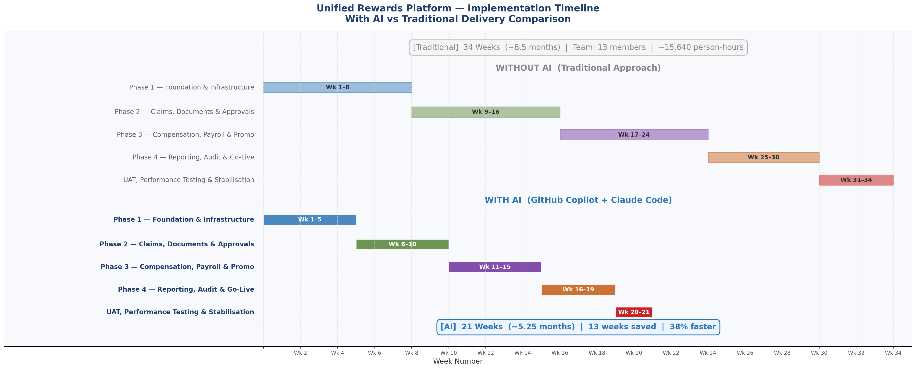
Estimations and Implementation Plan — Timeline Comparison
With AI (GitHub Copilot + Claude Code) vs Traditional delivery — 4 phases + UAT
Notes:
This slide visually compares the delivery timeline with and without AI. It clearly shows that each phase is completed faster when AI tools are used, resulting in overall reduced project duration and improved efficiency.

Slide 24
11 Risks and Mitigations
Source: LLD Section 5.2 DR + HLD Section 5 + design review
#
RISK
IMPACT
MITIGATION
R-01
External payroll API failures (SAP/ADP/Workday)
High
Polly retry 3× + circuit breaker + Dead Letter Queue + WireMock mock adapter in dev/UAT
R-02
OCR accuracy on blurry / low-DPI receipt images
High
Confidence threshold: < 0.80 triggers re-upload prompt. Tesseract.NET fallback for handwritten receipts.
R-03
NRules performance under high concurrent CTC load
High
Compiled rule sessions cached in Redis (30 min TTL). Benchmarked at 500+ concurrent before go-live.
R-04
Multi-region failover misconfiguration (split-brain)
High
Azure auto-failover groups. Quarterly DR drills with documented runbook. Chaos Engineering tests.
R-05
GDPR compliance gap in audit event stream
High
PII masked in Event Hub events (userId only). East US 2 region-pinned storage. Erasure flow tested.
R-06
AKS operational complexity across 3 Availability Zones
Medium
Helm charts + GitOps. Azure Monitor node health alerting. All deployments declarative.
R-07
Scope creep from stakeholder additions mid-delivery
Medium
Change Control Board. Phased roadmap agreed up-front. Backlog gate reviews before each phase.
Notes:
This slide identifies key risks such as failures in external payroll integration, OCR inaccuracies, and performance issues in rules processing. Each risk is addressed with mitigation strategies like retry mechanisms, dead letter queues, fallback processing, and caching. This ensures system reliability and stability.

Slide 25
12 Link to LLD and HLD
All documents on SharePoint · Full technical specifications available for deep-dive review
HLD — High Level Design v1.0
Path: Cognizant-UnifiedRewardsPlatform-HLD v1.0.docx
Cognizant-UnifiedRewardsPlatform-HLD v1.0.docx
60+ pages · 11 architectural views · Functional, Logical, Security, Deployment, Integration views
LLD — Low Level Design v1.0
Path: Cognizant-UnifiedRewardsPlatform-LLD v1.0.docx
Cognizant-UnifiedRewardsPlatform-LLD v1.0.docx
Exact configurations, IP addresses, DB schemas, port matrices, service accounts, HA/DR strategy, capacity planning
API Specification v1.0
Path: Cognizant-UnifiedRewardsPlatform-API Specification v1.0.docx
Cognizant-UnifiedRewardsPlatform-API Specification v1.0.docx
9 REST API endpoints · OpenAPI 3.0 · Request/response schemas · Security framework · Postman collection
Diagram Repository: Supporting Diagrams on SharePoint: 6 Component Diagrams · 8 ER Diagrams · 6 Sequence Diagrams · 8 Class Diagrams · Architecture PDFs · Deployment Architecture PDF
Notes:
This slide provides references to detailed design documents. The HLD explains the overall architecture and design decisions, while the LLD contains detailed implementation-level specifications such as configurations and database design. The API specification defines all endpoints and integration details for the system.

Slide 26
13 Case Studies — Validated Patterns & Reference Architectures
Every major architectural decision is validated by real-world Cognizant client deployments
Microservices HR — BFSI Client (50K+ employees)
OCR Expense Management — Financial Services
Multi-Region DR — 2 Financial Services Clients
Same stack: 7-service AKS + React 18 Module Federation
Tesseract.Net pipeline: 50,000+ receipts/month since 2024
East/West US Azure paired regions with auto-failover groups
Outcome: 60% deploy-risk reduction · 12K concurrent users · Per-domain team ownership
Outcome: 94%+ accuracy in production · 70% reduction in manual review work
Outcome: Validated RTO < 30 min, RPO < 5 min in production failover tests
Zero-Credential Architecture — 4 Azure Solutions
CQRS + MediatR — 5+ .NET Enterprise Projects
Payroll Integration — Manufacturing
Managed Identity across all services — no stored credentials
MediatR CQRS deployed in 5+ projects with 10,000+ users
SAP REST + Polly retry + Service Bus + Dead Letter Queue
Outcome: Passed penetration test with zero findings · Adopted as Cognizant Azure standard 2025
Outcome: 40% fewer integration defects vs traditional N-tier architecture
Outcome: Zero data loss over 24 months · < 0.1% DLQ rate
Notes:
This slide presents real-world case studies where similar architectures and technologies have been successfully implemented. It demonstrates that the chosen design patterns such as microservices, OCR processing, payroll integration, and multi-region deployment are already proven in enterprise environments.

Slide 27
Thank You
Unified Rewards Platform — U2A Use Case Presentation 2026
266319 — Sandhya S
© 2025–2027 Cognizant | Private

