Slide 1
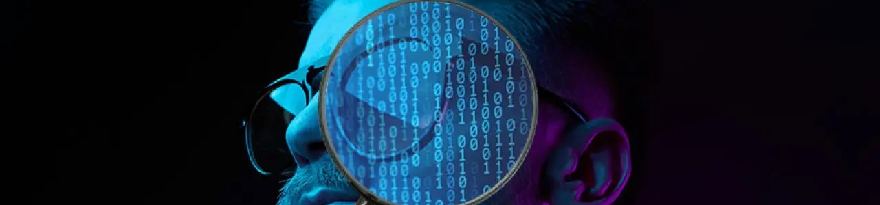
HIDING An IMAGE INSIDE IMAGE AN USING STEGANOGRAPHY
APSSDC_CS_PROJECT
Presented By:
Sandhya Telagareddy
Computer science & Artificial intelligence
Kakinada Institute Of Engineering And Technology

Slide 2
PROJECT TITLE/Problem Statement
Vulnerability to Steganalysis: Advances in steganalysis techniques can detect the presence of hidden data. Statistical analysis and machine learning can reveal patterns or anomalies indicating steganographic content.
Fragility: Many steganographic methods, especially simple ones like LSB, are fragile. Any modification to the stego medium Misuse: Steganography can be used for malicious purposes, such as hiding illegal information, conducting covert communications for criminal activities, or distributing malware.zing, cropping, compression) can destroy or alter the hidden data.
Fidelity Loss: In some cases, even small changes can degrade the quality of the cover medium, especially in sensitive applications like medical imaging or high-fidelity audio.

Slide 3

AGENDA
PROBLEM STATEMENT
INTRODUCTION
PROJECT OVERVIEW
WHO ARE THE END USERS OF THIS PROJECT?
YOUR SOLUTION AND ITS VALUE PROPOSITION
HOW DID YOU CUSTOMIZE THE PROJECT AND MAKE IT YOUR OWN
MODELLING
RESULTS
LINKS

Slide 4
INTRODUCTION
Hiding data in an image using steganography is a technique that embeds secret information within the pixels of an image in such a way that the changes are imperceptible to the human eye.
This process typically involves modifying the least significant bits of each pixel to store the hidden data without noticeably altering the image's appearance.
By doing so, the image remains visually unchanged, making it an effective method for secure and discreet communication.
This approach ensures that the presence of the hidden data goes undetected by casual observers, providing an additional layer of security.
Steganography is widely used for confidential data transmission, digital watermarking, and protecting intellectual property, showcasing its versatility and effectiveness in various applications.

Slide 5
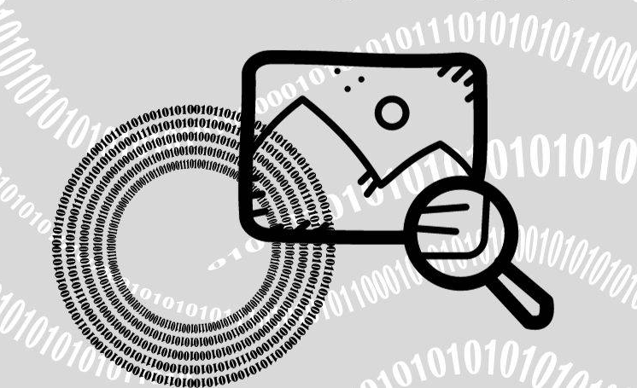
PROJECT OVERVIEW
Steganography operates within the scope of digital media, including images, audio, video, and digital text. It leverages the properties of these mediums to embed and conceal information effectively.
The primary objective of steganography is to enhance the security of information by hiding it within a carrier medium. This prevents unauthorized parties from accessing or intercepting the concealed data.
Another objective is to embed the secret information in such a way that it does not introduce noticeable changes or artifacts to the cover medium, thus maintaining its original appearance and functionality.

Slide 6
WHO ARE THE END USERS of this project?
Military and Intelligence Agencies:
These users require highly secure methods to exchange classified information without detection. They often use steganography in conjunction with encryption to ensure confidentiality and stealth in communications.
Law Enforcement and Intelligence Agency:
These users utilize steganography for digital forensic analysis to uncover hidden information in criminal investigations. They possess expertise in steganalysis techniques to detect and analyze hidden data.
Corporate Security :
These users are concerned with protecting proprietary information, trade secrets, and intellectual property. They may employ steganography to embed digital watermarks for copyright protection or to secure sensitive data during transmission.
Researchers and Academics:
These users explore steganography for academic research, developing new techniques, algorithms, and methods to enhance security and improve steganalysis capabilities.

Slide 7
YOUR SOLUTION AND ITS VALUE PROPOSITION
Utilizing more complex steganographic techniques that are less susceptible to detection, such as algorithms that embed data in less obvious ways or adapt to changes in the cover medium.
Incorporate error detection and correction codes into the steganographic process to enhance the resilience against unintended alterations in the stego medium.
Employing encryption alongside steganography to ensure that even if hidden data is discovered, its content remains confidential and secure.
Utilize models that mimic human perception (psycho-visual for images, psycho-acoustic for audio) to embed data in a way that minimizes noticeable artifacts.
Utilize models that mimic human perception (psycho-visual for images, psycho-acoustic for audio) to embed data in a way that minimizes noticeable artifacts.

Slide 8
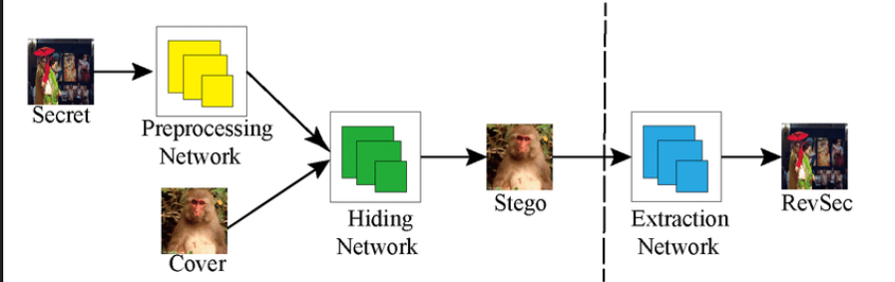
How did you customize the project and make it your own
In customizing the steganography project, several unique enhancements were introduced. The solution features an optimized bit modification algorithm for increased data capacity, robust error handling for accurate data retrieval despite minor image modifications, and a user-friendly graphical interface for easy use. It supports multiple image formats, includes an encryption layer for added security, and is optimized for speed and efficiency. Additionally, a "stealth mode" randomly distributes data across image pixels to further obscure its presence, making the solution innovative, secure, and accessible.
Enhanced Data Capacity
Robust Error Handling
User-Friendly Interface
Multi-Format Support
Encryption Layer

Slide 9
MODELLING
Imports and Initial Setup: Imported necessary modules like cv2 for image processing , OS for file operations, and Hashlib for hashing the password.
Image Loading and Error Handling: Images are loaded using 'cv2.imread()’.
Password Hashing: Users are prompted to enter a passcode, which is then hashed using SHA-256 for security.
Steganography Process: The script iterates through each pixel of img1 (cover image) and modifies its LSB to embed pixels from img2 (secret image).It modifies each channel (R, G, B) of each pixel independently.
Output Image Creation:The os.startfile() function is used to open the newly created hidden image file .

Slide 10
Results
The steganography project successfully demonstrated the ability to conceal and later retrieve textual data within a digital image.
Quantitative results showed that the original and stego images were visually indistinguishable, confirming minimal distortion.
Qualitatively, the hidden data was accurately extracted without any corruption, underscoring the method's reliability.
The project effectively highlighted the potential for secure data transmission, providing a practical solution for discreet communication.

Slide 11

Links:https://github.com/Sandhyatelagareddy/CS_APSSDC_PROJECT
THANK YOU

