Slide 1

SCORER Edge Developers Induction
August 2019

Slide 2
Outline
SCORER Edge
Key Features & Supported HW Configurations
SCORER Edge Data Flow (Video Analysis)
High Level Architecture
Components Overview
SCORER Code walkthrough
SCORER Build Procedure
Development on SCORER Edge
GitHub Account
Getting the Source Code
Submitting your changes
SCORER Edge Roadmap – 2019 (Key Features)
New Device UI : TDC – API Server, UI
Stack Manager: JCM – Docker compose based JCM
Remote Control Feature: C3
IDE (Jupyter) & Market Place Integration – SDK
SDK Ver2 Enhancements - SDK
Adding more algorithms – CA2
VPN Integration – C3 & TDC

Slide 3
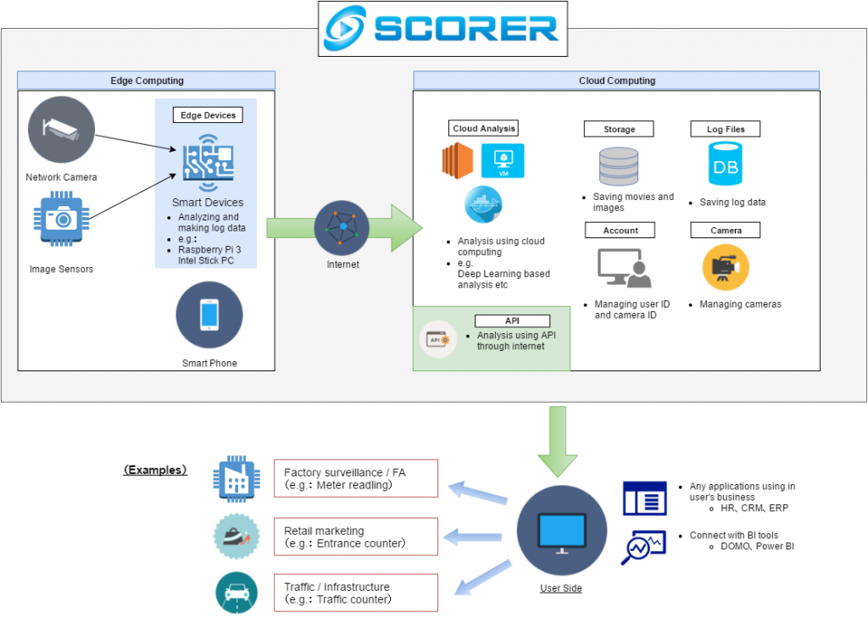
SCORER Edge
SCORER Edge Key Features
Ingestion of streams, images, videos
Edge Analytics
SDK
Cloud Data Transfer (Edge Gateway)
SCORER Edge Supported HW
Raspberry Pi
Intel
Intel with GPU
Upboard
Jetson Nano (To be done)

Slide 4
SCORER Edge Data Flow
Video / Image Processing Pipeline
High Speed Data Flow Area
CA2
CAF
Algorithm
ZeroMQ EP
MP4 Recorder
CAF
MP4 File
MP4 Player
ZeroMQ EP
I420 Frame High Speed Image Flow (1FHD = 6MB)
Recording Algorithm Generated Video
Web Cam
Frame Monitor/Monitor
CAF
I420
H264
MJPEG
SAC
Log files
MP4 files
CSI Cam
Frame Grabber/ Recorder
I420
H264
MJPEG
Dumping Images Periodically
C3
H.264 encode/decode
MP4 File Output
I420 Image Output
H264 Stream Output
S3 Uploader/Uploader
RTSP Cam
ZeroMQ EP
MP4 files
CAF
File Depot
MP4 Lumberer
MP4 files
Transient File Depot
For Priority-aware Buffered Uploading
Cutting MP4 Files for Browser Download
H264 (RTP)
RTSP Server
TDC
RTMP Broadcaster
C3
Live Streaming to Cloud
Pre-event Recorder
CAF
TDC
Kinesis Broadcaster
C3
WebRTC Server
Live Streaming to Local

Slide 5
SCORER Edge Architecture
Low latency data channel（L2DC）
Content Analysis Foundation （CAF）
Content Analysis Algorithms （CA2）
Commercial Algorithms
Community/Self Built Algorithms
Sensor Actuator Control（SAC）
Cloud Communication Channel
（C3）
Software Development Kit
（SDK）
T-(Mono?) Direct Control
（TDC）
Encrypted Storage（SS）
Dockerd
Job Control/Monitoring（JCM）
OS Monitoring（OSM）
Raspbian / Debian OS

Slide 6
SCORER Edge Architecture
Low latency data channel（L2DC）
Analyze
IN
OUT
OUT
Content Analysis Foundation （CAF）
Content Analysis Algorithms （CA2）
Commercial Algorithms
Community/Self Built Algorithms
Sensor Actuator Control（SAC）
Cloud Communication Channel
（C3）
Software Development Kit
（SDK）
Thing Direct Control
（TDC）
Encrypted Storage（SS）
Dockerd
Job Control/Monitoring（JCM）
OS Monitoring（OSM）
Raspbian / Debian OS

Slide 7
SCORER Edge Key Components

Slide 8
OSM – OS Resource Monitoring
Role: Visualize and monitor resource usage managed by OS
Area of responsibility
Record as time series statistics such as process number, load average, amount of memory used, communication volume, Graph the recorded statistical information, Automatic recovery from OS abnormality (thrashing, stall due to insufficient memory)
Implementation policy
Recording and Visualizing Statistics with NetData & Grafana & Influx DB
Monitoring by Watchdog Timer etc., Recovery by automatic restart
Main API / UI
NetData: For short-term monitoring
Grafana & InfluxDB: For long-term monitoring
Graph the transition over 7 days every hour, keep it in the cloud
Automatic reboot at stall by Watchdog Timer

Slide 9
JCM : Job Control & Monitoring
Role Starting job, monitoring during execution, recording execution result, fair resource distribution, visualization of situation
Area of responsibility
According to the job definition, allocate the request resource at the specified timing and start the job
If the job fails, retry etc. according to the job definition
Process job dependencies appropriately
Implementation policy
Control and monitor with Dockerd / Docker-Compose
Visualize with Portainer
Main API / UI
Job definition file
Visualization of current job execution status Visualization of Job Stack by UI: Portainer
Start job manually UI: Use for testing and debugging purposes: Operate on Portainer
Survey results of other Workflow / Job control engines
SLURM is suitable for cluster configuration, but one control is inconvenient.
Kubernetes is too heavy at raspi (1 cores will be 100%)
Airflow is attractive but immature, overspec

Slide 10
SAC: Sensor & Actuators control
Role: Control of camera, control of external device using GPIO etc.
Area of responsibility
Acquire video from camera, record, normalize MP4 file
Local distribution (RTSP, L2DC Endpoint)
IO control using GPIO, I2C, etc.
Output statistical information
Implementation policy
Implemented in Docker container: recorder, hubot
Main API / UI
Recording control (Start, Stop, Reload): scorer_sac.conf
FlatBuffers Protocol definition file, ZeroMQ Endpoint

Slide 11
CAF: Content Analytics Foundation
Role: Glue module for analyzing data obtained from SAC with an analysis algorithm (CA2) described later
Area of responsibility
Intermediates between peripheral modules (such as SAC and C3) and analysis algorithms (CA2)
Provide a convenient part group for analysis (MP4 file generation tool etc.)
In accordance with the use case, balance such as real time property, accuracy, data volume
Implementation policy
Implement with Docker container and connect with each other with ZeroMQ Endpoint
Package analysis tools to be used internally Included: Content Analysis Tools (CAT)
Main API / UI
ZeroMQ Endpoints
CAT: GStreamer, MP4Box, OpenCV, ..., etc. etc.
Load balancer for analysis on multiple hosts (ZeroMQ Load Balancer)
CA2
SAC
CAF
C3
CAT

Slide 12
CA2: Content Analysis Algorithms
Role: Analysis of input data such as video and output of results
Area of responsibility
Analyze data entered in a specific format and convert it to the target data format
Implementation policy
Using the Docker container
Assumed input: tuning parameter, area judgment information, video, image, sound, other sensor data
Expected output: Image (Raw / Annotated) detected, detected moving image (Annotated), JSON log
Main API / UI
Cascade analysis (face detection), HoG analysis (person detection), tracking etc.
Area pass judgment of tracking object
Window display for debugging (X Window or EGL)
CA2
SAC
CAF
C3
CAT

Slide 13
C3: Cloud Communication Control
Role: Communication and control between cloud and edge in general
Area of responsibility
Data uploading: movies, images, logs etc.
Docker image download, update
Device registration process to the cloud
Get instructions from the cloud, return results (via Shadow)
Implementation policy
Implemented in Docker container
Make it possible to communicate with clouds other than AWS by changing modules (Strategy Pattern)
Main API / UI
File to be uploaded, command acquisition: ZeroMQ Endpoint
Device registration: Web API

Slide 14
SDK: Software Development Kit
Role: Providing development environment
Area of responsibility
Allow development of algorithms etc. with web based IDE (Jupyter Lab)
Tools to make the developed code Docker image and share it in the cloud and P2P
Providing a Docker base image including required libraries
Implementation policy
CV related libraries, and Jupyter's Docker image, Docker-Compose running environment
Mount the host side home directory from the Docker container and persist data
Main API / UI
IDE (Web based – Jupyter- Earlier it was Cloud9), Docker base image
SDK Tools (CLI)

Slide 15
TDC: Thing Direct Control
Role: Terminal control from the local network and status confirmation of the terminal
Area of responsibility
Camera settings: exposure, frame rate, white balance, etc.
Display of camera image / Confirmation of angle of view (UI)
Monitoring results of jobs and OS resources (UI)
Setting of the terminal itself, such as Wifi and time zone, Login Terminal (Web based)
Implementation policy
Implemented in Docker container
For Wifi control etc, set up a lightweight API server inside the device and use it from Web UI
Main API / UI
UI (Web based)
Configuration storage DB, API server

Slide 16

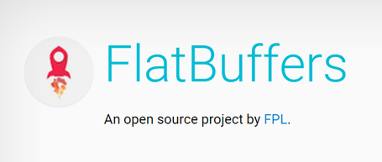
L2DC: Low Latency Data Channel
Role: Terminal control from the local network and status confirmation of the terminal
Area of responsibility
Camera settings: exposure, frame rate, white balance, etc.
Display of camera image / Confirmation of angle of view (UI)
Monitoring results of jobs and OS resources (UI)
Setting of the terminal itself, such as Wifi and time zone, Login Terminal (Web based)
Implementation policy
Implemented in Docker container
For Wifi control etc, set up a lightweight API server inside the device and use it from Web UI
Main API / UI
UI (Web based)
Configuration storage DB, API server

Slide 17
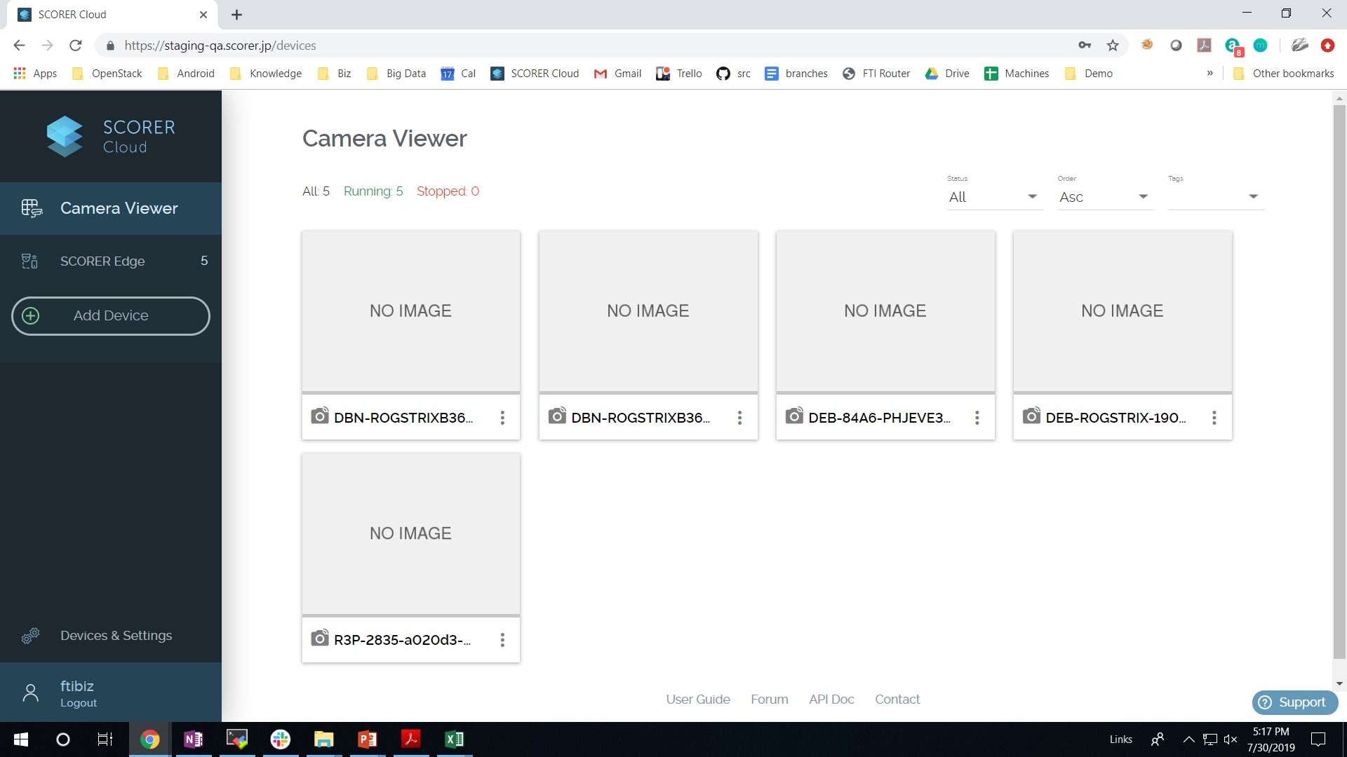
Edge Components Deployment View
containers
SCORER-Cloud
(AWS IOT)
SMC
AWS S3
SCORER Edge
2
Manufacturing/docker/scripts/RunAll.sh
Build/Pull/Push all docker images.
Edge-UI
mosquitto
mqtt_shadow_subscribe
uploader
stacks
stacks
mqtt_publish
rec
mon
stacks
Edge-API
algo
brdcst
device_registration
config-service
Docker repository (ECR)
host
zmq
endpoint
Docker volumes
zmq endpoint
avahi
rr_monitor
(OSM)
stack_mgr
(JCM)
Netdata, grafana
(OSM)
Local repo
1
OS (Debian)
Manufacturing/debian/scripts/RunAll.sh
Builds & Installs all host packages.

Slide 18
Directory structure (Post Installation)
Linux の Filesystem Hierarchy Standard（FHS）to follow
Basically, use under / opt / scorer Exception: When using the OS base packages, follow the OS rules
The definition file of the L2DC protocol is /opt/scorer/share/l2dc placed below
/opt/scorer
/etc
■ FlatBuffer (Example definition file (temporary)) l2dc
`-- schema
|-- opencv2
| `-- core.fbs
`-- sac
`-- rawframe.fbs
/bin, sbin
/lib, libexec
/include
/man
/share
/home

Slide 19
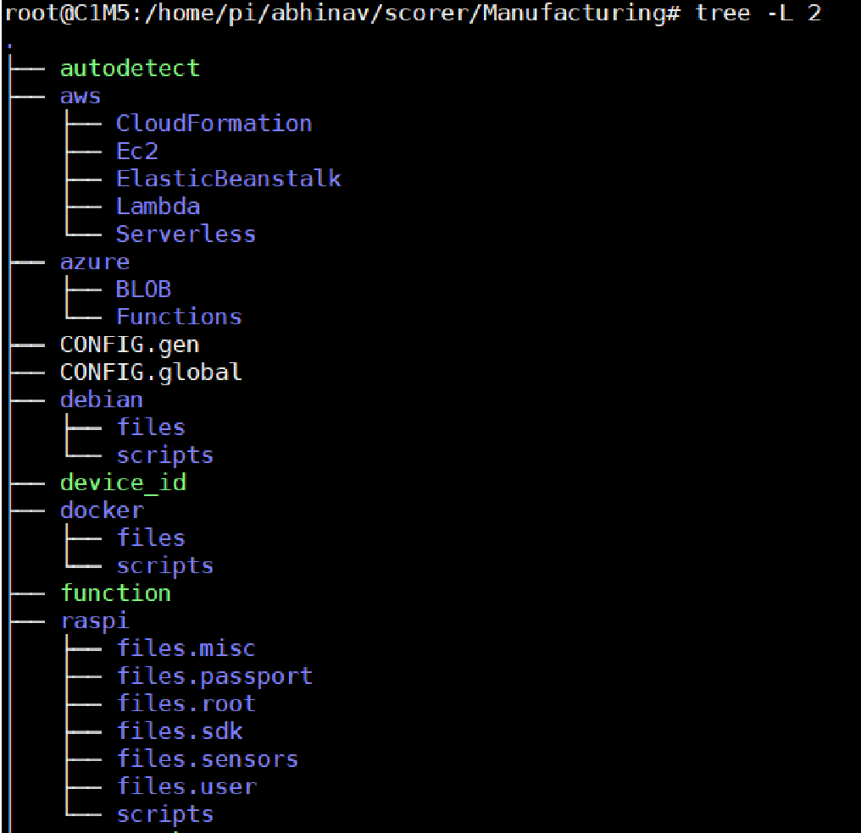
SCORER Edge Source Code Walkthrough
script to detect HW configuration automatically. It generates a file called config.gen which keeps information about various configurations detected and is used by other manufacturing scripts.
Build scripts for building SCORER edge for AWS. (Non docker)
Build scripts for building SCORER edge for Azure. (Non docker)
CONFIG.gen : configuration file generated by autodetect.
CONFIG.global: All configuration parameters required by different manufacturing scripts.
Debian: Scripts for setting up debian operating system and base packages running on host.
Docker: keeps all the files and scripts required to build and run dockers/containers for SCORER edge.
Function: A library file containing various reusable functions by different build scripts.
Raspi: Scripts for building SCORER edge for raspberry pi.
1
2
3
4
5
6
7
8
9

Slide 20
Organization of code for manufacturing of docker images
Refer folders/files under: scorer/Manufacturing/docker/scripts
1. builddeps: docker images containing packages required for building all other containers.
2. l2dc: docker images for low latency data channel.
3. cat: docker images for content analytics tools.
4. caf: docker images for content analytics foundation.
5. ca2: docker images for content analytics algorithms.
6. sac: docker images for sensors & actuation control.
7. c3 : docker images for cloud communication channel.
8. sdk: docker images for sdk
9. tdc : docker images for Thing Direct Control

Slide 21
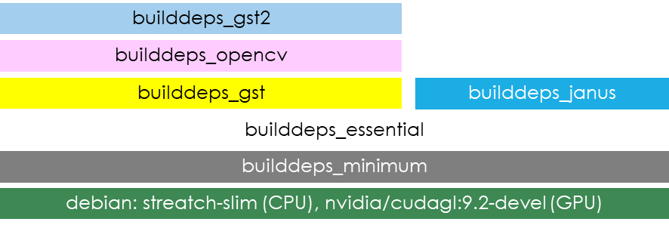
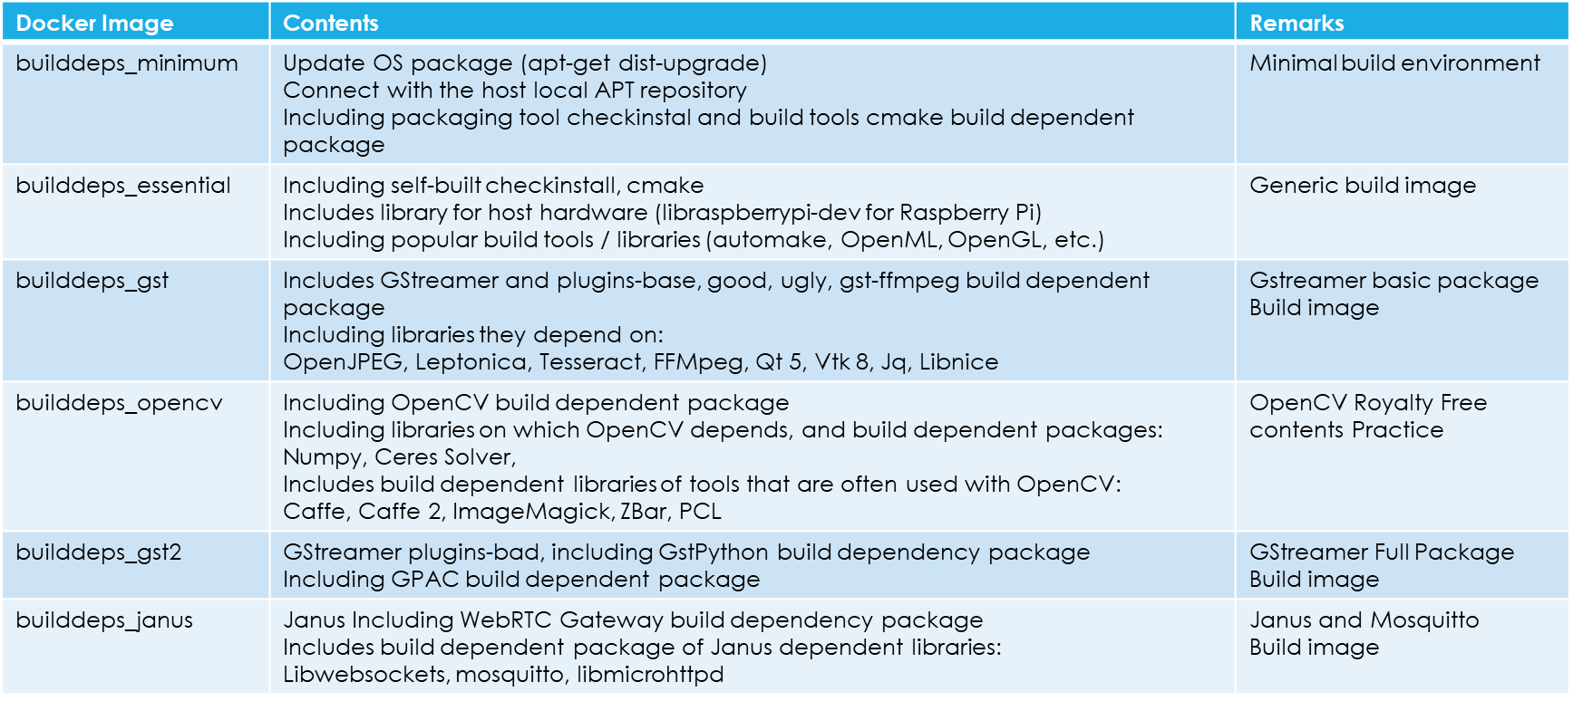
Builddeps docker Image layers

Slide 22
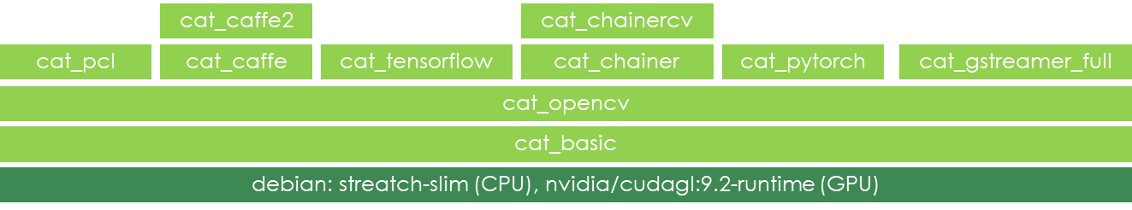
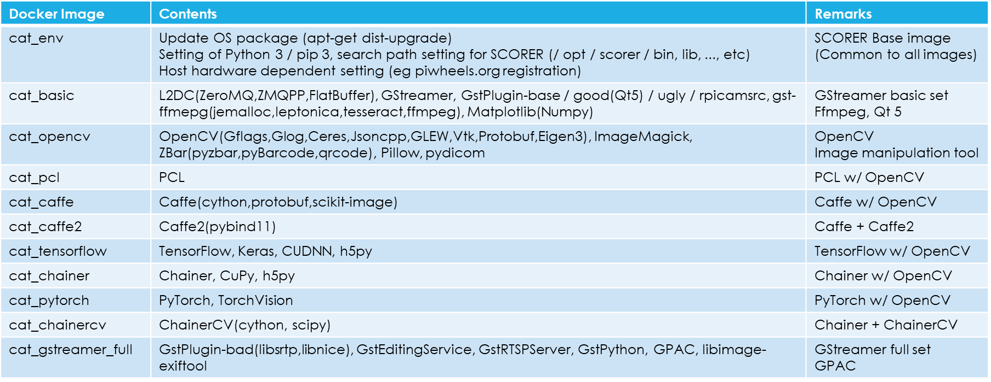
cat docker Image layers

Slide 23
Building SCORER Edge

Slide 24
Building SCORER Edge
Execute following commands in given sequence one after finishing previous.
It usually takes about 6-8 hours to build everything from scratch on intel machine and it can take few days on raspberry pi.
# cd scorer/Manufacturing
# ./autodetect
# cd debian/scripts
# ./RunAll.sh
# cd scorer/Manufacturing/docker/scripts
# ./RunAll.sh

Slide 25
Contributing to SCORER

Slide 26
GitHub Account
SCORER Edge source code is managed at github (www.github.com). You need to have an github account associated with your company email id and user account with username fti-<username>, before you make a request for access to this repository.
If you are new to github, follow this tutorial for beginners of github.
https://blog.udacity.com/2015/06/a-beginners-git-github-tutorial.html
Also, follow this tutorial for further details
https://drive.google.com/open?id=19_K940L5IbIHYg6tMo7wHxW9p1GEX5fO
Two Factor Authentication: SCORER Edge source code is protected by Two factor authentication, so not only username and password, but you also need to generate a special key for accessing github. For more details about Two Factor Authentication on github, please see following link :
https://help.github.com/en/articles/securing-your-account-with-two-factor-authentication-2fa
Note: Please make sure to activate recovery options and store them at safe place.
Action Items
Create github account with fti-<username> if not already created.
Enable TFA (Two factor Authentication) for the same.
Explore various operations, commands for git. Go through the PPT kept in gdrive and links shared which explains git operations.

Slide 27
Getting the SCORER Source Code
Once your user accounts are created on github and permissions to those accounts are given, you can checkout the source code by following steps :
1. On your machine, create a director for keeping source code with your username and change directory.
mkdir –p /home/fti/<uname>
cd /home/fti/<uname>
2. Checkout git source code
git clone https://github.com/future-standard/scorer.git
It will ask for username and password. You need to enter your github account id and Two factor authentication key as password.
Action Items
Checkout SCORER Edge source code.
Switch your branch to ‘Scorer-1702” which is current integration branch for SCORER Edge.

Slide 28
Submitting your changes
SCORER-1702
Integration branch
Pull request
Merge
Action Items
Go through following guideline documents for raising PR, commit messages & code reviews :
Git pull requests
https://drive.google.com/open?id=1krtjHyc2yqlUjtqdoFsu5pVH0gvUAb9e
Code review guidelines
https://docs.google.com/document/d/19-cVdJIc6p9M_teGyMEu2nb8gUTn46xTE35lbs54FNc/edit#
Note above links will be updated again. Please keep refreshing it during development.
origin/rc-1702-fti-12-02
Remote repo
rc-1702-fti-12-02
git push
Local repo
(staging)
/fti/xx/scorer
git commit
Development
Self Review
Peer Review & Tests
Client Review
Working copy
You will be assigned a distinct git branch for each independent development work.
Typically you should commit every small incremental change in your code locally on git with ‘git commit’ command. It can be as frequent as every 15-30 minutes while you are writing your code. Small incremental changes are easier to understand and revert if needed.
Also, you should regularly push your development to remote branch of git by “git push”, once you have attained a logical structure and the code is shareable. This can be as frequent one git push every few hours. Idea is to keep pushing regularly so that you are safe from any accidents on local machines.
Once you are done with development + self reviews, tests, you initiate peer review followed by client review by raising a pull request. After client review comments are fixed, code is merged back to Integration Branch for integration tests.

Slide 29
SCORER Edge Features Roadmap

Slide 30
Features Roadmap - 2019
TDC
C3
SDK
QA
L2DC
CA2
JCM
OSM
Edge API
Remote Control
Juypter Integration
QA Automation framework
Flatbuffers
Algorithms Integration
Stack Manager
Netdata
Edge UI
SDK 2
Automated tests
Grafana
VPN Integration
Market Place Integration

Slide 31
Thank You!

Slide 32
ci
jenkin_cd/nighly_qa
jenkin_ci_job
fti-dev
RunDiff.sh
Nightly QA Machine
jenkin_pre_release_job
release_work.sh branch
release_work.sh branch
release_work.sh branch
fti_v4-3_integ
59-01
59-02
59-03
make_release
59-01
59-02
59-03
Prajwal
Aniket
Chetan

Slide 34
??? Queries ???

