Slide 1
Credit Card Fraud Detection Using Machine Learning
Supervisor
Mr. Jayadeep Pati
Assistant Professor, Registrar In-Charge and Associate Dean (Academics & Faculty Affairs)
Present By
Sandeep Gupta
2022ug1100, CSE-2022-26

Slide 2
Overview
Problem statement: The increasing prevalence of credit card fraud in the digital era necessitates the development of robust and efficient fraud detection systems. This project aims to develop a machine-learning model to detect credit card fraud. The model will be trained on a dataset of historical credit card transactions and evaluated on a holdout dataset of unseen transactions.
Project Goal: The main aim of this project is the detection of fraudulent credit card transactions, as it is essential to figure out the fraudulent transactions so that customers do not get charged for the purchase of products that they did not buy.
Research question: What machine learning model is most suited for detecting fraudulent credit card transactions?

Slide 3
Data Description
Data Description: The dataset was retrieved from an open-source website, Kaggle.com
The project aims to predict fraudulent credit card transactions using machine learning models. This is crucial from the bank’s as well as the customer’s perspective. The banks cannot afford to lose their customers’ money to fraudsters. Every fraud is a loss to the bank as the bank is responsible for the fraudulent transactions.
The dataset contains transactions made over a period of two days by credit cards in September 2013 by European cardholders. This dataset presents transactions that occurred in two days, where we have 492 frauds out of 284,807 transactions. The dataset is highly unbalanced, the positive class (frauds) accounts for 0.172% of all transactions. We need to take care of the data imbalance while building the model and come up with the best model by trying various algorithms.
  Twenty-eight attributes are numeric variables that, due to the confidentiality and privacy of the customers.
  Time: which contains the elapsed seconds between the first and other transactions of each Attribute.
  Amount : Which is the amount of each transaction
  Class : which contains binary variables where 1 is a case of fraudulent transaction, and 0 is not as case of fraudulent transaction.
Dataset : https://www.kaggle.com/datasets/mlg-ulb/creditcardfraud

Slide 4
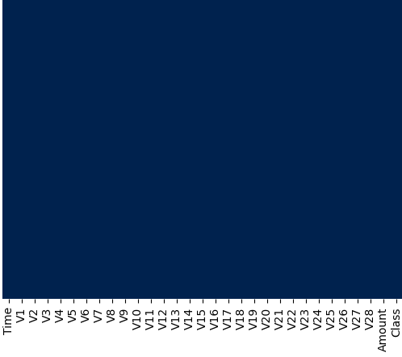
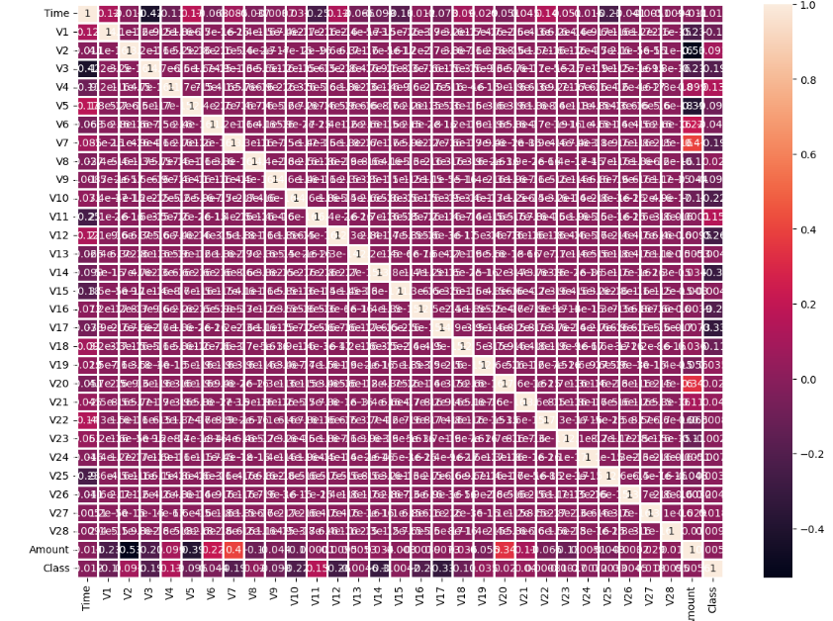
Data Analysis
Check Null Data
Data Correlation

Slide 5
Steps in Implementing Credit Card Fraud Detection:
The steps are broadly divided into the below steps. The sub-steps are also listed while we approach each of the steps.
1. Reading, understanding and visualizing the data
    2. Preparing the data for modelling
    3. Building the model
4. Evaluate the model

Slide 6
We have used a total of Four algorithms in our project
Logistic Regression
2. Decision Tree
3. Support Vector Machines
        4. K-Nearest Neighbour

Slide 7
Six Techniques are used for Under-sampling or Oversampling
Random oversampling
2. SMOTE Oversampling
3. Random Under-sampling
4. Tomek Links Under-sampling
5. Cluster centroids under-sampling
6. SMOTE + Tomek Links

Slide 8
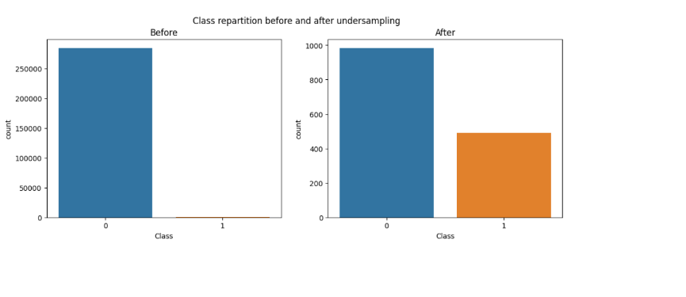
Under-Sampling of Data Before And After:

Slide 9
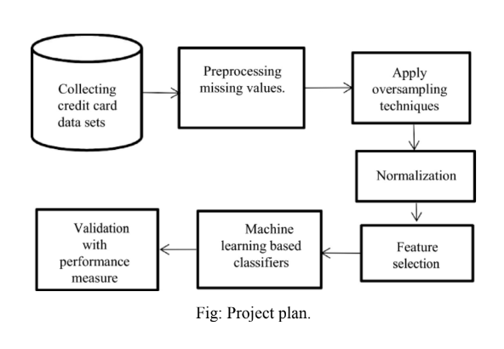
Methodology
Data collection:
The first phase will involve collecting a dataset of historical credit card transactions. The
data will be collected from various sources, including banks, credit card companies, and
merchants.
Data Cleaning:
Impute the missing values with the column's mean, median, or mode.
Drop the rows with missing values.
Use a machine learning model to predict the missing values like is null() and heatmap().
Normalize the data:
Normalization is scaling the data so that all features have similar values. This can
improve the performance of machine learning models by making the parts more
comparable.
Model training:
The second phase will involve training the machine learning model on the collected data.
The model will be prepared using a supervised learning algorithm like SVM.
Model evaluation:
The third phase will involve evaluating the machine learning model's performance on a
holdout dataset of unseen transactions. The model's performance will be evaluated using
accuracy, precision, and recall metrics.

Slide 10
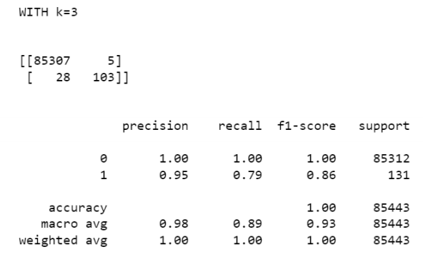
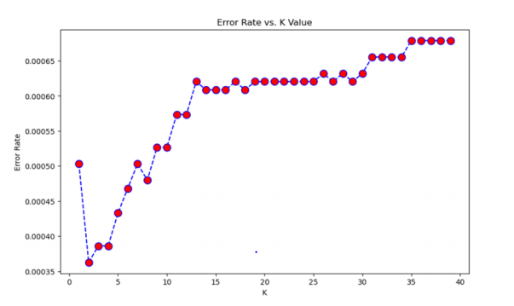
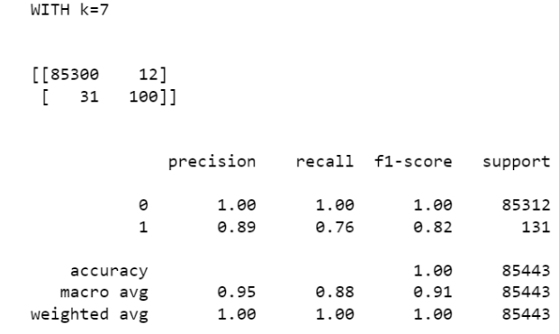
1. K-Nearest Neighbor (KNN):
Two Ks were used to determine the best KNN model, K=3 and K =7.
K = 3
While making the KNN model, We created two models: K =3 and K =7.
Figure 5 shows the model created in Jupiter Notebook; the model scored an accuracy of 71% and identified 85,443 transactions correctly and missed 131.
• K=7
There was a slight decrease in the Accuracy of the model created in Jupiter Notebook as it scored less than k=3 when K is 7, and the model miss classified 131 fraudulent transactions as no fraudulent

Slide 11
How SVM Works:
KNN is a supervised machine learning algorithm used for classification and regression.
It classifies a data point based on the majority class of its ‘K’ nearest neighbors.
KNN is a non-parametric algorithm, it makes no assumptions about the data distribution.
Works on the principle of “similar data points exist close to each other.”

Slide 12
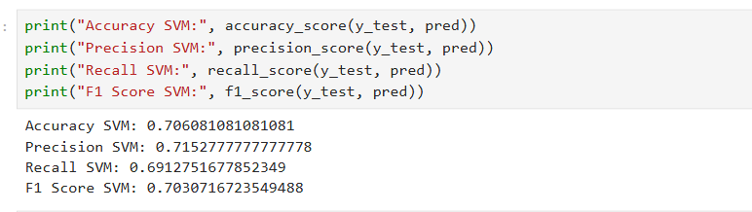
Accuracy, Precision, Recall, F1-Score for Under-sampling:
Each transaction is represented by features (V1–V28, Amount, etc.).
KNN compares new transactions with existing ones to detect similarity to fraudulent patterns.
Works well for smaller datasets after feature scaling.

Slide 13
2. Logistic Regression (L.R.):
Logistic Regression is a supervised machine learning algorithm used for classification problems.
It predicts the probability of a categorical outcome (e.g., fraud or not fraud).
The output is transformed using the sigmoid function to produce values between 0 and 1.
Often used for binary classification (Yes/No, 0/1).

Slide 14
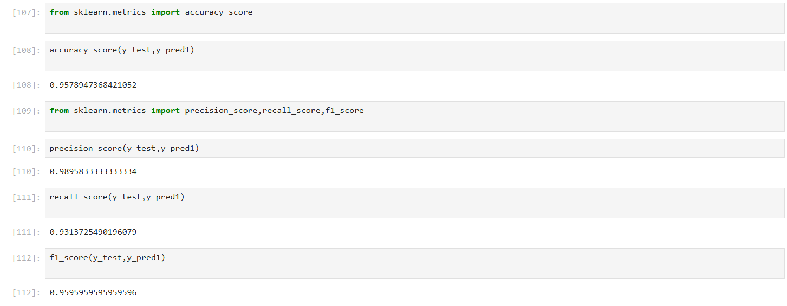
Accuracy, Precision, Recall, F1-Score for Under-sampling:

Slide 15
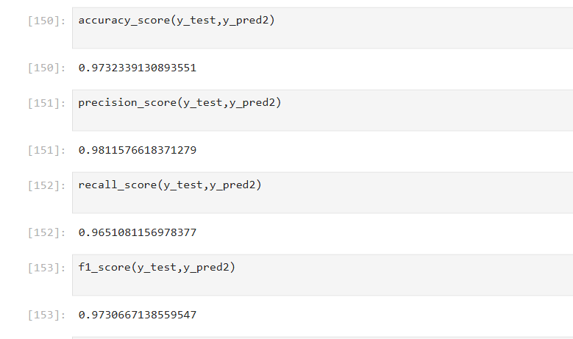
Accuracy, Precision, Recall, F1-Score for Oversampling:

Slide 16
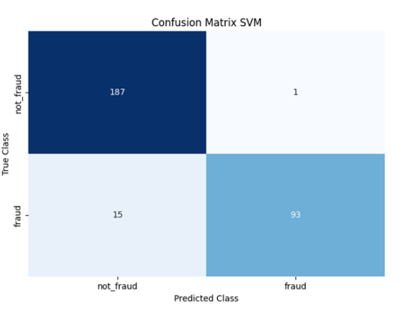
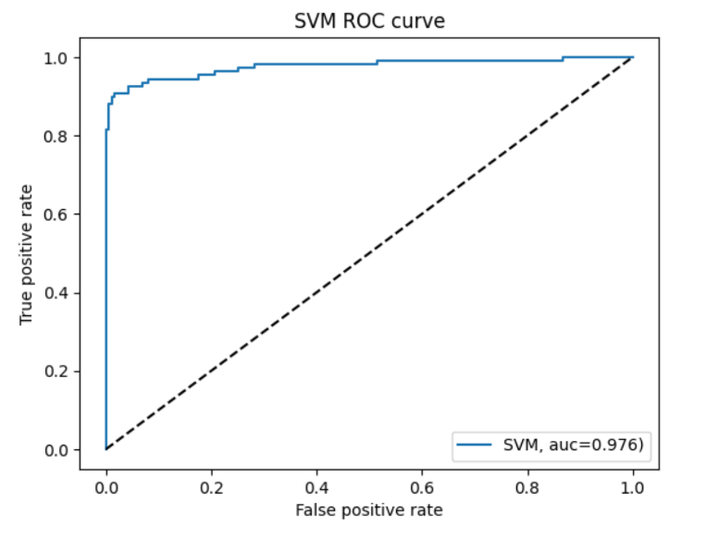
3. Support Vector Machine (SVM):
The model Support Vector Machine, as shown in blew Figure , scored 97.59% for the Accuracy.
SVM Confusion Matrix

Slide 17
How SVM Works
Each data point is represented as a vector in n-dimensional space.
The algorithm finds the hyperplane that best separates the two classes.
Points closest to the hyperplane are called Support Vectors.
The goal is to maximize the margin, the distance between the hyperplane and the support vectors.

Slide 18
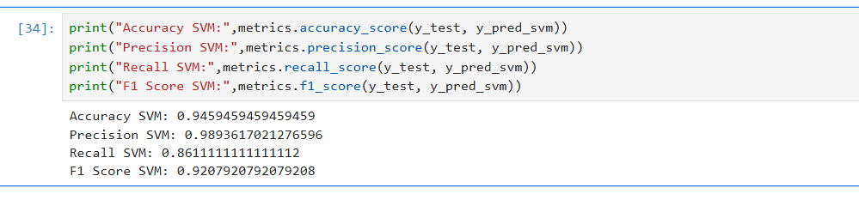
Accuracy, Precision, Recall, F1-Score for Under-sampling:
The dataset is highly imbalanced (many normal, few fraud).
SVM learns complex patterns from transaction features (V1–V28, Amount, etc.)
Used StandardScaler for normalization (SVM is distance-based).

Slide 19
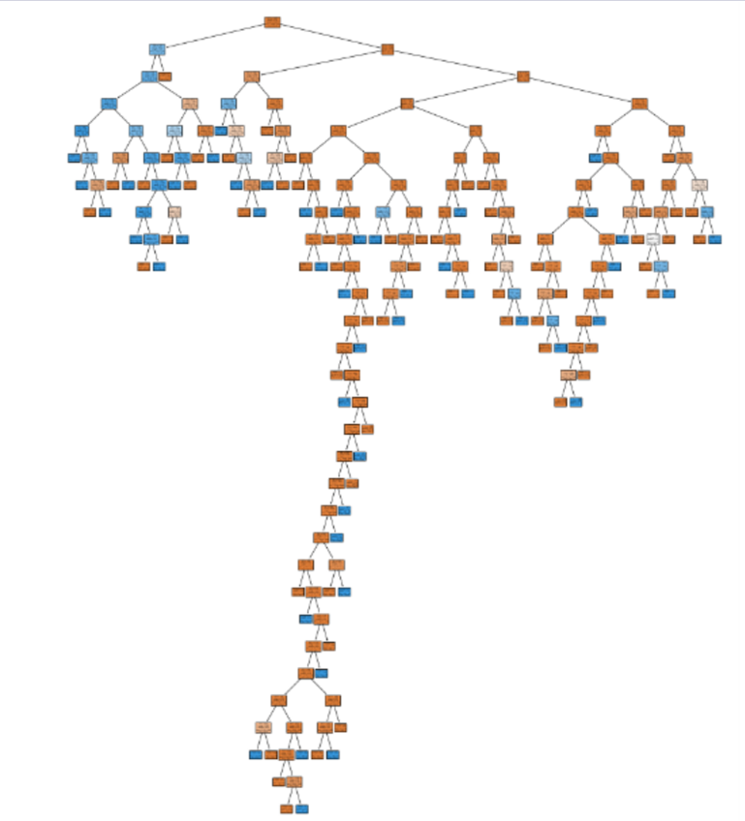
4. Decision Tree (D.T):
A Decision Tree is a supervised machine learning algorithm used for classification and regression tasks.
It works by splitting the dataset into smaller subsets based on feature values.
Each internal node represents a decision rule, and each leaf node represents an outcome.
The model resembles a flowchart, making it simple and interpretable.
Root Node: Represents the entire dataset.
Decision Node: Splits the data based on a condition.
Leaf Node: Final output or prediction.
Branches: Paths connecting nodes, showing the decision process.
Depth: Number of levels in the tree.

Slide 20
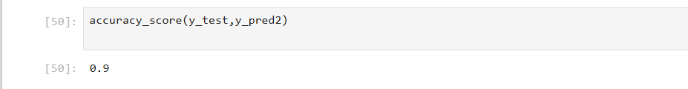
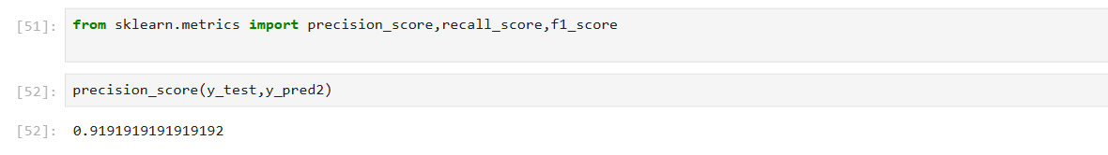
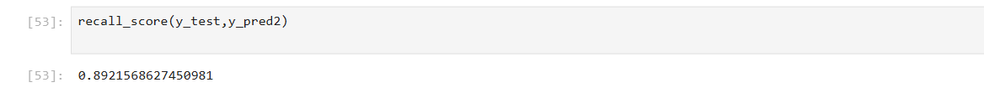
Accuracy, Precision, Recall, F1-Score for Under-sampling:

Slide 21
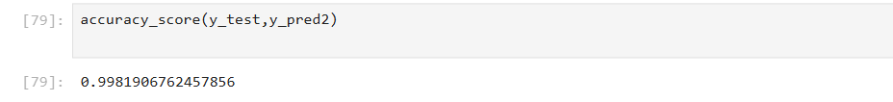
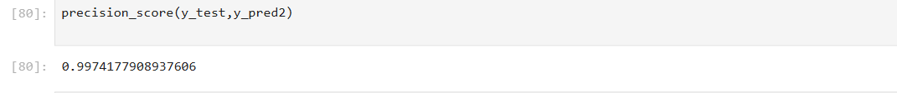
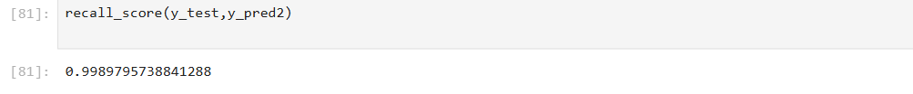
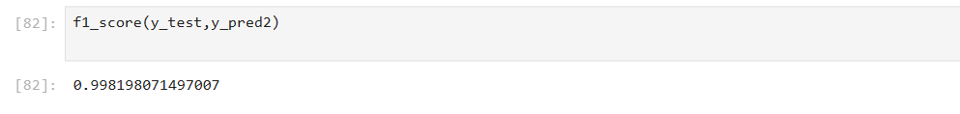
Accuracy, Precision, Recall, F1-Score for Oversampling:

Slide 22
References:
[1] . A. N. O. Alenzi, H. Z., “Fraud detection in credit cards using logistic regression.
https://thesai.org/Publications/ViewPaper?Volume=11&Issue= 12&Code=IJACSA&SerialNo=65, 2020
[2]. P. S. . K. S. Dighe, D., “Detection of credit card fraud transactions using machine learning algorithms and neural networks.”
https://doi.org/10.1109/iccubea.
[3] . D. E. . Sahin, Y., “Detecting credit card fraud by decision trees and support vector machines,” 2011. Accessed: 23-oct-2023.
[4] . S. A. A. S. . S. S. D. Maniraj, S. P., “Credit card fraud detection using machine learning and data science.”
https://doi.org/10.17577/ijertv8is090031, 2019. Accessed: 25-oct-2023.

Slide 23
Thank You!

