Slide 1
Predicting Streaming Churn at STADIOchoice
CAP182 Capstone · SS1 through SS3
Sandile Jali · 26304684

Slide 2
The Business Problem
PART 01
Why STADIOchoice needs to see churn coming before it happens

Slide 3
A churn problem the company already knows it has
Retention offers go out indiscriminately today, wasting spend on subscribers who would have stayed, while households who quietly drift away without ever clicking cancel are missed entirely.
6.5% → 9.2%
R240 → R355
~R0
Streaming monthly churn, in two years
Cost to acquire one streaming subscriber
Targeting on current retention offers, sent to almost anyone who clicks cancel
This sits directly against STADIOchoice's own 2030 strategy:
“win the streaming war on retention, not just sign-ups.”

Slide 4
Framing it as a data science problem
Predict the probability of near-term cancellation for every household — using only information available before the decision.
01 SIGNALS
02 LEARNING
03 ACTION
Behavioural, billing and support signals
Supervised classification
A ranked, actionable list
Information that exists before cancellation.
Historical cancellation outcomes provide the labels.
The retention team can focus effort where it matters most.
SIX REQUESTED DATA TABLES
Subscription & billing · Viewing logs · Cancellation & retention · Customer support · Content catalogue · Search queries

Slide 5
Proving the Approach
PART 02
STADIOchoice's real data wasn't ready yet, so the method was proven on a public benchmark first

Slide 6
A proof of viability, grounded in real literature
7,043
MODEL 01
MODEL 02
Logistic
Regression
XGBoost
customers in the IBM Telco Customer Churn benchmark
Interpretable baseline
Gradient-boosted ensemble
Used by two of the three academic papers reviewed, keeping the result comparable with published benchmarks.
FAIR COMPARISON
Same train/test split
Same metrics
Both models tested head to head

Slide 7
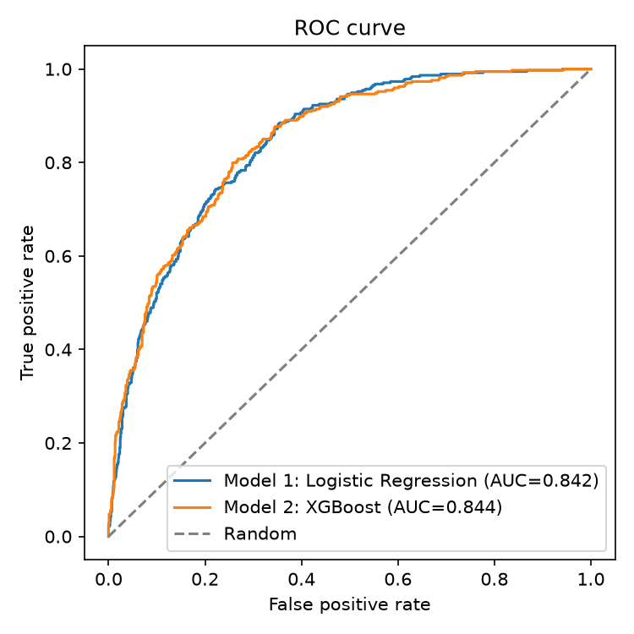
XGBoost wins, and it's not close
TEST-SET COMPARISON
ACCURACY
0.753 vs 0.734
ROC-AUC
0.844 vs 0.842
McNEMAR'S EXACT TEST
p = 0.0108
The difference is statistically significant — not just a small numeric edge.
Decision: carry XGBoost forward into SS3.

Slide 8
The Real Data
PART 03
Applying the same method to STADIOchoice's own 4,485 households

Slide 9
Real operational data, real mess
Every figure was found by profiling the data directly — then corrected with a documented reason, not accepted as generic 'messy data'.
13
12
465
5
exact duplicate household rows
spellings of one plan tier
mixed-format viewing timestamps
events after the extract date
dropped
collapsed to 3 clean categories
parsed with a cascading, format-aware parser
found physically impossible and dropped
The cleaning logic is auditable: every removal, collapse and parse has an explicit reason.

Slide 10
Building honest features, not leaky ones
EXCLUDED ON PURPOSE
BUILT FROM REAL BEHAVIOUR
churn_date
tenure_months
entire cancellation table
VIEWING
Recency, watch time and sports-content exposure — a named churn trigger in the client briefing.
SUPPORT
Contact volume plus unresolved and escalated outcomes.
These fields describe events after a household has already decided to leave. Including them would teach the model to recognise its own label — not to predict churn.
SEARCH
Activity and zero-result rate — the client’s documented signal for unmet demand.
LABEL LEAKAGE

Slide 11
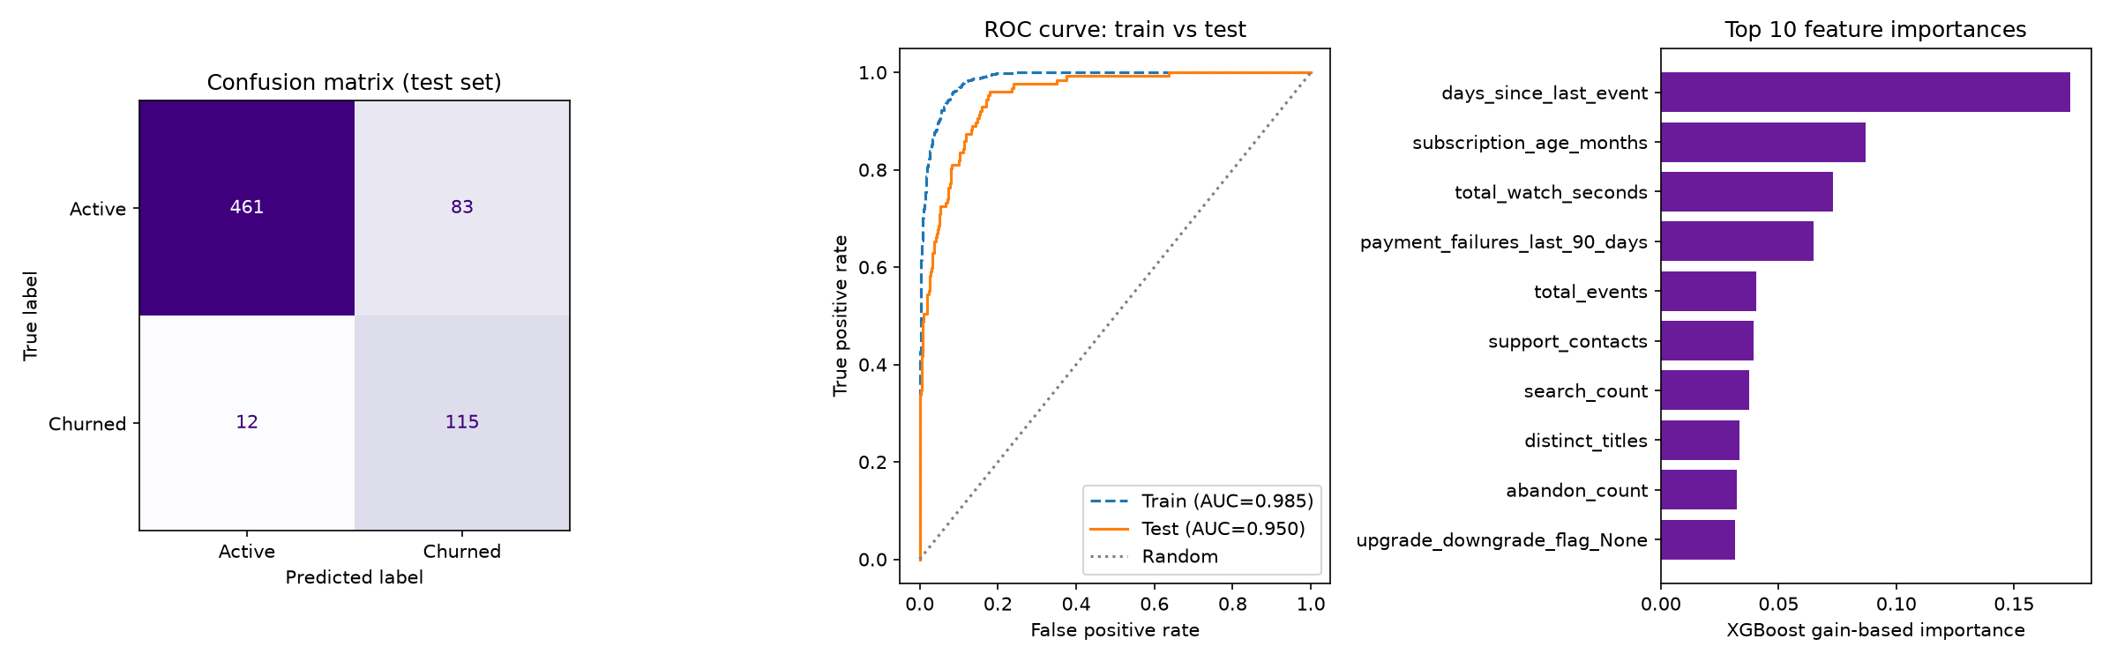
A model that holds up on real households
ACCURACY
RECALL
ROC-AUC
Days since last viewing is the strongest predictor — a signal the retention team can act on and explain.
0.858
0.906
0.950
Confusion matrix · ROC curve · Feature importance

Slide 12
Real behavioural data beats the proxy benchmark
The real-data model reaches 0.950 ROC-AUC, compared with 0.844 on the proxy benchmark.
SS2: telco proxy data
SS3: real STADIOchoice data

Slide 13
What STADIOchoice should do next
01
02
03
04
PILOT
CALIBRATE
EXPLAIN
RE-TRAIN
Run against a held-out group and track real retention outcomes — not only predicted risk.
Set the risk threshold to actual review capacity; the business decides how far down the ranked list to act.
Give the retention team a reason alongside every flagged household, using feature importance.
Refresh on a rolling basis as behaviour and offers change; a once-trained model will drift.
Start controlled, make risk operational, keep every decision explainable, and plan for drift.

Slide 14
Being honest about the limits
01
OVERFITTING SIGNAL
Precision drops from 0.70 to 0.58 between train and test on a 26-feature model trained on ~3,100 households. Monitor it; do not hide it.
02
TEMPORAL VALIDITY
The extract is one historical snapshot. A live system must be validated against genuinely new, unseen time periods.
03
TUNING NOT COMPLETE
Hyperparameters stayed aligned with SS2 for comparability. A dedicated tuning pass on this data is the next step — and has not yet been done.

Slide 15
Thank You
Sandile Jali · 26304684 · CAP182 Capstone

