Slide 1
Table of contents
Project Scope
Use-Case Diagram
Data Model
Process Model

Slide 2
Scope Definition
The system must satisfy the following functional requirements:
Maintain authors
Maintain books
Maintain members
Maintain events
Maintain readers
Lend books
Return books
Allocate readers to events
Record the number of attendees at events
Report top 10 events per time period

Slide 3
Use-Case Glossary
USE CASE NAME | USE CASE DESCRIPTION | PARTICIPATING ROLES & ACTORS
Maintain Events | Maintaining reading events | Administrator
Maintain Users | Maintaining users of system | Administrator, Employee
Maintain Books | Maintaining books in system | Administrator, Employee
Maintain Loans | Maintaining loans through system | Administrator, Employee
Maintain Readers | Maintaining readers for events | Administrator
Request Loans | Requesting to borrow book | Clients
Generate Reports | Generating reports | Administrator

Slide 4
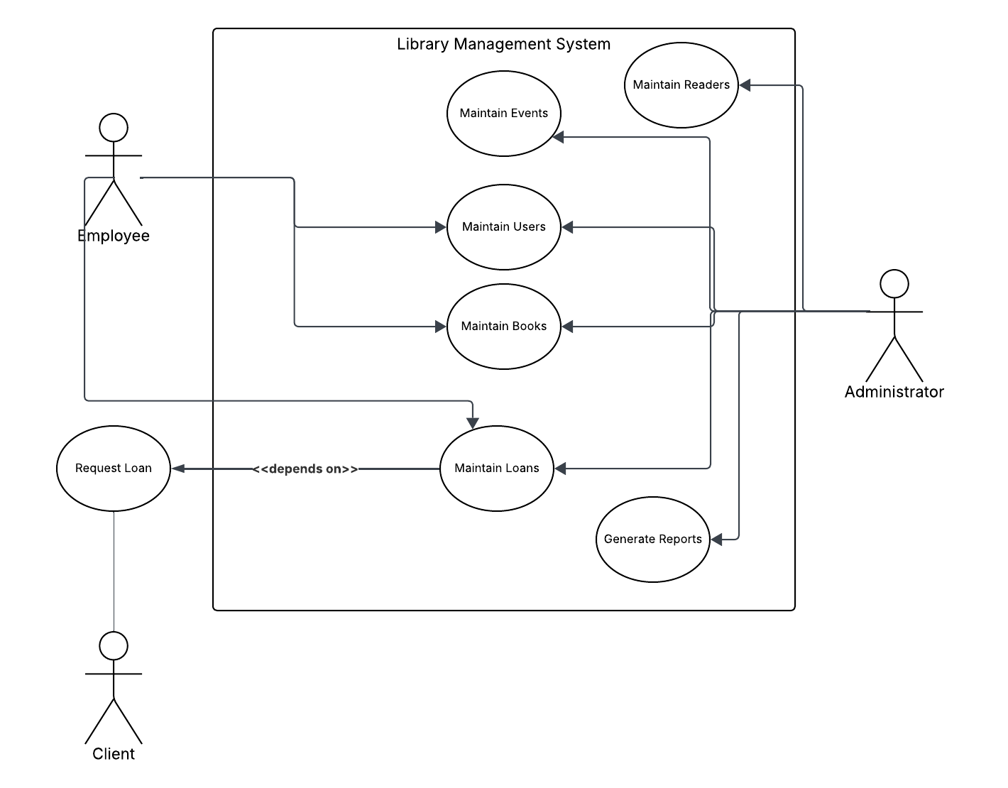
Use-Case model Diagram

Slide 5
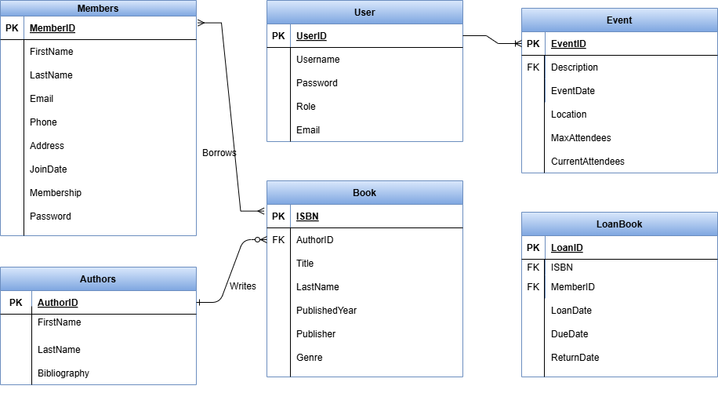
Data Model

Slide 6
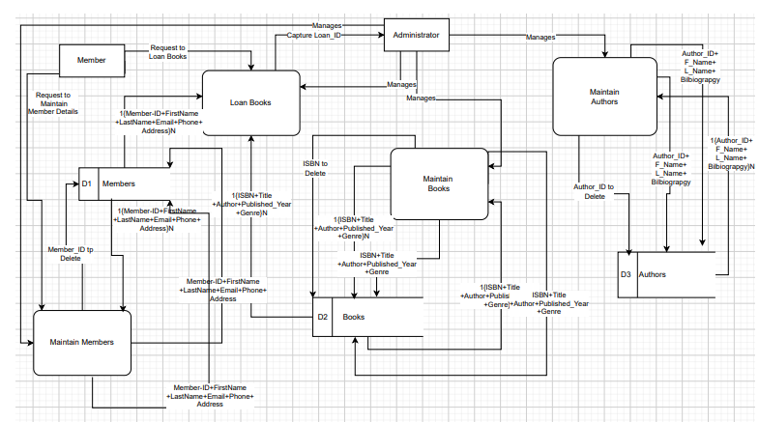
Process Models

