Slide 1
Table of content
Project Plan
Definitions, acronyms and abbreviations
Project description and Scope
Functional requirements i.e.
Business data requirements (inputs, outputs)
Business processes requirements
Business interface requirements
Non-functional requirements (categorized according to PIECES Framework
Feasibility Analysis Matrix
Use-Case Glossary & Use-Case Model Diagram
Examples of data, questionnaires, fact-finding techniques used
Summary, future & further planning

Slide 2
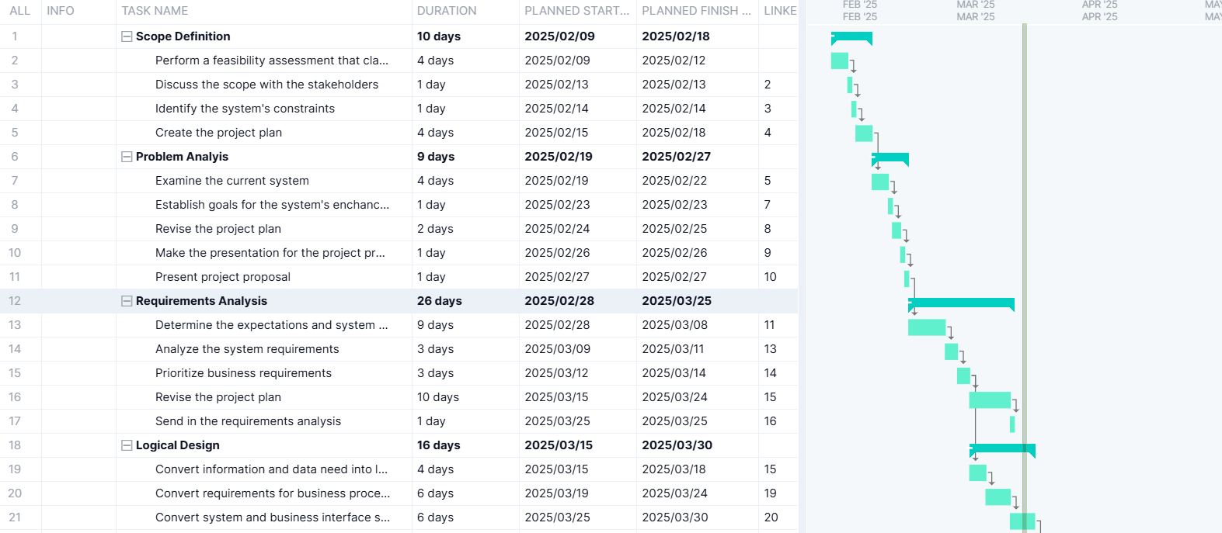
1. Project plan

Slide 3
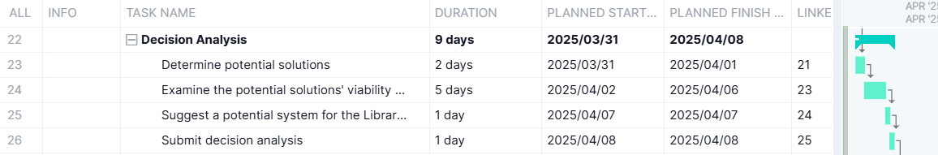
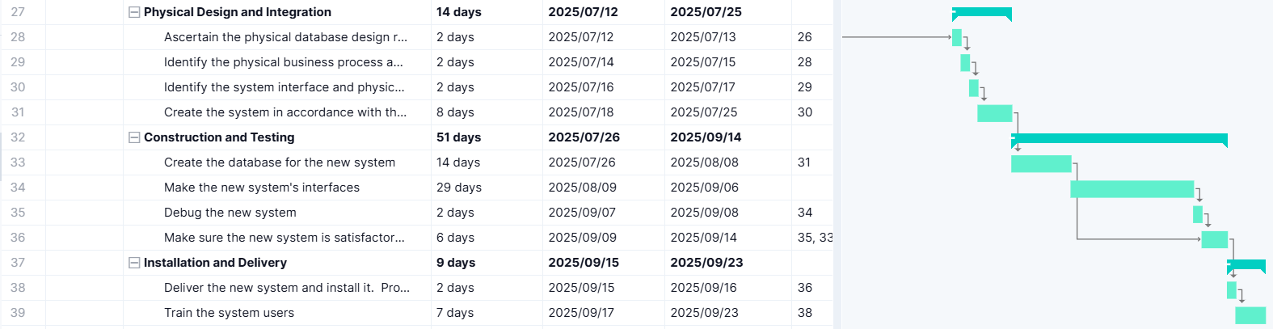
1. Project plan (Continued)

Slide 4
2. Definitions, acronyms & abbreviations
ABBREVIATIONS
GUI: Graphical User Interface
ISBN: International Standard Book Number
ID: Identity/Identification
FAST: Function Analysis System Technique
DEFINITIONS
GANTT-Chart: a project management tool that uses a bar chart to visually display a project’s timeline, task start and end times, inter-task dependencies and progress.
GUI: a visual way of interacting with a computer through buttons and menu’s.

Slide 5
2. Definitions, acronyms & abbreviations (CONTINUED)
ISBN: a 13-digit number that uniquely identifies each edition of a book.
ID: a unique identifier or attribute used to represent specific data.
FAST: an approach in system analysis to systematically analyze functions, identify relationships and find areas for improvement.

Slide 6
3. Project description and scope
The objective of this project is to develop a books and library events management system for SMRT library. The system will efficiently remove, receive and update authors, books, members, events and event readers. Keeping track of lent/returned books and provide reports that summaries the significance of events in the library by incorporating lent/returned books data. Additionally, the system should provide assistance in the form of suggestions and a dedicated help functions to navigate across the system. The system shall incorporate a backup function to store data. User authentication will be required to prevent unauthorized access. It should be able to integrate the database from the previous system into the new information system. For our development process, we will be using the FAST methodology, as we aim to be efficient but also flexible to any unforeseen circumstances. We will be utilizing SQL databases and Visual Studio C# to develop our project. Our organization aims to create a sustainable, efficient and suitable management system for the SMRT library and encourage members to attend more events.

Slide 7
3. Project description and scope (Continued)
The system must satisfy the following functional requirements:
Maintain authors
Maintain books
Maintain members
Maintain events
Maintain readers
Lend books
Return books
Allocate readers to events
Record the number of attendees at events
Report top 10 events per time period

Slide 8
3. Project description and scope (Continued)
In addition, the system must satisfy the following non-functional needs:
Help functionality
Secure access to the system by using unique credentials for each user
Processes and transactions should happen under 3 seconds
The database will hold at least 100 members ,over 700 books and 12 events per year
2 types of users:
Administrator = access to database and all functions
Employee = access to specified funtions

Slide 9
4. Functional data, process and interface requirements
MAINTAIN AUTHORS
Add new author
Input | Processing | Output
Author ID (System Generated) First Name (String, required) Last Name (String, required) Date of Birth (Date, optional) Biography (Text, optional) | Validate data types and required fields. Check for duplicate Author IDs. Generate a unique Author ID. Save the author details to the database. | Confirmation message upon successful addition. Display of newly added author details. Error message if required fields are missing or invalid.

Slide 10
4. Functional data, process and interface requirements (CONtinued)
MAINTAIN AUTHORS
Change existing author
Input | Processing | Output
Author ID First Name (String, required) Last Name (String, required) Date of Birth (Date, optional) Biography (Text, optional) | Verify Author ID exists. Validate updated data types and required fields. Save the updated author details to the database. | Confirmation message upon successful update. Display of updated author details. Error message if required fields are missing or invalid.

Slide 11
4. Functional data, process and interface requirements (CONtinued)
MAINTAIN AUTHORS
Delete existing author
Input | Processing | Output
Author ID | Verify Author ID exists. Prevent deletion if the author has books. Require confirmation before deletion. Remove the author record from the database. | Confirmation message upon successful deletion. Error message if Author ID does not exist or books are associated.

Slide 12
4. Functional data, process and interface requirements (CONtinued)
MAINTAIN BOOKS
Add new book
Input | Processing | Output
ISBN Title (String, required) Author ID (required) Genre (String, optional) Publication Year (Date, optional) | Validate data types and required fields. Check for duplicate ISBN. Generate a unique Book ID. Save the book details to the database. | Confirmation message upon successful addition. Display of newly added book details. Error message if required fields are missing or invalid

Slide 13
4. Functional data, process and interface requirements (CONtinued)
MAINTAIN BOOKS
Change existing book
Input | Processing | Output
ISBN Title (String, required) Author ID (required) Genre (String, optional) Publication Year (Date, optional) | Verify ISBN exists. Validate updated data types and required fields. Save the updated book details to the database. | Confirmation message upon successful update. Display of updated book details. Error message if required fields are missing or invalid.

Slide 14
4. Functional data, process and interface requirements (CONtinued)
MAINTAIN BOOKSS
Delete Existing book
Input | Processing | Output
ISBN (to identify the book to be deleted) | Verify the ISBN exists in the system. Check if the book is currently loaned out (prevent deletion if loaned). Require confirmation from the user before deletion. Remove the book record from the database. | Confirmation message upon successful deletion. Error message if the ISBN does not exist. Error message if the book is currently loaned out and cannot be deleted.

Slide 15
4. Functional data, process and interface requirements (CONtinued)
S
Input | Processing | Output
Member ID ISBN Loan Date (System Generated) Due Date (System Calculated) | Verify member exists and is in good standing (no overdue books or fines). Check book availability. Calculate the due date based on a predefined loan period (e.g., 2 weeks). Update the book’s status to "loaned out." Record the loan in the database. | Confirmation of successful loan. Error message if the book is already loaned out. Error message if the member does not exist or has outstanding fines. Loan record created in the system.

Slide 16
4. Functional data, process and interface requirements (CONtinued)
SSS
Input | Processing | Output
ISBN Return Date (System Generated) | Verify the ISBN. Calculate overdue fines based on the return date and due date. Update the book’s status to "available." Record the return in the loan history. | Confirmation of successful return. Calculation of any overdue fines (if applicable). Update of the book’s status to "available."

Slide 17
4. Functional data, process and interface requirements (CONtinued)
REQUEST REPORT
Input | Processing | Output
Start Date End Date | Query event attendance records within the specified date range. Sort events by the number of attendees in descending order. Limit the output to the top ten events. Generate the report in a readable format. | A ranked list of the top ten events: Event Title Event Date Number of Attendees

Slide 18
5. Non-functional requirements
Performance:
The system shall complete a book loan transaction in under 3 seconds.
The system shall handle at least 100 concurrent users.
Information (and Data):
The system shall ensure data accuracy and integrity through validation rules (e.g., ISBN format, date ranges).
The system shall encrypt sensitive data (e.g., member passwords) stored in the database.
Economics:
The system shall reduce the time spent on manual tasks, such as book check-in/check-out, by 50%.
The system shall reduce the cost of upkeep due to ease of use and functionality.

Slide 19
5. Non-functional requirements (Continued)
Control and Security:
Only librarians shall have access to member's Personally Identifiable Information.
The system shall maintain an audit trail of all system activities, including logins, data modifications, and report generation.
Efficiency:
The system shall provide a user-friendly search interface that allows users to quickly find books by title, author, or ISBN.
The system shall automate the process of generating overdue notices, freeing up staff time for other tasks.
Service:
The system shall provide help function to assist users in understanding the system.
The development team shall provide technical support to the library staff during and after the implementation.

Slide 20
6. Feasibility analysis matrix
Description | Weight | Candidate 1 AS – IS | Candidate 2 COTS Package Software Solution | Candidate 3 Custom Designed Solution
Technical Feasibility | 35% | Score:0 | Score:60 | Score:80
Compatibility | 15% | High (Already in Place) | Medium (May require customization/integration) | High (Designed to fit existing infrastructure)
Scalability | 10% | Low (Limited by existing setup) | Medium (Scalability varies by package) | High (Scalable design possible)
Security | 10% | Low (Outdated, potential vulnerabilities) | Medium (Varies by vendor, needs review) | High (Security measures can be built-in)
Operational feasibility | 30% | Score:10 | Score:50 | Score:70
User Friendliness | 15% | Low (Difficult, inefficient workflows) | High (Typically user-friendly interfaces) | Medium (Customizable, but requires careful design)
Training | 5% | Low (Staff already familiar) | Medium (Requires training on new system) | Medium (Requires training on new system)
Maintenance | 10% | High (Requires ongoing manual effort) | Medium (Vendor support, but ongoing costs) | Medium (Internal or external maintenance contracts)
Risk feasibility | 15% | Score:0 | Score:40 | Score:80

Slide 21
6. Feasibility analysis matrix (Continued)
Implementation Risk | 10% | Low (No new implementation required) | Medium (Implementation challenges possible) | High (Longer implementation timeframe, higher risk)
Technical Risk | 5% | Low (Known, but outdated tech) | Medium (Reliant on vendor stability) | Medium (Dependent on team's expertise)
Economic feasibility | 5% | Score:100 | Score:90 | Score:60
cost to develop: |  | N/A (Already in place) | R300,000 (COTS License, Implementation, Training) | R500,000 (Development, Implementation, Initial Support)
Payback period: |  | N/A | 2.5 Years | 3.5 Years
Net present value: |  | N/A | R80,000 | R60,000

Slide 22
6. Feasibility analysis matrix (Continued)
Detailed Calculation: |  |  | Initial Cost: R300,000 (This includes License, Implementation, Training, and potential customization) Annual Savings (Increased Efficiency, Reduced Errors): R120,000 (Reduction in consultant cost, some improvement in efficiency) Payback Period: R300,000 / R120,000 = 2.5 Years NPV (Over 5 Years at 10% Discount Rate): Approximately R80,000 | Initial Cost: R500,000 (Development, Implementation, Initial Support) Annual Savings: R140,000 (Greater efficiency gains, reduced errors, better reporting) Payback Period: R500,000 / R140,000 = 3.5 Years NPV (Over 5 Years at 10% Discount Rate): Approximately R60,000

Slide 23
6. Feasibility analysis matrix (Continued)
Schedule Feasibility | 5% | High (Currently operational) Score:0 | Medium (Implementation timeframe: 3 months) Score:70 | Low (Development timeframe: 6-9 months) Score:50
Cultural feasibility | 5% | High (Staff accustomed) score: 60 | Medium (Requires adaptation to new processes) score:50 | Medium (Can tailor to existing workflows) Score:50
Legal feasibility | 5% | High (No new legal issues) score:100 | High (Varies by vendor - ensure compliance) score:100 | High (Can ensure compliance during development) Score:100
Weighted feasibility | 100% | 30% | 51% | 54%

Slide 24
7. use-case glossary
USE CASE NAME | USE CASE DESCRIPTION | PARTICIPATING ROLES & ACTORS
Log Into System | The event where a user gains access to certain functions after successfully entering their username and password | Administration & Employees
Maintain Authors | The event where book authors will be added, changed or deleted on the system | Administration & Employees
Maintain Books | The event where books and their ISBN will be added to the system, changed or removed from the system | Administration & Employees
Maintain Members | The event where member details are added, maintained or removed from the system | Administration & Employees
Maintain Events | The event where events are added to the system, details updated of an event or existing events deleted from the system | Administration
Maintain Readers | The event where readers that read at events are added, their details changed or removed from the system | Administration
Lend Books | This use case describes the event where books are lent out to a member | Administration & Employees
Return Books | This use case describes the event where books are returned by members | Administration & Employees
Request Report | This use case describes the event where a report is requested and displayed on the screen. | Administration

Slide 25
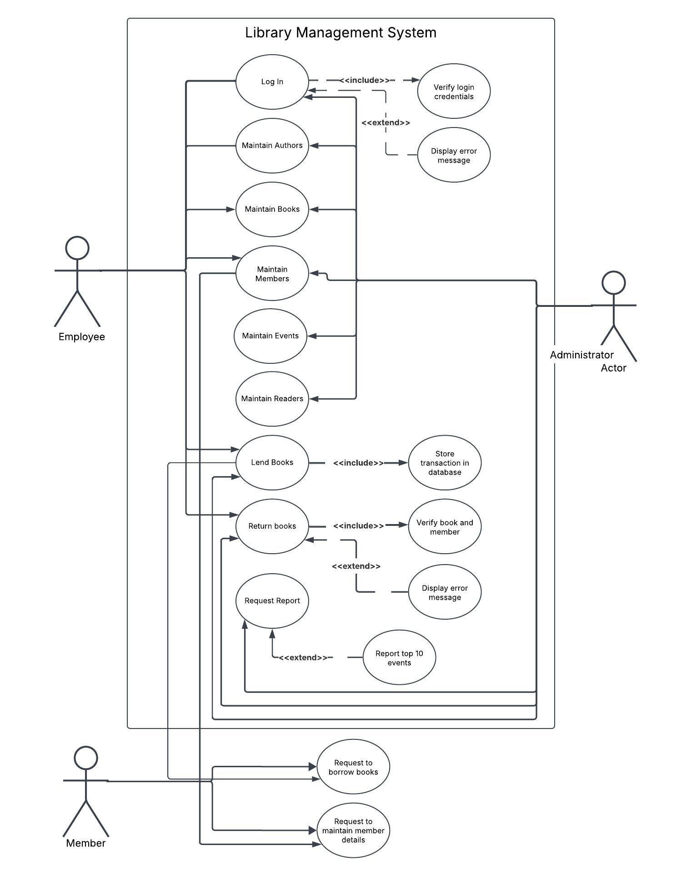
7. Use-case model diagram
Notes:
S

Slide 26
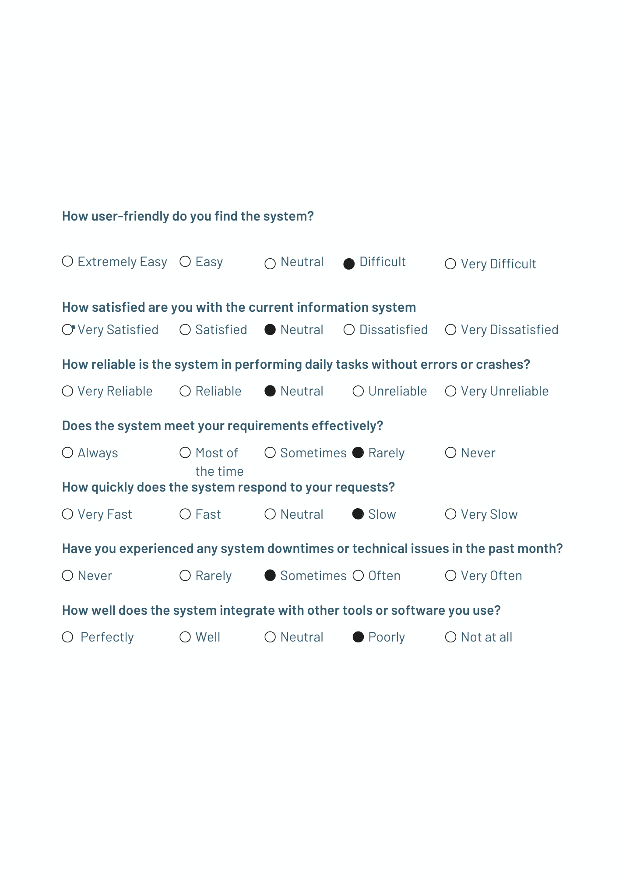
8. Examples of data, questionnaires and fact-finding techniques used

Slide 27
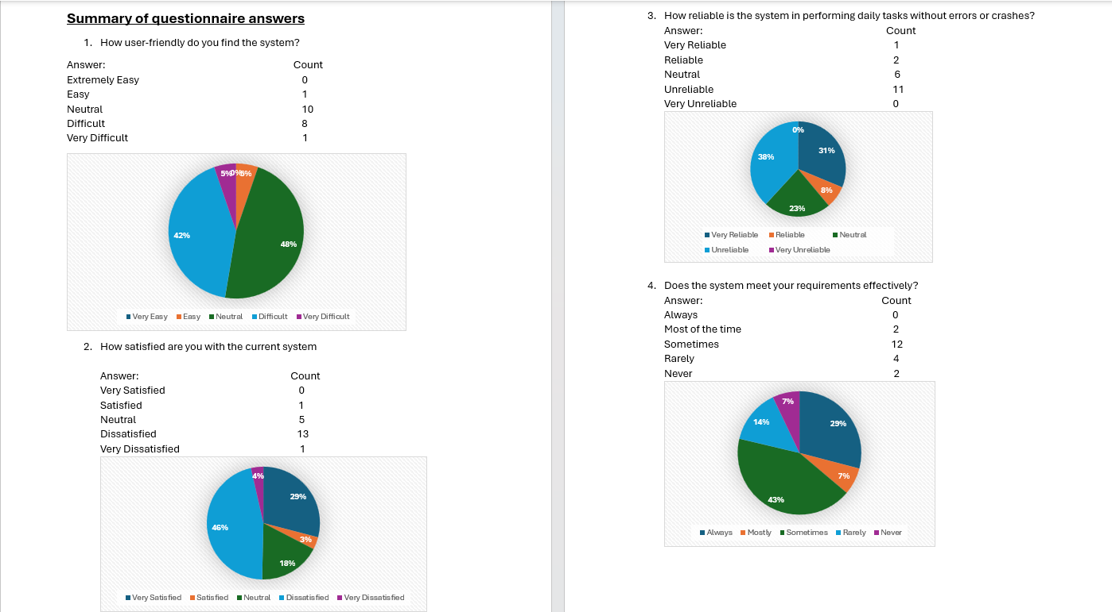
8. Examples of data, questionnaires and fact-finding techniques used (continued)

Slide 28
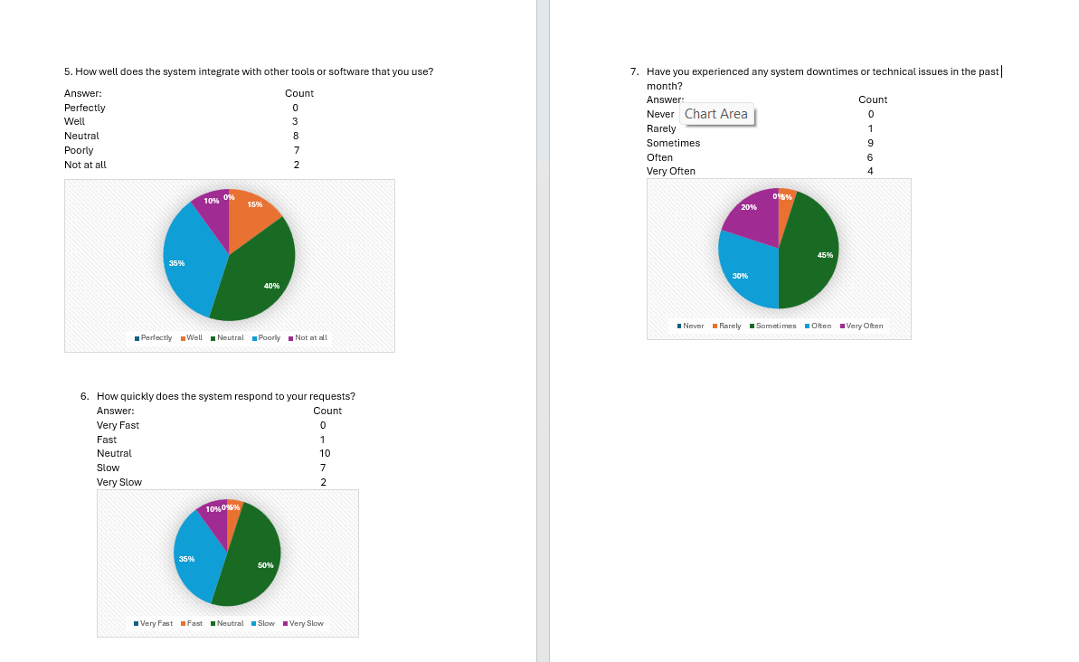
8. Examples of data, questionnaires and fact-finding techniques used (continued)

Slide 29
9. summary, future & further planning
The requirements for the Library Management System (LMS) were discussed in this document. This brings the project's requirements analysis phase to a close.
The project's scope definition, problem analysis, and requirements analysis stages are now finished.
Following approval of this requirements document, the project team will move forward with the project's logical design phase, which is scheduled to be finished on April 22, 2019.

