Slide 1

Parvatibai Genba Moze Colleg of Engineeing Wagholi,Pune.
“Department of Computer Engineering”
Analysis and prediction of students Academic performance Based on educational Data mining
Project Review II
by
1 Abhinav Chandurkar
2 Mayur Chipade
3 Sandip Jadhav
Guided By
Prof. Jaishri Shilpakar
Notes:
Kindly keep your Project title as the footer of each slide along with the slide no.

Slide 2
Introduction
In the past few decades, the application of data mining technology in the educational environment has become an active research field.
Due to the availability of online datasets and learning systems, it has gained wide popularity in recent years.
Educational data mining involves the development and realization of data mining methods, which facilitate the analysis of massive data from various educational backgrounds.
Higher education institutions regard students’ academic performance as one of the most important criteria.

Slide 3
The development of intelligent technologies gains popularity in the education field.
The rapid growth of educational data indicates traditional processing methods may have limitations and distortion.
Therefore, reconstructing the research technology of data mining in the education field has become increasingly prominent.
In order to avoid unreasonable evaluation results and monitor the students’ future performance

Slide 4
MOTIVATION
Traditional Processing
Education
Real time
problems
avoid unreasonable evaluation results
Low Performance

Slide 5
Problem Statement
We Build and Implement analysis and prediction of students academic performance based on educational data mining

Slide 6
Literature Survey (sample)
Sr. No. | Paper Name | Publication Year | Conclusion
01 | A systematic review of deep learning approaches to educational data mining(IEEE) | 2019 | Student’s performance in the educational process can literally be defined as something that is obtained from changes in the behavior of students based on their experiences, besides that learning outcomes are also a realization of the potential or capacity possessed by students
02 | Implementing AutoML in educational data mining for prediction tasks | 2020 | These learning outcomes from students can be seen from their behavior, both behavior in the form of understanding knowledge, thinking skills, or motor skills
03 | Integration of data mining clustering approach in the personalized E-learning system | 2018 | an outcome of the process of changing student behavior after attending lessons

Slide 7
Literature Survey (sample)
Sr. No. | Paper Name | Publication Year | Conclusion
01 | A systematic review of deep learning approaches to educational data mining(IEEE) | 2019 | Student’s performance in the educational process can literally be defined as something that is obtained from changes in the behavior of students based on their experiences, besides that learning outcomes are also a realization of the potential or capacity possessed by students
02 | Implementing AutoML in educational data mining for prediction tasks | 2020 | These learning outcomes from students can be seen from their behavior, both behavior in the form of understanding knowledge, thinking skills, or motor skills
03 | Integration of data mining clustering approach in the personalized E-learning system | 2018 | an outcome of the process of changing student behavior after attending lessons
04 | The use of tools of data mining to decision making in engineering education—A systematic mapping study | 2019 | The concrete form of student’s performance can be seen from their understanding of the knowledge being studied, their expertise in processing information and making decisions based on certain thoughts or motor skills
05 | Data mining in educational technology classroom research: Can it make a contribution? | 2017 | . Giving a weight or rating for student’s achievement in learning requires the preparation of suitable assessment indicators, and needs to be ensured of the validity and the reliability

Slide 8
Project Scope and Feasibility
The research problem of this paper is to objectively evaluate students’ academic achievement from the perspective of clustering, and predict the future achievement based on the existing achievement.

Slide 9
Existing System
Limited dataset used
Low accuracy detected

Slide 10
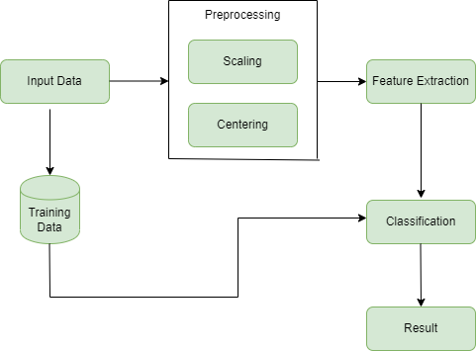
Proposed System Architecture

Slide 11

Algorithm
Naive Bayes
Naïve: It is called Naïve because it assumes that the occurrence of a certain feature is independent of the occurrence of other features. Such as if the fruit is identified on the bases of color, shape, and taste, then red, spherical, and sweet fruit is recognized as an apple. Hence each feature individually contributes to identify that it is an apple without depending on each other.
Bayes: It is called Bayes because it depends on the principle of Bayes' Theorem.
Bayes' Theorem:
Bayes' theorem is also known as Bayes' Rule or Bayes' law, which is used to determine the probability of a hypothesis with prior knowledge. It depends on the conditional probability.
The formula for Bayes' theorem is given as:
Where,
P(A|B) is Posterior probability: Probability of hypothesis A on the observed event B.
P(B|A) is Likelihood probability: Probability of the evidence given that the probability of a hypothesis is true.
P(A) is Prior Probability: Probability of hypothesis before observing the evidence.
P(B) is Marginal Probability: Probability of Evidence.

Slide 12
Algorithm
Naive Bayes
Steps:
Given training dataset D which consists of documents belonging to different class say Class A and Class B
Calculate the prior probability of class A=number of objects of class A/total number of objects
Calculate the prior probability of class B=number of objects of class B/total number of objects
Find NI, the total no of frequency of each class
Na=the total no of frequency of class A
Nb=the total no of frequency of class B
Find conditional probability of keyword occurrence given a class:
P (value 1/Class A) =count/ni (A)
P (value 1/Class B) =count/ni (B)
P (value 2/Class A) =count/ni (A)
P (value 2/Class B) =count/ni (B)
…………………………………..
…………………………………..
…………………………………..
P (value n/Class B) =count/ni (B)
Avoid zero frequency problems by applying uniform distribution
Classify Document C based on the probability p(C/W)
Find P (A/W) =P (A)*P (value 1/Class A)* P (value 2/Class A)……. P(value n /Class A)
Find P (B/W) =P (B)*P (value 1/Class B)* P (value 2/Class B)……. P(value n /Class B)
Assign document to class that has higher probability.

Slide 13

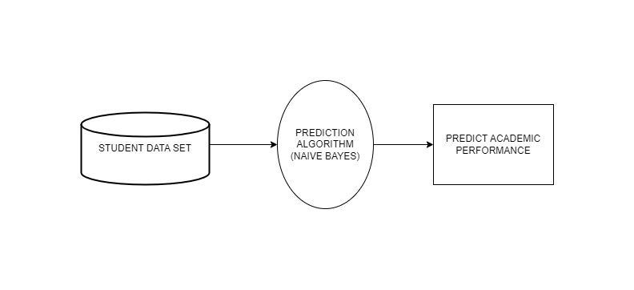
DFD 0

Slide 14
Advantages
Aims to contribute in the growing work on machine learning
To build student performance system

Slide 15
Expected Results/Outcome
Student performance prediction
High performance
Low performance
Medium performance

Slide 16
Hardware and Software/Tools Required
Hardware Requirements:
Operating System - Windows
Application Server - Apache Tomcat
Front End - HTML, Bootstrap, js,CSS, JSP, Servlet
Language - Java.
Database - My SQL
IDE – Eclipse
Software Requirements:
Processor - Intel i3/i5/i7
Speed - 3.1 GHz
RAM - 4 GB(min)
Hard Disk - 20 GB
Key Board - Standard Windows Keyboard
Mouse - Two or Three Button Mouse
Monitor – SVGA

Slide 17
Different types of Risks
Overall traffic load
Data loss, inaccuracy, inconsistency
Mathematical challenges
Information security and security on technical like network, device, OS etc.
Data damage
Qualitative and quantitative risks

Slide 18
Project cost analysis
Effort = a*loc^{b}
Duration = c*effort^{d}
Staffing = effort/durat
Variable A | 1.5
Variable B | 1.05
Variable C | 2.5
KLOC | 15
Effort (In Person / Month) | 41.21991232716921
Duration (In months) | 10.272607456387178

Slide 19
Project’s End Users/ Applications
Colleges
Educational institutes

Slide 20
Conclusion
The system focuses on the student academic growth analysis using machine learning techniques.
For analysis Decision tree and KNN classifier are used.
This process can help the instructor to decide easily about performance of the students and schedule better method for improving their academics.
In future additional features are added to our dataset to acquire better accuracy.

Slide 21
References
H. B. Antonio, H. F. Boris, T. David, and N. C. Borja, ‘‘A systematic review of deep learning approaches to educational data mining,’’ Complexity, vol. 2019, May 2019, Art. no. 1306039.
M. Tsiakmaki, G. Kostopoulos, S. Kotsiantis, and O. Ragos, ‘‘Implementing AutoML in educational data mining for prediction tasks,’’ Appl. Sci., vol. 10, no. 1, pp. 90–117, Jan. 2020.
S. Kausar, X. Huahu, I. Hussain, W. Zhu, and M. Zahid, ‘‘Integration of data mining clustering approach in the personalized E-learning system,’’ IEEE Access, vol. 6, pp. 72724–72734, 2018.
D. Buenaño-Fernandez, W. Villegas, and S. Luján-Mora, ‘‘The use of tools of data mining to decision making in engineering education—A systematic mapping study,’’ Comput. Appl. Eng. Educ., vol. 27, no. 3, pp. 744–758, May 2019.
C. Angeli, S. K. Howard, J. Ma, J. Yang, and P. A. Kirschner, ‘‘Data mining in educational technology classroom research: Can it make a contribution?’’ Comput. Educ., vol. 113, pp. 226–242, Oct. 2017.

