Slide 1
CYBERSECURITY THREAT ANALYTICS
& INCIDENT MANAGEMENT
Power BI Dashboard Presentation
Advanced Threat Incident Analytics and Security Visualization Framework
DATA VISUALIZATION GROUP-2 BATCH-1
Submitted by
Sandip Kala

Slide 2
Presentation Overview
The dashboard suite is structured as a decision-support workflow: understand the overall risk, classify threats, study when and where incidents occur, assess response performance, and use predictive indicators for forward-looking action.
1 Executive Intelligence
2 Security Risk Assessment
Leadership-level security posture and risk summary.
Risk distribution, exposure, severity and concentration.
3 Threat Classification & Geospatial Intelligence
4 Temporal Incident Analytics
Threat types, cities, severity and response patterns.
Seasonal, monthly, weekly, daily and hourly patterns.
5 Incident Response Analytics
6 Predictive Intelligence
Open/closed incidents, response and resolution efficiency.
Risk probability, predicted risk and emerging patterns.
7 Interactive Threat Analytics & Incident Management
8 City Details
Interactive incident, threat and location monitoring.
City-level operational drill-down and response analysis.

Slide 3
Analytical Framework
DATA & MODEL
DECISION FLOW
• Fact_Security_Incidents forms the central incident-level analytical table.
• Asset inventory dimensions provide location, city and department context.
• Incident response data supports response-time, resolution and status analysis.
• The Date Table enables year, quarter, month, week, day and season analysis.
• Measures such as Total Incidents, Critical Incidents, Average Risk Score and response metrics power the KPI layer.
01 Monitor
02 Assess
Executive Intelligence
Security Risk Assessment
03 Classify
04 Explain
Threat & Geospatial
Temporal Analytics
05 Respond
06 Predict
Incident Response
Predictive Intelligence
07 Drill Down
City Details

Slide 4
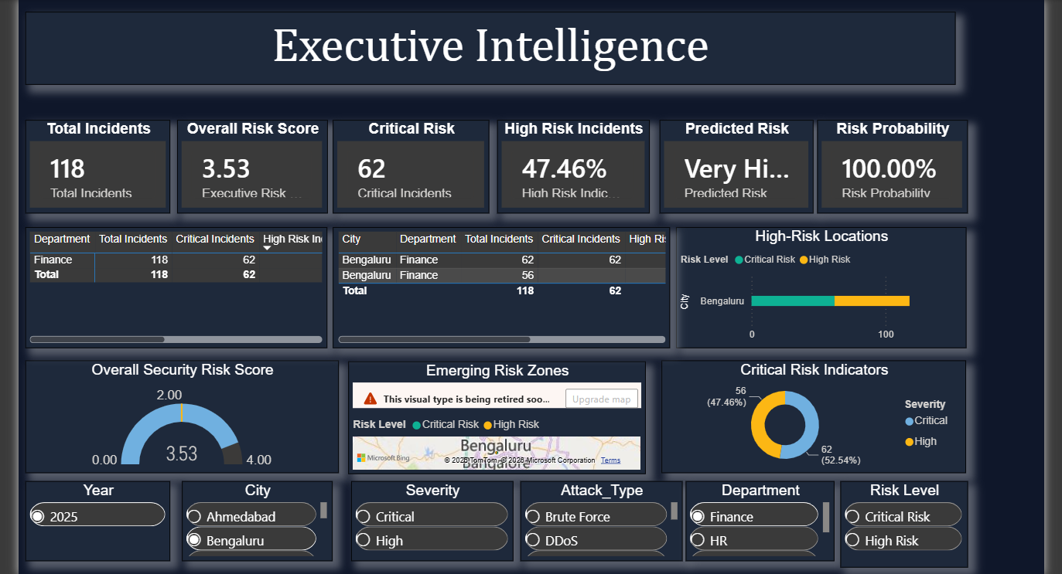
04. Executive Intelligence
Provides a leadership-oriented summary of the organization’s security posture, combining high-level KPIs with department, city and risk-level context.
KEY COMPONENTS
• Overall Risk Score and gauge for an at-a-glance posture assessment.
• Total incidents, critical incidents, high-risk indicators and predicted risk.
• Risk Probability KPI to express the likelihood of adverse outcomes.
• City map and city/department visuals to identify concentration areas.
• Severity distribution and department-level summary table.
Paste the Executive Intelligence dashboard screenshot here
INTERPRETATION
How serious is the current security situation, where is risk concentrated, and which indicators require immediate attention?

Slide 5
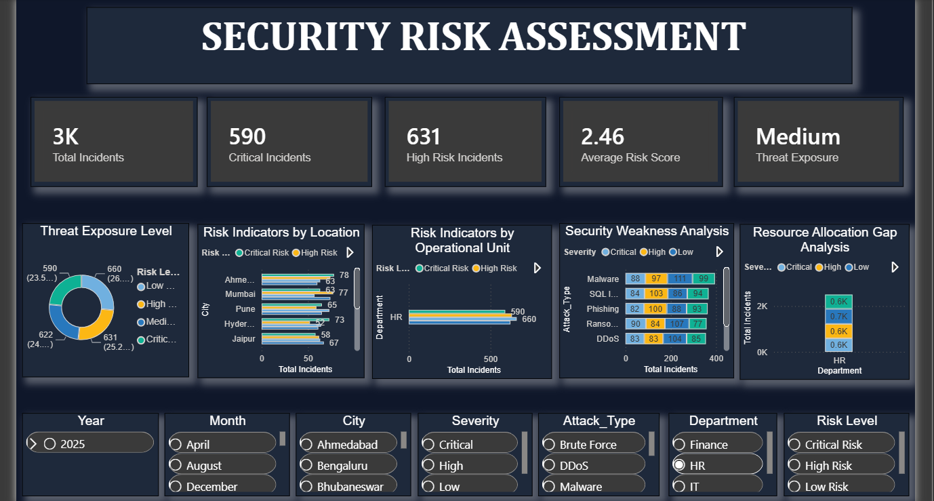
05. Security Risk Assessment
Focuses specifically on risk exposure and severity, allowing analysts to understand how incidents are distributed across risk levels, departments, cities and attack types.
KEY COMPONENTS
• Risk-level distribution through a donut chart.
• Critical and high-risk incident KPI cards.
• Average Risk Score and Threat Exposure indicators.
• Department × severity comparison for incident concentration.
• City × risk-level comparison to identify geographic hotspots.
• Attack type × severity analysis for threat concentration.
Paste the Security Risk Assessment dashboard screenshot here
INTERPRETATION
This dashboard supports prioritization. High-risk and critical clusters can be isolated by geography, department and attack type, helping teams focus limited security resources.

Slide 6
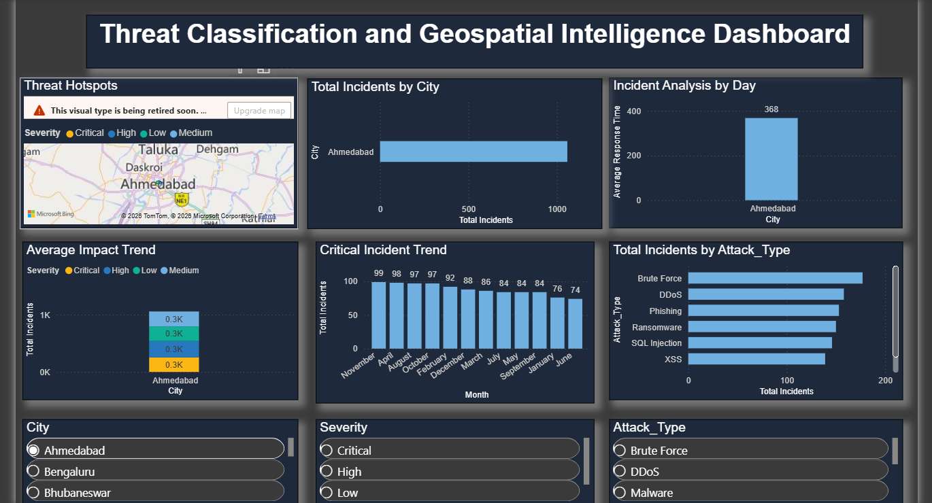
06. Threat Classification & Geospatial Intelligence
Combines threat classification with location intelligence to show what attacks are occurring, where they occur, how severe they are, and how response time varies by city.
KEY COMPONENTS
• Attack-type ranking by total incident volume.
• Monthly incident trend to identify changing activity.
• City-level incident volume comparison.
• City × severity distribution for geographic risk profiling.
• Department/city response-time comparison.
• Interactive map combining city, severity, incident volume and impact context.
• City, attack type and severity filters.
INTERPRETATION
The page is particularly useful for geographic prioritization. It connects the nature of attacks with the locations experiencing them and the operational response burden.

Slide 7
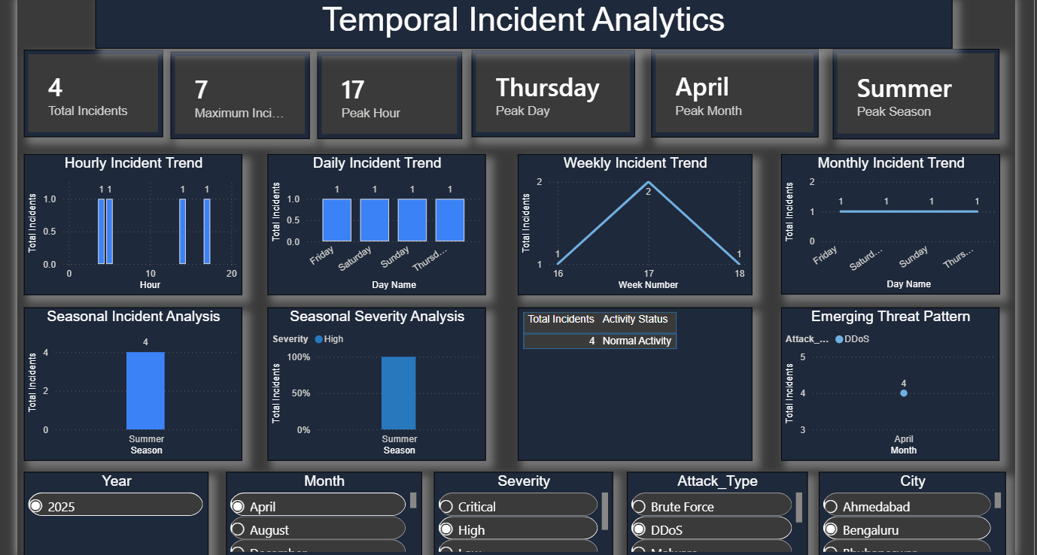
07. Temporal Incident Analytics
Explains when incidents happen by analyzing season, month, week, day and hour, enabling organizations to recognize recurring patterns and potential high-activity periods.
KEY COMPONENTS
• Peak Season, Peak Month, Peak Day and Peak Hour KPI cards.
• Seasonal incident totals and severity composition.
• Monthly attack-type trend line.
• Weekly incident trend and day-of-week comparison.
• Hourly incident distribution to locate peak activity windows.
• Activity status table for quick operational context.
INTERPRETATION
Temporal patterns can guide staffing, monitoring schedules and preventive controls. Repeated peaks may indicate periods requiring additional surveillance or preparedness.

Slide 8
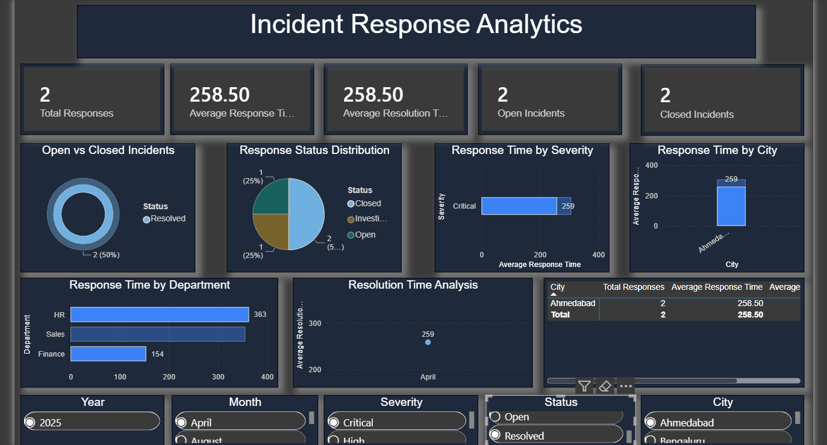
08. Incident Response Analytics
Measures the operational effectiveness of incident handling by comparing response activity, response time, resolution time, status and organizational location.
KEY COMPONENTS
• Total responses, open incidents and closed incidents KPIs.
• Average Response Time and Average Resolution Time.
• Response status distribution and incident status distribution.
• Severity × average response time comparison.
• Department and city response-time comparisons.
• City-level response/resolution summary table.
• Monthly resolution-time trend.
INTERPRETATION
This dashboard moves from threat detection to operational performance. It helps identify where response is slower, where incidents remain open, and whether resolution efficiency is improving.

Slide 9
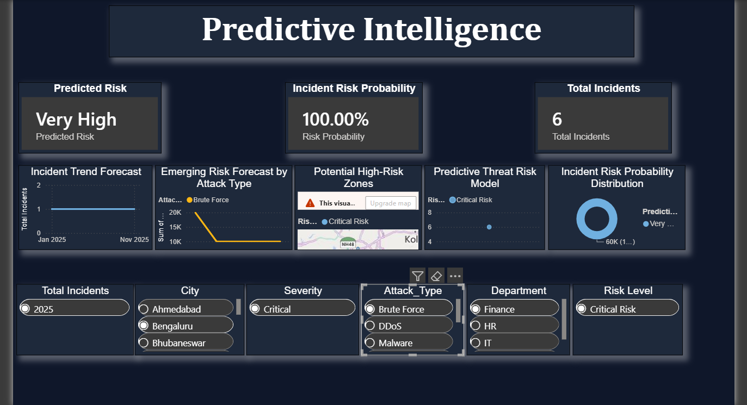
09. Predictive Intelligence
Adds a forward-looking layer by combining predictive risk indicators with incident history, attack types, locations and time trends.
KEY COMPONENTS
• Risk Probability and Predicted Risk KPI cards.
• Predictive Risk Category distribution.
• Attack-type trend over time.
• Geographic map of predicted/risk-level incident concentration.
• Overall incident trend with date hierarchy drill-down.
• Attack type × risk level scatter analysis with incident volume and risk score.
• Filters for year, severity, attack type, department, risk level and city.
Paste the Predictive Intelligence dashboard screenshot here
INTERPRETATION
Use this view to move beyond descriptive reporting. Predictive indicators can support early-warning workflows, prioritization and proactive allocation of security resources.

Slide 10
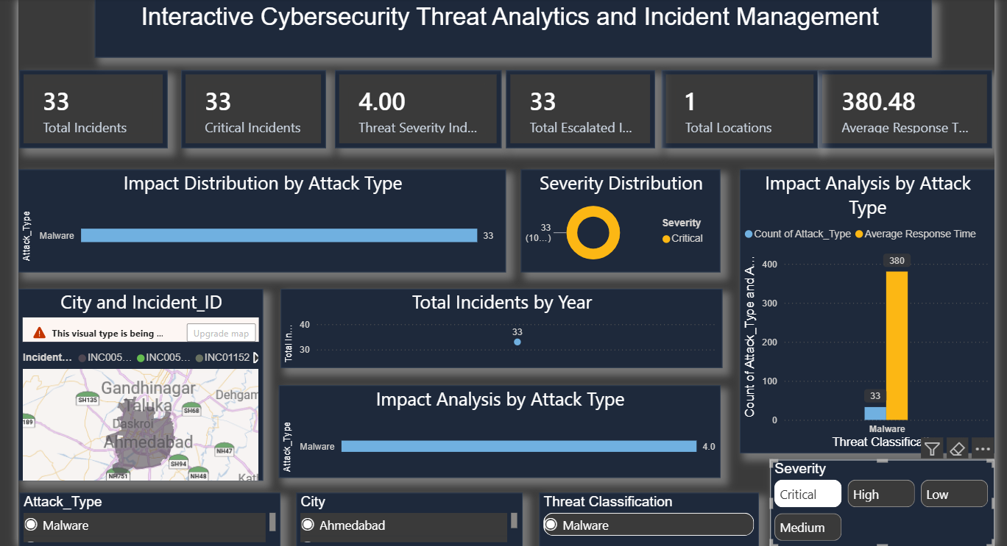
10. Interactive Threat Analytics & Incident Management
Provides an interactive operational view that connects threat classification, incident severity, response performance, locations and attack impact.
KEY COMPONENTS
• Threat classification and city filters for rapid segmentation.
• Annual incident trend and attack-type selection.
• Average Response Time, Total Escalated Incidents and Threat Severity Index.
• Severity distribution and total locations/incident KPIs.
• Threat classification × attack count × response-time combination chart.
• Filled map for geographic incident monitoring.
INTERPRETATION
This page is designed for interactive investigation. Analysts can filter the dashboard to a threat class, city or severity and immediately inspect the related operational indicators.

Slide 11
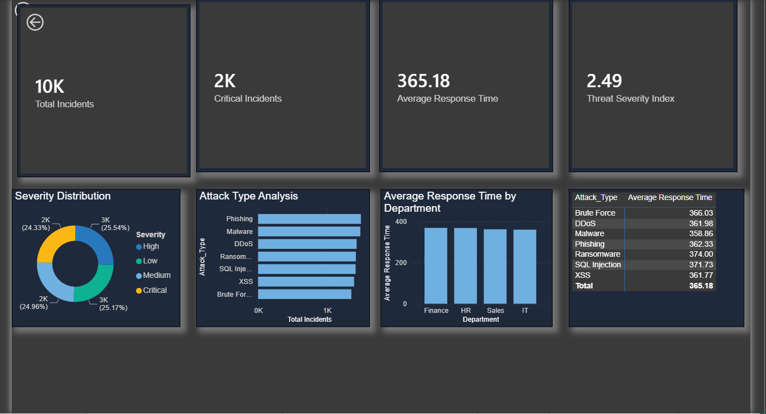
11. City Details
Provides a focused operational drill-down for a selected city, emphasizing incident severity, attack mix, department response performance and overall threat severity.
KEY COMPONENTS
• Critical incident KPI for the selected city context.
• Department-level average response time comparison.
• Attack-type incident volume ranking.
• Attack-type response-time summary.
• Severity distribution for the city.
• Total incidents and Average Response Time KPIs.
• Threat Severity Index for overall city-level risk context.
INTERPRETATION
This page is useful after a geographic hotspot is identified. It allows decision-makers to move from enterprise-level patterns to a city-specific operational view.

Slide 12
Cross-Dashboard KPI & Visual Map
Dashboard
Primary KPIs / Visuals
Decision Question
Executive Intelligence
Overall Risk Score • Predicted Risk • Risk Probability • Critical Incidents
Executive posture
Security Risk Assessment
Risk Level • Threat Exposure • Avg Risk Score • High/Critical Incidents
Risk prioritization
Threat & Geospatial
Attack Type • City • Severity • Avg Response Time
Where & what
Temporal Analytics
Peak Season • Month • Day • Hour • Trends
When
Incident Response
Open/Closed • Avg Response • Avg Resolution • Total Responses
How fast
Predictive Intelligence
Predicted Risk • Risk Probability • Predictive Category
What next
Interactive Threat Analytics
Escalations • Severity Index • Locations • Impact
Investigate
City Details
City incidents • Attack mix • Department response • Severity Index
Local action

Slide 13
Suggested Demonstration Flow
1
Start with Executive Intelligence
2
Move to Security Risk Assessment
Establish the overall risk posture and key management indicators.
Show where risk is concentrated and which severities dominate.
3
Classify & Locate Threats
4
Explain the Time Dimension
Connect attack types to cities, severity and response burden.
Identify peak seasons, months, days and hours.
5
Evaluate Response
6
Introduce Predictive Intelligence
Discuss response time, resolution time and open/closed status.
Show risk probability and predicted risk indicators.
7
Investigate Interactively
8
Finish with City Details
Use filters to demonstrate a focused threat/city scenario.
Translate enterprise findings into a local operational action.

Slide 14
Conclusion
• The eight dashboards provide complementary views rather than isolated reports.
• Descriptive analytics explain what happened; temporal and geospatial views explain when and where.
• Incident response analytics measure operational performance and resolution efficiency.
• Predictive indicators extend the dashboard from monitoring toward proactive risk management.
• Interactive filters and drill-down views support investigation from enterprise level to city level.
• Together, the dashboards form a practical decision-support layer for cybersecurity monitoring and incident management.

Slide 15

Presented By:
𝒮𝒶𝓃𝒹𝒾𝓅 𝓀𝒶𝓁𝒶

