Slide 1
“Machine Learning Based Child Immunization System”
Genba Sopanrao Moze College Of Engineering Balewadi, Pune
Project Review -1 Presentation on
Presented by :- SANDIP KAMBLE
PANKAJ DUKARE GANESH KADAM
Under Guidance of
Prof. Supriya Kamble

Slide 2
OBJECTIVES
The Main Objectives of this system is to provide user friendly UI for schedule the vaccination and gives reminder to parents
This system can define immunization, vaccination, immunity, antigen and antibody awareness.
This system will helpful for storing the child data for future analysis of the child health.
This system will increase the knowledge and skill among parents regarding immunization.
This system can predict the health report as per the child data
Send a message regarding routine vaccination date and location of nearest health center .

Slide 3
Abstract
Child Immunization is one of the core infrastructure elements in building smart cities, an initiative taken up by Indian government recently. India has the highest number of child mortality in the world due to inadequate healthcare, malnutrition and poor sanitation, all of which can be prevented. We develop the ml based child immunization system to address healthcare issue, where a common platform to store and retrieve complete child medical history information. It includes mandatory vaccination schedule details of child along with the previous medical history records and also use machine learning algorithm to predicts the child health and gives specific suggestions to improve child health Reminders to provide timely vaccinations to their child are also provided to alert parents to give their child health protection. Using Web and Mobile based technology, parents and doctors get access of the child’s medical reports online anywhere, anytime with required privileges. This work helps both parents and doctors to provide better quality healthcare services. Finally, the collection of data can further be analysed to find the trends and pattern of diseases and this can pave a new beginning in the field of engineering and medical research for better and quality living.

Slide 4
PROBLEM STATEMENT
Parents sometimes fail to vaccinate their children on time, which is one of the main causes. Existing vaccination system of India is incompetent and ineffective. Mismanagement and insecurity are major problems of the existing system. These deficiencies push the vaccine program to a halt and raise the number of children who are not vaccinated. As a result, there is a need for a framework that can deal with existing problems while still being able to adapt to changing times and technology. The vaccination program must be strengthened. The immunization awareness program also needs to be improved.

Slide 5
PLAN OF ACTION
PHASE 1 :
Finding Project Topic
Finding Existing system and disadvantages
Collecting Information about the project topic
PHASE 2 :
Literature Survey
Synopsis
Analysis of future scope and objective
PHASE 3 :
i)Requirement Gathering
software requirement
hardware requirement
ii)Design, Algorithm, Architecture
iii)Report

Slide 6
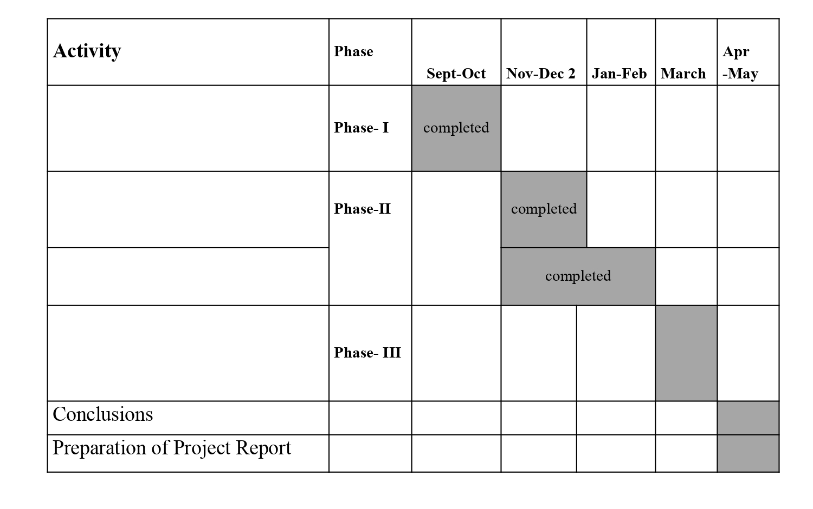

Slide 7
LITERATURE SURVEY
Santoshi Kumari, Haripriya.A, Aruna.A, Vidya.D.S, Nithya.M.N,” Immunize - Baby Steps for smart healthcare”
Smart Healthcare is one of the core infrastructure elements in building smart cities, an initiative taken up by Indian government recently. We present in this paper, a generic system to address healthcare issue, where a common platform to store and retrieve complete child medical history information. It includes mandatory vaccination schedule details of child along with the previous medical history records. Reminders to provide timely vaccinations to their child are also provided to alert parents to give their child health protection. Using Web and Mobile based technology, parents and doctors get access of the child’s medical reports online anywhere, anytime with required privileges. This work helps both parents and doctors to provide better quality healthcare services. Finally, the collection of data can further be analyzed to find the trends and pattern of diseases and this can pave a new beginning in the field of engineering and medical research for better and quality living
Assam Hamed Abbas, Yuhanis Yusof “Children Vaccination Reminder Via SMS Alert”
This study presents a model for children vaccination reminder using short message service (SMS). The model consists of data flow in reminding parents of their children vaccination schedule. Existing practice on vaccination schedule is via written appointment. Nevertheless, such approach may not be sufficient as parents may forget due to a tight work schedule and daily routines. The proposed model was evaluated by allowing selected respondents to use to the developed prototype. Results show that respondents do agree on the benefit of having reminder send via SMS. In addition, all of the respondents feel that the proposed system is useful.

Slide 8
LITERATURE SURVEY
Sneha Grampurohit ,Chetan Sagarnal “Disease Prediction using Machine Learning Algorithms ”
The development and exploitation of several prominent Data mining techniques in numerous real-world application has led to the utilization of such techniques in machine learning environments. in order to extract useful pieces of information of the specified data in healthcare communities, biomedical fields etc. The techniques of machine learning have been successfully employed in assorted applications including Disease prediction. The aim of developing classifier system using machine learning algorithms is to immensely help to solve the health-related issues by assisting the physicians to predict and diagnose diseases at an early stage. A Sample data of 4920 patients’ records diagnosed with 41 diseases was selected for analysis. A dependent variable was composed of 41 diseases. 95 of 132 independent variables(symptoms) closely related to diseases were selected and optimized. This research work carried out demonstrates the disease prediction system developed using Machine learning algorithms such as Decision Tree classifier, Random forest classifier, and Naïve Bayes classifier.
Shirin Hasan, Mir Mohammad Yousuf, Mubashir Farooq,” e-Vaccine: An Immunization App”
Due to lack of adequate healthcare, India has high Infant Mortality rates. Making sure that children have access to proper healthcare and immunization against diseases that can be prevented by vaccines, is a huge challenge that is being faced by developing countries like ours. This highlights the importance and need of having a better, smarter system in place, to improve the situations. In this paper, we discuss an android application that was developed to address this concern. This application provides a system to provide information, store records and help parents schedule vaccination appointments for their children.

Slide 9
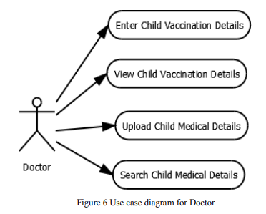
MATHEMATICAL MODEL
Fig :- Use Case Diagram for Doctor

Slide 10
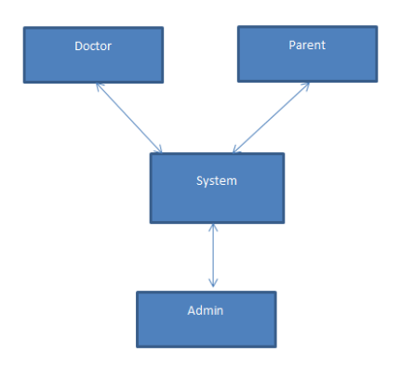
FIG : System Overview Of User Design

Slide 11
Algorithm Used
step 1 : start .
step 2 : Doctors can register on system.
step 3 : Parents register their child with their own mobile number.
step 4 : doctors, parents and nurses can be able to login into the system.
step 5 : Admin can manage the users and uploads all the blogs regarding. Vaccinations.
step 6 : parents can gets appointment from the doctors by using the system.
step 7 : Then doctors accepts the appointment and schedule baby’s vaccination.
step 8 : both doctors and parents can be able to track the vaccination report.
step 9 : System can be predicts the baby’s health as per the data of vaccinations.
step 10 : system automatically send the SMS to their parents for remainder.
step 11 : User Logout.

Slide 12
SYSTEM REQUIREMENTS
Hardware Specification
Processor : Dual Core 64-bit processor-i3
Ram : 4 GB
Hard disk :100 GB
Software Specification
technologies : HTML , CSS , Bootstrap , Python
Database : MySQL
Framework: - Django
IDE: visual studio code.

Slide 13
WORK TO BE CARRIED OUT
Phase – IV: Coding / Implementation
•Software used
•Hardware specification
• Programming language Platform
•Components
•Tools
Phase – V: Testing
•Test data Sets, Result and Analysis
• Test plan
• Test case
Phase – VI: Deployment
Phase – VII: Maintenance

Slide 14
REFERENCE
[1] http://countrymeters.info/en/India
[2] Ahluwalia, Isher Judge. "Challenges of Urbanisation in India." Contemporary Issues in Development Economics. Palgrave Macmillan UK, 2016. 163-177.
[3] Nijman J. India's urban challenge. Eurasian Geography and Economics. 2012 Jan 1;53(1):7-20.
[4] Ding D, Conti M, Solanas A. A smart health application and its related privacy issues. InSmart City Security and Privacy Workshop (SCSP-W), 2016 2016 Apr 11 (pp. 1-5). IEEE.
[5] Hasan AS, Malik A, Shukla I, Malik MA. Antibody levels against polioviruses in children following pulse polio immunization program. Indian Pediatr. 2004 Oct 4;41(10):1040- 4.
[6] John TJ, Thacker N, Deshpande JM. Setback in polio eradication in India in 2002: Reasons and remedies. Indian Pediatr 2003; 40: 195-203.

Slide 15
REFERENCE
.
[7] Sharma S. Immunization coverage in India. Institute of Economic Growth, University of Delhi; 2007.
[8] Dempsey AF, Schaffer S, Singer D, Butchart A, Davis M, Freed GL. Alternative vaccination schedule preferences among parents of young children. Pediatrics. 2011 Sep 27:peds-2011.
[9] Yadav K, Srivastava R, Kumar R, Chinnakal P, Rai SK, Krishnan A. Significant vaccination delay can occur even in a community with very high vaccination coverage: evidence from Ballabgarh, India. Journal of tropical pediatrics. 2012 Apr 1;58(2):133-8.
[10] Vashishtha VM, Choudhury P, Kalra A, Bose A, Thacker N, Yewale VN, Bansal CP, Mehta PJ. Indian Academy of Pediatrics (IAP) recommended immunization schedule for children aged 0 through 18 years—India, 2014 and updates on immunization. Indian pediatrics. 2014 Oct 1;51(10):785-800.

Slide 16
Thank You

