Slide 1

G. S. Moze College of Engineering,
BALEWADI, PUNE
Machine Learning Based Child
Immunization System
Guide- Prof. Supriya kamble
Pankaj Babaji Dukare A-15 Ganesh Vishwas Kadam B-23 Sandip Anant Kamble B-25

Slide 2
CONTENTS
1
Introduction
2
Problem Statement
3
Objective
4
System Architecture
5
Methodology
6
Project Planning
7
Project Design
8
Conclusion

Slide 3
Introduction
Anywhere, anytime with required privileges. This work helps both parents and doctors to provide Child Immunization is one of the core infrastructure elements in building smart cities, an initiative taken up by Indian government recently. India has the highest number of child mortality in the world due to inadequate healthcare, malnutrition and poor sanitation, all of which can be prevented. We develop the ml based child immunization system to address healthcare issue, where a common platform to store and retrieve complete child medical history information. It includes mandatory vaccination schedule details of child along with the previous medical history records and also use machine learning algorithm to predicts the child health and gives specific suggestions to improve child health Reminders to provide timely vaccinations to their child are also provided to alert parents to give their child health protection. Using Web and Mobile based technology, parents and doctors get access of the child’s medical reports online better quality healthcare services. Finally, the collection of data can further be analysed to find the trends and pattern of diseases and this can pave a new beginning in the field of engineering and medical research for better and quality living.

Slide 4
Problem Statement
Parents sometimes fail to vaccinate their children on time, which is one of the main causes. Existing vaccination system of India is incompetent and ineffective. Mismanagement and insecurity are major problems of the existing system. These deficiencies push the vaccine program to a halt and raise the number of children who are not vaccinated. As a result, there is a need for a framework that can deal with existing problems while still being able to adapt to changing times and technology. The vaccination program must be strengthened. The immunization awareness program also needs to be improved.

Slide 5
Objective
The Main Objectives of this system is to provide user friendly UI for schedule the vaccination and gives reminder to parents
This system can define immunization, vaccination, immunity, antigen and antibody awareness.
This system will helpful for storing the child data for future analysis of the child health.
This system will increase the knowledge and skill among parents regarding immunization.
This system can predict the health report as per the child data
Send a message regarding routine vaccination date and location of nearest health center .

Slide 6
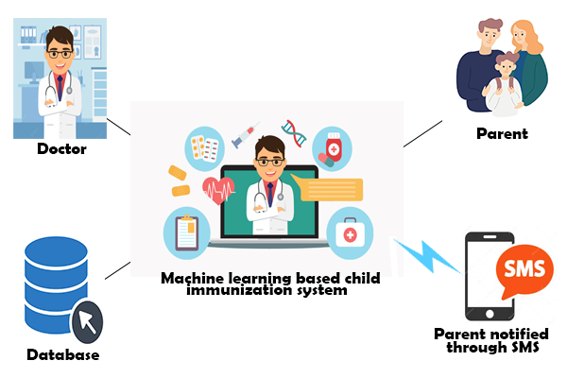
System Architecture

Slide 7
Methodology
step 1 : start .
step 2 : Doctors can register on system.
step 3 : Parents register their child with their own mobile number.
step 4 : doctors, parents and Admin can be able to login into the system.
step 5 : Admin can manage the users and uploads all the blogs regarding vaccinations.
step 6 : parents can gets appointment from the doctors by using the system.
step 7 : Then doctors accepts the appointment and schedule baby’s vaccination.
step 8 : both doctors and parents can be able to track the vaccination report.
step 9 : System can be predicts the baby’s health as per the data of vaccinations.
step 10 : system automatically send the SMS to their parents for remainder.
step 11 : User Logout.

Slide 8
Project Planning
PHASE 1 :
Finding Project Topic
Finding Existing system and disadvantages
Collecting Information about the project topic
PHASE 2 :
Literature Survey
Synopsis
Analysis of future scope and objective
PHASE 3 :
i)Requirement Gathering
software requirement
hardware requirement
ii)Design, Algorithm, Architecture
iii)Report

Slide 9
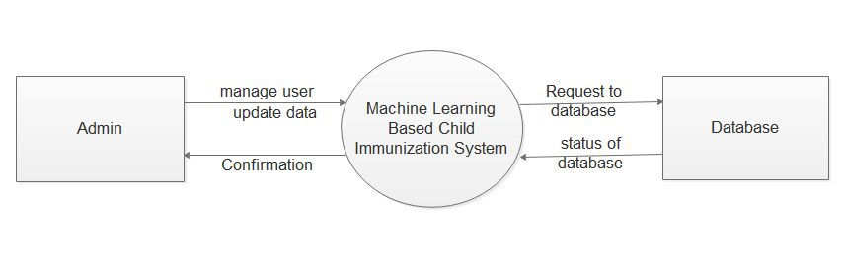
Project Design
DFD Level 0
FIG : DFD Level 0

Slide 10
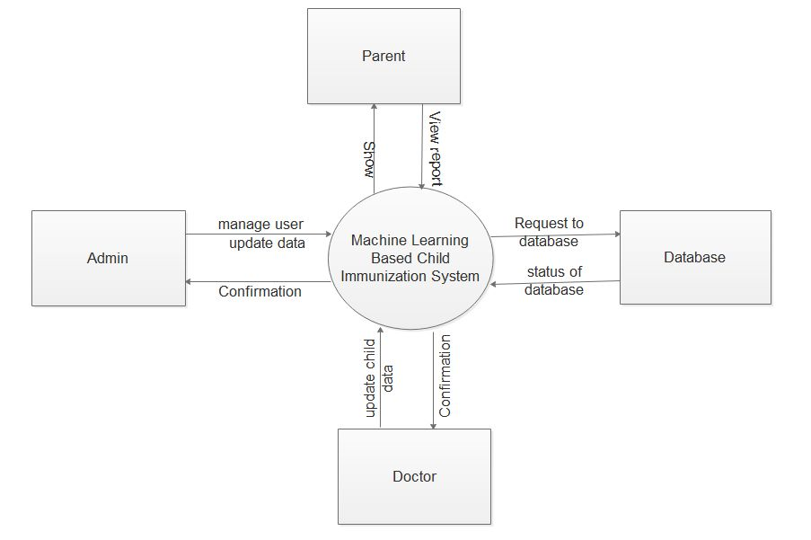
DFD Level 1
FIG : DFD Level 1

Slide 11
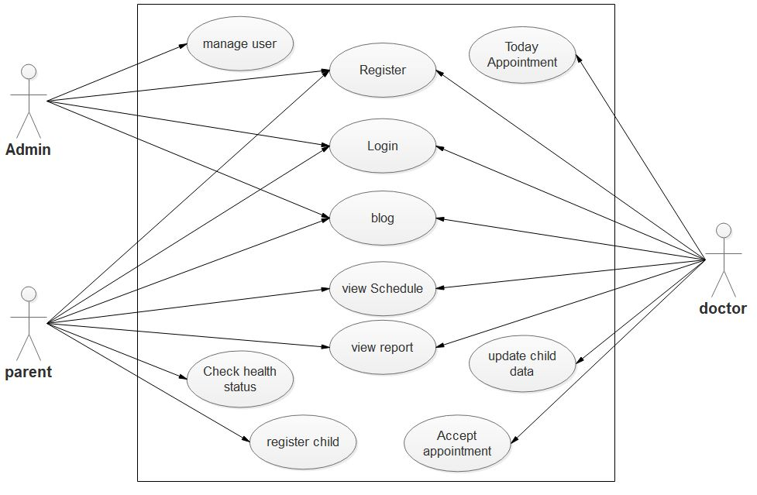
Use Case Diagram
FIG : Use Case Diagram

Slide 12
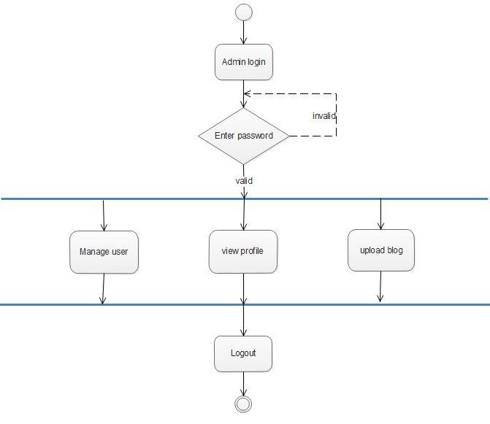
Activity Diagram
i)Admin Activity Diagram

Slide 13
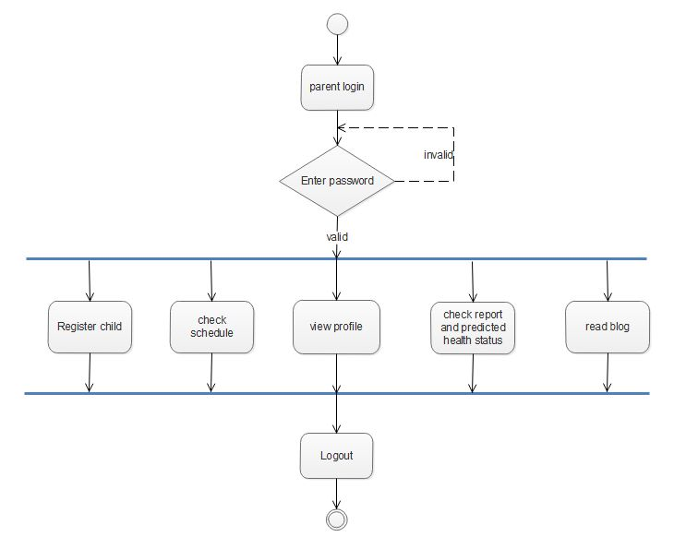
ii)Parent Activity Diagram

Slide 14
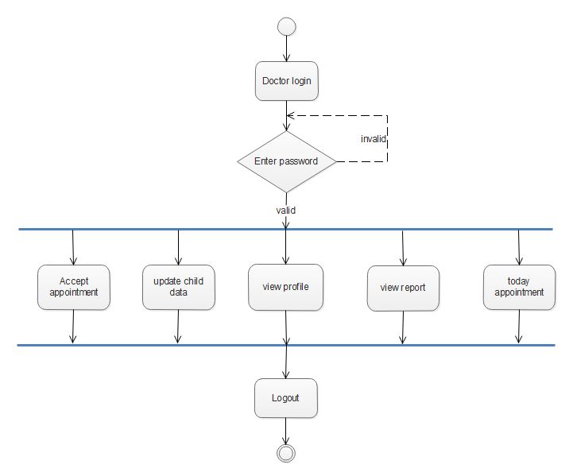
iii)Doctor Activity Diagram

Slide 15
CONCLUSION
A system is proposed with an idea of providing a common platform to store and retrieve
medical records of child with mandatory vaccination schedule details to start with as the child mortality rate due to vaccine preventable diseases are significantly high in numbers. As the mobile and internet technology continuous to evolve rapidly, regular alerts to parents for providing timely vaccination to their child/children for giving protection from vaccine preventable diseases are implemented using SMS and E-Mail messages. The facility to view previous medical records can help in speedy diagnose and action.

Slide 16
References:-
[1] http://countrymeters.info/en/India
[2] Ahluwalia, Isher Judge. "Challenges of Urbanisation in India." Contemporary Issues in Development Economics. Palgrave Macmillan UK, 2016. 163-177.
[3] Nijman J. India's urban challenge. Eurasian Geography and Economics. 2012 Jan 1;53(1):7-20.
[4] Ding D, Conti M, Solanas A. A smart health application and its related privacy issues. InSmart City Security and Privacy Workshop (SCSP-W), 2016 2016 Apr 11 (pp. 1-5). IEEE.
[5] Hasan AS, Malik A, Shukla I, Malik MA. Antibody levels against polioviruses in children following pulse polio immunization program. Indian Pediatr. 2004 Oct 4;41(10):1040- 4.
[6] John TJ, Thacker N, Deshpande JM. Setback in polio eradication in India in 2002: Reasons and remedies. Indian Pediatr 2003; 40: 195-203.

Slide 17
THANK YOU
Special thanks to guide PROF. Supriya Kamble Mam

