Slide 1

College Informatics

Slide 2
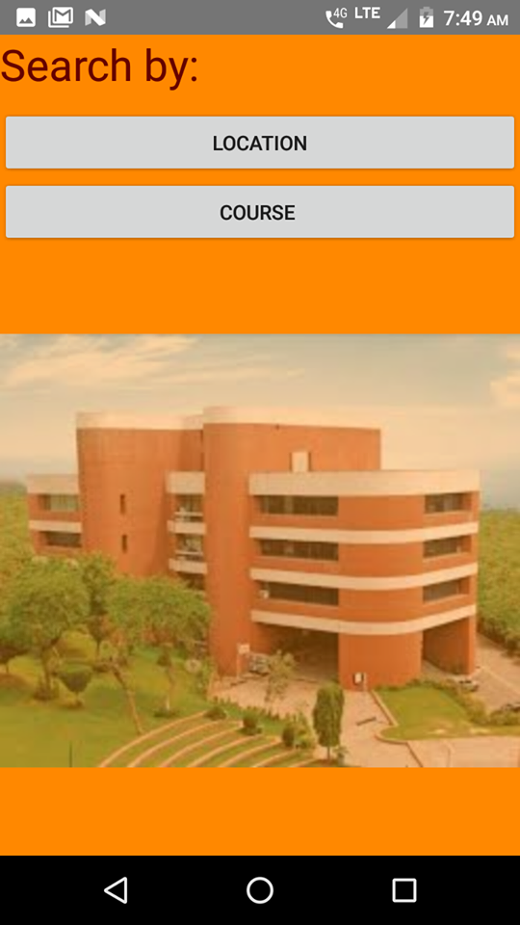
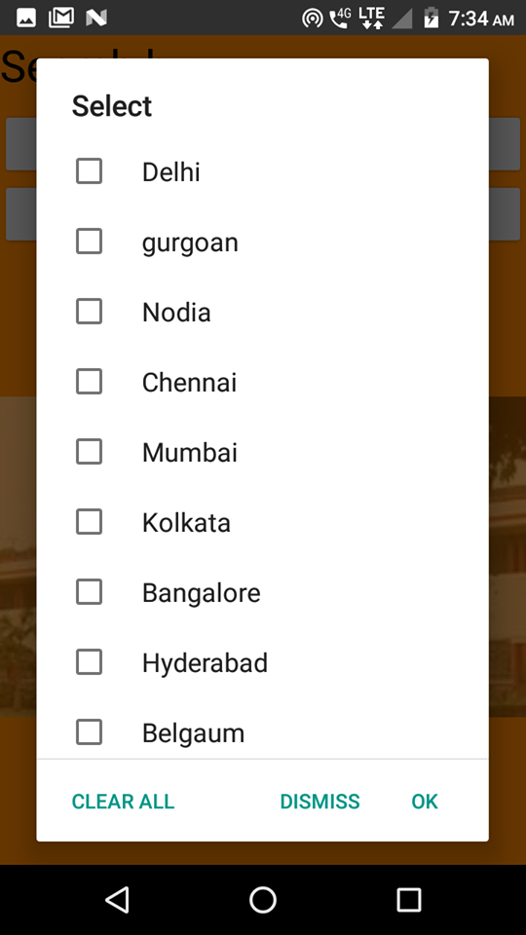
Stage 1
The user will filter the list of colleges by selecting the respective location(s) or course(s).
After selecting the choices ,the user will be taken to next activity where the list of respective colleges appears .

Slide 3
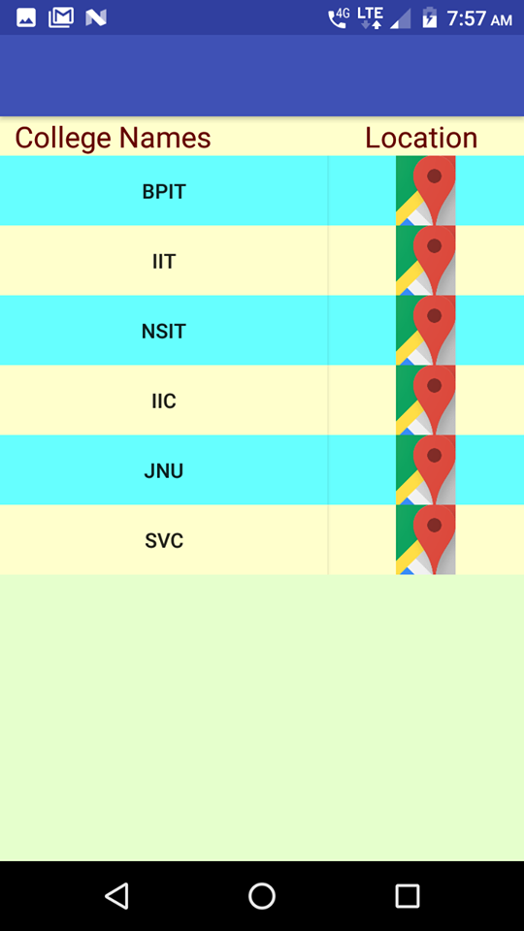
Stage 2
Now user can sort the college list on the basis of diiferent factors like Infrastructure,All India Ranking,Accreditation granted etc.
Then the user may select the desired college from the respective list.

Slide 4
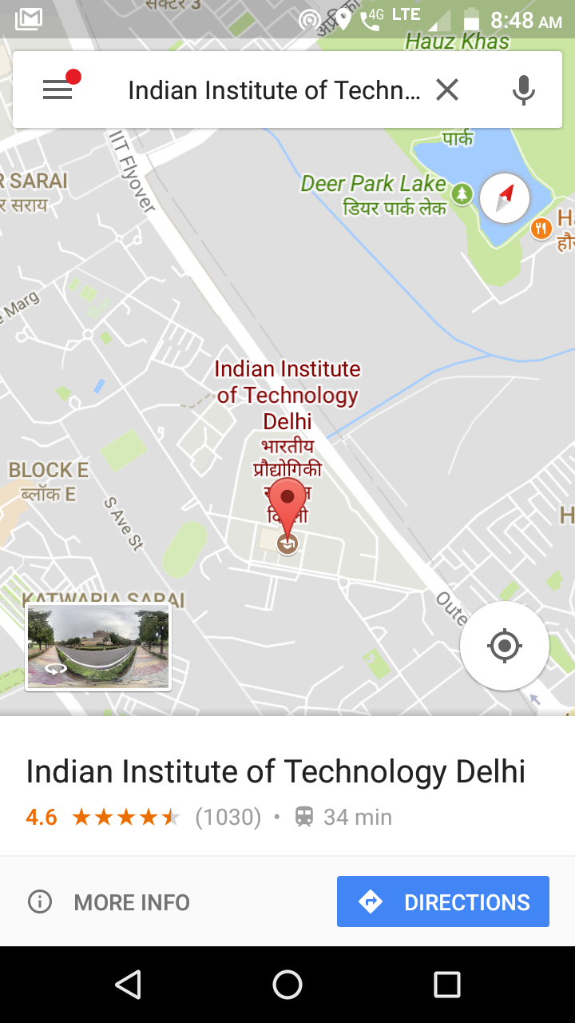
Final Stage
Here the user can access all the information of the college as the user is directed towards the official webpage of the college.
The location of the selected college is also directed which can provide them with the knowledge of their surrounding areas.
Hence the app is multifacilitated according to the basic requirements of the user.

