Slide 1
3 Tier Architecture
Sandip Kumar

Slide 2
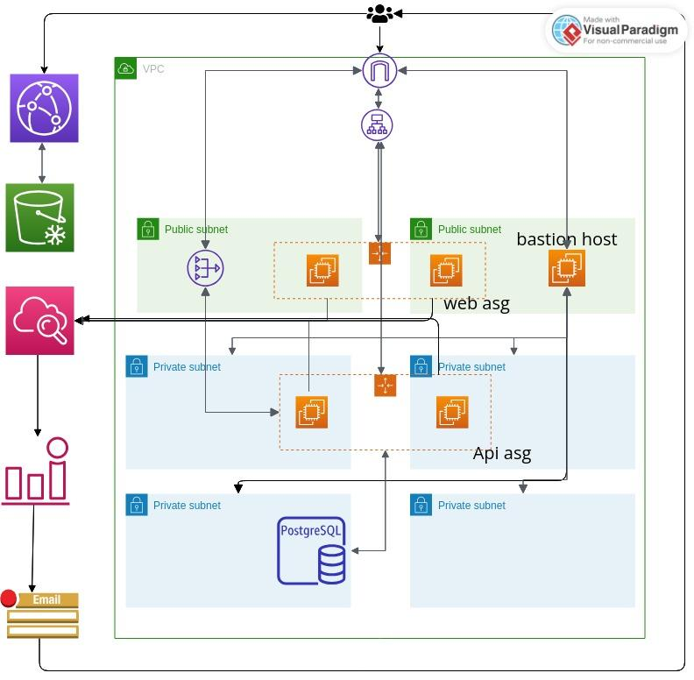
aws architecture

Slide 3
App Access
Web access url
http://external-load-balancer-1784107043.us-east-1.elb.amazonaws.com/
Api access url http://external-load-balancer-1784107043.us-east-1.elb.amazonaws.com/api/status
cdn url
https://dzew1p18vi060.cloudfront.net/public/images/nyan.gif

Slide 4
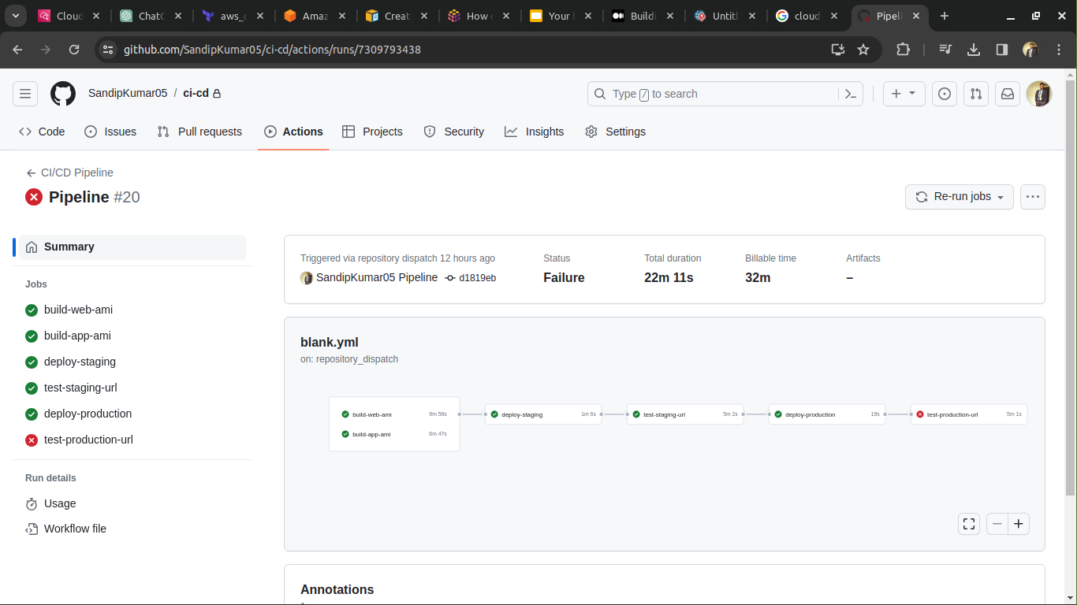
Deployment Pipeline (Using github actions for pipeline)
-> Any push in main branch trigger this pipeline using git pre-push hook.

Slide 5
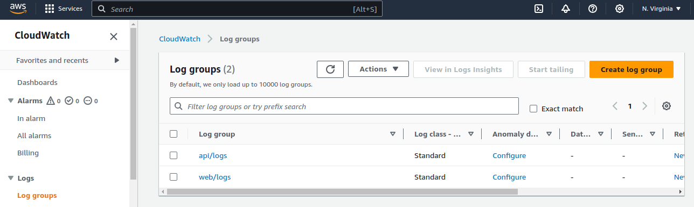
Logs
Web access url ->
Api access url ->
Cloudfront url ->
I am pushing all the required metrics/logs on aws cloudwatch

Slide 6
Cloud watch Alarms
Cost Anomaly Alert (more than $100 in a month)
Alarm on URL accessibility. (url reachable or not)
Alert if autoscaling group reached its maximum state.
CPU/Memory Alarm (autoscaling use this metrics to autoscale)
RDS free storage alert

