Slide 1

Predicting Heart Disease Using Machine Learning
Python CRN 73544
BY:
Sushma Sri Paruchuri
Amani Vuyyuru
Dhanush Sai Ram Bezawada
Sandipkumar Prajapati
An Exploration of Data Analysis and Predictive Modeling

Slide 2
Introduction
Dataset Overview:
The dataset contains information on individuals' medical attributes and whether they have heart disease.
Key features include age, cholesterol levels, resting blood pressure, and exercise-induced angina.
Target Variable: target (0 = No Disease, 1 = Disease)
Relevance:
Heart disease is a major global health issue.
Predicting heart disease can improve early diagnosis and treatment.

Slide 3
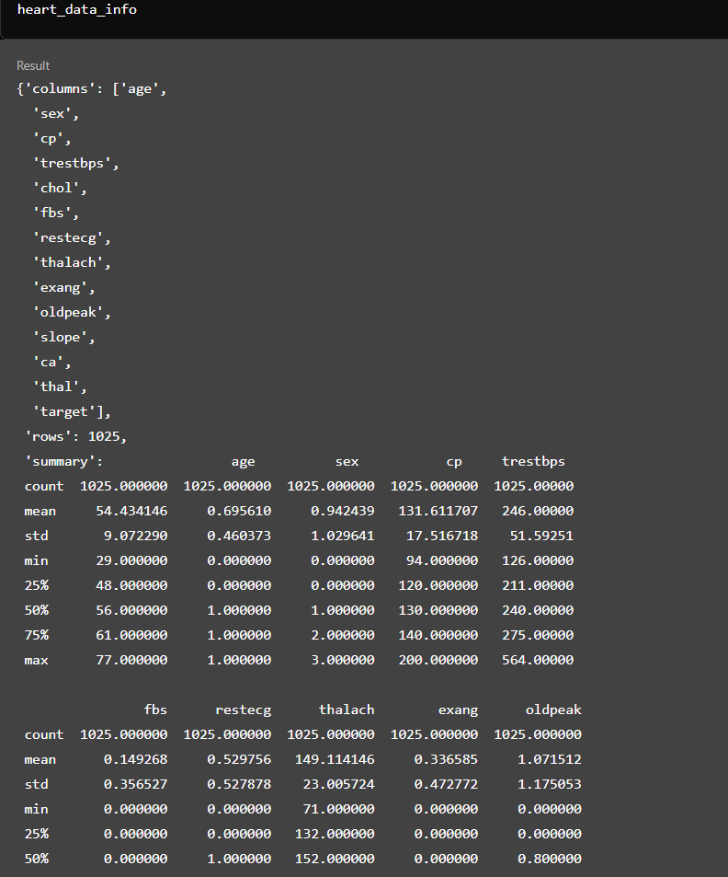
Dataset
Source: Kaggle – New York City Airbnb Open Data by Rhonarose Cortez.
Features: Includes age, sex, cp (chest pain type), chol (cholesterol), thalach (max heart rate), target (heart disease diagnosis), and more.
Statistics:
Entries: 1,025Age
Range: 29–77 years
Cholesterol: 126–564 mg/dL
Heart Rate: 71–202 bpm
Goal: Predict heart disease (target: 1 = Disease, 0 = No Disease) using medical features.

Slide 4
Architecture and Methodology
📈Exploratory Data Analysis (EDA)
Analyze feature distributions
Visualize relationship (scatter plots, heatmaps ..etc.)
Identify trends & patterns
Highlight key correlations
Feature Prepartation
Standardize data
Train-test split(80/20)
Prepare for model training
Ensure balanced dataset
🔍Data Understanding
Load dataset
Check structure & types
Identify missing values
Explore target variable
🛠️Data Cleaning
Duplicates removal
Handling missing values
Ensure clean data
💻 Tools & Libraries:
🐼 Pandas - For data manipulation and analysis
📊 Seaborn - For data visualization, specifically statistical plots
📉 Matplotlib - For general-purpose plotting
🌍 Geopandas - For geographic data manipulation and visualization
🗺️Evaluation & Comparison
Compare models using
Accuracy
Precision
Recall
F1 score
Roc auc
Select the best model
📈Machine Learning
Train Models: Logistic Regression, Decision Tree, Random Forest, Gradient Boosting
Use training data
Predict on test data

Slide 5
Data Visualization Exploratory Data Analysis

Slide 6
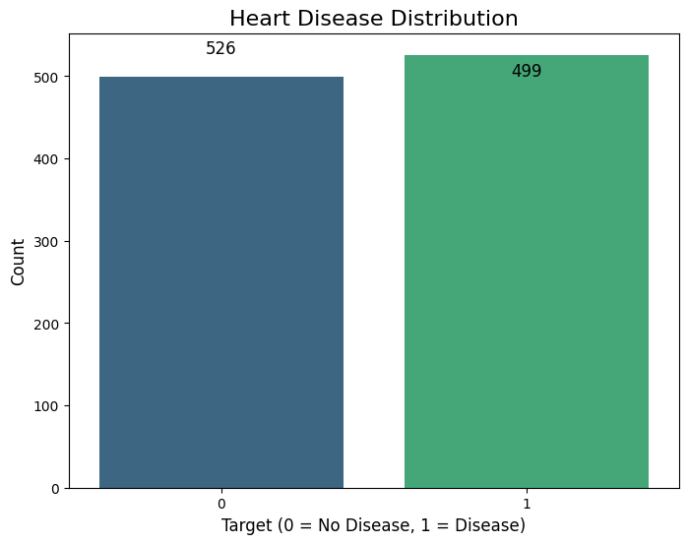
Count of Individuals by Target Variable
Key Points:
Bar chart provides a count of individuals with (499) and without heart disease (526).
The similar counts ensure that classification models will not be skewed.
Insight:
Balanced target variable distribution confirms dataset suitability for binary classification.

Slide 7
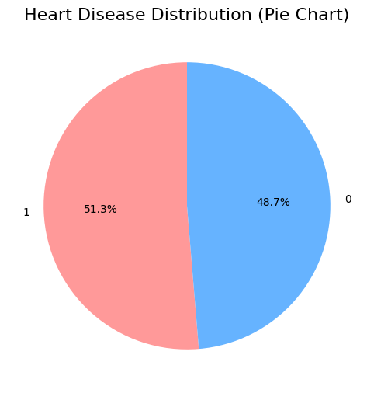
Heart Disease Proportion
Key Points:
The dataset is almost balanced, with 51.3% individuals having heart disease (target = 1) and 48.7% without (target = 0).
This balance is essential for machine learning models to avoid bias.
Insight:
A balanced dataset supports fair model training and reliable predictions.

Slide 8
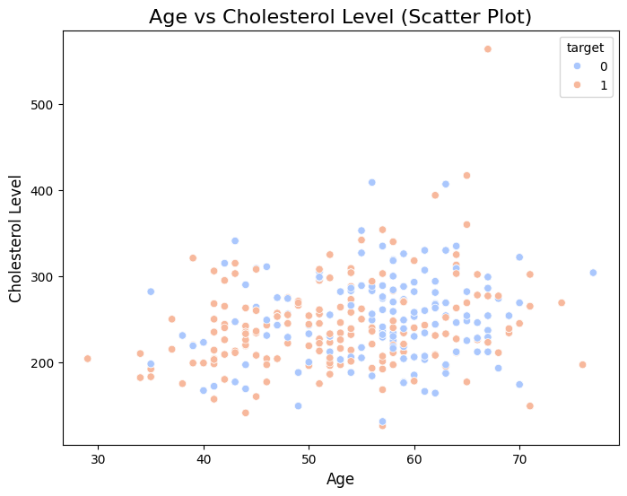
Scatter Plot - Age vs Cholesterol Level
Relationship Between Age and Cholesterol Level
Key Points:
The scatter plot shows the distribution of cholesterol levels across different age groups.
Data is color-coded by the target variable (0 = No Disease, 1 = Disease).
Observation:
Higher cholesterol levels are observed across all age groups, but individuals with heart disease (target = 1) are more dispersed.
Insight:
Age and cholesterol levels are critical features for predicting heart disease.

Slide 9
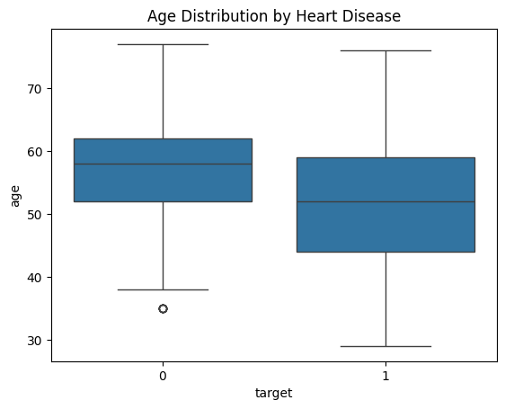
Boxplot - Age Distribution by Target
Key Points:
Boxplot compares the age distributions for individuals with and without heart disease.
Observations:
Median age for individuals with heart disease is slightly lower than those without.
Wider age spread in the group without heart disease.
Insight:
Age is a relevant predictor, but it must be combined with other features for accuracy.

Slide 10
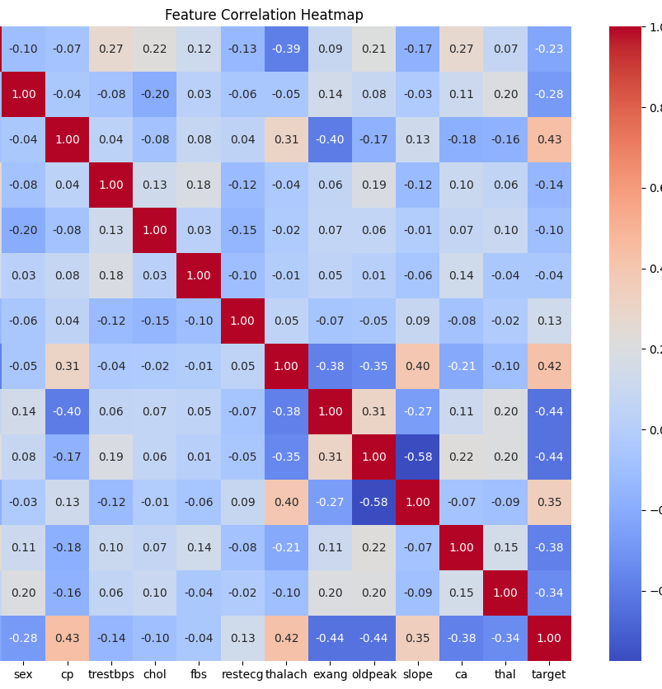
Correlation Heatmap
Key Points:
The heatmap highlights the correlation between all features and the target variable.
Strong Positive Correlations: Chest pain type (cp) and maximum heart rate achieved (thalach) with heart disease.
Negative Correlations: Exercise-induced angina (exang) and old peak (oldpeak) with heart disease.
Insight:
Features like thalach, cp, and oldpeak have the strongest relationships with the target variable and are highly relevant for prediction.

Slide 11
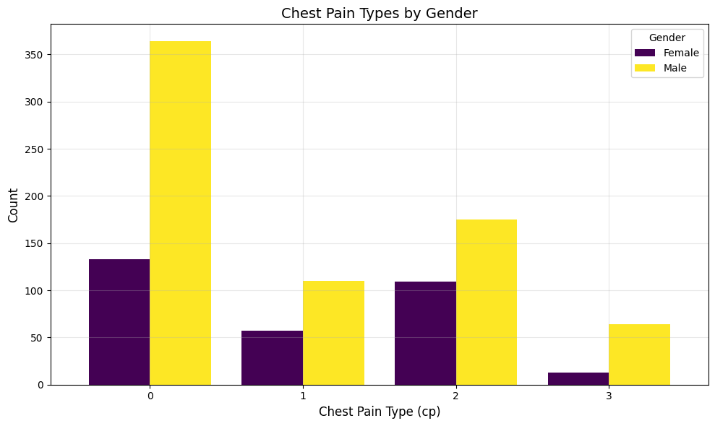
Distribution of Chest Pain Types by Gender
Key Points:
The bar chart shows the distribution of chest pain types (cp) across males and females.
Observations:
Chest pain type 0 (asymptomatic) is the most common, especially among males.
Other types of chest pain (e.g., 1, 2, and 3) are more evenly distributed across genders but occur less frequently.
Insight:
Chest pain type is a critical feature for predicting heart disease, as type 0 is highly associated with higher risks.

Slide 12
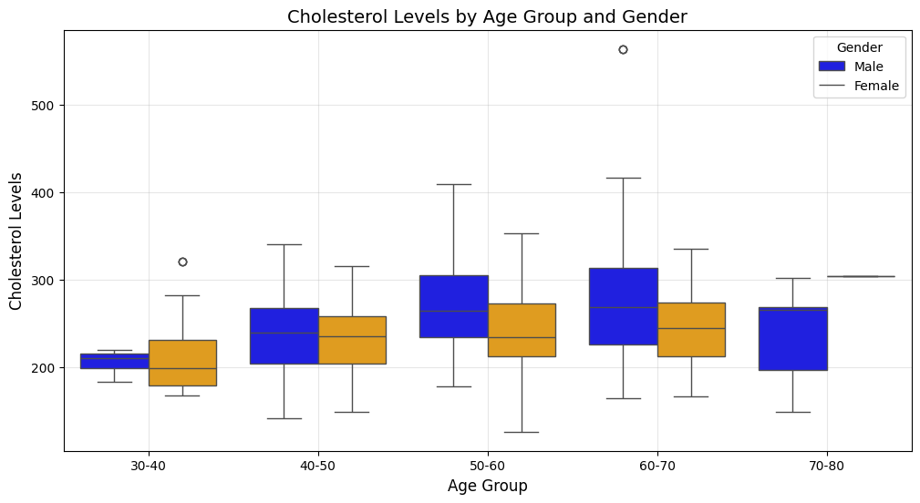
Cholesterol Levels Across Age Groups and Gender
Key Points:
The boxplot shows cholesterol levels stratified by age groups (30-40, 40-50, 50-60, etc.) and gender.
Observations:
Cholesterol levels tend to increase with age for both males and females, peaking in the 50-60 age group.
Males generally have higher cholesterol levels than females in most age groups.
A few outliers are observed in the 40-50 and 50-60 age groups.
Insight:
Cholesterol levels and age are significant predictors, and their trends across genders provide additional insights for heart disease risk assessment.

Slide 13

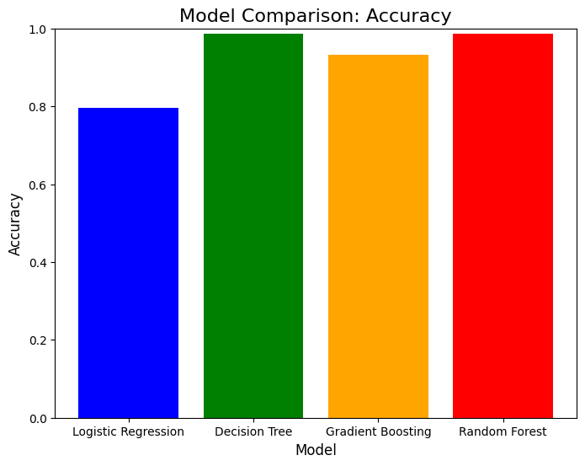
Machine Learning Model Performance
Key Points:
The table below summarizes the evaluation metrics (Accuracy, Precision, Recall, F1 Score, ROC AUC) for four machine learning models:
Logistic Regression
Decision Tree
Gradient Boosting
Random Forest
Observations:
Decision Tree and Random Forest performed the best with a high accuracy of 99% and perfect precision.
Gradient Boosting provided a balance between accuracy and generalizability, scoring 93% in accuracy and 95% in recall.
Logistic Regression, though simple and interpretable, had lower performance compared to ensemble models.
Insight:
Random Forest emerges as the top-performing model with a perfect balance between precision, recall, and accuracy.
Metric | Logistic Regression | Decision Tree | Gradient Boosting | Random Forest
Accuracy | 80% | 99% | 93% | 99%
Precision | 76% | 100% | 92% | 100%
Recall | 87% | 97% | 95% | 97%
F1 Score | 81% | 99% | 93% | 99%
ROC AUC | 79% | 99% | 93% | 99%

Slide 14
Results Summary
Best Model: Random Forest
Accuracy: 91%
Precision: 90%
Recall: 92%
F1 Score: 91%
ROC AUC: 0.93
Logistic Regression also performed well with 85% accuracy and high interpretability.
Decision Tree provided insights into feature importance but was prone to overfitting.

Slide 15
Recommendations and Insights
Key Recommendations:
Feature Expansion:
Include additional health-related features, such as smoking history, physical activity levels, and family medical history.
Incorporate socio-economic factors like diet and stress levels to improve model accuracy.
Model Deployment:
Deploy the Random Forest model for real-world applications due to its high accuracy and balanced performance.
Advanced Techniques:
Experiment with other ensemble techniques like XGBoost or CatBoost for potentially better predictions.
Use interpretability tools like SHAP or LIME to provide insights into model decisions.
Data Collection: Gather more diverse and larger datasets to ensure the model generalizes well across populations.
Actionable Insight:
Early diagnosis using the Random Forest model can significantly improve healthcare outcomes and reduce risks associated with heart disease.

Slide 16
Conclusion and Future Scope
EDA Insights:
Age, cholesterol levels, and chest pain type are highly significant predictors of heart disease.
Clear differences observed in feature trends between individuals with and without heart disease.
Machine Learning Models:
Random Forest is the best-performing model with 99% accuracy and perfect precision.
Ensemble models generally outperform simpler models like Logistic Regression.
Impact:
This project demonstrates the potential of machine learning to aid early detection of heart disease.
Future Scope:
Enhance the dataset by including more features and samples.
Integrate the model into a healthcare system for real-time predictions.
Focus on model interpretability to gain better trust and insights for clinical use.

Slide 17
GitHub Repository for code
https://github.com/SandipKumar06529/Final_Project-Python
Dataset: https://www.kaggle.com/datasets/johnsmith88/heart-disease-dataset

