Slide 1
Project Title: HireMaster - Freelance Platform for Graduate Students
Team Members:
Sandipkumar Prajapati
Hinal Pujara
Guide: Professor Daniel Evans

Slide 2
Project Description
What is HireMaster?
A freelance marketplace exclusively for graduate students.
Connects students with clients for projects in Web development, software development, technical writing, and more.
Key Features:
Freelancer registration and profile creation.
Client project posting and bidding system.
Rating and feedback system for freelancers and clients.
Payment Tracking for Freelancers and Clients.
Real-time notifications for bids, payments, and project updates.
Objective:
Bridge the gap between graduate students and industry professionals.
Provide students with real-world experience while earning money.

Slide 3
Project Plan
Phase 1: Requirement Analysis (week 1)
Gather and analyze user stories for freelancers and clients.
Define functional and non- functional requirements.
Phase 2: Database Design (week 2 and 3)
Design MongoDB collections for users, freelancers, clients, projects, bids, payments, and ratings.
Phase 3: Frontend Development (week 4 and 5)
Develop user interfaces for freelancers and clients using React.js.
Create dashboards for project management, bidding, and payment tracking.
Phase 6: Deployment (OPTIONAL if time permits)
Deploy the platform on a cloud service (e.g., AWS, Heroku).
Ensure scalability and security
Phase 5: Integration and Testing (week 9 and 10)
Integrate frontend and backend components.
Perform unit testing, integration testing, and user acceptance testing.
Phase 4: Backend Development (weeks 6,7 and 8)
Implement APIs for user authentication, project posting, bidding, real-time notifications and payment tracking using Node.js

Slide 4
Team Members and Assignments
Sandipkumar Prajapati:
Database design and implementation (MongoDB).
Backend development (API integration, server logic).
Debugging.
Hinal Pujara:
Frontend development (UI/UX design, page technology).
Project documentation and presentation (PPT creation).
Testing

Slide 5
Technologies
Frontend:
React.js (for building interactive user interfaces).
HTML, CSS, JavaScript (for structuring and styling).
Backend:
Node.js (for server-side logic).
Express.js (for API development).
GraphQL (for efficient data querying and manipulation).
Database:
MongoDB (for storing user data, projects, bids, payments, and ratings).
Deployment:
AWS or Heroku (for hosting the platform).

Slide 6
Key Features
For Freelancers:
Create and manage profiles.
Bid on projects.
Receive notifications for bid status and payments.
Rate clients and receive feedback.
For Clients:
Post projects with descriptions, deadlines, and budgets.
Browse freelancer profiles and select bids.
Track project progress and make payments.
Rate freelancers and provide feedback.

Slide 7
Database Design Overview
Collections:
Users: Authentication and role management.
Freelancers: Profile details, skills, and experience.
Clients: Company details and project postings.
Projects: Project details, deadlines, and budgets.
Bids: Freelancer proposals and bid statuses.
Payments: Transaction details and statuses.
Ratings: Feedback and ratings for freelancers and clients.
Notifications: Real-time updates for bids and payments.

Slide 8
Challenges and Solutions
Challenges:
Managing real-time notifications for bids and payments.
Handling a large volume of user data and projects.
Solutions:
Implement real-time updates using MongoDB Change Streams.
Optimize database queries and indexing for scalability.
Use GraphQL to reduce over-fetching and under-fetching of data, improving API efficiency.

Slide 9
Future Enhancements
Mobile Application:
Develop a mobile app for HireMaster (iOS and Android).
Advanced Search Filters:
Add filters for skills, experience level, and project categories.
AI-Based Matching:
Use machine learning to match freelancers with projects based on skills and preferences.
Multi-Language Support:
Add support for multiple languages to attract global users.

Slide 10
Conclusion
Summary:
HireMaster is a platform designed to empower graduate students by connecting them with real-world projects.
It provides a seamless experience for freelancers and clients through features like bidding, payment tracking, and feedback.
Impact:
Helps students gain industry experience while earning money.
Provides clients with access to skilled and affordable freelancers.

Slide 11
Project review 2
1. Project Overview
HireMaster is a freelancing platform designed to connect clients with freelancers.
It ensures smooth project management, bidding, payments, and real-time notifications.
We are currently in Phase 2: Database Design.

Slide 12
Project review 2 Continue…
2. Project Backlog (Scrum Process): We have structured our product backlog, focusing on core functionalities:
User authentication and role management.
Project posting and freelancer bidding.
Payment tracking and notifications.
Rating and review system.
Profile management and project tracking.
3. Completed Work
GitHub Repository: Set up and managing codebase.
Database Structure Design:
Collections Created: Users, Freelancers, Clients, Projects, Bids, Payments, Ratings, and Notifications.
Rationale:
Secure user authentication.
Organized freelancer-client interactions.
Transparent rating system.
Real-time notifications for key events.

Slide 13
Project review 2 Continue…
4. Key Design Decisions
Database Choice: MongoDB
Flexible schema allows dynamic modifications.
Scalable for growing user base and data.
Efficient handling of nested data for projects and bids.
Real-time updates using Change Streams.
Role-Based Access Control
Clients and freelancers have distinct privileges.
Embedded vs. Referenced Data Models
Projects reference Clients and Bids.
Ratings reference both Clients and Freelancers.
5. Outstanding Design Decisions
Advanced Search and Filtering: How to improve freelancer-client matching.
Analytics and Reporting: Best way to visualize freelancer ratings and project success rates.

Slide 14
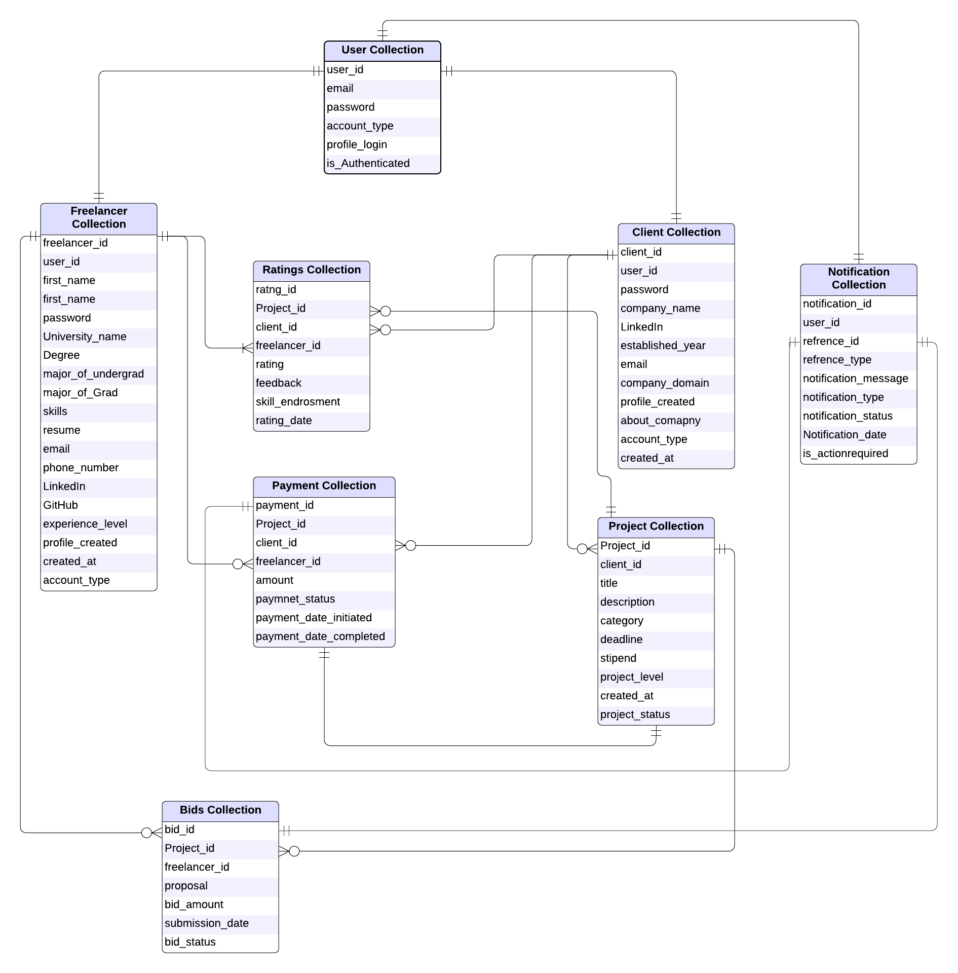

Slide 15
Project review 2 Continue…
6. External Data Usage
Email/Notification Service: User alerts for bids, payments, and project updates.
7. Task Distribution
Sandipkumar | Database schema design User authentication and role management
Hinal | GitHub setup and management Project posting and bidding system

Slide 16
Project review 2 Continue…
8. Challenges Faced
Database Structuring: Optimizing relations without performance issues.
9. Current Sprint Backlog (Short-term Plans)
Designing UI in figma or other designing tool.
Finalizing the API endpoints for core features.
Implementing a basic frontend UI for user interaction.
Developing the bidding system for freelancers.
Integrating notifications for bid status updates.
Testing authentication and security measures.

Slide 17
Project review 2 Continue…
10. GitHub Management Issues
Currently, no major issues with version control.
Ensuring proper branching strategy for feature development.
Conclusion
Significant progress has been made in database design and structuring.
Core functionalities like authentication, project posting, bidding, and payments are well-defined.
Next steps involve API development, frontend integration, and testing.
We are on track for the next project milestone!

Slide 18
Thank You

