Slide 1

Diabetic Retinopathy Classification
Presented By
Sandip Wagh

Slide 2
Abstract
In Global, diabetic retinopathy suffered patients growing vastly. And the fact is earliest stage could not diagnoses to normal eye vision.
Increasing necessity of finding a diabetic retinopathy as earliest would stops vision loss for prolonged diabetes patient although suffered youngs’.
A proposed deep learning approach such as Deep Convolutional Neural Network (DCNN) gives high accuracy in classification of these diseases through spatial analysis.

Slide 3
Research Papers
Classifying Diabetic Retinopathy using Deep Learning Architecture
By T Chandrakumar. And R Kathirvel
Link: https://www.ijert.org/research/classifying-diabetic-retinopathy-using-deep-learning-architecture-IJERTV5IS060055.pdf

Slide 4

Convolution Neural Network
CNN image classifications takes an input image, process it and classify it under certain categories.
Technically, deep learning CNN models to train and test, each input image will pass it through a series of convolution layers with filters, Pooling, fully connected layers (FC) and apply Softmax function to classify an object with probabilistic values between 0 and 1.

Slide 5
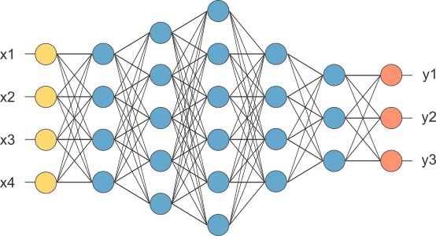
Continued...
Convolutional Layer
Strides
Padding
Non Linearity (ReLU)
Pooling Layer
Fully Connected Layer

Slide 6

Proposed Methodology
Data augmentation
Preprocessing
Deep Convolutional Neural Network Classification
Convolutional Layer
Pooling Layer
ReLULayer
Dropout layer
Fully connected Layer
Classification Layer

Slide 7
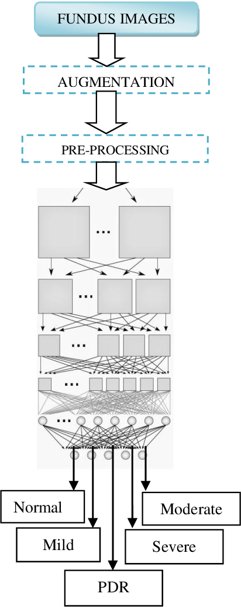
Continued...

Slide 8
Thank
You

