Slide 1
CAB RIDE ANTITD PRICE
TITANIC
SUBMIT BY –
Vikas Data
Al Wasi Khan
Sandipta Subir Khare

Slide 2
COLUMNS IN THE DATASET

Slide 3
Titanic was one of the biggest cruise ship of the world. Titanic, in full Royal Mail Ship (RMS) Titanic, British luxury passenger liner . In the early 1900s the transatlantic passenger trade was highly profitable and competitive, with ship lines vying to transport wealthy travelers and immigrants.
The objective of using regression is to predict the survival of passengers on titanic ship.
The Dataset which we had selected is labelled data and hence comes under the supervised learning technique. Classification is the problem of identifying to which of a set of categories (sub-populations) a new observation belongs, on the basis of a training set of data containing observations (or instances) whose category membership is known.
There are total number of 14 columns and 1310 rows labels included.

Slide 4
K-NEAREST NEIGHBORS(KNN) ALGORITHM: K-Nearest Neighbors (KNN) is one of the simplest algorithms used in Machine Learning for regression and classification problem. KNN algorithms use data and classify new data points based on similarity measures (e.g. distance function). Classification is done by a majority vote to its neighbors. The data is assigned to the class which has the nearest neighbors. As you increase the number of nearest neighbors, the value of k, accuracy might increase.
SUPPORT VECTOR MACHINE(SVM): Support Vector Machine(SVM) is quite different than other Regression models. Support Vector Regression tries to fit the best line within a predefined or threshold error value.
LOGISTIC ALGORITHM: Logistic Classifier is a ‘Statistical Learning’ technique categorized in ‘Supervised’ Machine Learning (ML) methods dedicated to ‘Classification’ tasks. It has gained a tremendous reputation for last two decades especially in financial sector due to its prominent ability of detecting defaulters.

Slide 5
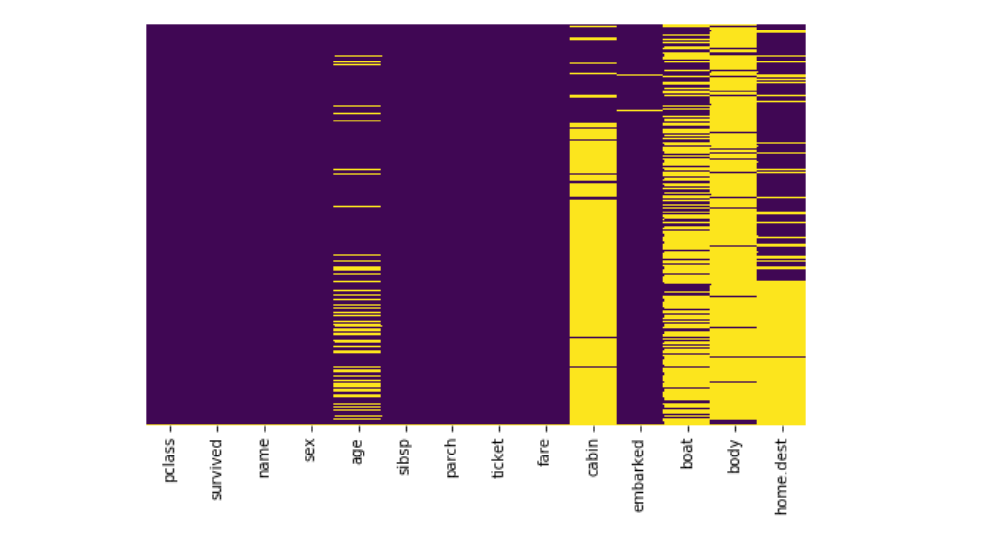
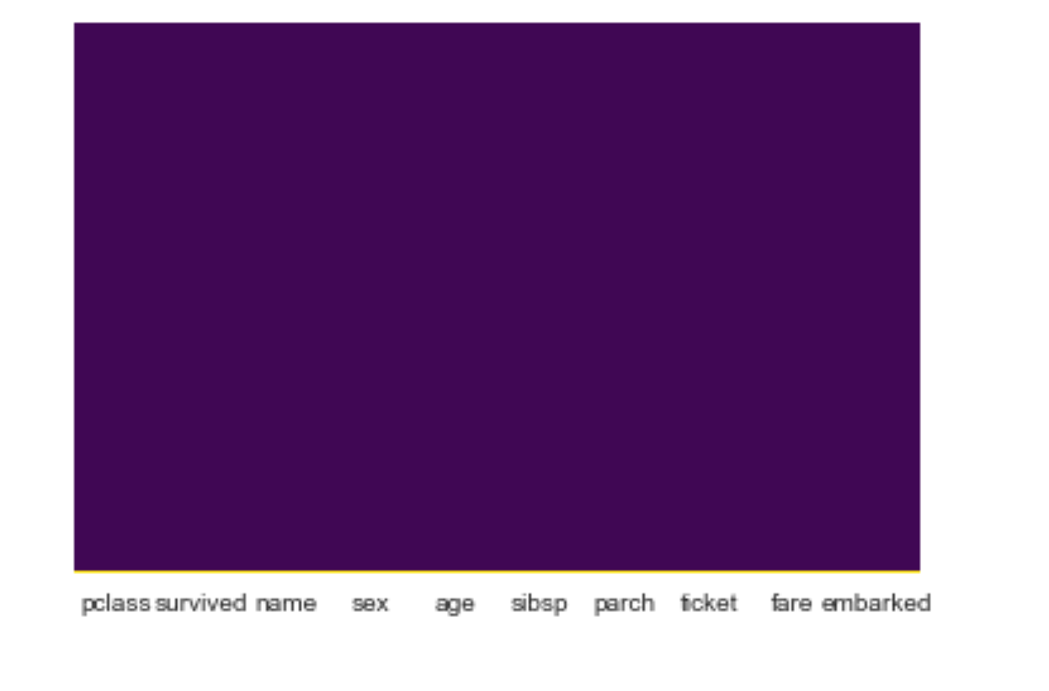
EDA- The left Image contains many nan values in different columns such as Age, cabin, boat, body and home.dest. Whereas in right image, we have cleared all the nan values.

Slide 6
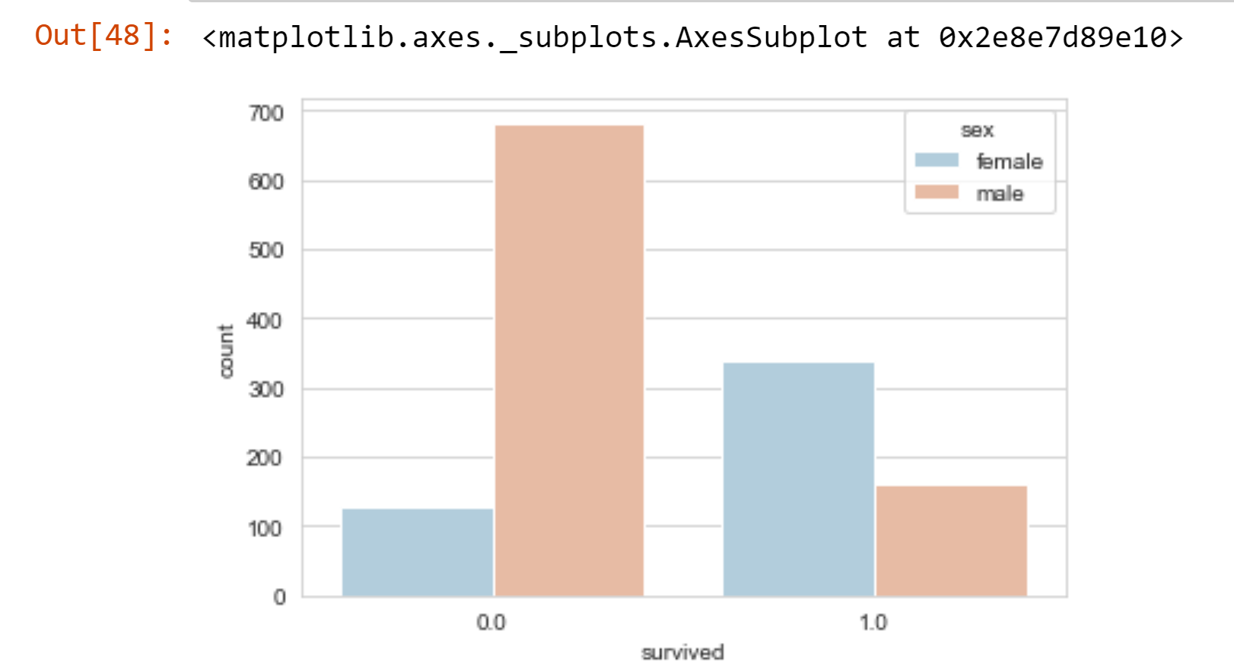
MAXIMUM of people who didn’t Survived

Slide 7
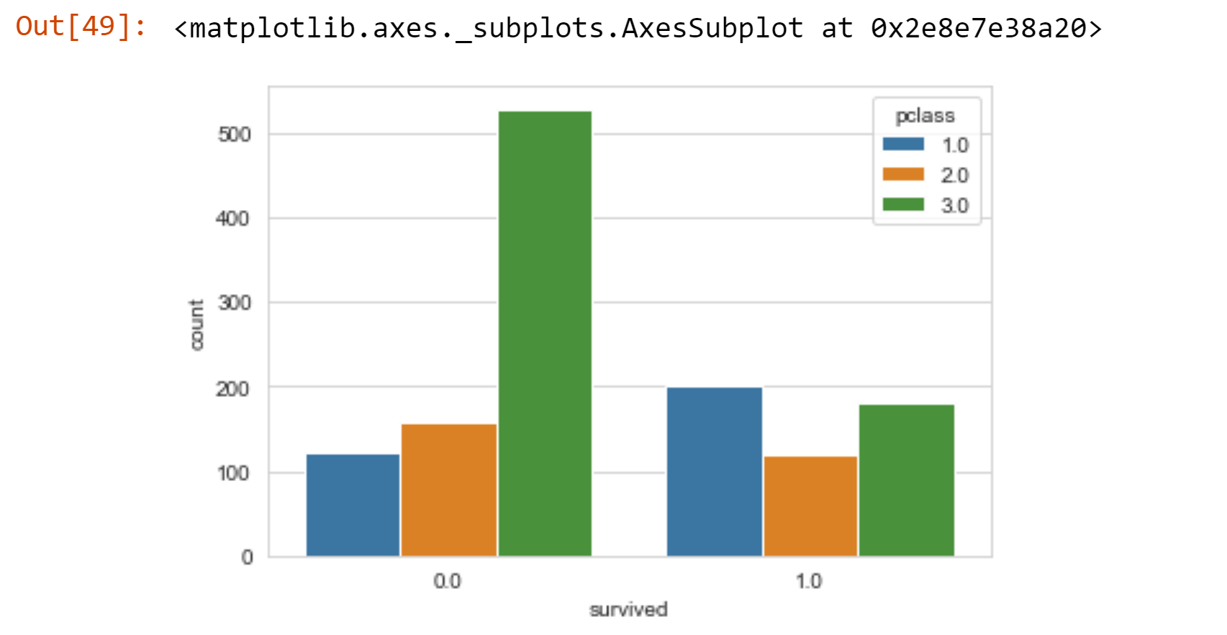
MAXIMUM OF PEOPLE WHO SURVIVED

Slide 8
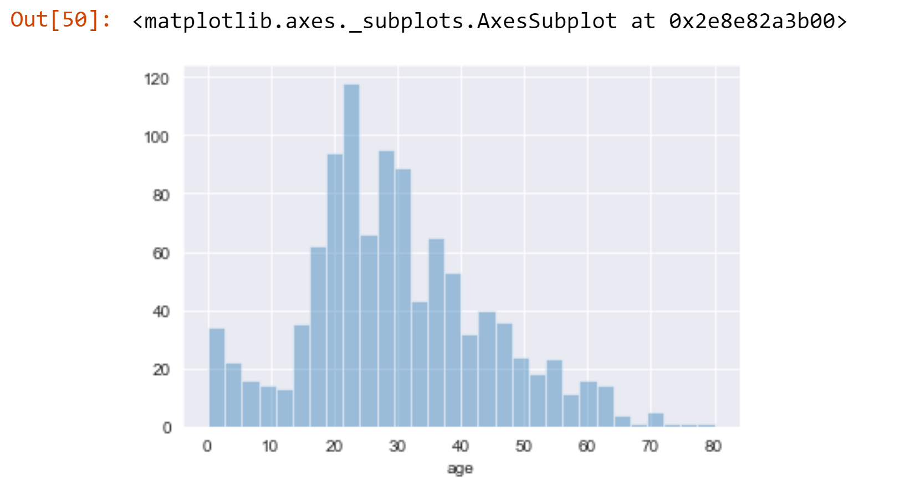
Distribution of people on base of age group

Slide 9
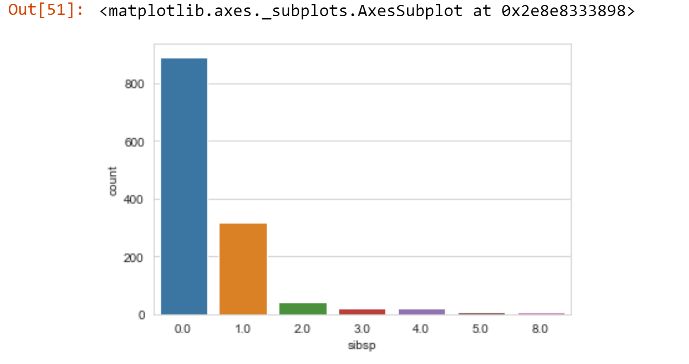
Distribution of people on base of SINGLE WITH NO SPOUSE OR CHILDREN, Category 1 are probably married couples

Slide 10
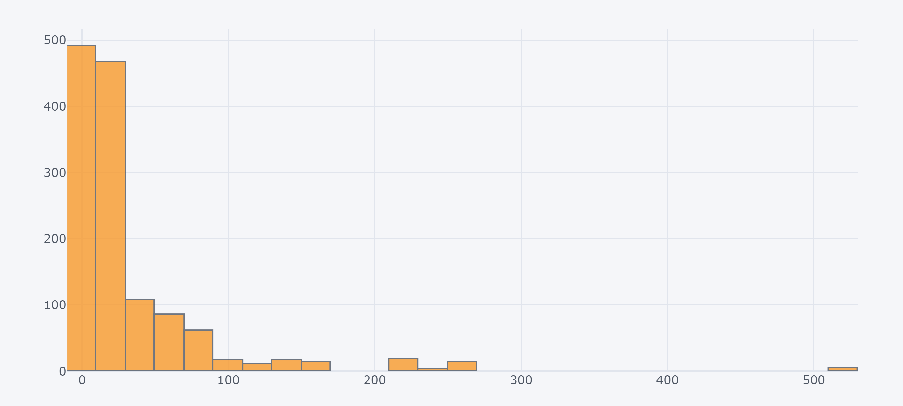
MOST TICKETS SOLD

Slide 11
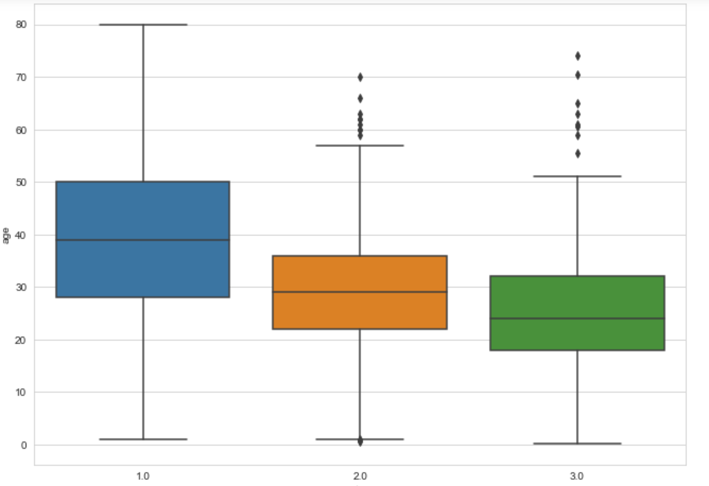
CLEANING OF DATA

Slide 12
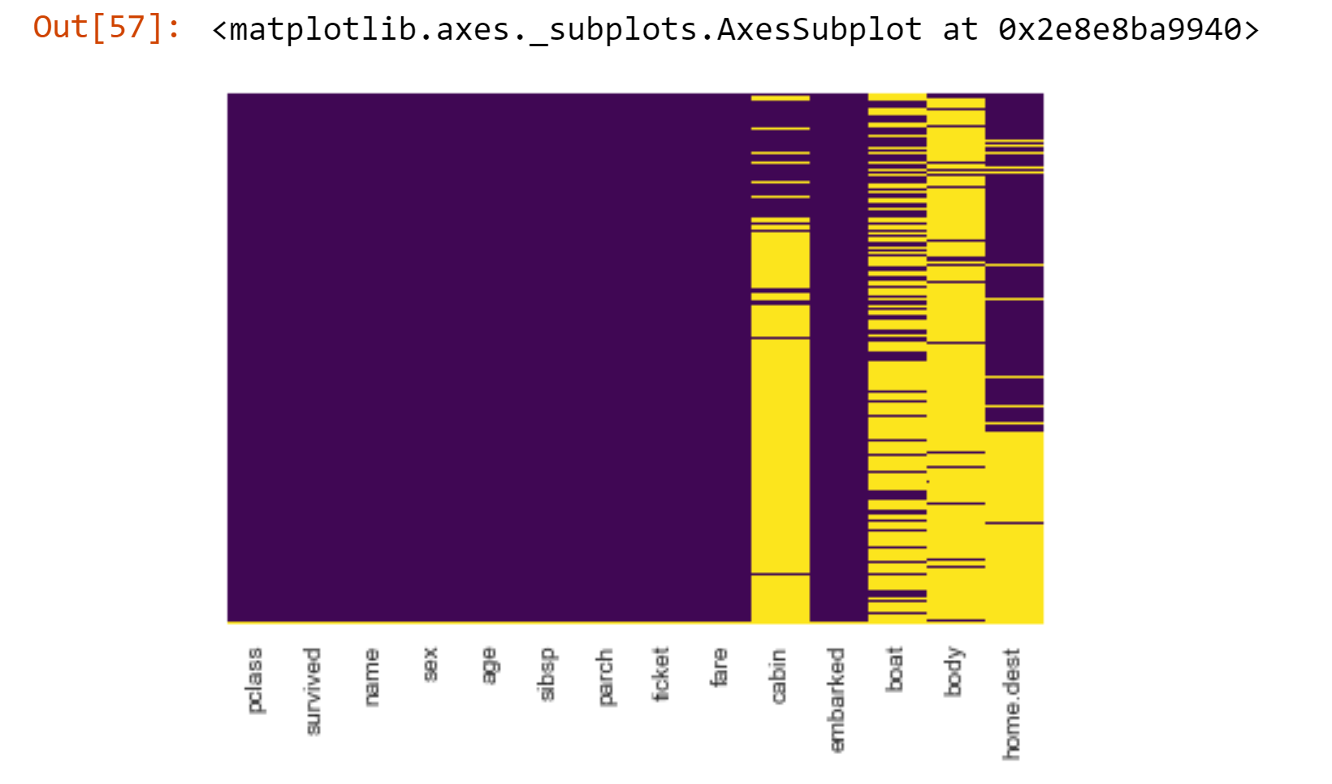
FILLING OF NULL VALUE in AGE COLUMN

Slide 13
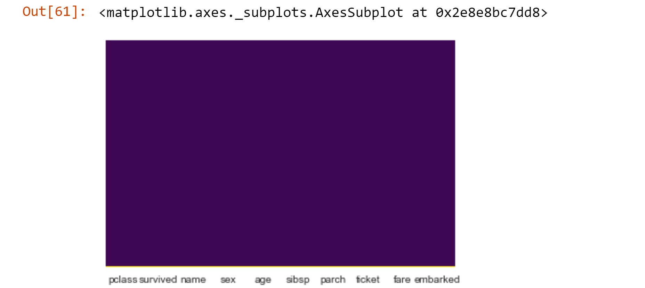
FILLING ALL THE NULL VALUES IN REMAINING COLUMS

Slide 14
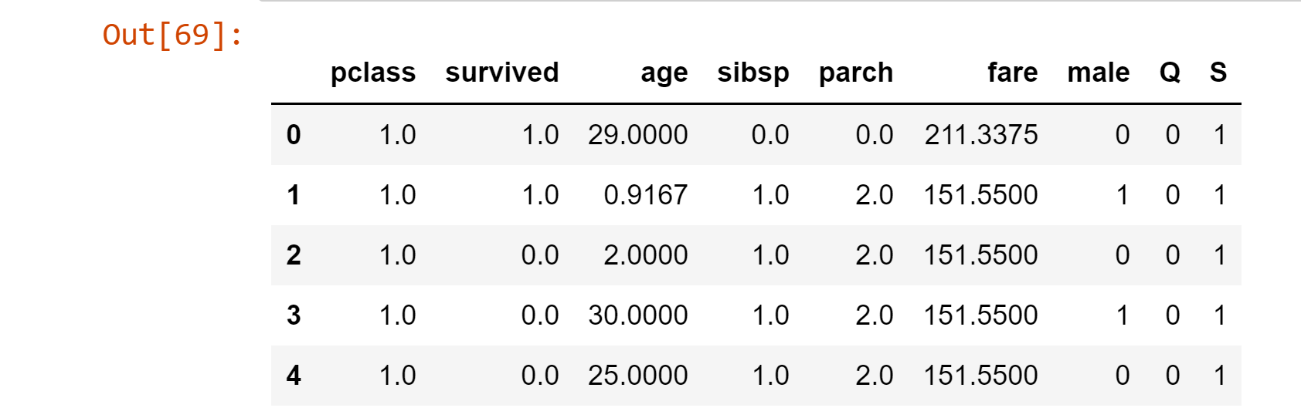
MODELS APPLIED ON COLUMNS

Slide 15
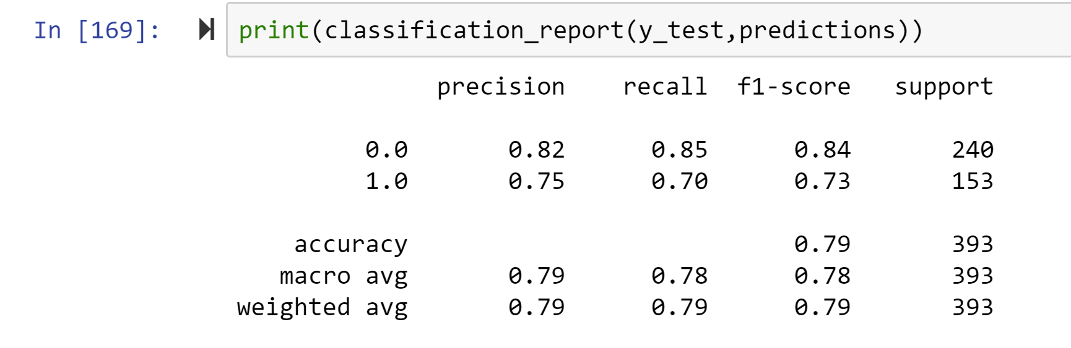
LOGISTIC REGRESSION ACURACY

Slide 16
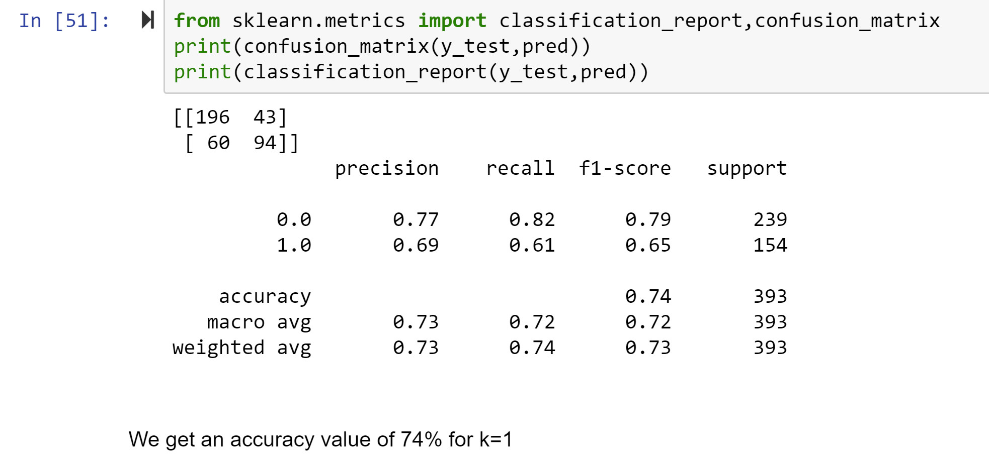
KNN ALGORITHM CLASSIFICATION REPORT AND CONFUSION MATRIX

Slide 17
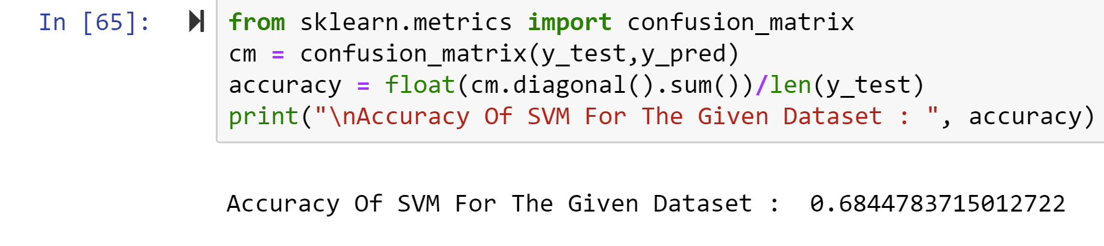
SVM ACCURACY

Slide 18
CONCLUSION

