Slide 1
Module 5 Data Visualization and Dashboard Implementation
Lesson 1: Executive Interview with Matthew Caton of Data Source Consulting

Slide 2
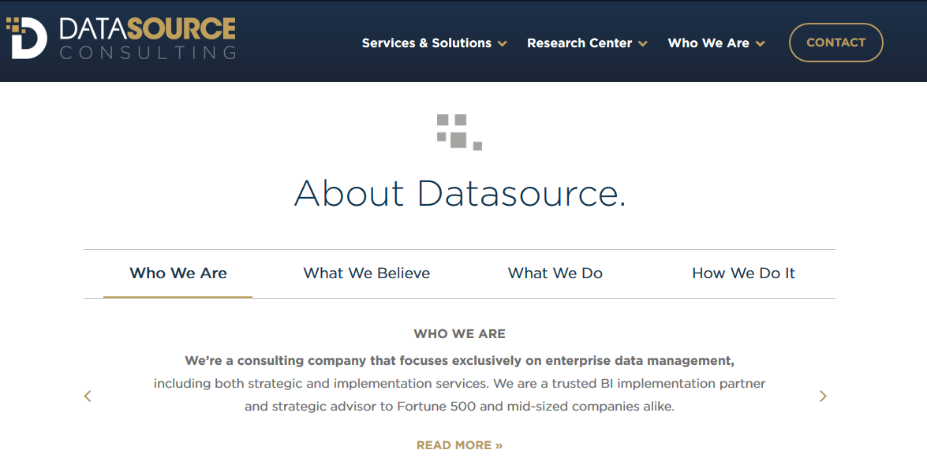
About Datasource

Slide 3
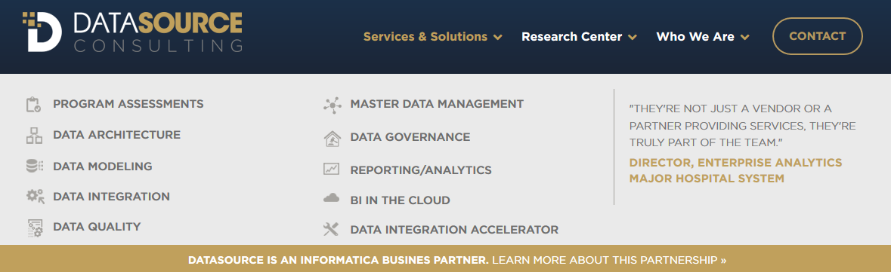
Services, Solutions & Timeline
Notes:
What is a typical consulting engagement that you have conducted at Data Source consulting?
What problems can you provide assistance for your clients?
What skills do you and your team possess to conduct the engagement?

Slide 4
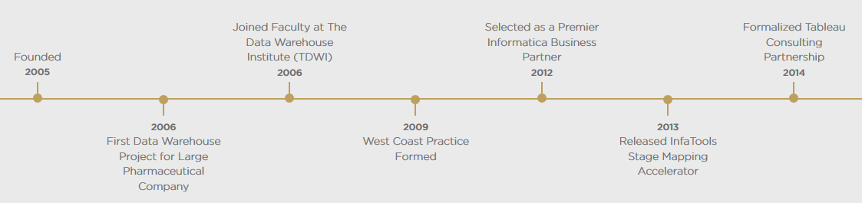
Timeline for Data Source Consulting
Notes:
What is a typical consulting engagement that you have conducted at Data Source consulting?
What problems can you provide assistance for your clients?
What skills do you and your team possess to conduct the engagement?

Slide 5


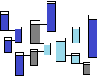


Where does BI fit in?
Source
Acquisition
Integration
Dimensional
Presentation
“Rescue” the data
-- Land
-- Possibly Stage
-- Build to Scale
-- Define keys
-- Conform data
-- Cleanse data
-- Track History
-- Attempt to MASTER
-- Prepare for
Reporting & Analytics
-- Prepare for
efficient consumption
by BI tools
Finance
Marketing
Operations
Acquisition
Integration
Dimensional
Sales
HR
Industry
Comps

Slide 6








BI & Analytics Build Continuum
Data Mart
Semantic
Reporting
Data Governance
Application Server
Presentation Server
Work Station
Security & Access Control
Model Purpose
Web
Mobile
Email
Database Server
Reporting
Self-Service
Self-Service Analysis
Tables
Views
1 : 1
Model Types
Gold Standard Reporting
Relational
Multi-dimensional
DMR
Report Types
Dashboards
Canned Reports
Guided Analytics
Triggered Events
Validation
1 : 1
Notes:
What best practices are major challenges for organizations in a typical consulting engagement?

Slide 7
Core Consulting Skills
SQL coding
Connect with client
Understand client’s business
Deliver solutions faster

Slide 8
Lessons from BI Consulting
Apply tools to client needs
Manage disruption between established and analytic tools
Apply governance to manage tool usage

Slide 9






Tool Usage
Traditional enterprise reporting tools
Advanced analytic tools

