Slide 1
PROJECT C – Kubernetes cluster
Container deployment on K3s with docker hub integration & Monitoring
Docker Hub integration · kube-prometheus-stack · Grafana dashboards
Presented by Sandra Kinya Gikundi
TCS DevOps Internship Program 2025
Notes:
Welcome everyone. Today I'm presenting the final sprint of Project C — the local Kubernetes cluster project. This sprint focused on three things: getting real monitoring in place with Prometheus and Grafana, integrating a real cloud container registry with Docker Hub, and finalizing documentation. I'll walk through the architecture, show you the Helm chart structure, and then run two live demos: pulling an image from Docker Hub into the cluster, and demonstrating self-healing and scaling live on the Grafana dashboard.

Slide 2
Sprint Objectives
What this sprint set out to achieve
1
Install kube-prometheus-stack via Helm
2
Confirm Prometheus scrapes the app's /metrics endpoint
Prometheus, Grafana, Alertmanager, and exporters deployed into a dedicated `monitoring` namespace.
ServiceMonitor wired to the app's Service, verified UP on the Targets page.
3
Build Grafana dashboards
4
Test self-healing, scaling, and alerting
Custom app metric, request rate, CPU/memory usage, pod restarts, and running pod count.
Live validation, not just installation — proof the stack actually works.
5
Integrate Docker Hub with k3s
6
Optional tasks
Replaced local-only image imports with a real cloud registry pull.
SBOM report
Project C — Local Kubernetes Cluster (k3s)
2
Notes:
Six concrete objectives for this sprint. The key shift from earlier sprints is that this one is about proving things work in practice — scraping, dashboards, and alerts — not just installing software. We also added a genuine cloud element with Docker Hub, and closed out with full documentation so the project is reproducible by someone else.

Slide 3
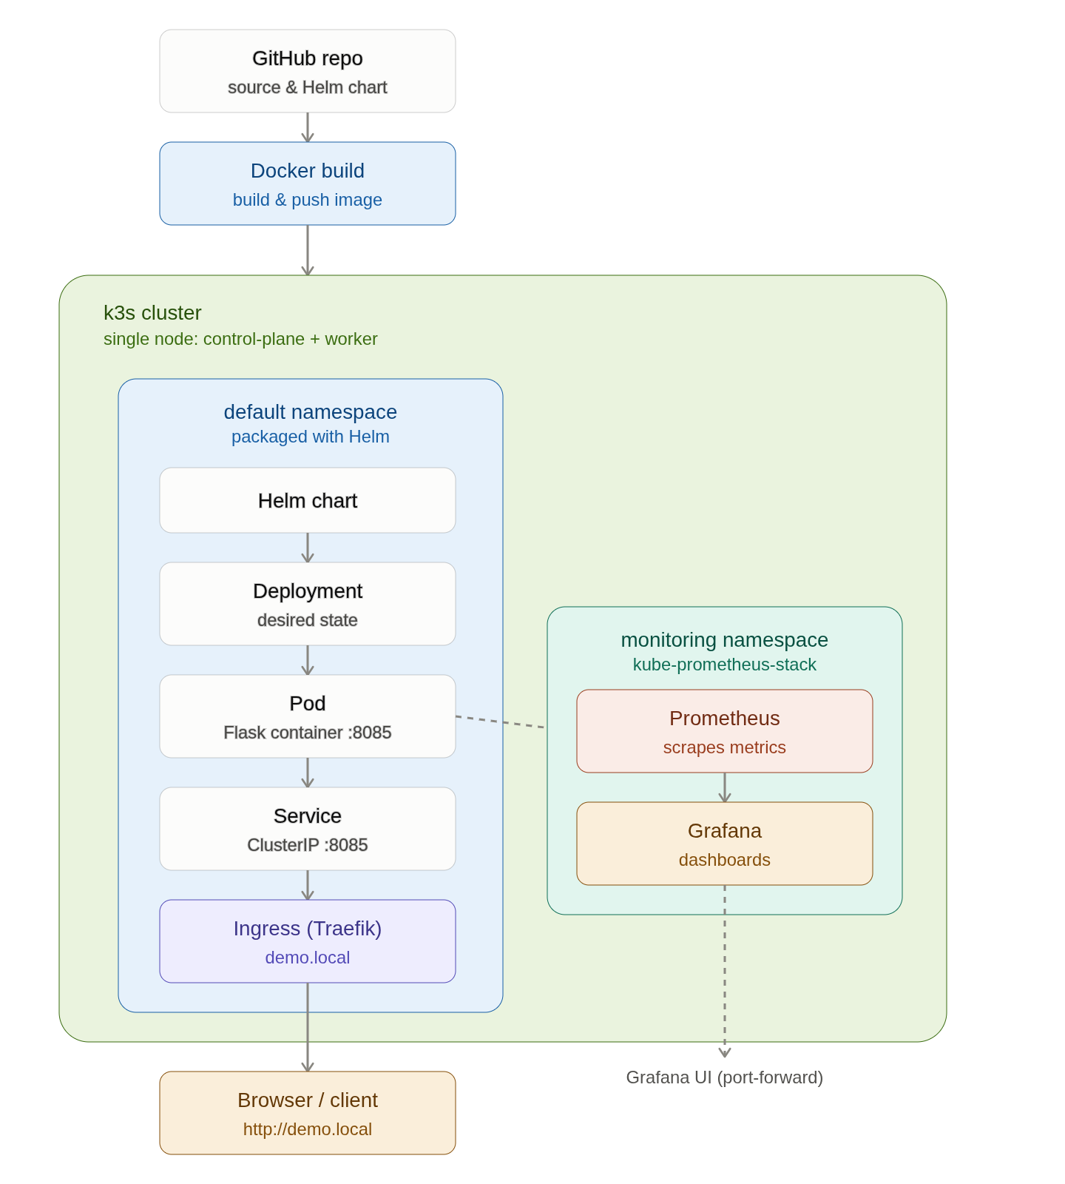

Slide 4
Architecture Overview
How the app, k3s cluster, Docker Hub, and monitoring stack fit together
Image is built locally, then pushed to Docker Hub (cloud registry)
Docker Hub
k3s pulls the image directly from Docker Hub — no local import step
k3s cluster
Helm facilitates the Deployment, Service, ConfigMap, and Ingress
Pod + Service
Prometheus +
Grafana
Traefik Ingress routes demo.local traffic to the Service
Flask app :8085
Ingress (Traefik)
scrapes /metrics
Prometheus scrapes the app's /metrics via a ServiceMonitor
Grafana visualizes metrics; Alertmanager tracks alert state
Browser / Client
Project C — Local Kubernetes Cluster (k3s)
3
Notes:
This is the full picture end to end. On the left is the flow in words; on the right is where I'll drop in the architecture diagram we built earlier — showing the whole chain from a code push, through Docker Hub, into the k3s cluster, out through Traefik to the browser, and sideways into Prometheus and Grafana for observability. Worth noting this is a single-node cluster acting as both control-plane and worker.

Slide 5
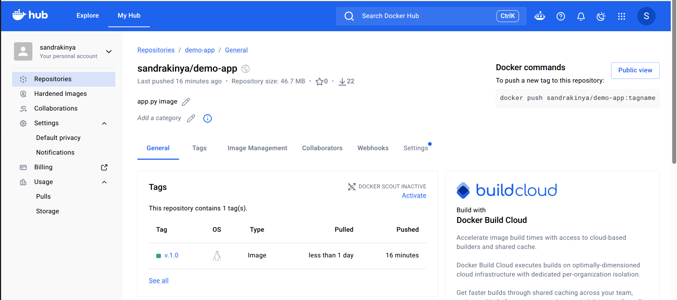
Docker Hub Integration
Build → push → pull, replacing local-only image imports
1
2
3
4
Build
→
Push
→
Pull
→
Run
docker build -t
sandrakinya/demo-app:v.1.0 .
docker push
sandrakinya/demo-app:v.1.0
k3s pulls the image
over the network
Pod starts using the
cloud-hosted image
Key config change: pullPolicy: Never → pullPolicy: IfNotPresent values.yaml
This tells Kubernetes to pull from the registry when the image isn't already cached locally — the exact mechanism that makes cloud delivery work.
Project C — Local Kubernetes Cluster (k3s)
4
Notes:
Previously we were importing images directly into containerd with docker save piped to k3s ctr images import — that only works on the machine that built the image. Pushing to Docker Hub means any machine, or any teammate, can pull the same image. The one config change that matters is the pull policy — from Never to IfNotPresent.

Slide 6
kube-prometheus-stack Installation
One Helm chart, five components, one dedicated namespace
1
Prometheus
Collects and stores metrics from the cluster and the app
Deployed with:
kubectl create namespace
monitoring
helm install monitoring
prometheus-community/
kube-prometheus-stack
-n monitoring
2
Grafana
Visualizes metrics as dashboards
3
Alertmanager
Tracks alert state — Inactive, Pending, Firing
4
Node Exporter
Exposes host-level CPU/memory metrics
Isolated in its own namespace for clean separation from the app and easy cleanup.
5
kube-state-metrics
Exposes Kubernetes object state — pods, deployments, replicas
Project C — Local Kubernetes Cluster (k3s)
6
Notes:
One Helm install brought in five components at once. We deliberately put this in its own monitoring namespace, separate from where the app itself runs — that keeps kubectl get pods readable and means we can tear the whole monitoring stack down cleanly with one namespace delete if we ever needed to.

Slide 7
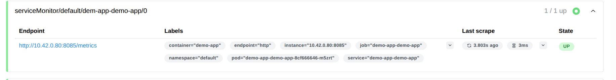
Prometheus Scraping Configuration
How ServiceMonitor discovers and scrapes /metrics
Service
ServiceMonitor
Prometheus Operator
Prometheus
Labeled app: demo-app
→
matchLabels: app: demo-app
endpoint: /metrics, every 15s
→
Watches for ServiceMonitors
labeled release: monitoring
→
Scrapes the target,
shows status UP
Expose metrics end point and is labeled demo-app
Looks for services with that label and tells Prometheus where and how often to scrape the metrics.
Expose metrics end point and is labeled demo-app
Expose metrics end point and labeled demo-app
Setup:
The Service needs a metadata.labels block (not just spec.selector).
A ServiceMonitor matches the Service's own labels, not its pod selector.
Insert screenshot
Prometheus /targets page — demo-app-demo-app shown as UP
Project C — Local Kubernetes Cluster (k3s)
7
Notes:
This is the piece that took the longest to debug, so it's worth walking through carefully. A ServiceMonitor doesn't look at where the Service sends traffic — it looks at the Service's own label. We had the app label on the pod selector but not on the Service's own metadata, so Prometheus found zero matching targets until we added it.

Slide 8
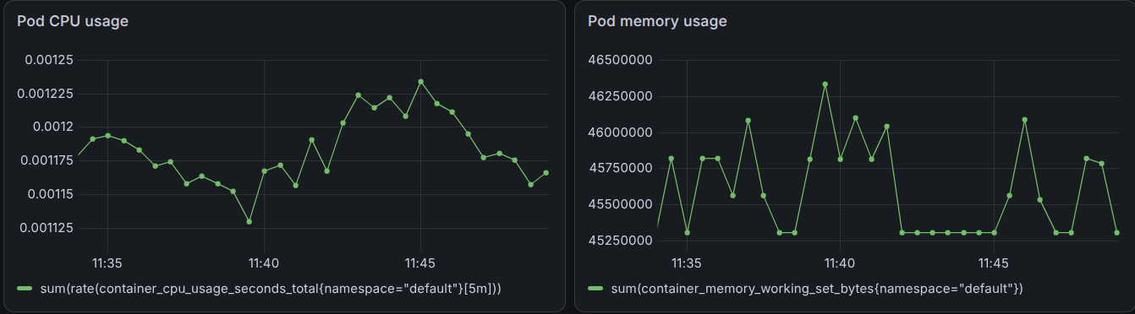
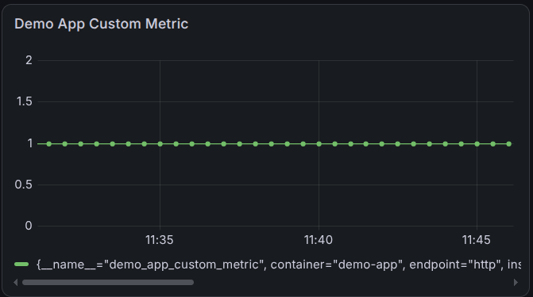
Grafana Dashboards
Live custom application metric alongside cluster resource usage
Project C — Local Kubernetes Cluster (k3s)
8
Notes:
Four panels on one dashboard: the custom app metric, cluster CPU and memory usage, a live request-rate view, and pod health. I generated real traffic before this presentation so the graphs show actual movement rather than a flat line — I'll drop the real screenshots in here.

Slide 9
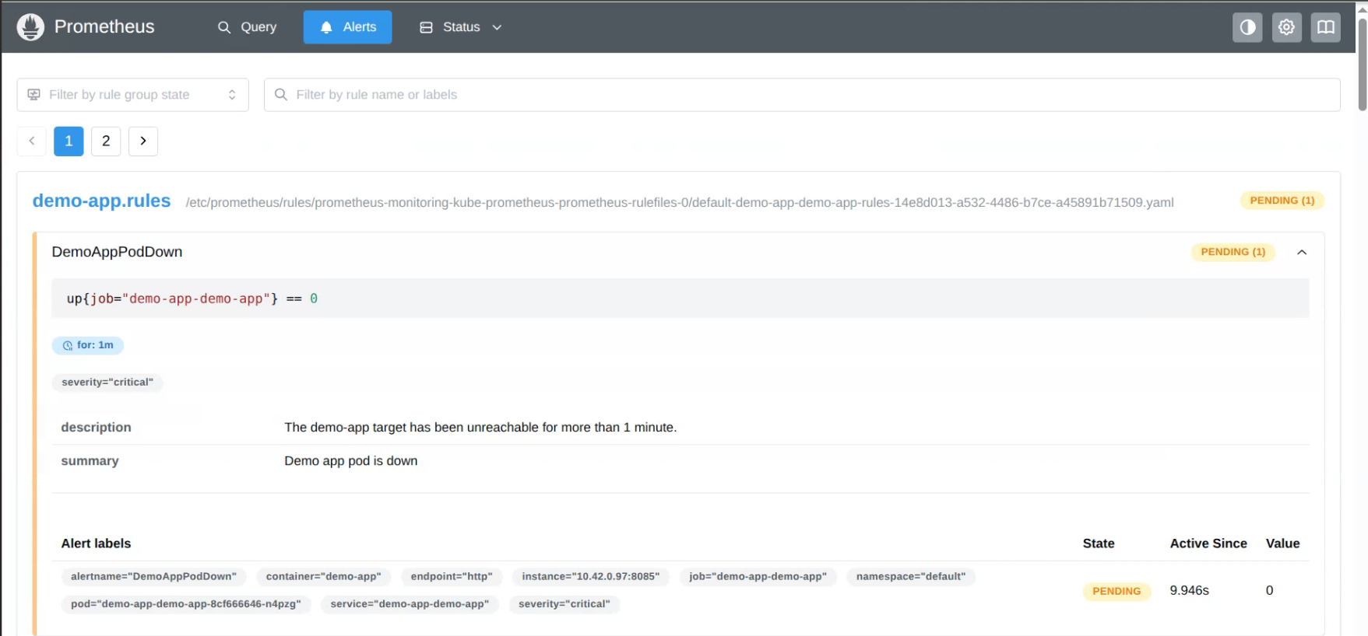
Testing & Validation
1
Self-healing
2
Scaling
3
Alert firing
Deleted a running pod — Kubernetes recreated it automatically within seconds.
Scaled from 1 → 3 replicas, confirmed all healthy, scaled back down.
Scaled to 0 replicas — DemoAppPodDown alert progressed Inactive → Pending → Firing.
Project C — Local Kubernetes Cluster (k3s)
9
Notes:
These three tests are the actual demo I'll run live in a moment. Self-healing and scaling both show up visibly on the Grafana dashboard as they happen. The alert test is the most convincing one — it proves the whole chain from a real outage to a fired alert actually works, not just that Prometheus and Grafana are running.

Slide 10
Summary & Next Steps
Completed
Next Steps
Monitoring stack installed and scraping confirmed
Grafana dashboards built (app + cluster metrics)
Alerting configured and tested end to end
Docker Hub integrated — real cloud registry pull
Documentation finalized: architecture, setup, chart
Create a new environment (UAT or DEMO)
Separate environment specific configuration
Parameterize Helm deployments
Create environment specific deployment scripts
Verify deployments
Validate monitoring
Update the project structure
Eliminate vulnerabilities
Thank you — questions welcome.
Notes:
To close: the sprint delivered a working, tested monitoring stack, a real cloud registry integration, and documentation that would let someone else reproduce this from scratch. The next steps are mostly about hardening — real alert routing, private registry auth, and broader alert coverage. Happy to take questions.

