Slide 1
TCS DEVOPS INTERNSHIP 2025 · FINAL PRESENTATION
Project C: Deploying an app to K3s Cluster.
Flask app → Helm → k3s → Prometheus & Grafana, with Docker Hub delivery and multi-environment support
Presented by Sandra Kinya Gikundi
Repo: tcsdevopsintern/Sandra_tcs-devop-project-C
Notes:
Introduce the project: a Flask app deployed to a local k3s cluster, packaged with Helm, monitored with Prometheus and Grafana — plus several additional tasks completed beyond the base requirements.

Slide 2
Deliverables Across Sprints
Sprint 1
Sprint 2
Sprint 3
Installation, App Running & Helm charts
Monitoring & Docker hub(Optional)
Installed kube-prometheus-stack (Prometheus, Grafana, Alertmanager) in a dedicated monitoring namespace
Setup ServiceMonitor to scrape the app's /metrics endpoint
Built Grafana dashboards: custom metric, request rate, CPU/memory, pod restarts, running pods
Created and tested PrometheusRule alert (Inactive → Pending → Firing)
Added persistent storage (PVCs) for Prometheus and Grafana
Created a secret for grafana credentials
Pushed image to Docker Hub.
Set up cluster to pull from the cloud registry
Optional tasks: uat env, Makefile & fine tuning
Wrote a script which creates a new namespace, deploys app & cleans up uat env. (Dynamic per-PR uat environment using NodePort-based)
Added an environment filter to grafana dashboard so that it is possible to toggle between dev and UAT views.
Exported Grafana dashboards as JSON, stored them in Git, and provisioned them through a ConfigMap.
Created a Makefile to wrap a sequence of manual commands into single commands (Improving automation)
Generated SBOM report via Trivy (CycloneDX format)
Added pod and container security: run as non-root, and disable privilege escalation.
Added liveness and readiness probes.
Installed k3s and Helm; verified cluster with kubectl get nodes
Built Flask app (app.py) with / and /metrics routes
Created Dockerfile
Created Helm chart: Chart.yaml, values.yaml, _helpers.tpl, deployment.yaml, service.yaml
Deployed the app via kubectl port-forward
Added ingress.yaml with Traefik annotation, exposed app via demo.local
Added ConfigMap for configurable app greeting
Practiced full Helm lifecycle: upgrade, rollback, uninstall, reinstall
Added CPU/memory requests and limits to protect other workloads
Local Kubernetes Cluster (k3s) — Final Presentation
2
Notes:
Sprint 1 established the working foundation — app, image, chart. Sprint 2 hardened it with Ingress, security context, and probes. Sprint 3 added the full observability layer plus every additional task: Docker Hub, UAT, dynamic environments, SBOM, and workflow automation.

Slide 3
Project deliverables: Required vs Delivered
Base project scope, fully met, plus additional tasks completed
Required Deliverables
✓
Functional k3s cluster (single node, control-plane + worker)
✓
App accessible via Ingress (Traefik, demo.local) and kubectl port-forward
✓
Multi-container-ready app deployed via Helm
✓
Grafana dashboards for app metrics and container/cluster resource usage
Optional / Additional Tasks Delivered
✓ ConfigMap for dynamic app greeting
✓ Docker Hub cloud registry integration
✓ Prometheus alert rule (PrometheusRule) tested live
✓ Persistent storage (PVCs) for Prometheus & Grafana
✓ Pod/container security context (non-root, disable privilege escalation)
✓ Dynamic uat environment script (NodePort)
✓ CPU/memory requests & limits
✓ UAT environment (separate namespace + values file)
✓ Liveness & readiness probes
✓ SBOM report via Trivy (CycloneDX format)
✓ Full Helm lifecycle tested (upgrade/rollback/uninstall)
✓ Resource utilization checks (kubectl top)
✓ Created a make file
Local Kubernetes Cluster (k3s) — Final Presentation
3
Notes:
The base assignment required four things — all delivered. Beyond that, twelve additional tasks were completed: from security hardening and persistent storage to multi-environment deployment and vulnerability scanning.

Slide 4
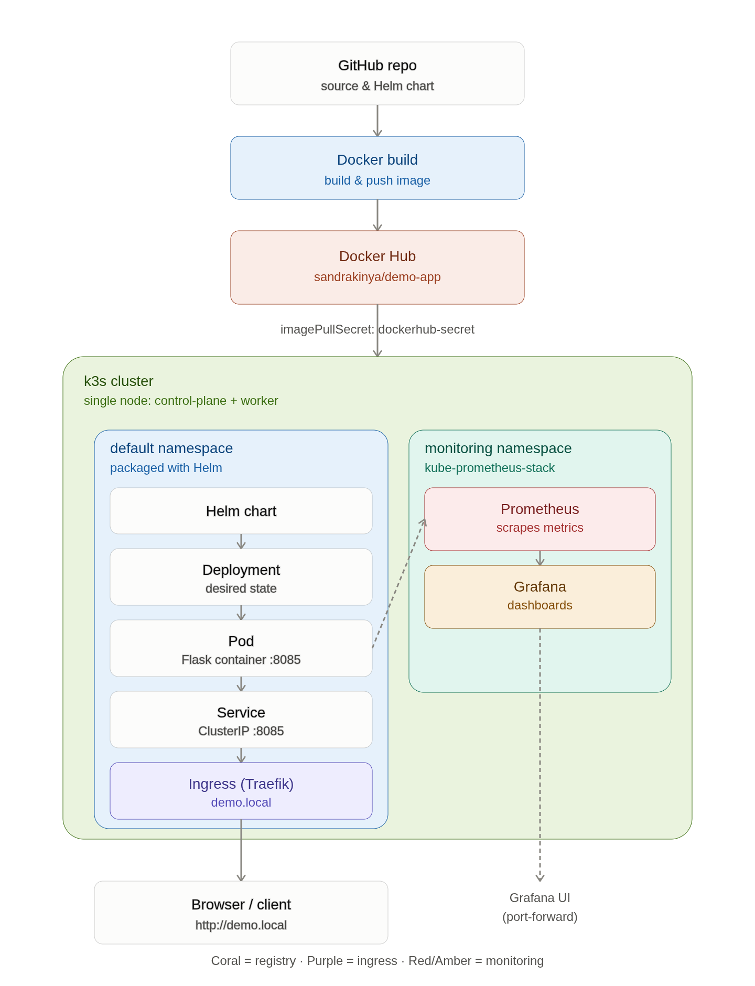
Project Architecture
Full pipeline: source → build → registry → cluster → observability
Diagram covers: GitHub → Docker build → Docker Hub → k3s cluster (Helm-managed Deployment, Service, Ingress) → Prometheus/Grafana → dev/UAT/dynamic environments
Local Kubernetes Cluster (k3s) — Final Presentation
4
Notes:
This is the full architecture diagram already committed to the repo README — covering the build pipeline, cluster internals, and the observability layer in one view.

Slide 5
Docker & Containerization
Flask app packaged into a minimal, non-root container image
app.py — key routes
FROM python:3.12-slim
WORKDIR /app
COPY app/app.py .
RUN pip install flask
EXPOSE 8085
RUN useradd -m appuser
USER appuser
CMD ["python", "app.py"]
GREETING = os.environ.get(
'APP_GREETING', 'Hello...')
request_count = 0
@app.route('/metrics')
# returns text/plain,
# demo_app_custom_metric N
Every request to / increments request_count — makes the custom metric dynamic, not static.
Dockerfile — non-root user added for k8s security context compatibility
docker build -t demo-app:v.1.0 .
Local Kubernetes Cluster (k3s) — Final Presentation
5
Notes:
The /metrics route required an explicit text/plain Content-Type — Flask defaults to text/html, which Prometheus rejected as an unsupported content type until fixed.

Slide 6
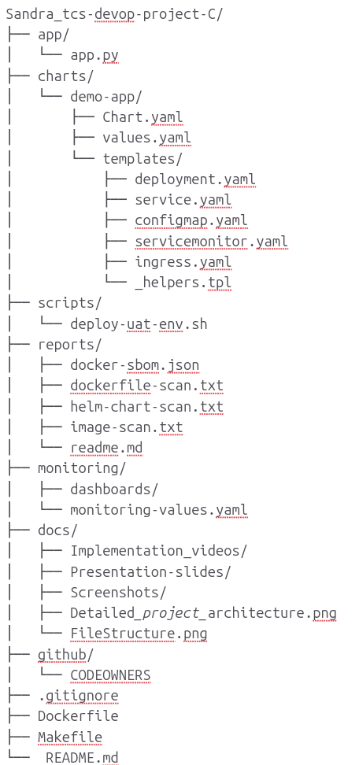
Helm Chart Structure
charts/demo-app/ — one values file, one naming source, eight templates
Chart.yaml
values.yaml
_helpers.tpl
deployment.yaml
Defines the chart identity, name, and version information.
Stores the configurable settings used across the Helm chart.
Provides reusable naming templates for consistent Kubernetes resource names.
Defines the application Pods, container image, resources, probes, and security settings.
service.yaml
ingress.yaml
configmap.yaml
servicemonitor.yaml
Exposes the application internally through a Kubernetes Service.
Provides external access to the application through the demo.local host.
Stores non sensitive application configuration such as APP_GREETING.
Configures Prometheus to scrape metrics from the application.
prometheusrule.yaml
Defines the DemoAppPodDown alert for detecting application Pod failures.
{{- define "demo-app.fullname" -}}
{{- .Release.Name -}}-{{- .Chart.Name -}}
{{- end -}}
Not built-in — {{ include }} only works because this file defines it. Keeps Deployment, Service, and Ingress names in sync automatically.
Local Kubernetes Cluster (k3s) — Final Presentation
6
Notes:
Nine files, each with one job. _helpers.tpl is the piece most worth explaining — Helm's include function only works because this file defines the naming logic, which is what kept Deployment, Service, and Ingress names consistent throughout the project.

Slide 7
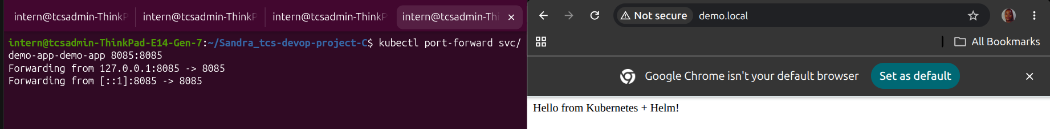
Port forwarding & Ingress
Single-node cluster, Traefik routes demo.local to the Service
ingress.yaml — Traefik annotation
curl -sfL https://get.k3s.io | sh -
sudo k3s kubectl get nodes
ROLES: control-plane (single node)
metadata:
annotations:
kubernetes.io/ingress.class: traefik
spec:
rules:
- host: {{ .Values.ingress.host
| default "demo.local" }}
kubectl port-forward vs Ingress
kubectl port-forward svc/demo-app-demo-app \
8085:8085
curl http://demo.local/
curl http://demo.local/metrics
Hostname parameterized so the same chart serves demo.local (dev) and uat.demo.local (UAT).
Local Kubernetes Cluster (k3s) — Final Presentation
9
Notes:
k3s bundles control-plane and worker onto one node. Traefik ships as k3s's default Ingress — the hostname was later parameterized to support UAT without duplicating the chart.

Slide 8
Monitoring Stack Installation
kube-prometheus-stack in an isolated namespace, with persistence.
Persistent storage override (monitor-values.yaml)
helm repo add prometheus-community \
https://prometheus-community.github.io/helm-charts
kubectl create namespace monitoring
helm install monitoring \
prometheus-community/kube-prometheus-stack \
-n monitoring
grafana:
persistence: { enabled: true, size: 1Gi }
prometheus:
prometheusSpec:
storageSpec: { ... storage: 2Gi }
Isolated namespace: clean kubectl get pods, and clean teardown.
Default was ephemeral (emptyDir) — dashboards and metrics history would be lost on pod restart without this.
Access commands
kubectl port-forward svc/monitoring-kube-prometheus-prometheus -n monitoring 9091:9090
kubectl port-forward svc/monitoring-grafana -n monitoring 3001:80
Local Kubernetes Cluster (k3s) — Final Presentation
10
Notes:
One Helm install brings in Prometheus, Grafana, Alertmanager, and exporters. Persistence was added afterward as an optional task, once it became clear the default storage was ephemeral.

Slide 9
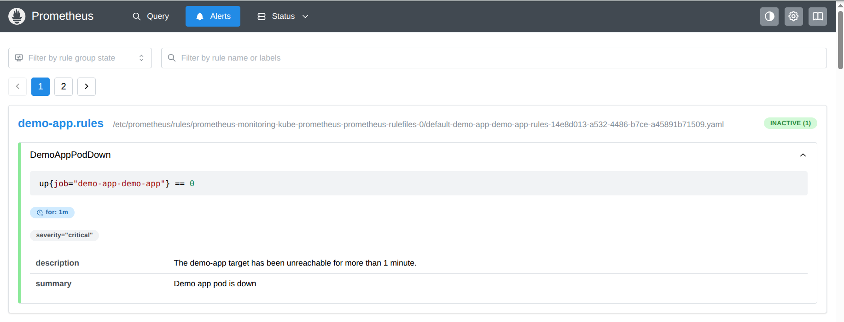
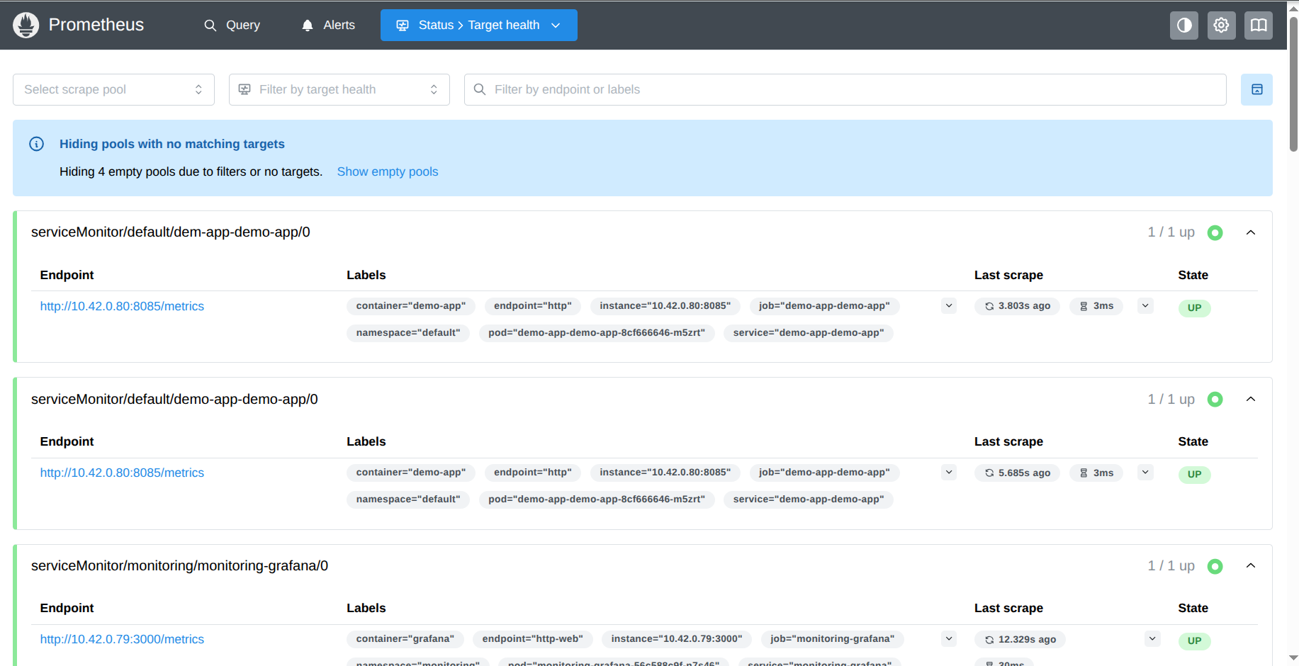
Prometheus Scraping & Alerting
ServiceMonitor discovery + PrometheusRule alert, tested live
kind: ServiceMonitor
spec:
selector:
matchLabels: { app: demo-app }
endpoints:
- port: http
path: /metrics
interval: 15s
kind: PrometheusRule
spec:
- alert: DemoAppPodDown
expr: up{job="demo-app-demo-app"}==0
for: 1m
labels: { severity: critical }
Test: kubectl scale deployment demo-app-demo-app -n default --replicas=0
Alert progressed Inactive → Pending → Firing after the full 1-minute threshold, then cleared automatically on restore.
Local Kubernetes Cluster (k3s) — Final Presentation
11
Notes:
The debugging story worth telling: a ServiceMonitor matches the Service's own labels, not its pod selector — that gap cost the most time to find. The alert was proven end to end, not just installed.

Slide 10
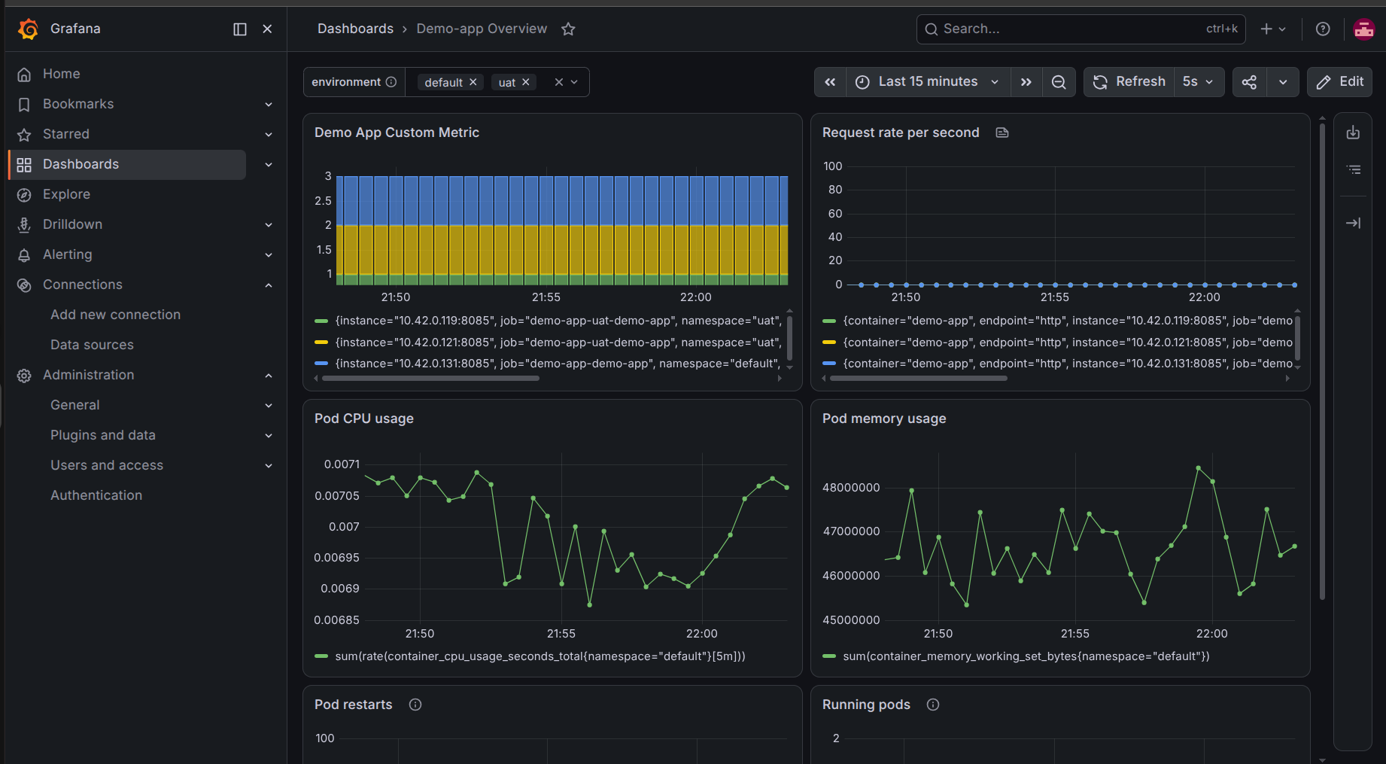
Grafana Dashboards
Six PromQL panels — custom app metric plus cluster resource usage
Demo App Custom Metric
demo_app_custom_metric
Request Rate (per second)
rate(demo_app_custom_metric[1m])
Pod CPU Usage
sum(rate(container_cpu_usage_seconds_total{namespace="default"}[5m]))
Pod Memory Usage
sum(container_memory_working_set_bytes{namespace="default"})
Pod Restarts
kube_pod_container_status_restarts_total{namespace="default"}
Running Pods
count(kube_pod_status_phase{namespace="default", phase="Running"})
Local Kubernetes Cluster (k3s) — Final Presentation
12
Notes:
Six panels, all PromQL-driven, live during the demo — Pod Restarts and Running Pods are the two that visibly react during self-healing and scaling tests.

Slide 11
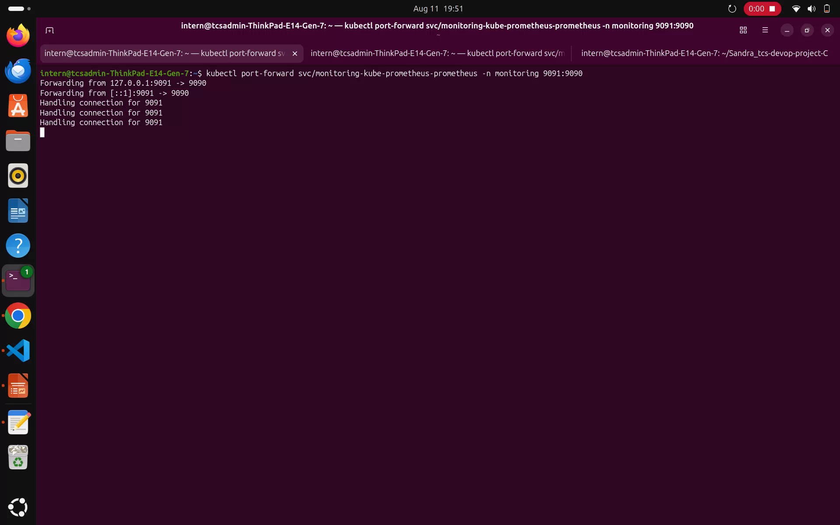
Testing & Validation
Self-healing, full Helm lifecycle, scaling, and resource checks
Self-healing
Helm lifecycle
Scaling
kubectl delete pod
(replicas: 2)
upgrade → history →
rollback → uninstall → reinstall
--replicas=3, curl repeatedly,
then --replicas=1
New pod appears automatically
Full revision control tested
Service load-balances across pods
Local Kubernetes Cluster (k3s) — Final Presentation
13
Notes:
Self-healing was tested with 2 replicas. The full Helm lifecycle — upgrade, rollback, uninstall, reinstall — was practiced and recorded, not just the initial install.

Slide 12
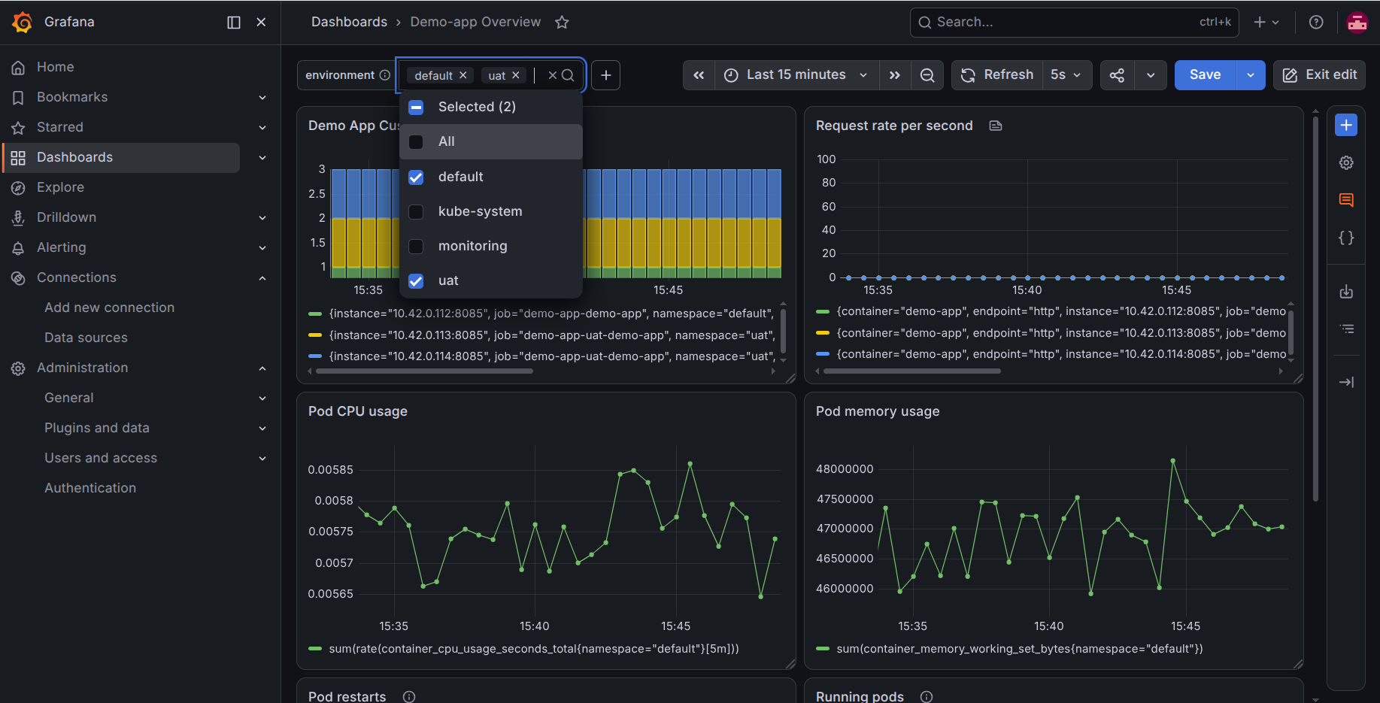
Multi-Environment: UAT & Dynamic Environments
Same chart, different values — dev, UAT, and per-PR test environments
dev
uat
pr-<id>
default namespace
uat namespace, 2 replicas
dynamic namespace
demo.local
uat.demo.local
node-ip:NodePort
Cross-namespace scraping (namespaceSelector)
deploy-uat-env.sh — dynamic lifecycle
namespaceSelector:
matchNames: [default, uat]
./deploy-uat-env.sh 7 # deploy
./deploy-uat-env.sh --cleanup 7 # tear down
Why dynamic environments: no collisions between reviewers · a live link to click, not just code · automatic resource reclaim on cleanup.
Local Kubernetes Cluster (k3s) — Final Presentation
14
Notes:
The <id> is a real PR number when available; in a real CI pipeline this would be injected automatically. The same chart drives all three environment shapes, differing only by values file and namespace.

Slide 13
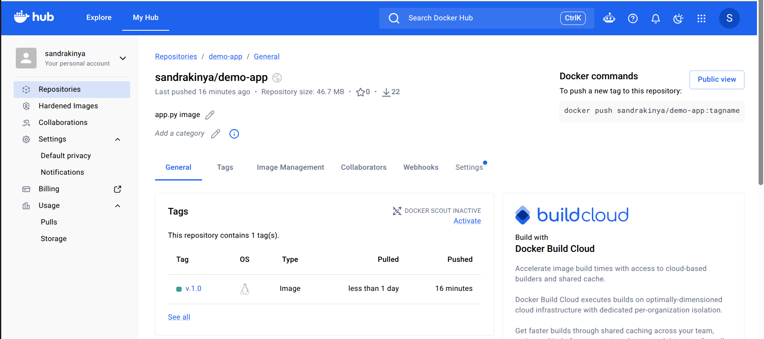
Docker Hub Integration
Build → push → pull — cloud registry replaces local containerd import
1. Tag
2. Push
3. Pull
docker tag demo-app:v.1.0
sandrakinya/demo-app:v.1.0
docker push
sandrakinya/demo-app:v.1.0
kubelet pulls over the
network on pod schedule
Key config change
CI/CD pattern demonstrated
build → push to cloud registry → cluster pulls over the network, instead of relying on local-only images. Any app.py change now requires: docker build → docker push → kubectl delete pod.
image:
repository: sandrakinya/demo-app
pullPolicy: IfNotPresent # was: Never
Local Kubernetes Cluster (k3s) — Final Presentation
8
Notes:
This shifts the project from a local-only workflow to a real cloud delivery pattern. pullPolicy IfNotPresent is the switch that makes it real — Kubernetes reaches out to the registry instead of trusting only local cache.

Slide 14
SBOM & Security Scanning
Using Trivy to generate SBOM and security reports.
SBOM report (Trivy, CycloneDX)
Image security
trivy image --format cyclonedx \
-o reports/docker-sbom.json sandrakinya/demo-app:v.1.0
trivy image --severity HIGH,CRITICAL --output reports/image-scan.txt sandrakinya/demo-app:v.1.0
Local Kubernetes Cluster (k3s) — Final Presentation
15
Notes:
SBOM generation is inventory, not a full audit — it documents exactly what's inside the image. The challenges list is deliberately the ones that took the most time to diagnose, each with a one-line root cause.

Slide 15
Security Hardening
Pod and container security context, plus health probes — added as an optional task
podSecurityContext:
runAsNonRoot: true
runAsUser: 1000
fsGroup: 1000
containerSecurityContext:
allowPrivilegeEscalation: false
capabilities: { drop: [ALL] }
livenessProbe:
httpGet: { path: /, port: 8085 }
initialDelaySeconds: 5
readinessProbe:
httpGet: { path: /, port: 8085 }
initialDelaySeconds: 3
Resource requests & limits — prevents one workload from starving others
resources:
requests: { cpu: 50m, memory: 64Mi }
limits: { cpu: 200m, memory: 128Mi }
Applied to both dev (values.yaml) and UAT (values-uat.yaml, sized higher for 2 replicas).
Local Kubernetes Cluster (k3s) — Final Presentation
7
Notes:
Non-root execution required a matching Dockerfile change (useradd). Probes give Kubernetes a real signal of app health, not just process-alive. Resource limits protect the monitoring stack from being starved by the app.

Slide 16
Dynamic UAT Deployment Script
A temporary, isolated environment is created from the application version.
1
make uat-install
2
Git SHA
3
test-<ID>
Starts the deployment script
Identifies the image version built
Creates a unique UAT namespace
4
Helm deploy
5
Rollout check
6
UAT ready
Deploys the image with the SHA tag
Waits until the Deployment is ready
Shows the service access details
Cleanup: make uat-clean ID → Helm release removed → test-<ID> namespace deleted
Local Kubernetes Cluster (K3s) — Dynamic UAT

Slide 17
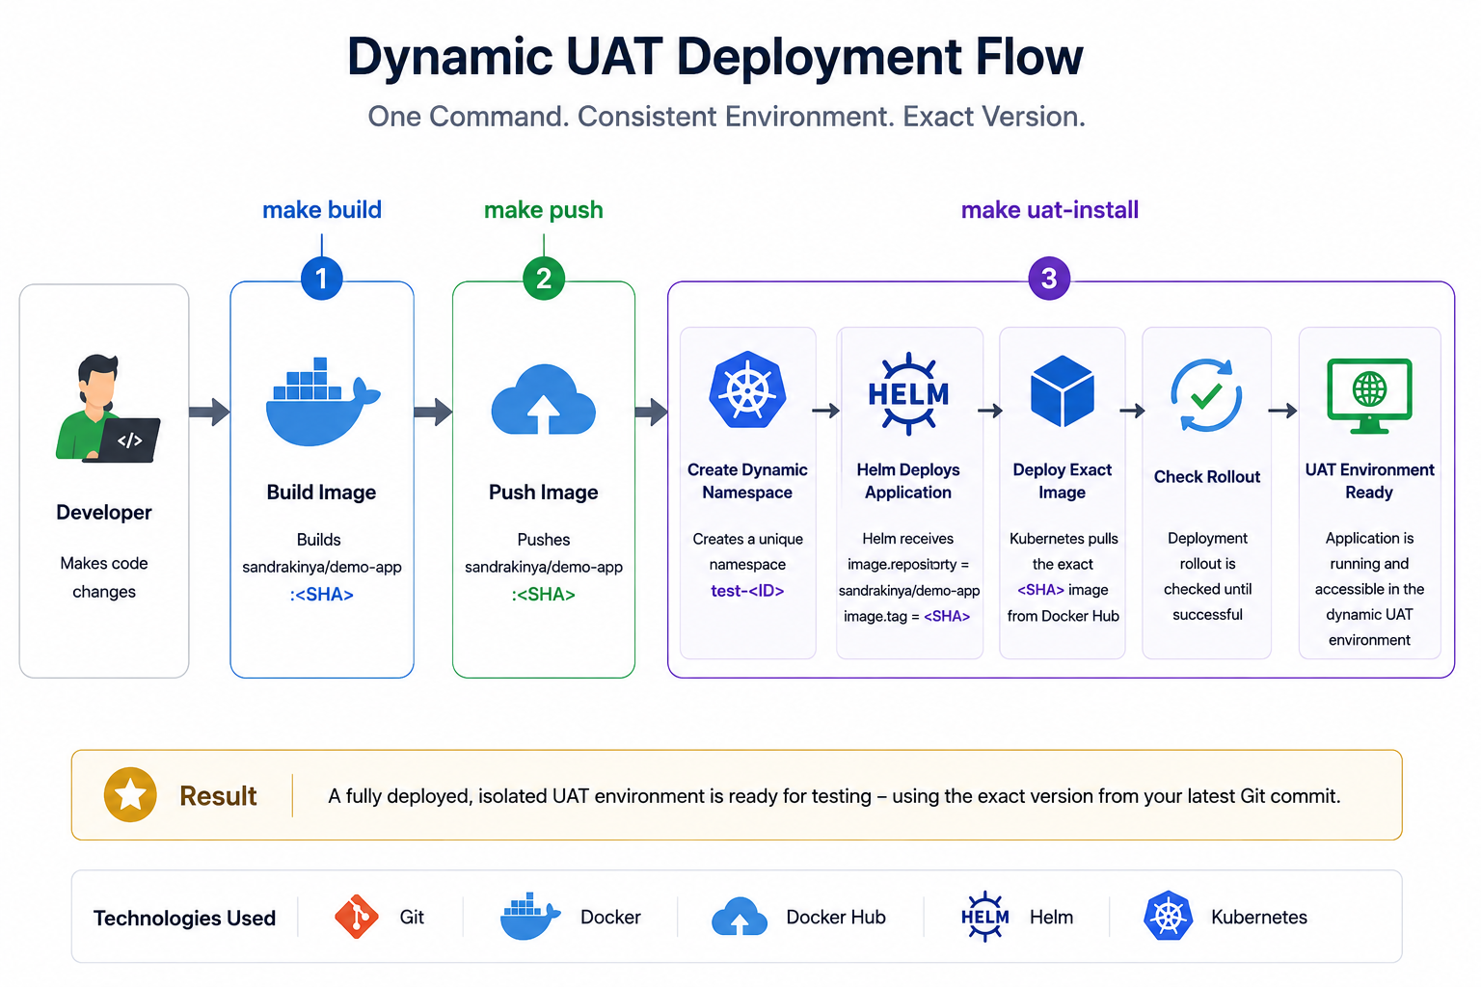
Developer Workflow Automation
The entire workflow using Makefile commands
Local Kubernetes Cluster (k3s) — Final Presentation
17
Notes:
This was the one piece of platform-engineering feedback adopted directly: a Makefile wraps the existing manual command sequences into single targets, without adopting Tilt or restructuring the repository — same benefit, no new tooling to learn or document.

Slide 18
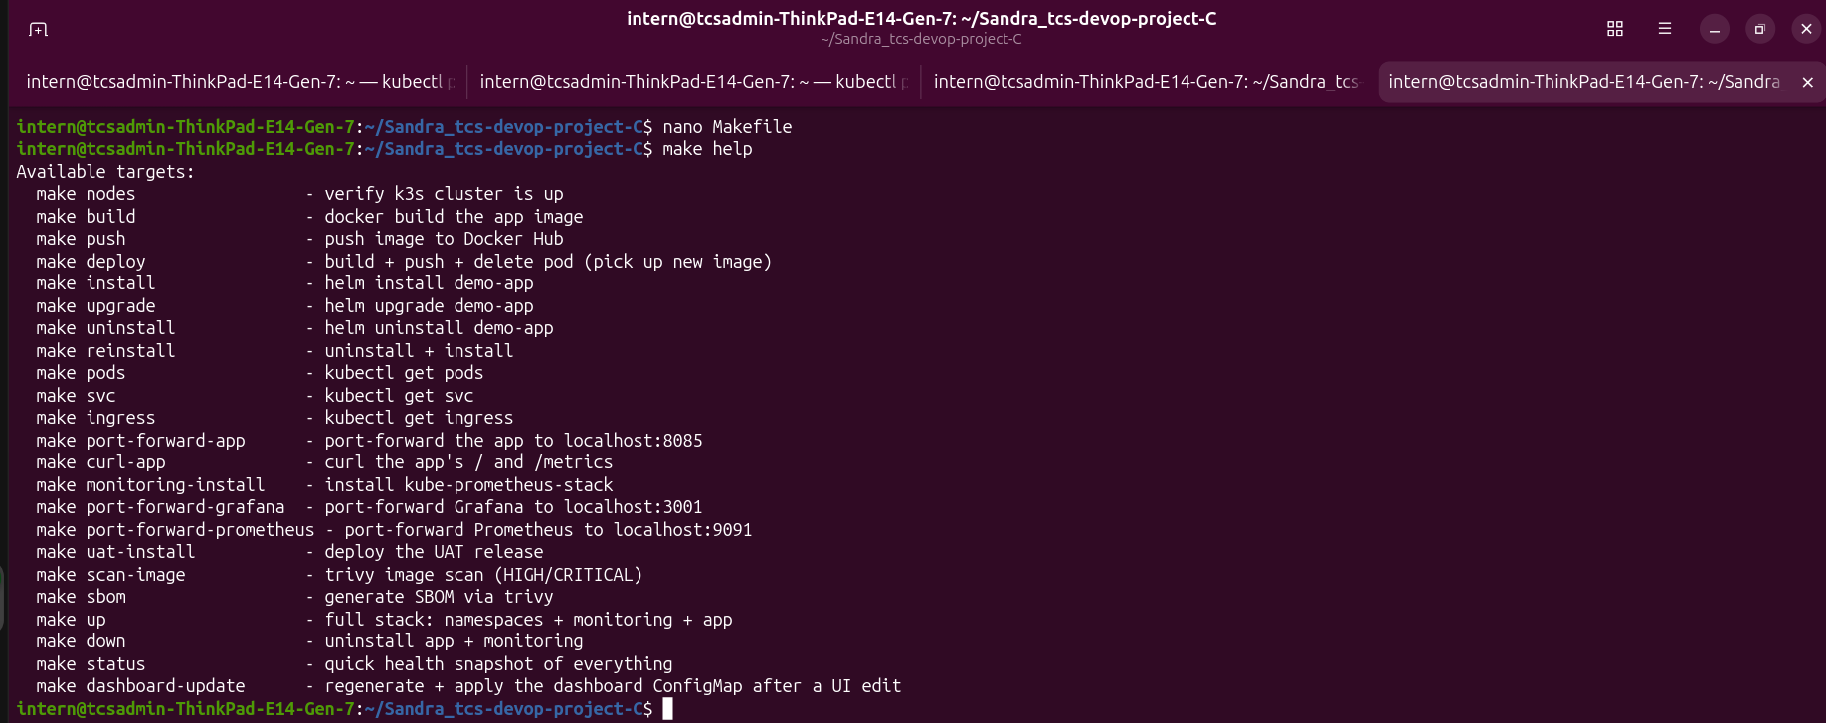
Developer Workflow Automation
Makefile wraps existing sequence of commands into one single command
Before: manual, repeated on every app.py change
Sample Makefile targets
docker build -t sandrakinya/demo-app:v.1.0 .
docker push sandrakinya/demo-app:v.1.0
kubectl delete pod -l app=demo-app -n default
build: docker build -t $(IMAGE) .
push: docker push $(IMAGE)
deploy: push + delete-pod + rollout
install: helm install demo-app
upgrade: helm upgrade demo-app
monitoring-install: kube-prometheus-stack
up: namespaces + monitoring + app
status: nodes + releases + pods snapshot
After: one command
make deploy
Deliberately scoped: no new frameworks (Tilt, k3d) — plain make, using tools already demonstrated in this project. Repo structure is unchanged.
Local Kubernetes Cluster (k3s) — Final Presentation
16
Notes:
This was the one piece of platform-engineering feedback adopted directly: a Makefile wraps the existing manual command sequences into single targets, without adopting Tilt or restructuring the repository — same benefit, no new tooling to learn or document.

Slide 19
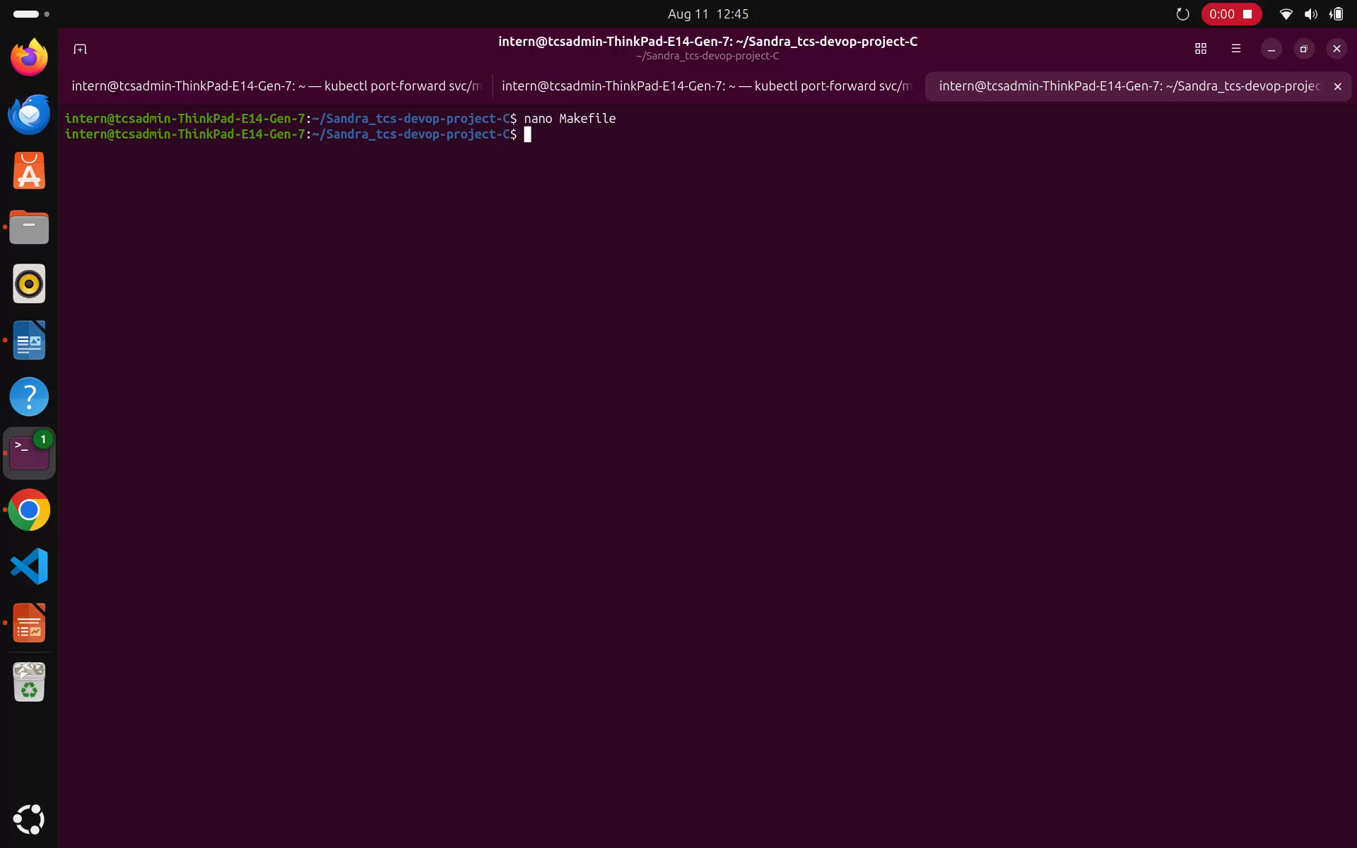
Developer Workflow Automation
The entire workflow using Makefile commands
Local Kubernetes Cluster (k3s) — Final Presentation
15
Notes:
This was the one piece of platform-engineering feedback adopted directly: a Makefile wraps the existing manual command sequences into single targets, without adopting Tilt or restructuring the repository — same benefit, no new tooling to learn or document.

Slide 20
Future Work
1
Integrate the project with CI/CD pipeline. (ProjectA)
Automate the existing dynamic UAT environment so that each Pull Request automatically creates a temporary test and removes it when the Pull Request is closed.
The current dynamic UAT environment is created manually through make uat-install, which runs deploy-test-env.sh to create a unique test ID namespace, build and push the SHA tagged image, deploy it with Helm, and verify that the application rollout is ready.
6
Thank you — questions welcome.
Local Kubernetes Cluster (k3s) — Final Presentation
19
Notes:
This is external platform-engineering feedback received on the project — genuinely valuable direction, kept deliberately out of scope for this submission except for the Makefile, which was adopted directly without requiring new tools or a repo rewrite.

