Slide 1
Chapter 13: Data Storage Structures

Slide 2
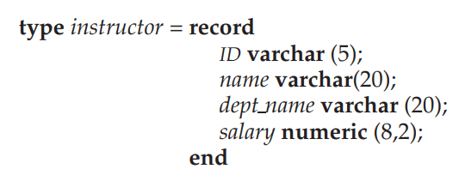
File Organization
The database is stored as a collection of files. Each file is a sequence of records. A record is a sequence of fields.
One approach
  Assume record size is fixed
  Each file has records of one particular type only
  Different files are used for different relations
  This case is easiest to implement; will consider variable length records later
We assume that records are smaller than a disk block
  .

Slide 3
🧠 File Organization: Database কীভাবে disk-এ রাখা হয়?
🔹 Database → Files → Records → Fields
স্তর | ব্যাখ্যা
Database | অনেকগুলো relation/table নিয়ে গঠিত
File | প্রতিটি relation/table → আলাদা file
Record | প্রতিটি file → অনেকগুলো record (row)
Field | প্রতিটি record → অনেকগুলো field (column)
👉 ধরো তুই একটা "instructor" table রাখছো → সেটা একটা file → প্রতিটি row = record, প্রতিটি column = field
🔹 Fixed-Length Record Assumption
এই স্লাইডে বলা হয়েছে:
প্রতিটি record-এর size fixed
প্রতিটি file-এ এক ধরনের record থাকে
Variable-length later আসবে
👉 এতে implementation সহজ হয় — indexing, block allocation predictable হয়
🔹 Record Size < Disk Block Size
প্রতিটি disk block অনেক byte ধারণ করতে পারে (e.g. 4KB)
এক block-এ একাধিক record রাখা যায়
Faster access → একবারে অনেক record read করা যায়
🔸 উদাহরণ: Instructor Record
type instructor = record
ID varchar(5);
name varchar(20);
dept_name varchar(20);
salary numeric(8,2);
end
👉 এখানে:
ID → 5 character
name → 20 character
dept_name → 20 character
salary → 8 digit + 2 decimal
→ সব মিলিয়ে fixed size record → easier to store and retrieve

Slide 4
File Organization
However, there are two problems with this simple approach:
1. Unless the block size happens to be a multiple of 53 (which is unlikely), some records will cross block boundaries. That is, part of the record will be stored in one block and part in another. It would thus require two block accesses to read or write such a record.
2. It is difficult to delete a record from this structure. The space occupied by the record to be deleted must be filled with some other record of the file, or we must have a way of marking deleted records so that they can be ignored

Slide 5
Simple File Organization-এর দুইটা বড় সমস্যা
এই স্লাইডে বলা হয়েছে: যদি আমরা fixed-size record ধরে simple sequential allocation করি, তাহলে দুইটা সমস্যা দেখা দেয় —
🔹 Problem 1: Record crosses block boundary
বিষয় | ব্যাখ্যা
Record size = 53 bytes | ধরো block size = 512 bytes
512 divisible by 53 নয় → কিছু record block-এর মাঝখানে ভেঙে যায়
ফলে | এক record পড়তে গেলে দুইটা block access করতে হয়
Impact | Performance degrade — latency বেড়ে যায়
👉 ধরো তুই একটা বাক্য পড়ছো, কিন্তু অর্ধেক এক পৃষ্ঠায়, অর্ধেক অন্য পৃষ্ঠায় → দুইবার পৃষ্ঠা উল্টাতে হয়
🔹 Problem 2: Record deletion is hard
বিষয় | ব্যাখ্যা
Simple sequential layout → middle থেকে record delete করলে gap পড়ে
Fix করতে হলে:
অন্য record দিয়ে gap fill করতে হয়
অথবা delete mark রাখতে হয় (e.g. tombstone flag)

Slide 6
🧺 গল্প দিয়ে বুঝি:
ধরো তুই একটা খাতা লিখছো:
প্রতিটি পৃষ্ঠা 512 bytes
তুই 53-byte করে paragraph লিখছো
কিছু paragraph দুই পৃষ্ঠায় split হয়ে যাচ্ছে → পড়তে সময় লাগছে
মাঝের paragraph মুছতে চাইলে → either shift করতে হয়, নয়তো "deleted" লিখে রাখতে হয়
এইভাবে simple sequential file layout practical use-এ সমস্যা তৈরি করে — তাই advanced techniques (e.g. slotted page structure, variable-length record handling) ব্যবহার করা হয়।

Slide 7
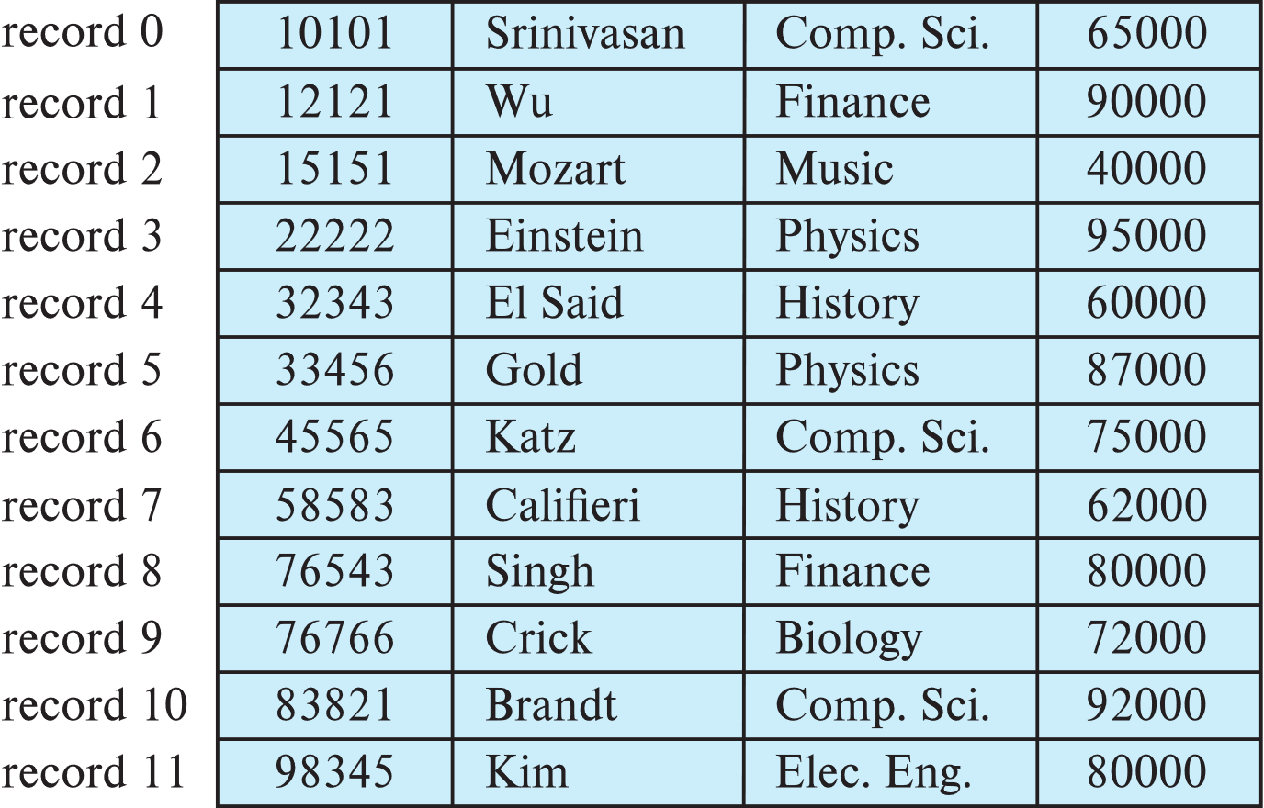
Fixed-Length Records
Simple approach:
  Store record i starting from byte n ∗ (i – 1), where n is the size of each record.
  Record access is simple but records may cross blocks
    Modification: do not allow records to cross block boundaries

Slide 8
Fixed-Length Record Storage: Simple Formula
🔹 Storage Rule:
Record i stored starting from byte:
n×(i−1)
→ যেখানে n = record size (bytes)
👉 ধরো record size n=53 bytes → তাহলে:
Record | Byte Offset
0 | 53×(0)=0
1 | 53×(1)=53
2 | 53×(2)=106
… | …
এইভাবে sequentially record store করা হয়
🔹 Advantage:
Access formula খুব simple
Random access possible → direct byte offset থেকে record read করা যায়
⚠️ Problem: Block Boundary Crossing
বিষয় | ব্যাখ্যা
Disk block size ≠ multiple of record size | যেমন block size = 512 bytes, record size = 53 bytes
কিছু record block-এর মাঝখানে ভেঙে যায় | এক অংশ এক block-এ, অন্য অংশ অন্য block-এ
Impact | এক record read করতে দুইটা block access করতে হয় → latency বেড়ে যায়
✅ Modification: Prevent Cross-Block Records
Rule change: এক block-এ record ভাঙা যাবে না
যদি block-এ জায়গা না থাকে → পরের block-এ store করো
Slight space wastage, but performance better
📊 Example Table (From Slide)

Slide 9
Record | ID | Name | Dept | Salary
0 | 10101 | Srinivasan | Comp. Sci. | 65000
1 | 12121 | Wu | Finance | 90000
… | … | … | … | …
👉 সব record fixed format-এ আছে → predictable layout

Slide 10
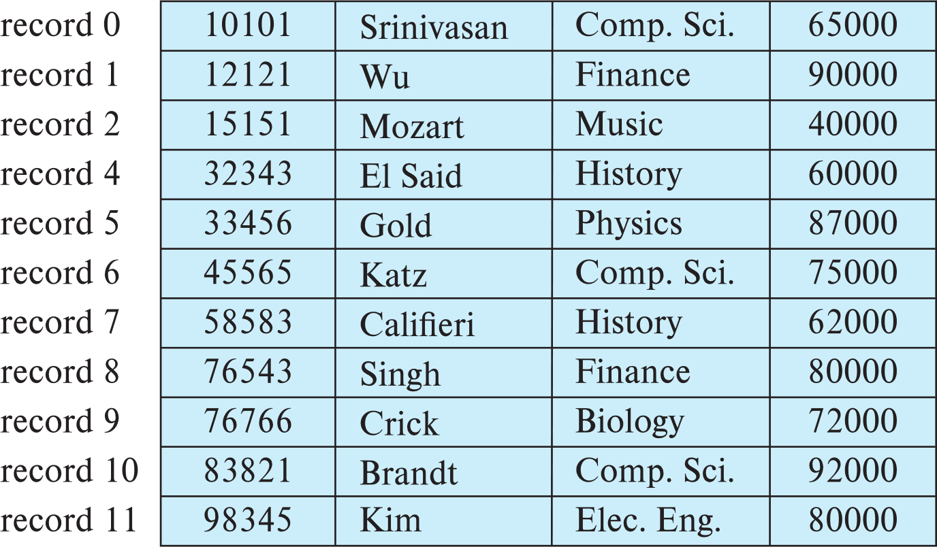
Fixed-Length Records
Deletion of record i: alternatives:
  move records i + 1, . . ., n to i, . . . , n – 1
  move record n to i
  do not move records, but link all free records on a free list
  Record 3 deleted

Slide 11
🔹 1. Shift Method
👉 Move records i+1,...,n → i,...,n−1
বৈশিষ্ট্য | ব্যাখ্যা
Deleted record-এর জায়গায় পরেরগুলো shift হয়
সব record sequential থাকে
Drawback → অনেক block write লাগে → slow

Slide 12
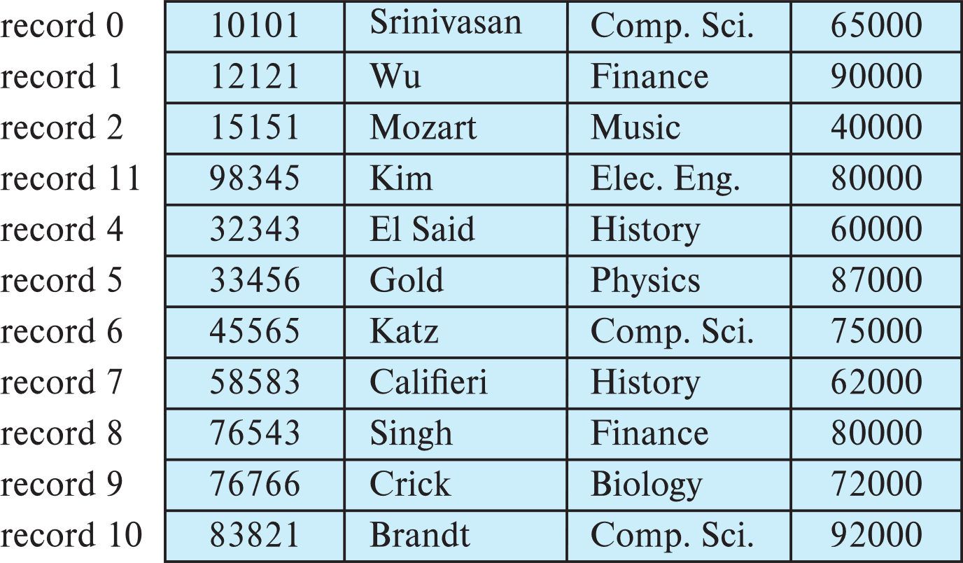
Fixed-Length Records
Deletion of record i: alternatives:
  move records i + 1, . . ., n to i, . . . , n – 1
  move record n to i
  do not move records, but link all free records on a free list
  Record 3 deleted and replaced by record 11

Slide 13
🔹 2. Swap Method
👉 Move record n → position i
বৈশিষ্ট্য | ব্যাখ্যা
শেষ record দিয়ে gap fill করা হয়
Faster than shifting
Drawback → record order নষ্ট হয়

Slide 14
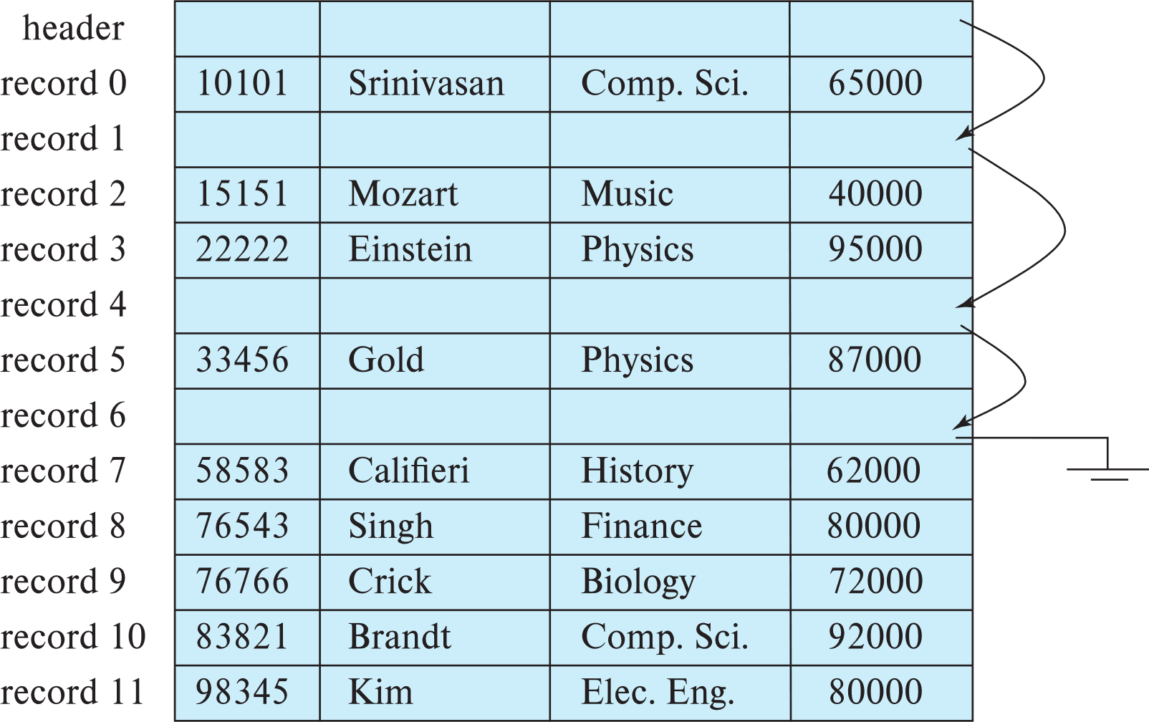
Fixed-Length Records
Deletion of record i: alternatives:
  move records i + 1, . . ., n to i, . . . , n – 1
  move record n to i
  do not move records, but link all free records on a free list

Slide 15
🔹 3. Free List Method
👉 Do not move records → link deleted slots in a free list
বৈশিষ্ট্য | ব্যাখ্যা
Deleted record-এর জায়গায় pointer রাখা হয় → next free slot
Insert করলে free list থেকে slot নেওয়া যায়
Efficient for frequent insert/delete
Drawback → extra pointer management লাগে
👉 ধরো তুই খালি জায়গাগুলো চিহ্নিত করে রাখছো → পরে নতুন নাম বসাতে পারো

Slide 16
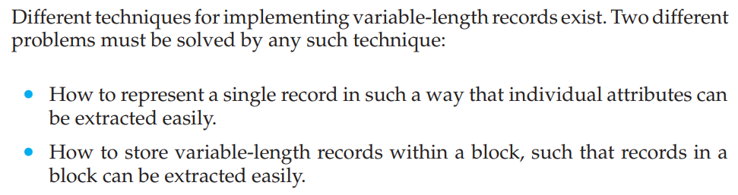
Variable-Length Records
Variable-length records arise in database systems in several ways:
  Storage of multiple record types in a file.
  Record types that allow variable lengths for one or more fields such as strings (varchar)
  Record types that allow repeating fields (used in some older data models).

Slide 17
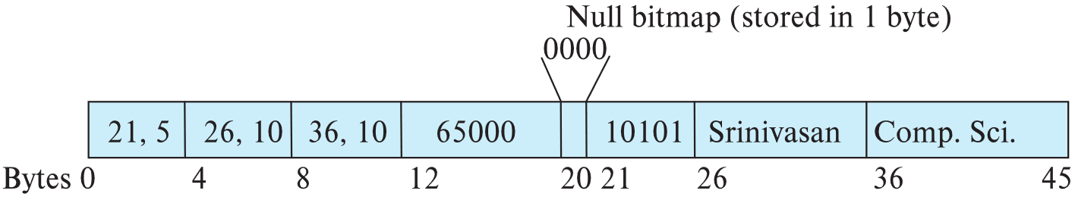
Variable-Length Records
Attributes are stored in order
Variable length attributes represented by fixed size (offset, length), with actual data stored after all fixed length attributes
Null values represented by null-value bitmap
Record Header | Fixed length field | Variable length field

Slide 18
🧠 Variable-Length Record: কীভাবে store করা হয়?
🔹 Record Structure Breakdown
একটা record তিনটা অংশে ভাগ করা হয়:
Record Header → Metadata: total size, pointer info → Example: Byte 0–4
Fixed-Length Fields → যেমন numeric, ID — যেগুলোর size সবসময় same → Example: Byte 4–20
Variable-Length Fields → যেমন name, dept_name — যেগুলোর size vary করে → Stored separately, with pointer info (offset + length) → Example: Byte 21–45
Variable-Length Field Handling
বিষয় | ব্যাখ্যা
Actual data stored later | Fixed fields-এর পরে
Offset + Length pair | প্রতিটি variable field-এর জন্য fixed-size pointer
Example | name = (offset=21, length=10), dept_name = (offset=31, length=10)
👉 ধরো তুই একটা বাক্য লিখছো, আর তার location + length আলাদা করে note রাখছো
🔹 Null Value Handling
Null Bitmap ব্যবহার করা হয়
প্রতিটি field-এর null status indicate করে
Example: Byte 20 → 0000 (সব field non-null)
👉 ধরো তুই একটা checklist রাখছো — কোন কোন field আছে, কোনটা missing
Byte Range | Content
0–4 | Record Header (21, 5)
4–20 | Fixed fields (ID, salary, offset info)
20 | Null bitmap (0000)
21–45 | Variable fields (Srinivasan, Comp. Sci.)

Slide 19
Variable-Length Records: Slotted Page Structure
Slotted page header contains:
  number of record entries
  end of free space in the block
  location and size of each record
Records can be moved around within a page to keep them contiguous with no empty space between them; entry in the header must be updated.
Pointers should not point directly to record — instead they should point to the entry for the record in header.

Slide 20
Slotted Page Structure: Variable-Length Record Management
🔹 কেন দরকার?
Variable-length record (যেমন name, address) store করতে গেলে:
Fixed offset-based access কাজ করে না
Record delete/insert করলে gap পড়ে
তাই smart layout দরকার → slotted page structure
🔧 Page Layout Breakdown
🧱 1. Block Header (Page-এর শুরুতে)
Component | কাজ
# Entries | কতগুলো record আছে
End of Free Space | free space কোথায় শেষ হয়েছে
Location + Size | প্রতিটি record কোথায় আছে + কত বড়
👉 Header = index table → record access efficient হয়
📦 2. Record Storage Area
Actual record-গুলো page-এর শেষে থেকে শুরু হয়
নতুন record insert করলে → free space থেকে grow করে
Delete করলে → gap পড়ে → later compact করা যায়
🧵 3. Free Space
Header আর record-এর মাঝে থাকে
Insert/delete করলে এই জায়গা adjust হয়
End of Free Space pointer দিয়ে track করা হয়
🔁 Record Movement
Record delete/insertion করলে → record-গুলো move করা যায়
Header-এর pointer update করতে হয়
External pointer কখনো record-এ directly point করে না → header entry-তে point করে
👉 এতে record move করলেও pointer break হয় না

Slide 21
Storing Large Objects
E.g., blob/clob types
Records must be smaller than pages
Alternatives:
  Store as files in file systems
  Store as files managed by database
  Break into pieces and store in multiple tuples in separate relation
    PostgreSQL TOAST

Slide 22
Organization of Records in Files
Heap – record can be placed anywhere in the file where there is space
Sequential – store records in sequential order, based on the value of the search key of each record
In a multitable clustering file organization records of several different relations can be stored in the same file
  Motivation: store related records on the same block to minimize I/O
B⁺-tree file organization
  Ordered storage even with inserts/deletes
  More on this in Chapter 14
Hashing – a hash function computed on search key; the result specifies in which block of the file the record should be placed
  More on this in Chapter 14

Slide 23
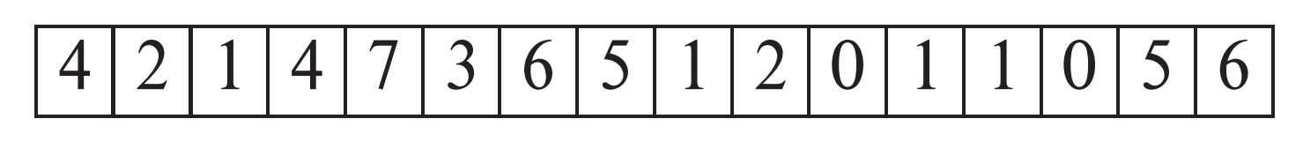
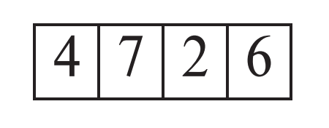
Heap File Organization
Records can be placed anywhere in the file where there is free space
Records usually do not move once allocated
Important to be able to efficiently find free space within file
Free-space map
  Array with 1 entry per block. Each entry is a few bits to a byte, and records fraction of block that is free
  In example below, 3 bits per block, value divided by 8 indicates fraction of block that is free
  Can have second-level free-space map
  In example below, each entry stores maximum from 4 entries of first-level free-space map
Free space map written to disk periodically, OK to have wrong (old) values for some entries (will be detected and fixed)

Slide 24
🧠 Heap File Organization: Overview
🔹 কী হয় এখানে?
Record-গুলো যেকোনো খালি জায়গায় রাখা যায়
একবার জায়গা পেলে record সাধারণত move হয় না
তাই free space খুঁজে বের করা efficient হতে হবে
🔧 Free-Space Map: খালি জায়গার খোঁজ রাখার কৌশল
🔸 First-Level Map
বৈশিষ্ট্য | ব্যাখ্যা
প্রতিটি block-এর জন্য 1 entry
Entry = 3 bits → মান 0–7
মান ÷ 8 = block-এর খালি অংশের অনুপাত
Example:
Code
4 2 1 4 7 3 6 5 1 2 0 1 1 0 5 6
👉 ধরো block 0-এর মান 4 → খালি fraction = 4/8 = 50% → block 4-এর মান 7 → খালি fraction = 7/8 = 87.5%
🔸 Second-Level Map
বৈশিষ্ট্য | ব্যাখ্যা
4টি first-level entry-এর মধ্যে max value রাখা হয়
Faster lookup — কোন group-এ বেশি খালি জায়গা আছে
Example:

Slide 25
Code
4 7 2 6
👉 1st group (4,2,1,4) → max = 4 → 2nd group (7,3,6,5) → max = 7
🔸 Practical Notes
Map periodically disk-এ লেখা হয়
কিছু entry ভুল থাকলেও সমস্যা নেই — insert time-এ detect করে fix করা যায়

Slide 26
Sequential File Organization
Suitable for applications that require sequential processing of the entire file
The records in the file are ordered by a search-key

Slide 27
Sequential File Organization (Cont.)
Deletion – use pointer chains
Insertion –locate the position where the record is to be inserted
  if there is free space insert there
  if no free space, insert the record in an overflow block
  In either case, pointer chain must be updated
Need to reorganize the file
from time to time to restore
sequential order

Slide 28
🧠 Sequential File Organization: কীভাবে কাজ করে?
🔹 মূল ধারণা:
Record-গুলো sorted order-এ থাকে (e.g. ID অনুযায়ী)
Insert/delete করলে pointer chain দিয়ে link manage করতে হয়
Periodically reorganization দরকার হয় sequential order restore করতে
🔧 Deletion Strategy
Record delete করলে → pointer chain adjust করতে হয়
Deleted record-এর pointer আগের record থেকে পরের record-এ redirect হয়
Physical space free হয় না, কিন্তু logical link ঠিক রাখতে হয়
👉 ধরো তুই একটা নামের তালিকা থেকে মাঝের নাম মুছলে → আগের নাম থেকে পরের নামের দিকে arrow adjust করতে হয়
🆕 Insertion Strategy
Step-by-step:
Position খুঁজে বের করো → sorted order অনুযায়ী
Free space থাকলে → সেখানেই insert করো
Free space না থাকলে → overflow block-এ insert করো
Pointer chain update করো → যেন logical order ঠিক থাকে
👉 Example:
Main table full → নতুন record (ID 32222, Verdi) overflow block-এ যায়
Pointer chain update হয় → যেন Verdi logically Mozart-এর পরে থাকে
Overflow Block:
বৈশিষ্ট্য | ব্যাখ্যা
Main block full হলে | নতুন record overflow block-এ যায়
Logical order pointer দিয়ে maintain হয়
Performance degrade হয় যদি overflow বেশি হয়
Periodic reorganization দরকার → overflow কমাতে
👉 ধরো তুই একটা shelf full → নতুন বই পাশের overflow shelf-এ রাখছো, কিন্তু index ঠিক রাখছো

Slide 29
🧺 গল্প দিয়ে বুঝি:
ধরো তুই একটা লাইব্রেরি চালাচ্ছো:
বইগুলো ID অনুযায়ী সাজানো
কেউ একটা বই নিয়ে গেলে → আগের বই থেকে পরের বইয়ের দিকে arrow adjust করো
নতুন বই রাখার জায়গা না থাকলে → overflow shelf-এ রাখো
মাঝে মাঝে সব বই আবার সাজিয়ে sequential order restore করো
এইভাবে sequential file organization কাজ করে — sorted layout + pointer chain + overflow handling

Slide 30
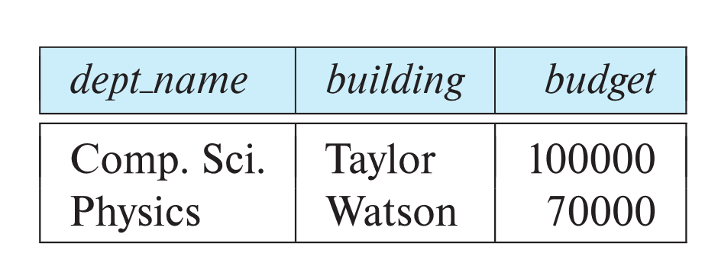
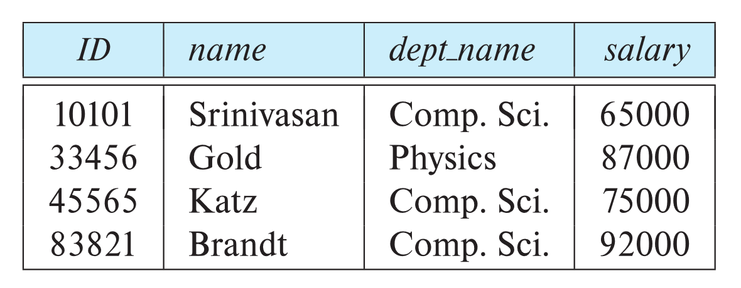
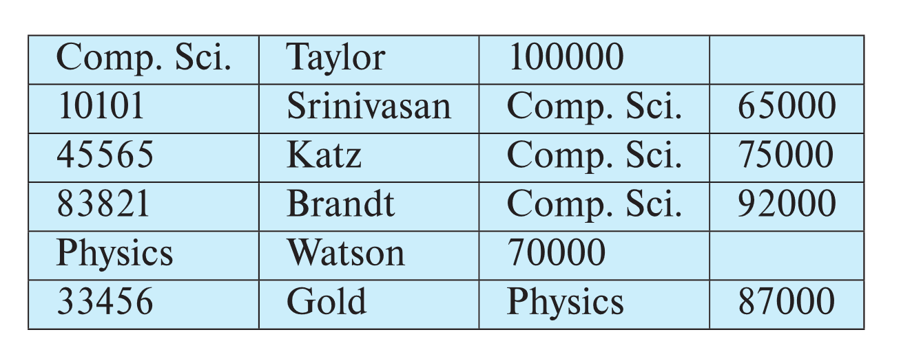
Multitable Clustering File Organization
Store several relations in one file using a multitable clustering file organization
department
instructor
multitable clustering
of department and
instructor

Slide 31
Multitable Clustering File Organization (cont.)
good for queries involving department ⨝ instructor, and for queries involving one single department and its instructors
bad for queries involving only department
results in variable size records
Can add pointer chains to link records of a particular relation

Slide 32
🧠 Multitable Clustering File Organization: কী?
এটা এমন একটা technique যেখানে একাধিক relation/table-এর data একই file/block-এ store করা হয় — clustered ভাবে।
🔹 উদাহরণ দিয়ে বুঝি:
ধরো আমাদের কাছে দুইটা table আছে:
department
  dept_name | building | budget
  Comp. Sci. | Taylor | 100000
  Physics | Watson | 70000
instructor
  ID | name | dept_name | salary
  10101 | Srinivasan | Comp. Sci. | 65000
  33456 | Gold | Physics | 87000
  ...
🔸 Multitable Clustering Layout:
এখন আমরা এই দুইটা table-এর data cluster করে রাখি:
✅ সুবিধা (Advantages)
Scenario | Benefit
Join query: department ⋈ instructor | Faster access — clustered data একসাথে
Single department query: e.g. all instructors of Physics | Efficient — sequential block read suffice
❌ অসুবিধা (Disadvantages)
Scenario | Drawback
Only department query | Extra block read — instructor data skip করতে হয়
Variable record size | Compaction harder, fragmentation possible
Pointer chain needed | যদি relation-wise traversal দরকার হয় → extra linking overhead

Slide 33
Partitioning
Table partitioning: Records in a relation can be partitioned into smaller relations that are stored separately
E.g., transaction relation may be partitioned into
transaction_2018, transaction_2019, etc.
Queries written on transaction must access records in all partitions
  Unless query has a selection such as year=2019, in which case only one partition in needed
Partitioning
  Reduces costs of some operations such as free space management
  Allows different partitions to be stored on different storage devices
    E.g., transaction partition for current year on SSD, for older years on magnetic disk

Slide 34
Data Dictionary Storage
The Data dictionary (also called system catalog) stores metadata; that is, data about data, such as
Information about relations
  names of relations
  names, types and lengths of attributes of each relation
  names and definitions of views
  integrity constraints
User and accounting information, including passwords
Statistical and descriptive data
  number of tuples in each relation
Physical file organization information
  How relation is stored (sequential/hash/…)
  Physical location of relation
Information about indices (Chapter 14)

Slide 35
Relational Representation of System Metadata
Relational representation on disk
Specialized data structures designed for efficient access, in memory

Slide 36
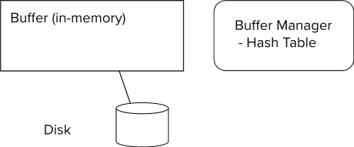
Storage Access
Blocks are units of both storage allocation and data transfer.
Database system seeks to minimize the number of block transfers between the disk and memory. We can reduce the number of disk accesses by keeping as many blocks as possible in main memory.
Buffer – portion of main memory available to store copies of disk blocks.
Buffer manager – subsystem responsible for allocating buffer space in main memory.
Notes:
36

Slide 37
Buffer Manager
Programs call on the buffer manager when they need a block from disk.
  If the block is already in the buffer, buffer manager returns the address of the block in main memory
  If the block is not in the buffer, the buffer manager
    Allocates space in the buffer for the block
      Replacing (throwing out) some other block, if required, to make space for the new block.
      Replaced block written back to disk only if it was modified since the most recent time that it was written to/fetched from the disk.
    Reads the block from the disk to the buffer, and returns the address of the block in main memory to requester.
Notes:
37

Slide 38
Buffer Manager
Buffer replacement strategy (details coming up!)
Pinned block: memory block that is not allowed to be written back to disk
  Pin done before reading/writing data from a block
  Unpin done when read /write is complete
  Multiple concurrent pin/unpin operations possible
    Keep a pin count, buffer block can be evicted only if pin count = 0
Shared and exclusive locks on buffer
  Needed to prevent concurrent operations from reading page contents as they are moved/reorganized, and to ensure only one move/reorganize at a time
  Readers get shared lock, updates to a block require exclusive lock
  Locking rules:
    Only one process can get exclusive lock at a time
    Shared lock cannot be concurrently with exclusive lock
    Multiple processes may be given shared lock concurrently

Slide 39
Buffer-Replacement Policies
Most operating systems replace the block least recently used (LRU strategy)
  Idea behind LRU – use past pattern of block references as a predictor of future references
  LRU can be bad for some queries
Queries have well-defined access patterns (such as sequential scans), and a database system can use the information in a user’s query to predict future references
Mixed strategy with hints on replacement strategy provided
by the query optimizer is preferable
  Example of bad access pattern for LRU: when computing the join of 2 relations r and s by a nested loops
  for each tuple tr of r do
  for each tuple ts of s do
  if the tuples tr and ts match …
Notes:
39

Slide 40
🧠 Buffer-Replacement Policies: LRU vs Toss-Immediate
🔹 1. LRU (Least Recently Used)
বৈশিষ্ট্য | ব্যাখ্যা
পুরনো access history দেখে | কোন block সবচেয়ে কম recently use হয়েছে → সেটাই replace করা হয়
Assumption | যেটা আগে use হয়নি, সেটা future-এও use হবে না
✅ Good for | Random access workloads
❌ Bad for | Sequential scan, nested loop join
Example | Nested loop join: outer loop block বারবার use হয়, কিন্তু LRU ভুলভাবে discard করে
👉 ধরো তুই একটা বইয়ের পৃষ্ঠা পড়ছো — LRU বলে, যেটা অনেকক্ষণ আগে পড়া হয়েছে, সেটা discard করো → কিন্তু nested loop join-এ সেই পুরনো পৃষ্ঠা আবার দরকার হয়!

Slide 41
🔹 2. Toss-Immediate Strategy
বৈশিষ্ট্য | ব্যাখ্যা
Block-এর শেষ tuple process হয়ে গেলে → সাথে সাথে memory থেকে free করে দেওয়া হয়
No reuse assumption | Future-এ block দরকার হবে না
✅ Good for | Sequential scan
❌ Bad for | Repeated access workload
Example | Table scan: প্রতিটি block একবারই পড়া হয় → toss করে দিলে buffer efficient হয়
👉 ধরো তুই conveyor belt-এ ফল বাছাই করছো — একবার দেখে ফেললে বাক্সটা ফেলে দিচ্ছো

Slide 42
Buffer-Replacement Policies (Cont.)
Toss-immediate strategy – frees the space occupied by a block as soon as the final tuple of that block has been processed
Most recently used (MRU) strategy – system must pin the block currently being processed. After the final tuple of that block has been processed, the block is unpinned, and it becomes the most recently used block.
Buffer manager can use statistical information regarding the probability that a request will reference a particular relation
  E.g., the data dictionary is frequently accessed. Heuristic: keep data-dictionary blocks in main memory buffer
Operating system or buffer manager may reorder writes
  Can lead to corruption of data structures on disk
    E.g., linked list of blocks with missing block on disk
    File systems perform consistency check to detect such situations
  Careful ordering of writes can avoid many such problems
Notes:
42

Slide 43
MRU (Most Recently Used)
যখন কোনো block process হচ্ছে → সেটা pin করা হয় (buffer থেকে সরানো যাবে না)।
Process শেষ হলে → block unpin হয়।
তখন সেটাই buffer-এর most recently used block হিসেবে mark হয়। 👉 মানে: recent block আবার দরকার হতে পারে, তাই buffer-এ রাখা হয়।
🔹 Statistical Heuristics
Buffer manager probability দেখে decide করে কোন relation বেশি use হবে।
যেমন: data dictionary প্রায়ই access হয় → তাই সবসময় buffer-এ রাখা হয়। 👉 Frequent-use relation memory-তে pin করে রাখলে performance বাড়ে।
🔹 Write Reordering Risk
OS বা buffer manager write order change করতে পারে।
এতে linked structure corrupt হতে পারে (যেমন missing block)।
Solution: careful ordering বা journaling → consistency বজায় রাখা যায়। 👉 মানে: write order ভুল হলে data loss হতে পারে, তাই safe journaling দরকার।

Slide 44
Optimization of Disk Block Access (Cont.)
Buffer managers support forced output of blocks for the purpose of recovery (more in Chapter 19)
Nonvolatile write buffers speed up disk writes by writing blocks to a non-volatile RAM or flash buffer immediately
  Writes can be reordered to minimize disk arm movement
Log disk – a disk devoted to writing a sequential log of block updates
  Used exactly like nonvolatile RAM
    Write to log disk is very fast since no seeks are required
Journaling file systems write data in-order to NV-RAM or log disk
  Reordering without journaling: risk of corruption of file system data

Slide 45
Optimization of Disk Block Access (Cont.)
এই slide-এ মূলত বলা হয়েছে কীভাবে database system disk I/O optimize করে আর data consistency বজায় রাখে।
🔹 1. Forced Output for Recovery
Buffer manager কিছু block force করে disk-এ লিখে দেয়।
কারণ: transaction recovery-এর সময় latest data দরকার হয়। 👉 মানে critical data delay না করে সাথে সাথে permanent storage-এ পাঠানো হয়।
🔹 2. Nonvolatile Write Buffers
RAM-এর বদলে NVRAM বা flash buffer ব্যবহার করা হয়।
Power off হলেও data safe থাকে।
Write order optimize করা যায় → disk arm movement কমে। 👉 এতে write speed অনেক বেড়ে যায়।
🔹 3. Log Disk
আলাদা disk শুধু log write করার জন্য রাখা হয়।
Sequential write → no seek → super fast।
Log disk behave করে NVRAM-এর মতো। 👉 মানে সব update sequentially log disk-এ লেখা হয় → পরে recovery-তে কাজে লাগে।
🔹 4. Journaling File System
Write করার আগে log/NVRAM-এ entry করা হয়।
Reordering হলেও consistency থাকে।
Journaling না করলে → reordering থেকে corruption হতে পারে। 👉 মানে আগে diary-তে লিখে রাখো, তারপর main খাতায় transfer করো → ভুল হলে diary থেকে restore করা যাবে।

Slide 46
🧺 গল্প দিয়ে বুঝি:
ধরো তুই একটা অফিস চালাচ্ছো:
Critical info সাথে সাথে archive-এ পাঠাচ্ছো (forced output)
Temporary info pen drive-এ রাখছো (NVRAM buffer)
Update log আলাদা diary-তে লিখছো (log disk)
সব কিছু আগে diary-তে লিখে, পরে খাতায় transfer করছো (journaling)
এইভাবে database system disk access optimize করে + consistency বজায় রাখে।

Slide 47
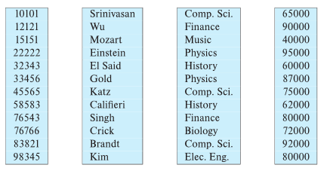
Column-Oriented Storage
Also known as columnar representation
Store each attribute of a relation separately
Example

Slide 48
Columnar Representation
Benefits:
  Reduced IO if only some attributes are accessed
  Improved CPU cache performance
  Improved compression
  Vector processing on modern CPU architectures
Drawbacks
  Cost of tuple reconstruction from columnar representation
  Cost of tuple deletion and update
  Cost of decompression
Columnar representation found to be more efficient for decision support than row-oriented representation
Traditional row-oriented representation preferable for transaction processing
Some databases support both representations
  Called hybrid row/column stores

Slide 49
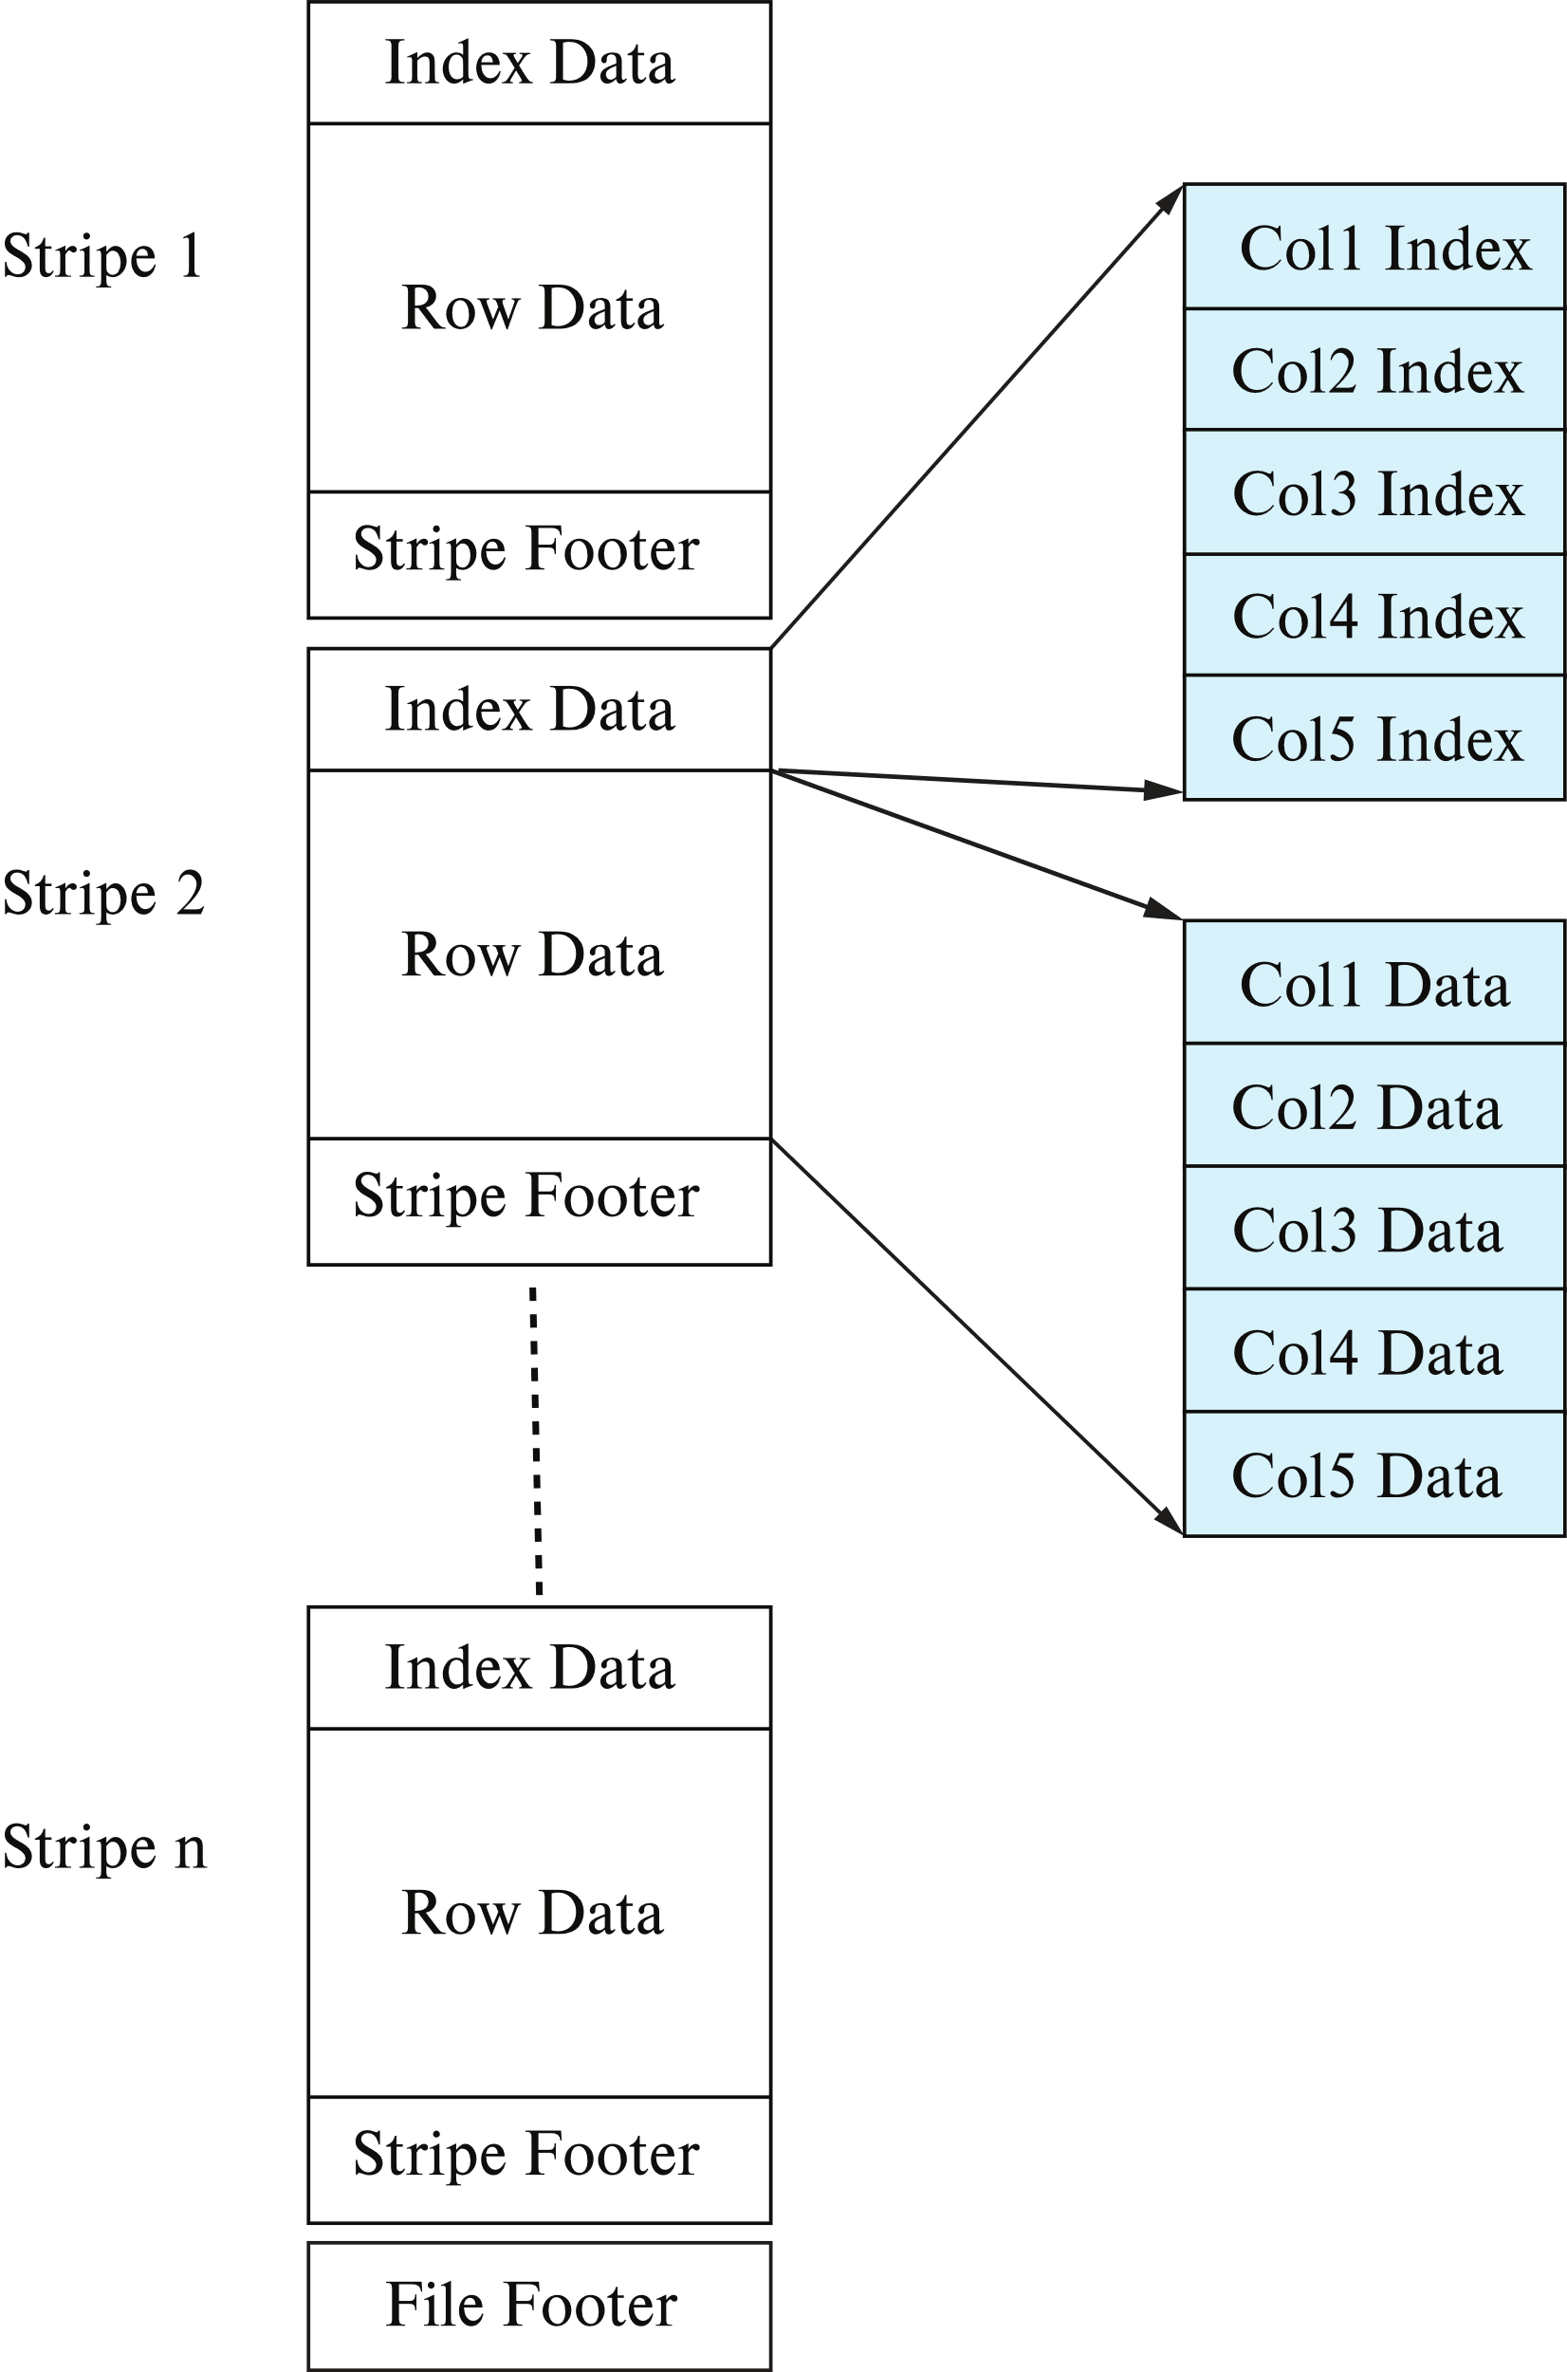
Columnar File Representation
ORC and Parquet: file formats with columnar storage inside file
Very popular for big-data applications
Orc file format shown on right:

Slide 50
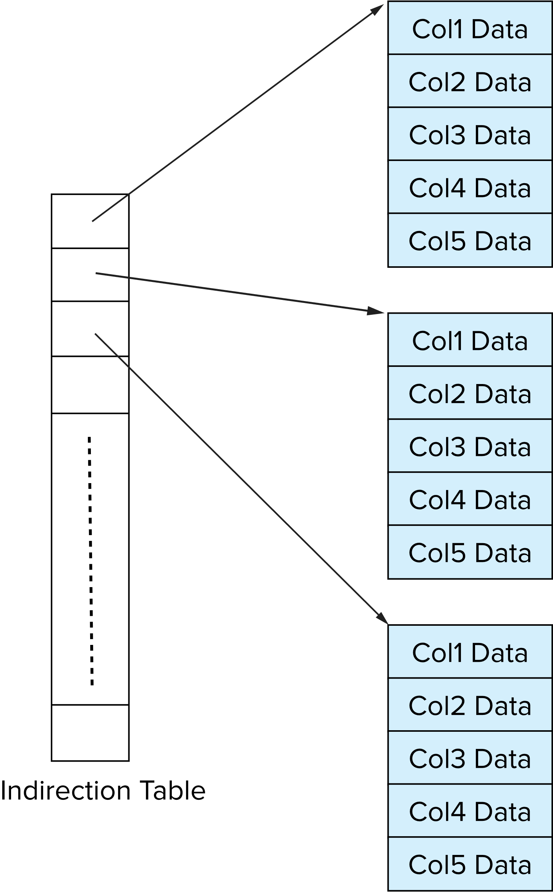
Storage Organization in Main-Memory Databases
Can store records directly in memory without a buffer manager
Column-oriented storage can be used in-memory for decision support applications
  Compression reduces memory requirement

Slide 51
End of Chapter 13

