Slide 1
Chapter 14: Indexing

Slide 2
Basic concepts
“Find all instructors in the Physics department” or “Find the total number of credits earned by the student with ID 22201”
Is it efficient to read entire relation of department or students to answer the query?
No, rather locate the record directly.
To allow this, we need additional structures associated with files.
Index of a book?
For example, to retrieve a student record given an ID, the database system would look up an index to find on which disk block the corresponding record resides, and then fetch the disk block, to get the appropriate student record.

Slide 3
Basic concepts
Indices are critical for efficient processing of queries in databases.
Implementing an index on the student relation by keeping a sorted list of students’ ID would not work well on very large databases, since
(i) the index would itself be very big,
(ii) even though keeping the index sorted reduces the search time, finding a student can still be rather time-consuming, and
(iii) updating a sorted list as students are added or removed from the database can be very expensive

Slide 4
Basic concepts
There are two basic kinds of indices:
Ordered indices: Based on a sorted ordering of the values.
Hash indices: Based on a uniform distribution of values across a range of buckets
Each techniques must be evaluated on the basis of
Access type
Access time
Insertion time
Deletion time
Space overhead

Slide 5
Basic concepts
Access types: Access types can include finding records with a specified attribute value and finding records whose attribute values fall in a specified range.
Access time: The time it takes to find a particular data item, or set of items, using the technique in question.
Insertion time: The time it takes to insert a new data item. This value includes the time it takes to find the correct place to insert the new data item, as well as the time it takes to update the index structure.
Deletion time: The time it takes to delete a data item. This value includes the time it takes to find the item to be deleted, as well as the time it takes to update the index structure.
Space overhead: The additional space occupied by an index structure. Provided that the amount of additional space is moderate, it is usually worthwhile to sacrifice the space to achieve improved performance.

Slide 6
Basic concepts
One file one index or more than one index?
Search a book by - Title, Author, Subject
Search key: An attribute or set of attributes used to look up records in a file is called a search key.

Slide 7
Order Indices
An ordered index stores the values of the search keys in sorted order and associates with each search key the records that contain it.
The records in the indexed file may themselves be stored in some sorted order,
A file may have several indices, on different search keys.
If the file containing the records is sequentially ordered, a clustering index is an index whose search key also defines the sequential order of the file. Clustering indices are also called primary indices;
The term primary index may appear to denote an index on a primary key, but such indices can in fact be built on any search key. The search key of a clustering index is often the primary key, although that is not necessarily so.

Slide 8
Indices whose search key specifies an order different from the sequential order of the file are called nonclustering indices, or secondary indices.
An index entry, or index record, consists of a search-key value and pointers to one or more records with that value as their search-key value.
The pointer to a record consists of the identifier of a disk block and an offset within the disk block to identify the record within the block.
Clustering index?
Non-Clustering index?

Slide 9
Index (ID) → Record Pointer
----------------------------
10101 → Srinivasan
12121 → Wu
15151 → Mozart
22222 → Einstein
32343 → El Said
33456 → Gold
45565 → Katz
58583 → Califieri
76543 → Singh
76766 → Crick
83821 → Brandt
98345 → Kim
Dept → List of Record IDs
--------------------------------
Biology → (76766)
Comp. Sci. → (10101, 45565, 83821)
Elec. Eng. → (98345)
Finance → (12121, 76543)
History → (32343, 58583)
Music → (15151)
Physics → (22222, 33456)

Slide 10
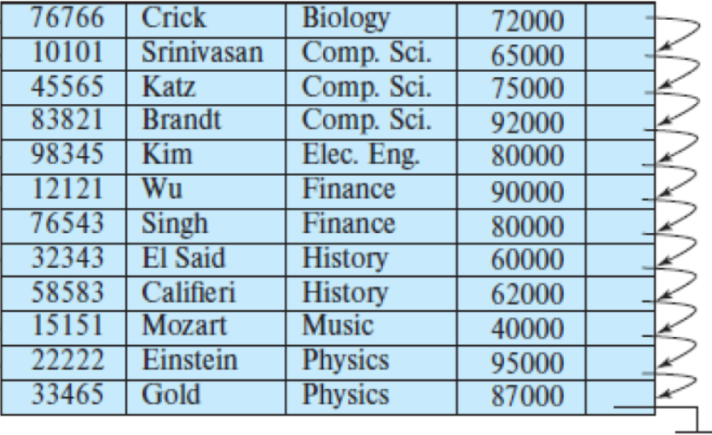
Dept → First Record ID
------------------------------
Biology → 76766
Comp. Sci. → 10101
Elec. Eng. → 98345
Finance → 12121
History → 32343
Music → 15151
Physics → 22222

Slide 11
Feature | Clustering Index | Non-Clustering Index
Physical data storage | Data rows are stored in the same order as the index key | Data rows are stored independently of the index order
Number per table | Only one (because data can only be ordered one way) | Can be many (since they don’t affect physical order)
Key storage | The index contains the actual data rows (leaf nodes store full records) | The index contains pointers (row IDs) to actual data rows
Performance | Very efficient for range queries and sorting | Efficient for point lookups, less optimal for ranges
Maintenance | More expensive for insert/update/delete, since data must remain ordered | Less costly to maintain, since order of data is unaffected
Default | Often created on the Primary Key | Usually created on non-key attributes for faster lookups
Example usage | Searching students with RollNo 100–200 | Searching by Name or Dept (non-primary key fields)

Slide 12
Dense index:
In a dense index, an index entry appears for every search-key value in the file.
In a dense clustering index, the index record contains the search key value and a pointer to the first data record with that search-key value.
The rest of the records with the same search-key value would be stored sequentially after the first record, since, because the index is a clustering one, records are sorted on the same search key.

Slide 13
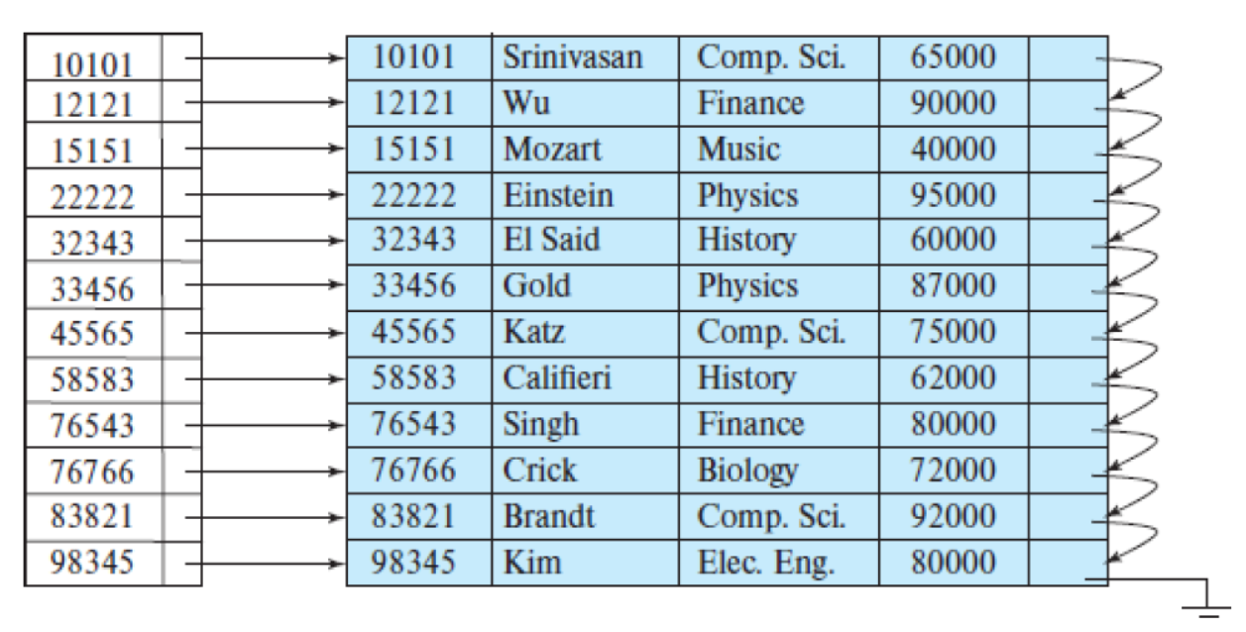
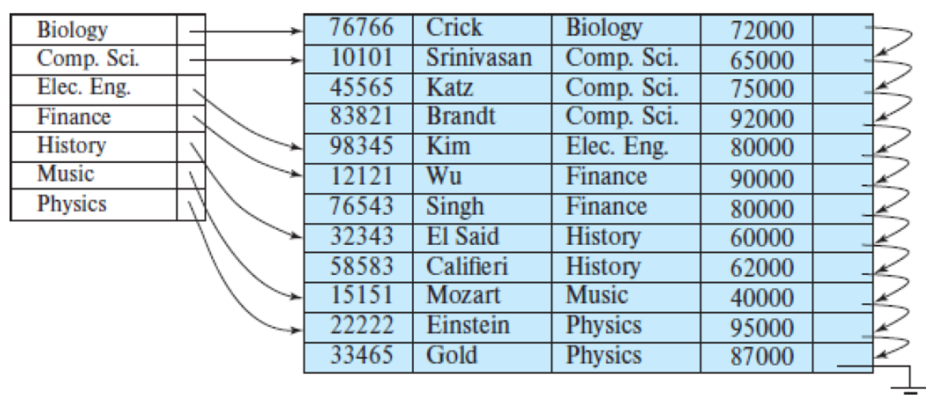
Order Indices
Dense
Dense

Slide 14
Order Indices
Sparse index:
In a sparse index, an index entry appears for only some of the search-key values.
Sparse indices can be used only if the relation is stored in sorted order of the search key; that is, if the index is a clustering index.
Each index entry contains a search-key value and a pointer to the first data record with that search-key value.
To locate a record, we find the index entry with the largest search key value that is less than or equal to the search-key value for which we are looking.
We start at the record pointed to by that index entry and follow the pointers in the file until we find the desired record.
Access time VS Space overhead

Slide 15
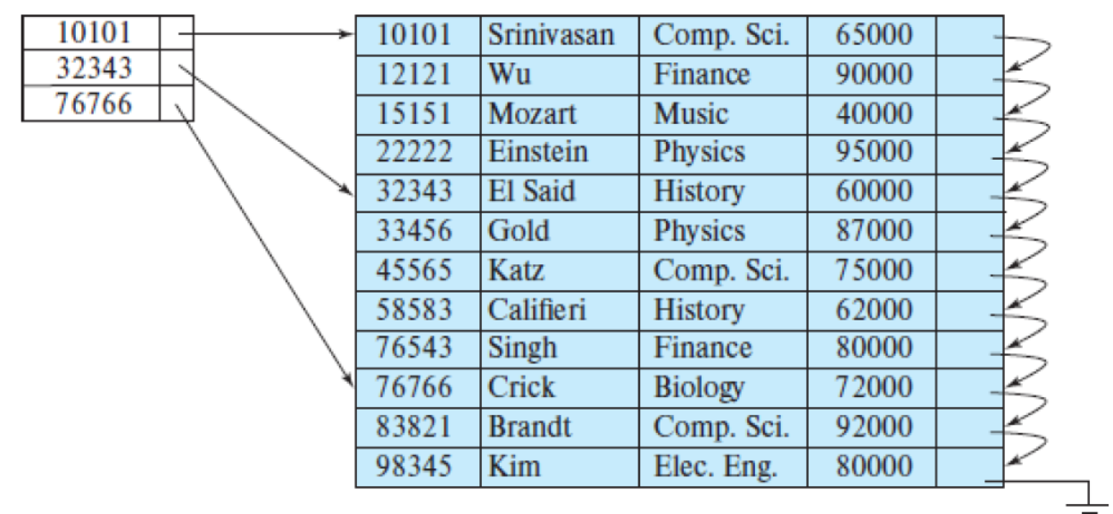
Order Indices
Sparse

Slide 16
Multilevel indices
Suppose we build a dense index on a relation with 1,000,000 tuples. Index entries are smaller than data records, so let us assume that 100 index entries fit on a 4-kilobyte block. Thus, our index occupies 10,000 blocks.
If the relation instead had 100,000,000 tuples, the index would instead occupy 1,000,000 blocks, or 4 gigabytes of space. Such large indices are stored as sequential files on disk.
If an index is small enough to be kept entirely in main memory, the search time to find an entry is low.
If the index is so large that not all of it can be kept in memory, index blocks must be fetched from disk when required.
The search for an entry in the index then requires several disk-block reads.
Binary search can be used on the index file to locate an entry, but the search still has a large cost.
For a 10,000-block index, binary search requires 14 random block reads

Slide 17
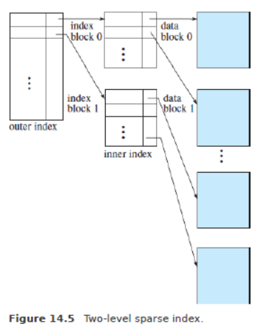
To deal with this problem, we treat the index just as we would treat any other sequential file, and we construct a sparse outer index on the original index, which we now call the inner index,

Slide 18
Index update (Insertion)
Dense indices:
1. If the search-key value does not appear in the index, the system inserts an index entry with the search-key value in the index at the appropriate position.
2. Otherwise the following actions are taken:
a. If the index entry stores pointers to all records with the same search-key value, the system adds a pointer to the new record in the index entry.
b. Otherwise, the index entry stores a pointer to only the first record with the search-key value. The system then places the record being inserted after the other records with the same search-key values.

Slide 19
Index update (Insertion)
Sparse indices: We assume that the index stores an entry for each block.
If the system creates a new block, it inserts the first search-key value (in search-key order) appearing in the new block into the index.
If the new record has the least search-key value in its block, the system updates the index entry pointing to the block;
if not, the system makes no change to the index.

Slide 20
Index update(Deletion)
Dense indices:
1. If the deleted record was the only record with its particular search-key value, then the system deletes the corresponding index entry from the index.
2. Otherwise the following actions are taken:
a. If the index entry stores pointers to all records with the same search-key value, the system deletes the pointer to the deleted record from the index entry.
b. Otherwise, the index entry stores a pointer to only the first record with the search-key value. In this case, if the deleted record was the first record with the search-key value, the system updates the index entry to point to the next record.

Slide 21
Index update(Deletion)
Sparse indices:
1. If the index does not contain an index entry with the search-key value of the deleted record, nothing needs to be done to the index.
2. Otherwise the system takes the following actions:
a. If the deleted record was the only record with its search key, the system replaces the corresponding index record with an index record for the next search-key value (in search-key order). If the next search-key value already has an index entry, the entry is deleted instead of being replaced.
b. Otherwise, if the index entry for the search-key value points to the record being deleted, the system updates the index entry to point to the next record with the same search-key value.

