Slide 1
Lecture 15
Network Programming and Java Socket

Slide 2
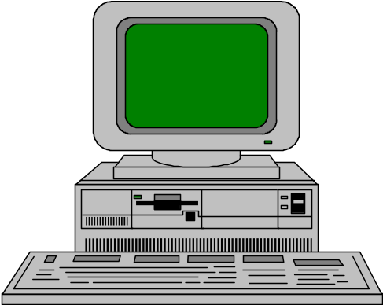
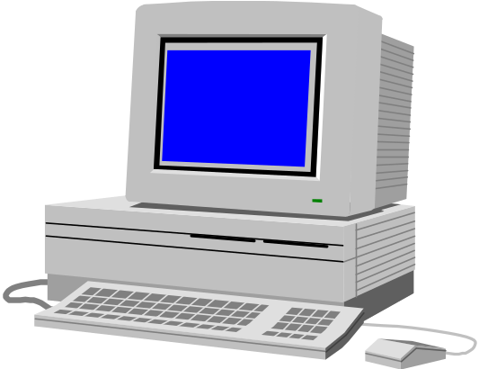
Element of Client-Server Programming
a client, a server, and network
Request
Client
Server
Network
Result

Slide 3
Client Server Model
Relationship between two computer programs.
Client
  Initiates communication
  Requests services
Server
  Receives communication
  Provides services
Client
Server
Client
Client
Server
Client

Slide 4
Client Programming
Basic steps
  Determine server location – IP address & port
  Open network connection to server
  Write data to server (request)
  Read data from server (response)
  Close network connection
  Stop client

Slide 5
Server Programming
Basic steps
  Determine server location - port (& IP address)
  Create server to listen for connections
  Open network connection to client
  Read data from client (request)
  Write data to client (response)
  Close network connection to client
  Stop server

Slide 6
Networking in Java
Packages
  java.net ⇒ Networking
  java.io ⇒ I/O streams & utilities
  java.rmi ⇒ Remote Method Invocation
  java.security ⇒ Security policies
  java.lang ⇒ Threading classes

Slide 7
Networking Basics
TCP/IP Stack
Applications Layer
Transport Layer
  TCP
  UDP
  Programming Interface:
    Sockets
Network Layer
  IP
Link Layer
Physical Layer
Application
(http,ftp,telnet,…)
Transport
(TCP, UDP,..)
Network
(IP,..)
Link
(device driver,..)
Physical Layer

Slide 8
Understanding Ports
The TCP and UDP protocols use ports to map incoming data to a particular process running on a computer.
server
P
o
r
t
TCP
Client
app
app
app
app
port
port
port
port
TCP or UDP
Packet
Data
port#
data
8

Slide 9
Understanding Ports
Port is represented by a positive (16-bit) integer value
Some ports have been reserved to support common/well known services:
  ftp 21/tcp
  telnet 23/tcp
  smtp 25/tcp
  login 513/tcp
User level process/services generally use port number value >= 1024

Slide 10
Sockets
Sockets provide an interface for programming networks at the transport layer.
Network communication using Sockets is very much similar to performing file I/O
  In fact, socket handle is treated like file handle.
  The streams used in file I/O operation are also applicable to socket-based I/O
Socket-based communication is programming language independent.
  That means, a socket program written in Java language can also communicate to a program written in Java or non-Java socket program.

Slide 11
Socket Communication
A server (program) runs on a specific computer and has a socket that is bound to a specific port. The server waits and listens to the socket for a client to make a connection request.
server
Connection request
port
Client

Slide 12
Socket Communication
If everything goes well, the server accepts the connection. Upon acceptance, the server gets a new socket bounds to a different port. It needs a new socket (consequently a different port number) so that it can continue to listen to the original socket for connection requests while serving the connected client.
server
port
port
Client
port
Connection

Slide 13
STREAM SOCKETS
Two classes are involed:
  java.net.ServerSocket
  java.net.Socket
Main steps:
  Establishing the connection
  Open streams for input/output
  Send/receive data network
  Server Client
Server socket
4455
output
output
input
input

Slide 14
Implementing a Server
1. Open the Server Socket:
ServerSocket server;
DataOutputStream os;
DataInputStream is;
server = new ServerSocket( PORT );
2. Wait for the Client Request:
Socket client = server.accept();
3. Create I/O streams for communicating to the client
is = new DataInputStream( client.getInputStream() );
os = new DataOutputStream( client.getOutputStream() );
4. Perform communication with client
Receive from client: String line = is.readLine();
Send to client: os.writeBytes("Hello\n");
5. Close sockets: client.close();

Slide 15
Implementing a Client
1. Create a Socket Object:
client = new Socket( server, port_id );
2. Create I/O streams for communicating with the server.
is = new DataInputStream(client.getInputStream() );
os = new DataOutputStream( client.getOutputStream() );
3. Perform I/O or communication with the server:
  Receive data from the server:
String line = is.readLine();
  Send data to the server:
os.writeBytes("Hello\n");
4. Close the socket when done:
client.close();

Slide 16
A simple server (simplified code)
import java.net.*;
import java.io.*;
public class SimpleServer {
public static void main(String args[]) throws IOException {
ServerSocket s = new ServerSocket(1234);
Socket s1=s.accept();
DataOutputStream os;
os = new DataOutputStream(s1.getOutputStream());
os.writeBytes("Hello from Server\n")
os.close();
s1.close();
}
}

Slide 17
A simple client (simplified code)
import java.net.*;
import java.io.*;
public class SimpleClient {
public static void main(String args[]) throws IOException {
Socket s1 = new Socket(“127.0.0.1",1234);
DataInputStream is;
is = new DataInputStream(s1.getInputStream() );
String line = is.readLine();
System.out.println(line);
is.close();
s1.close();
}
}

Slide 18
Chapter 20 of your Text Book

