Slide 1


An investigation of the spatial divergence in housing affordability in Denmark

Slide 2

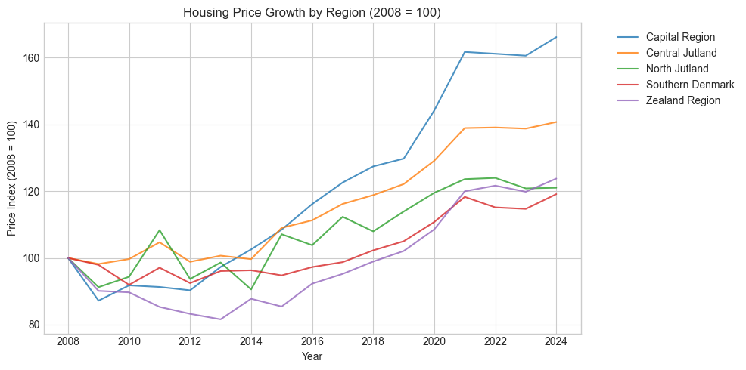
The Central Idea
Notes:
Housing prices in Denmark vary significantly across municipalities and regions. This project examines whether affordability is diverging between urban and rural areas, as these differences can reveal growing regional inequality and broader socioeconomic trends.

Slide 3
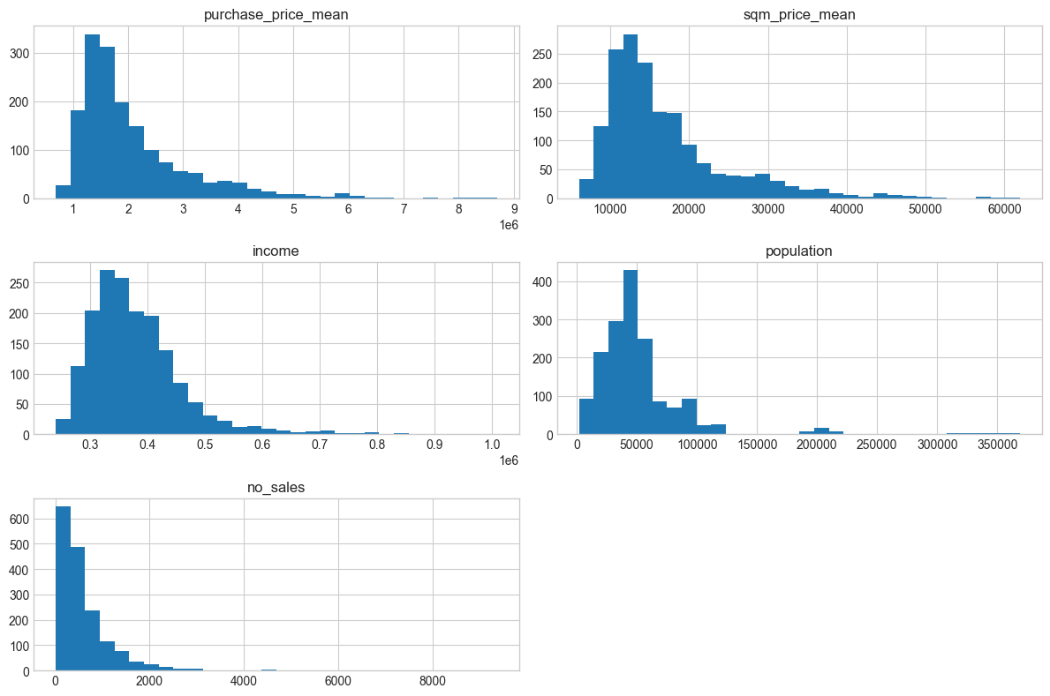
The Data and Fundamental Distributions
Datasets used:
Housing transactions (2008–2024, ~1.5 million sales)
Municipal income data (~1666 rows)
Population data (~1666 rows)
Data size:
Housing: 1,507,908 rows, 19 columns, 43 MB
Income and population: 1,666 rows, 4 columns, ~80 kB each
Combined dataset: 1,666 rows, 16 columns, 280 kB
Variables:
Time range: 2008–2024
Geographic scope: All Danish municipalities (geo-data)
Variables include: Municipality, Region, Year, Price, Sqm price, Interest rate, #sales, Income, Population
Notes:
We combine three datasets: housing transactions from 2008 to 2024 with about 1.5 million sales, municipal income data and population data with about 1600 rows each. The dataset covers all Danish municipalities over time and includes variables like prices, interest rates, number of sales, income, and population.

Slide 4
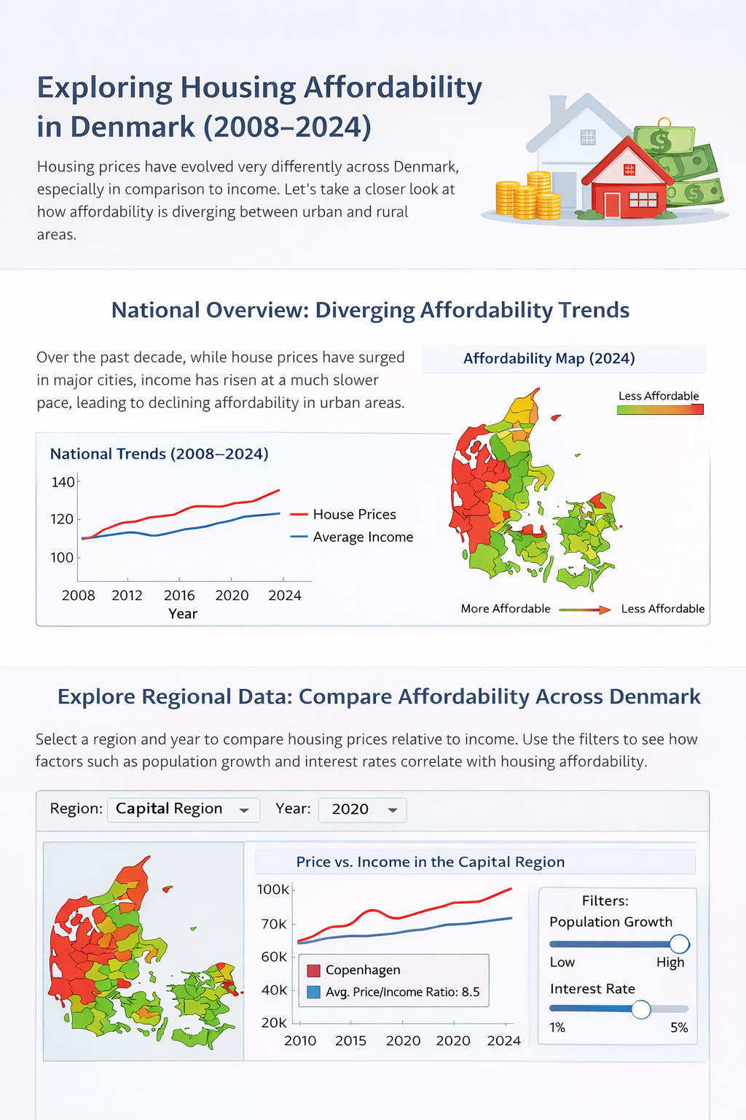
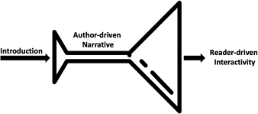
Genre and visualizations
https://www.researchgate.net/figure/Martini-glass-structure_fig1_385683496
Notes:
We want to build a Martini Glass–structured webpage, as This helps communicate a complex socioeconomic story in an accessible and interactive way.
We start with a guided national overview of housing affordability in Denmark, then transition into an interactive section where users explore and learn about regional differences in prices, income, and affordability.

Slide 5
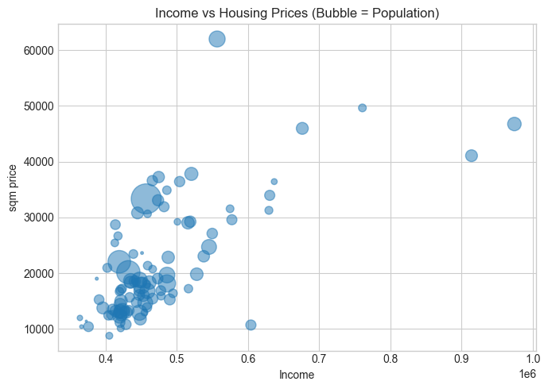
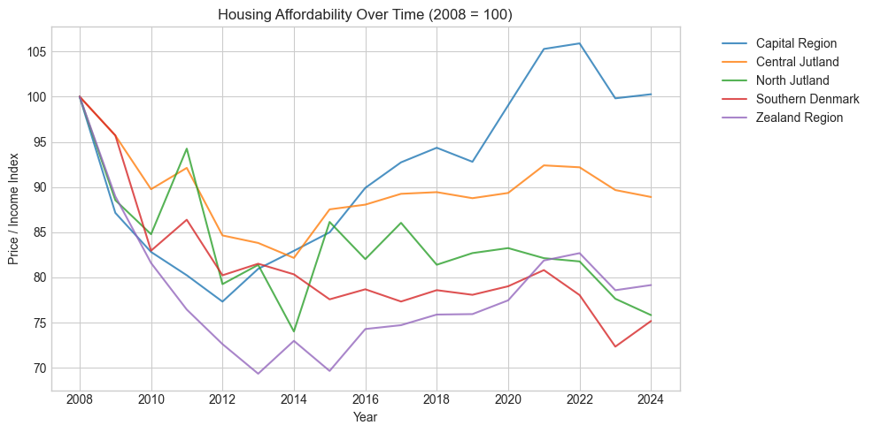
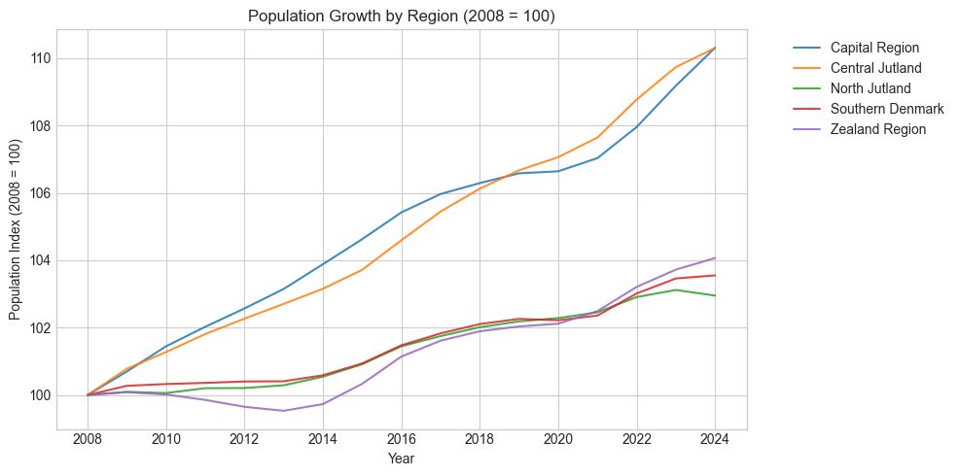
Notes:
The Capital Region becomes increasingly expensive relative to income, while other regions remain stable or even become more affordable.
This indicates a growing divide in housing accessibility across Denmark, which we wish to investigate further

