Slide 1
US REGIONAL SALES REPORT
A SQL PROJECT BY SANDRA ASAGADE

Slide 2

INTRODUCTION
Over the past 3 weeks, I’ve been focused on learning basic SQL; how to query a data, how to use joins, window functions, how to create stored procedure and so many more. This is the last week of my SQL Track (from my 3 months data challenge), and I’m ending it with this particular project. In this project, I’m going to be sharing the steps I took in analyzing the data, and I’ll also be transparent and sincere with my report.
ABOUT THE DATA
This project is about using SQL (Structured Query Language) to perform exploratory data analysis. The US Regional Sales data was gotten from Kaggle. It is a fictitious (imaginary) sales data for a certain company across the US regions. It’s a csv file broken down into 6 tables; customers, location, region, products, sales_team, and sales_order tables
TOOL USED
I made use of MySQL Workbench because it is what I’m more familiar with. In case you’re wondering what MySQL is, I mentioned it in my recent blogpost.

Slide 3
TABLES
customer
_CustomerID | int
CustomerNames | text
location
_StoreID | int
CityName | text
County | text
StateCode | text
State | text
Type | text
Latitude | double
Longitude | double
AreaCode | int
Population | int
Household Income | int
Median Income | int
Land Area | int
Water Area | int
Time Zone | text
sales_order
OrderNumber | text
SalesChannel | text
WarehouseCode | text
ProcuredDate | text
OrderDate | text
ShipDate | text
DeliveryDate | text
CurrencyCode | text
_SalesTeamID | int
_CustomerID | int
_StoreID | int
_ProductID | int
OrderQuantity | int
DiscountApplied | double
UnitPrice | double
UnitCost | double
product
_ProductID | int
ProductName | text
sales_team
_SalesTeamID | int
SalesTeam | text
Region | text
region
StateCode | text
State | text
Region | text

Slide 4
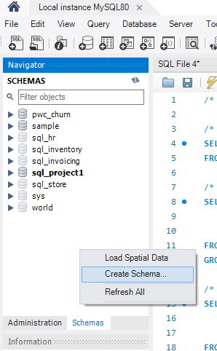
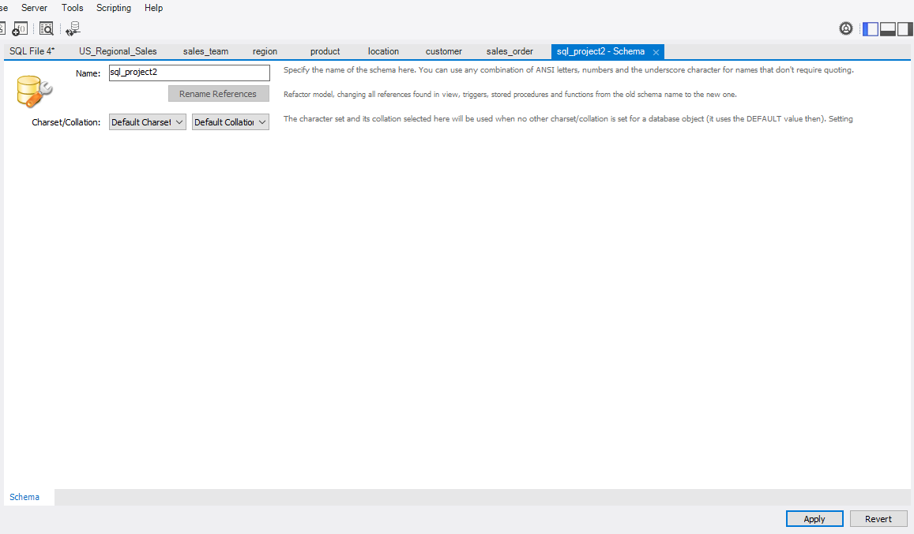
LOADING THE DATA – Create Schema
Whitespace
Rename Scheme Here
Since it is a new project, it is advisable to create a new schema. Right-click on the whitespace in the schema pane and click on ‘Create Schema’. A new page will be displayed, there you can rename your schema (I named mine ‘sql_project1’) and then click on ‘Apply’.

Slide 5
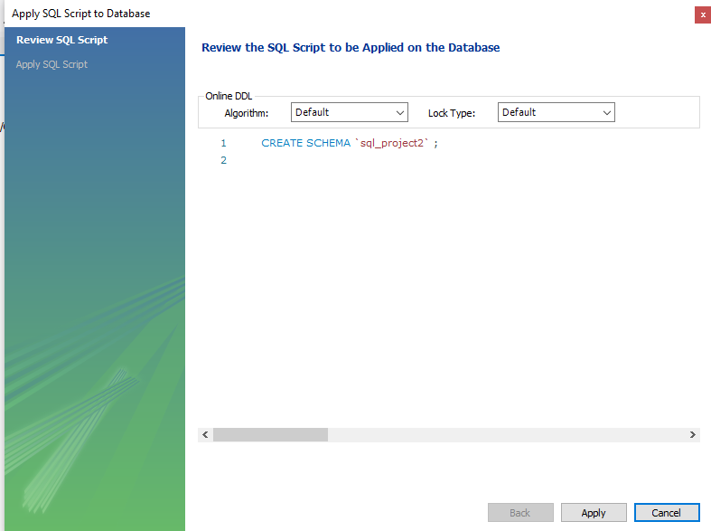
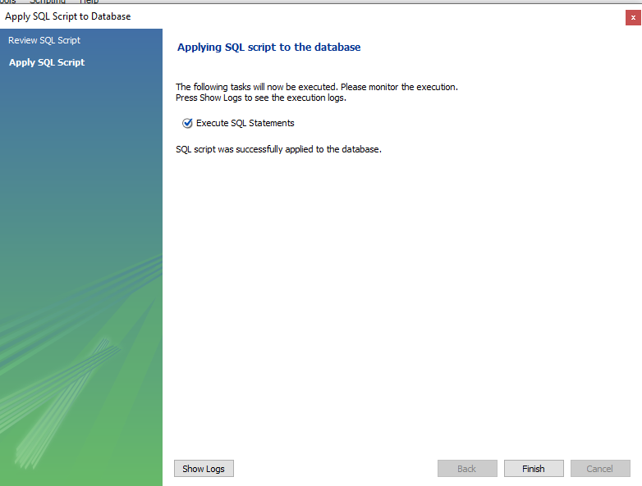

A pop-up page will be displayed asking you to review the SQL script (You can also create your schema this way in the SQL editor as shown in the pop-up). After reviewing the script and you are sure that it is correct, click on ‘Apply’ and then click ‘Finish’. On your schema pane, you would see a refresh icon, click on it to refresh your schema so it appears in the database
Refresh Icon

Slide 6
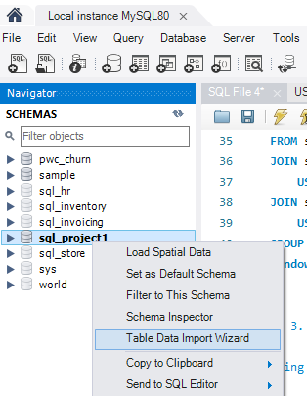
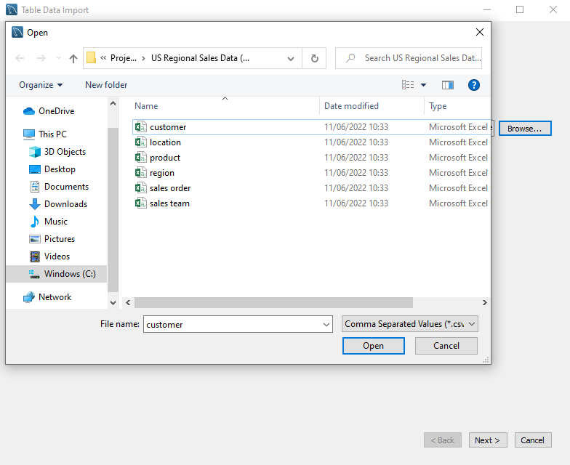
LOADING THE DATA – Importing tables (data)
Right-click on your new schema and click on ‘Table Data Import Wizard’. A pop-up will be displayed asking for the file path to the data, you can either copy and paste the file path or browse and select manually. In my own case, I browsed manually by clicking on ‘Browse’ and selecting the data, and then clicking on ‘Next >’.

Slide 7
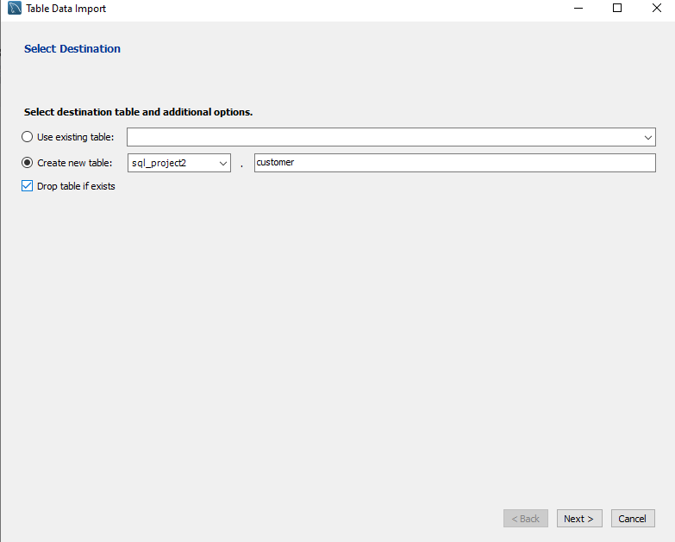
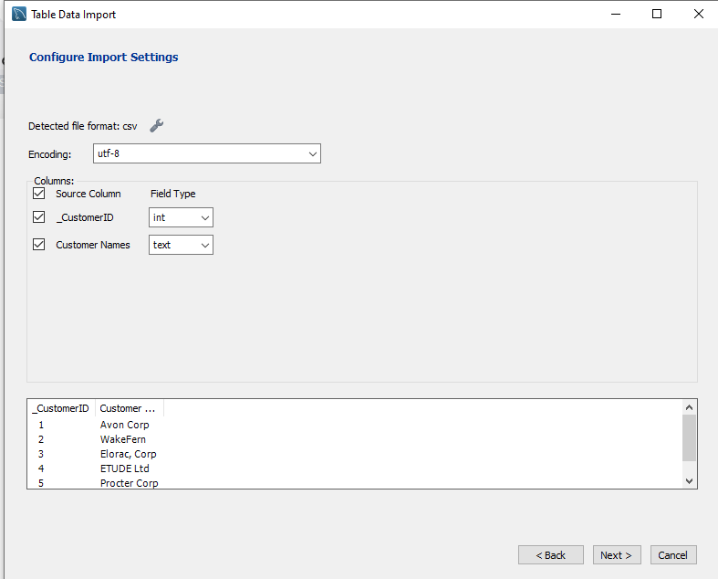
In the next pop-up, ensure to check the box that says ‘Drop table if exists’ as it would prevent duplicate tables. After doing all that, click on ‘Next >’. Another pop-up will be displayed showing you the columns in the data and their respective data types, you can choose to select the columns you want to import manually or select all and click on ‘Next >’.

Slide 8
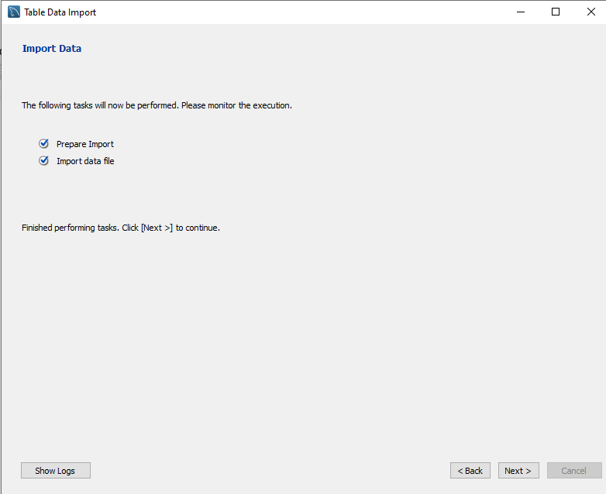
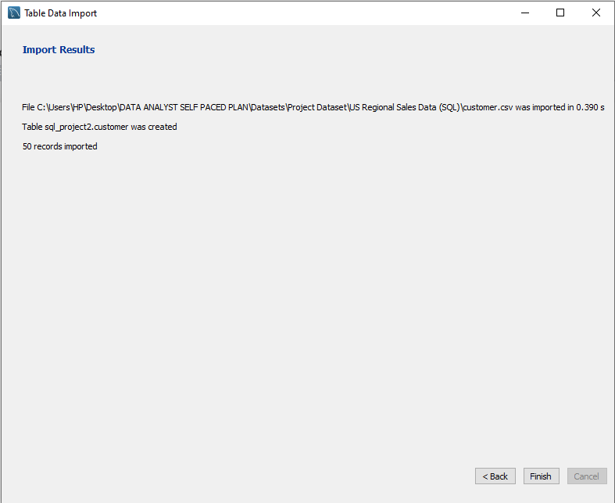
In the next pop-up that says ‘Import Data’, wait for the data to be imported and click on ‘Next >’ and finally in the next and final pop-up that says ‘Import Results’, click on ‘Finish’ and the refresh your schema to apply changes. I imported 6 tables; the customer, location, region, sales_team and sales_order tables. (NOTE: They have to be in csv format.)

Slide 9
EXPLORATORY DATA ANALYSIS
Now that the tables have been imported, it’s time for the interesting part, which is analyzing the data. Before I began analyzing the data, I listed out a couple of questions that would help me in writing the right queries to get insights for the analysis.
Are there duplicates in the data?
Are the data types correct?
What is the total number of transactions made, total quantity of products ordered, total revenue and total profit?
What is the total number of transactions made, total quantity of products ordered, total revenue and total profit per order date?
What is the total transaction per sales channel?
What is the total number of customers and sales teams?
What is the total number of transaction for each customer?
What is the total number of stores in each region?
What is the total number of states in each region?
What is the total transaction per location type?
What is the total revenue and profit in each region?
What is the date difference between the order date and the delivery date?
How did each sales team perform based on the total transaction, total quantity sold and revenue made?
What are the most expensive and least expensive products ordered by customers?
How can I view the sales order of any sales team by just entering their name?
Notes:
Hhnm;
‘;;’k

Slide 10
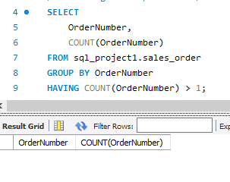
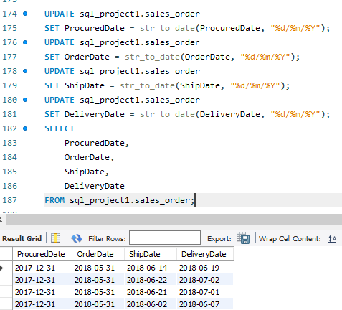
1. Are there duplicates in the data?
2. Are the data types correct?
After importing the tables, I discovered that the date columns where of type TEXT, and in order for me to be able to use the date functions, I had to change the type to DATE type
There were no duplicate entries in the data, and that is why the result is empty

Slide 11
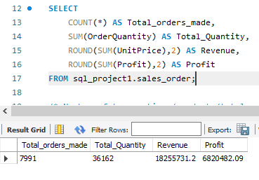
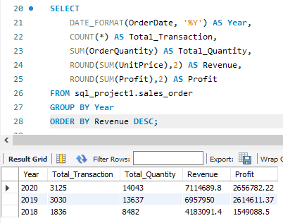
3. What is the total number of transactions made, total quantity of products ordered, total revenue and total profit?
4. What is the total number of transactions made, total quantity of products ordered, total revenue and total profit per order date?
Company’s revenue and profit increased continuously from 2018 to 2020

Slide 12
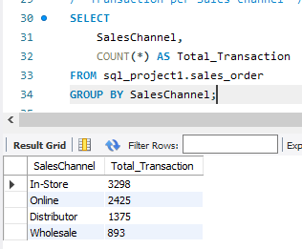
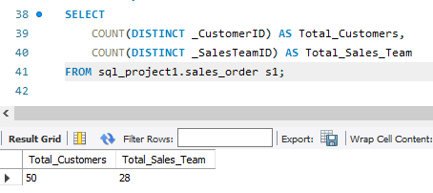
5. What is the total transaction per sales channel?
6. What is the total number of customers and sales teams?

Slide 13
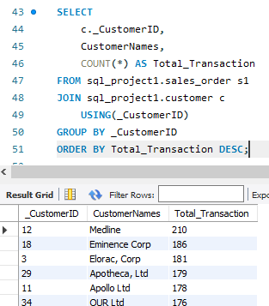
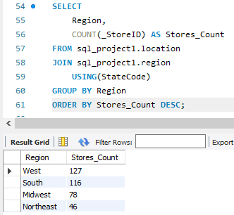
7. What is the total number of transaction for each customer?
8. What is the total number of stores in each region?
Out of the 50 customers who have been ordering, these are the top 6, with Medline being the customer who ordered the most.

Slide 14
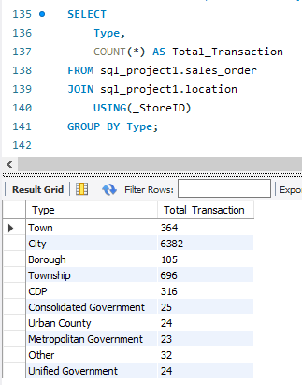
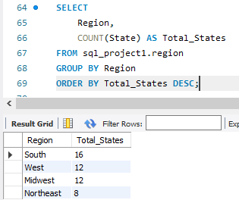
9. What is the total number of states in each region?
10. What is the total transaction per location type?
Customers who are based in the city ordered more than customers in other location type.

Slide 15
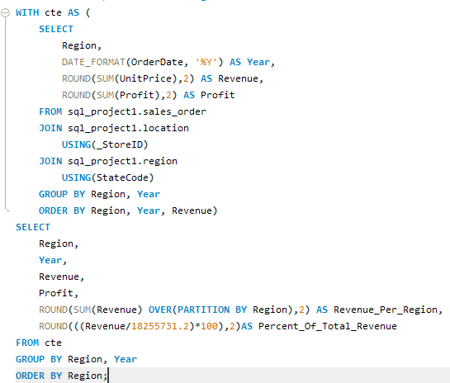
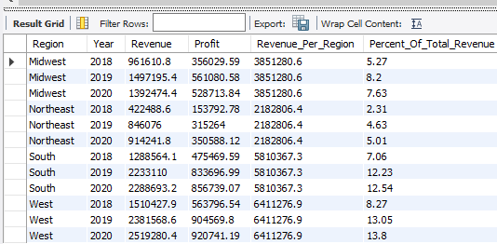
What is the total revenue and profit in each region?
Results
Region: Shows the 4 different regions in US
Year: Distinct years of sales for each region
Revenue: Total revenue for each region in their respective years
Profit: Total profit for each region in their respective years
Revenue_Per_Region: Total revenue for each region
Percent_Of_Total_Revenue: Percentage of total revenue made each region in their respective years

Slide 16
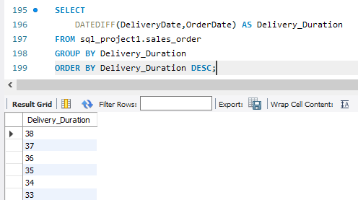
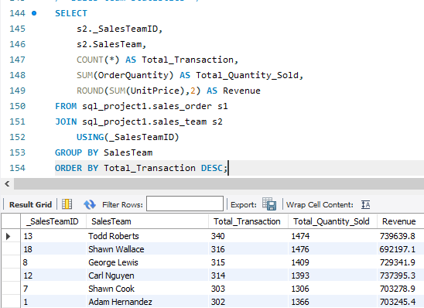
12. What is the date difference between the order date and the delivery date?
13. How did each sales team perform based on the total transaction, total quantity sold and revenue made?
So here, I wanted to know how long it takes products to get to the customers from the day it was ordered to the day it was delivered.

Slide 17
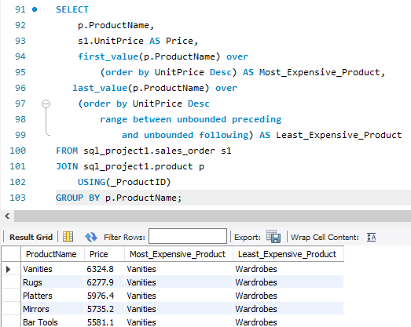
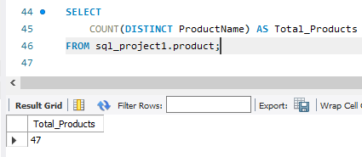
14. What are the most expensive and least expensive products ordered by customers?
Total number of products
There are 47 products all together. The most expensive is Vanites, while the least expensive is Wardrobes.

Slide 18
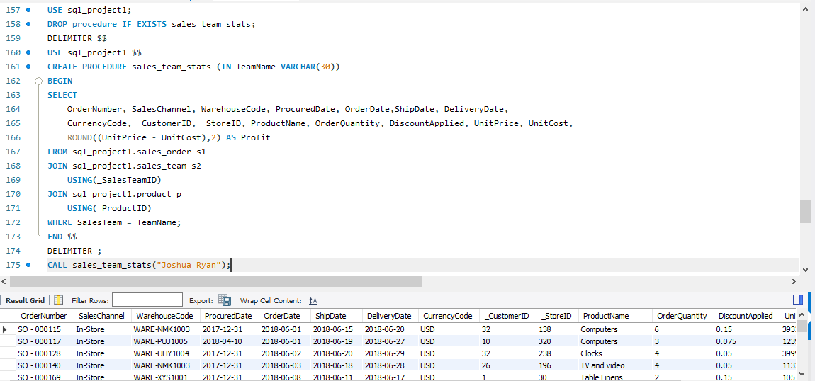
15. How can I view the sales order of any sales team by just entering their name?
I wanted to know the sales order of individual sales team, so that when I enter or input a particular sales team name, I get to see how customers ordered, what they ordered for, the quantity, price, etc.

Slide 19
CONCLUSION
I’ve heard people talk about their love for the GROUP BY clause, I didn’t quite understand why, but doing this project, I made use of it 90% of the queries.
I made use of inner join all through because I was focusing majorly on the sales_order table.
Importing the sales_order table took a long time because it contained 7991 entries. I might have to consider using another another DBMS in my next project.
SQL might seem weird for starters, but it is really a straight-forward language if we understand the problem or question we are trying to answer.
Thanks for reading and going through my project’s report. I am rooting for everyone who is still struggling with SQL queries, don’t stop practicing!

Slide 20
THE END

