Slide 1
Evolution of Communal Roosting Behavior in Birds
Sandra Cuadros
MSc.
BIOL 520 C

Slide 2
Context
Communal Roosting Behavior of Birds has evolved several times in different clades. This suggests there are benefits to this behavior.
A strong hypothesis suggests that one of the benefits of CRB is information sharing of food sources.
Some species may benefit from this behavior more than others.. So the question is:
What biological variables may determine the evolution of this behavior?

Slide 3
Competing hypotheses
H0: Evolution of Communal Roosting Behavior is just explained by evolutionary relatedness (phylogeny). No particular benefits to this behav.
H1: Evolution of Communal Roosting Behavior is explained by some biological variables but also affected by evolutionary relatedness (phylogeny)

Slide 4


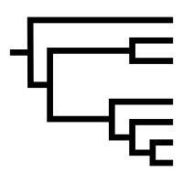
Workflow
CRB and biological variables
Collinearity and dropping variables
Phylogenetic data
Run models
Model CRB as a function of the selected predictors and compare
Databases and literature review
Run correlation on variables
VertLife and tree with phytools

Slide 5
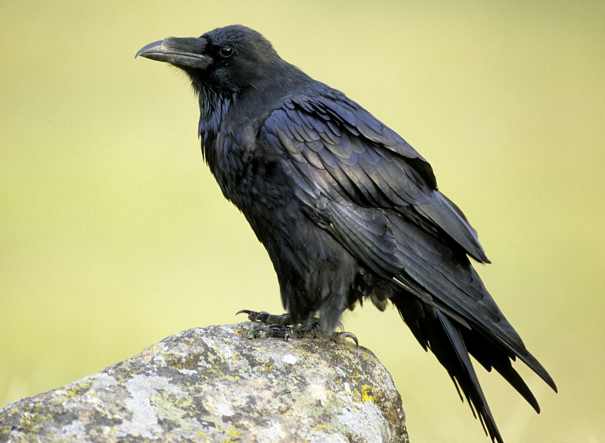
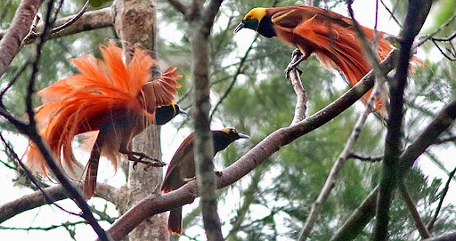
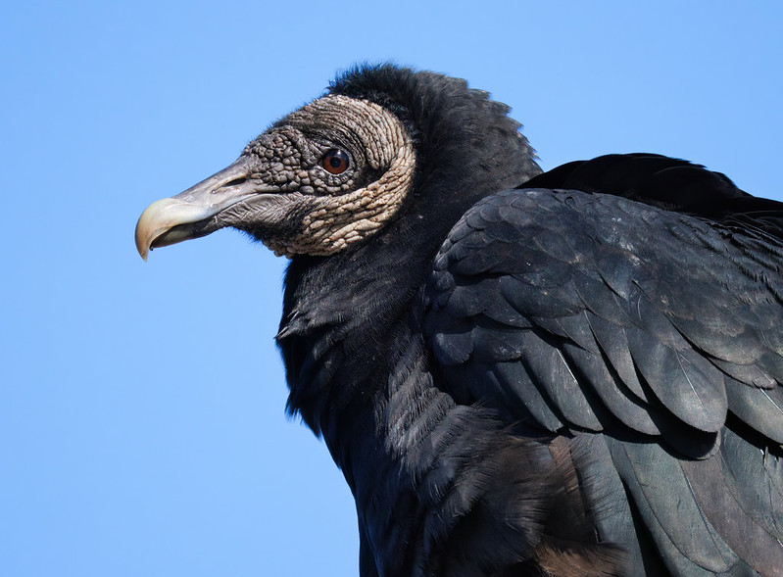
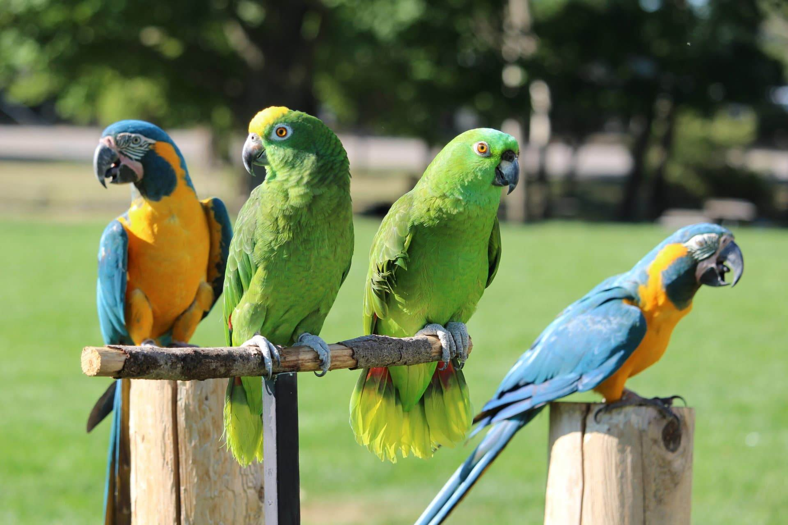
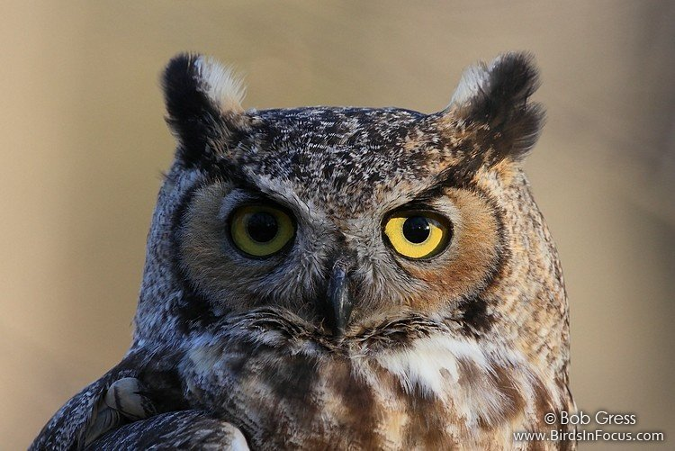
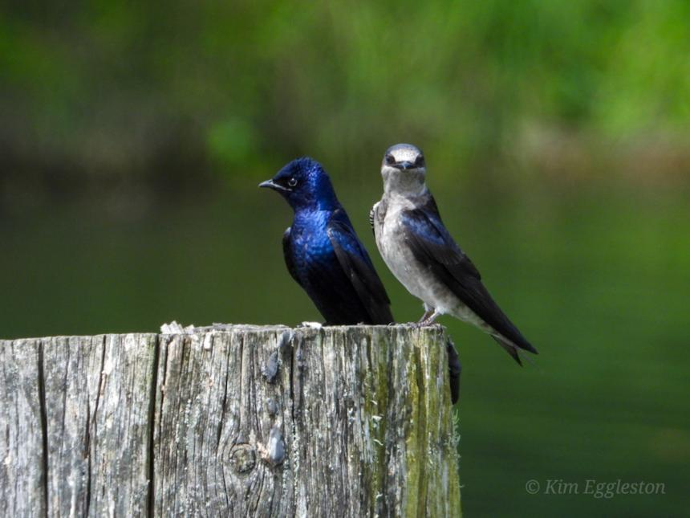
~8000 spp

Slide 6
METHODS
Predictor variables – biological
HWI – dispersal ability
Trophic Level
Mass (g)
Brain size – brain mass (kg)/volume (mm3)
Check for collinearity:
cor(Bird_data_clean$Mass, Bird_data_clean$HWI)
cor(Bird_data_clean_brain$Mass, Bird_data_clean_brain$brain_mass)
Mass and HWI showed little correlation (0.17), however mass and brain mass do show correlation of 0.7 This means that perhaps both variables should not be in the model or perhaps they can be included as interaction terms.

Slide 7
METHODS - II
Response variable – Communal Roosting Behavior (0,1)
- Null hypothesis model:
null_model <- brm(CRB_Final ~ 1 + (1|gr(phylogeny, cov = A)),
data = sub, #species in both phylogenetic trees and dataset
data2 = list(A = A), #matrix of spp
family = bernoulli(), #dist family w logit link function
iter=100000,
cores = 4)
Phylogenetic trees were available do download from VertLife (https://vertlife.org/phylosubsets/)

Slide 8
METHODS - III
Response variable – Communal Roosting Behavior (0,1)
- All data model:
Model_1 <- brm(CRB_Final ~ Mass + Trophic_level + HWI + (1|gr(phylogeny, cov = A)),
data = sub,
data2 = list(A = A),
family = bernoulli, #family of dis of resp var
iter = 1e6, warmup = 5e5,
chains = 8))
GLM(mixed effect to include phylogeny as a random effect) with brms package.
This package allows for more flexibility of the genetic hierarchy as well as bernoulli function to handle binomial response variables.

Slide 9
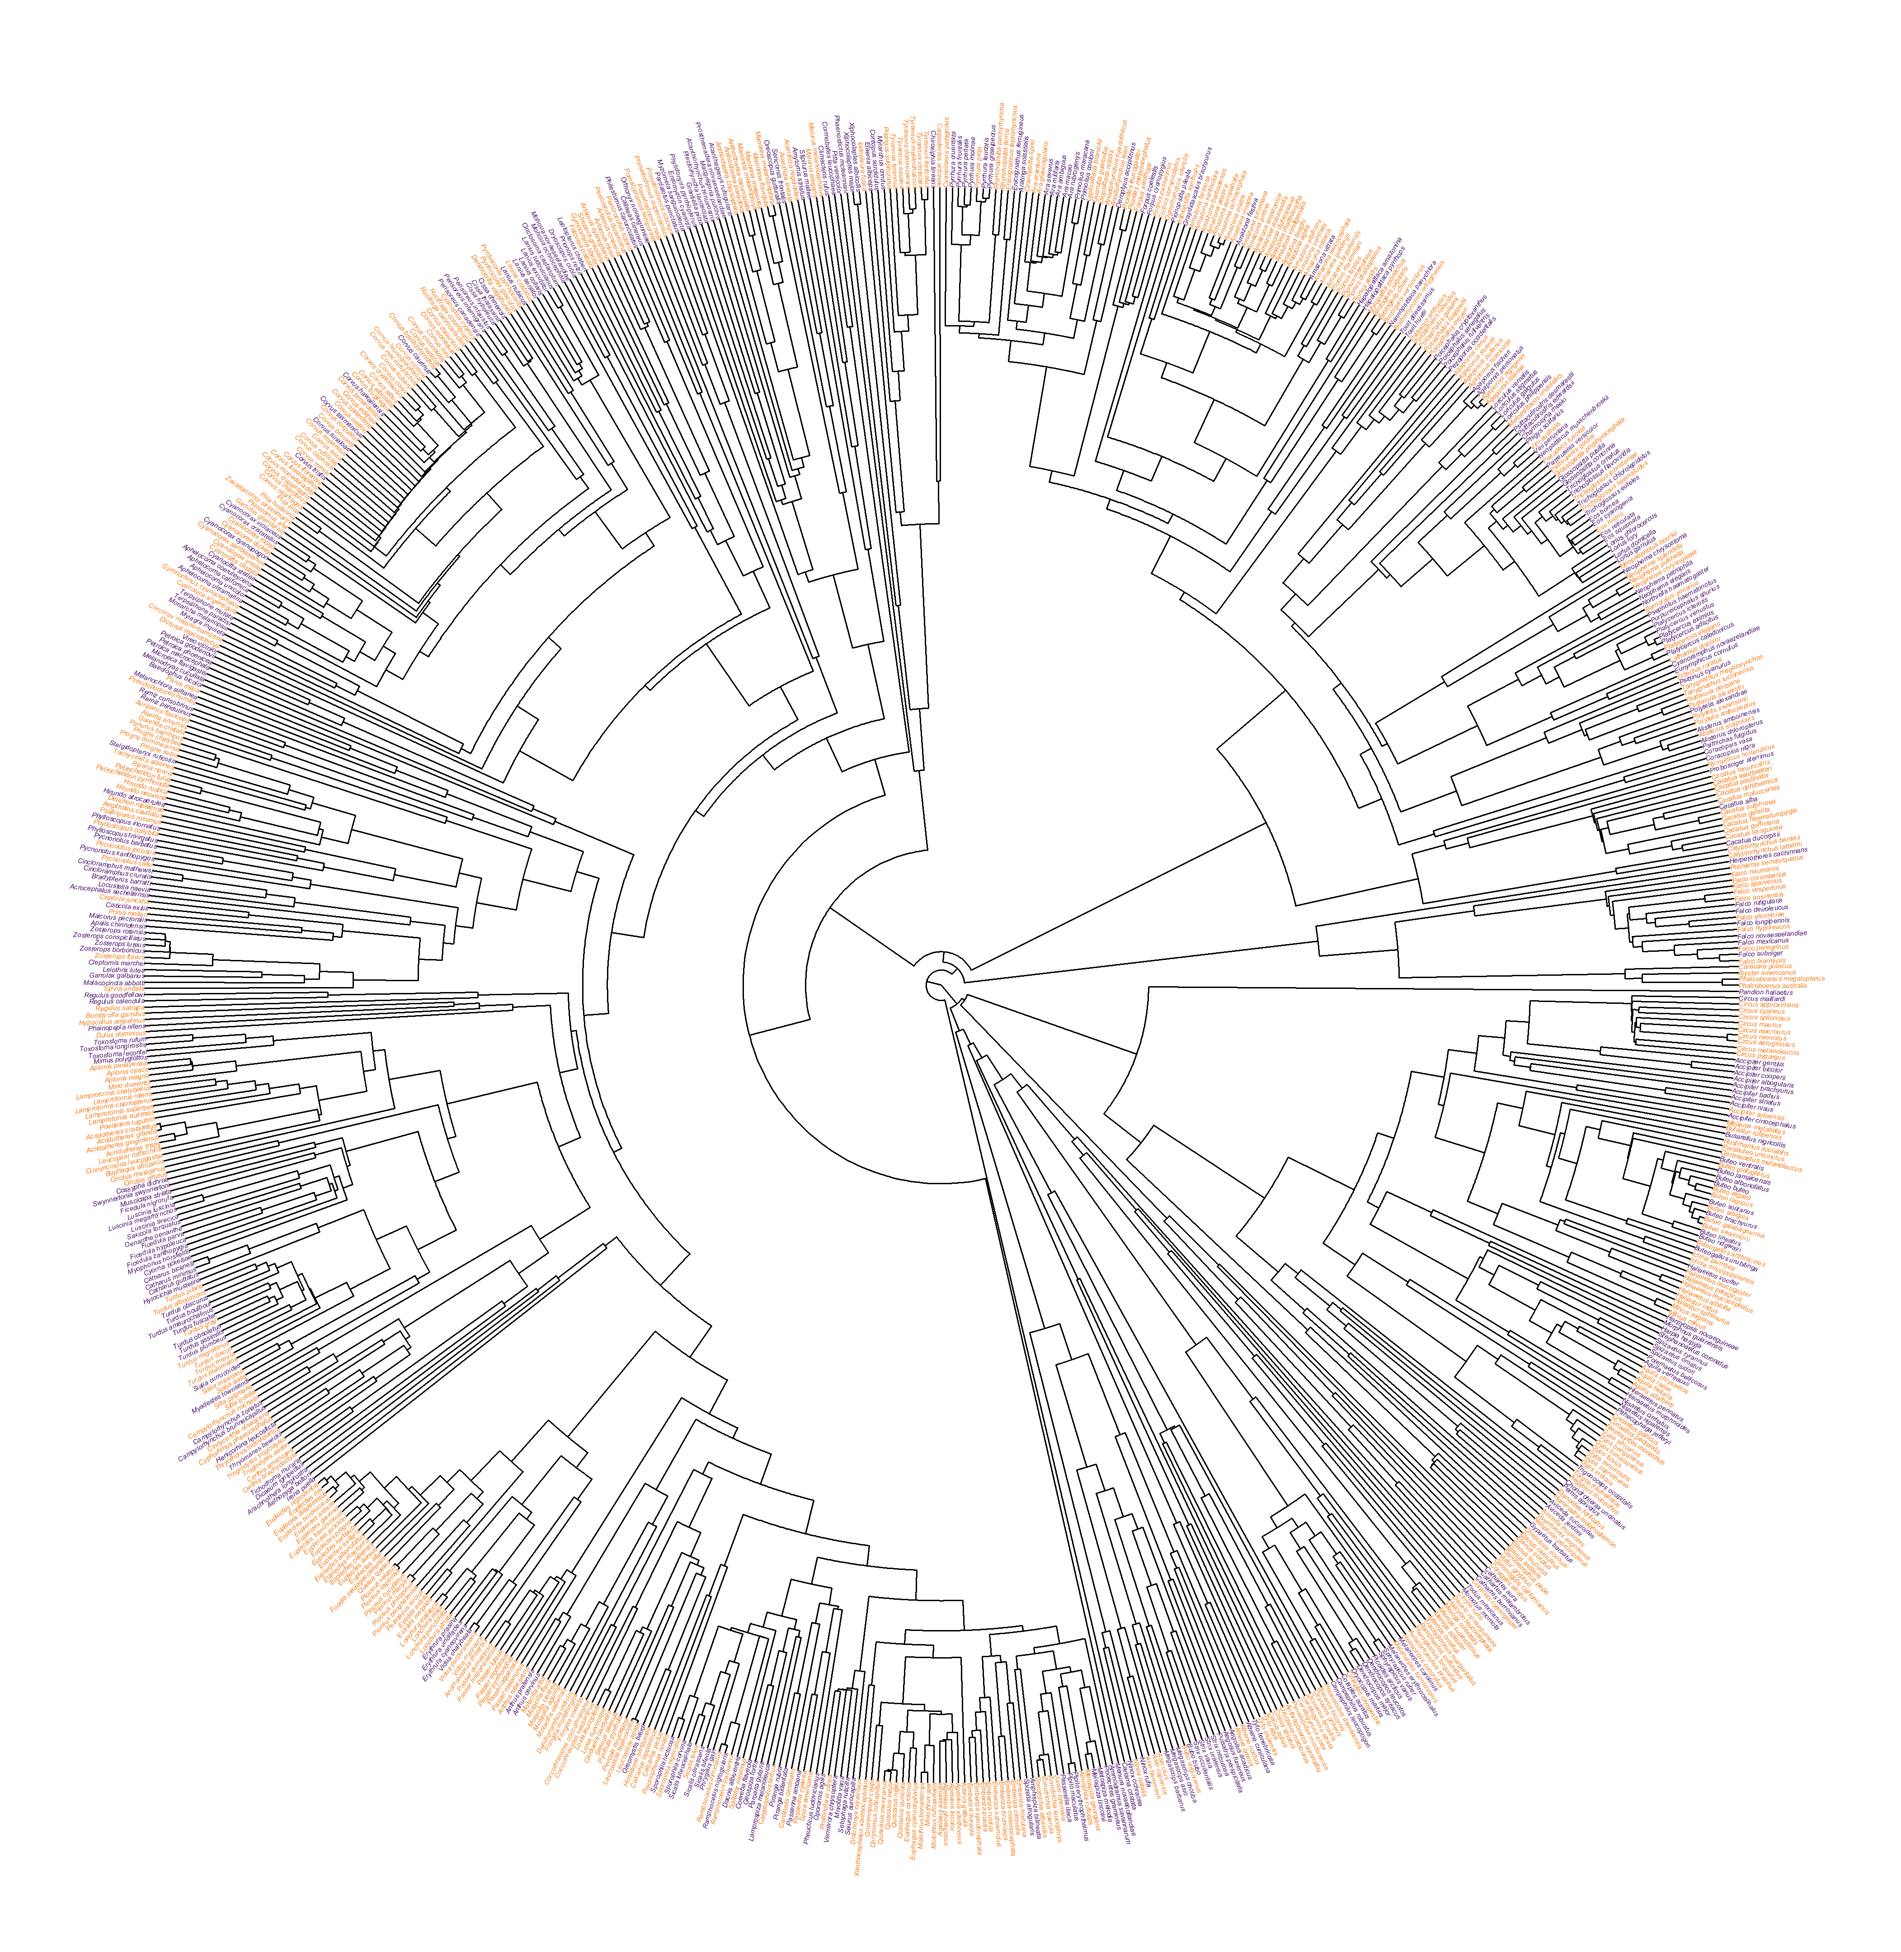
RESULTS I
Selected species (946)
and CRB

Slide 10
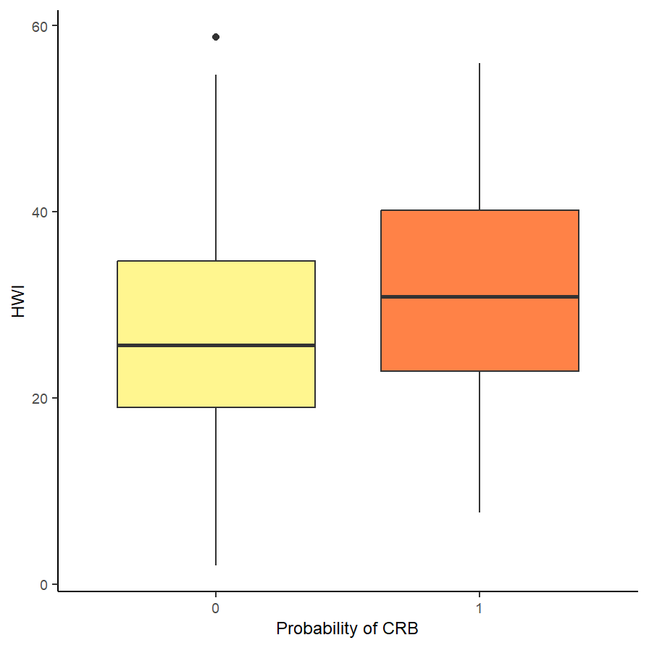
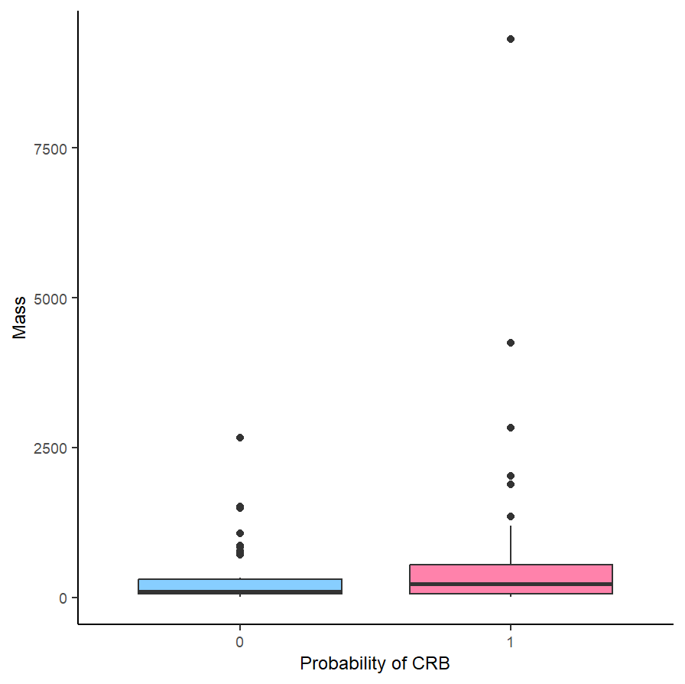
RESULTS II

Slide 11
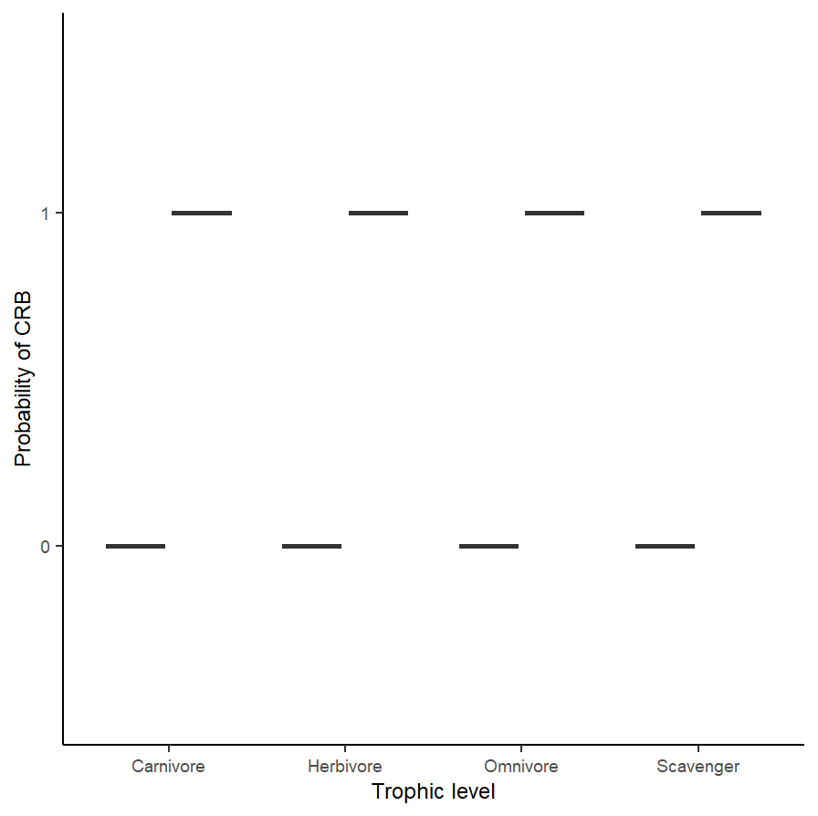
RESULTS II

Slide 12
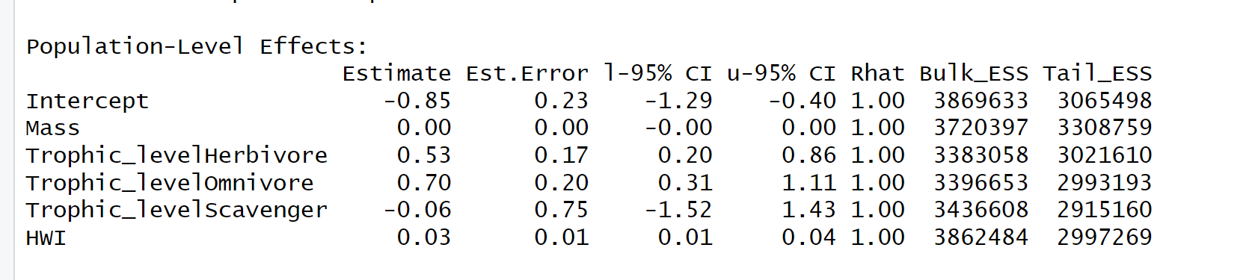
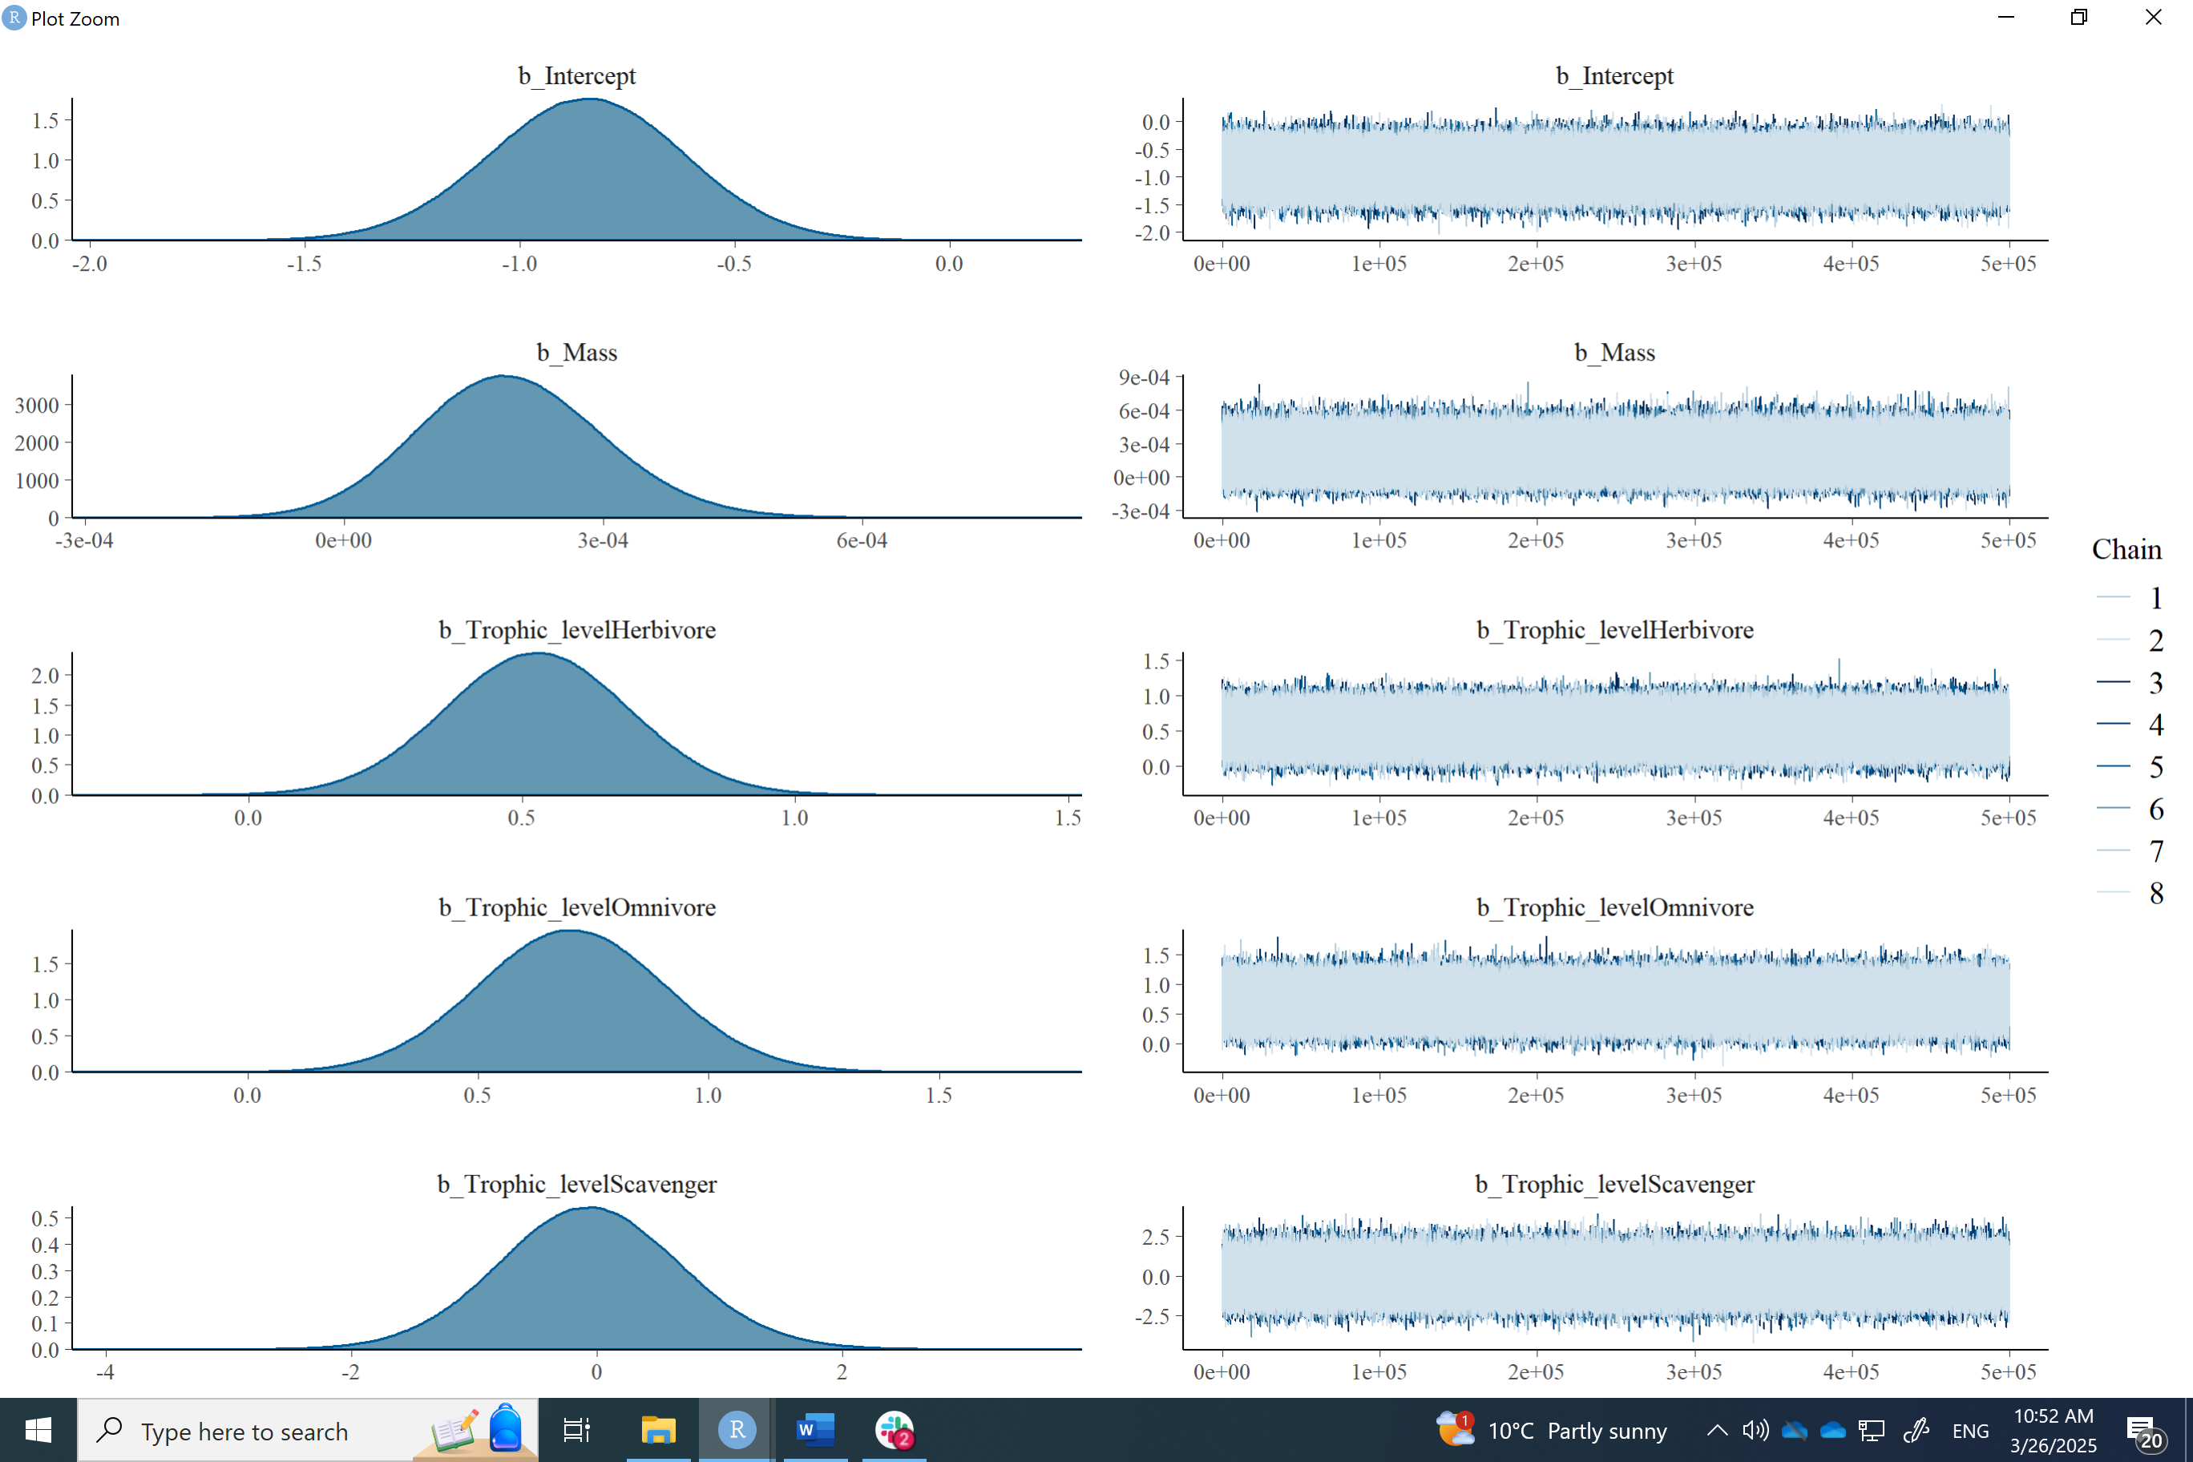
RESULTS III
No significance for scavengers
Caveat: phylogeny not accounted for in this model

Slide 13
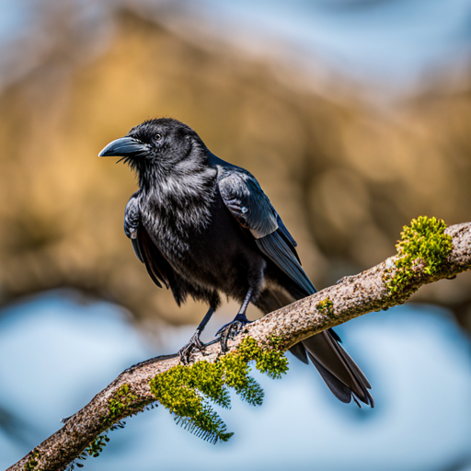
Future steps
Run the all data model on a subset number of species
Run the model above and include brain mass/body mass residuals as a predictor
Run the model above and include brain mass: body mass as an interaction term.
Compare models using DIC (eq to AIC in Bayesian)
model_phylo <- brm( Communal_roosting_behav ~ Mass + Trophic_level + HWI + Residuals_body_mass + (1|gr(phylogeny, cov = A)),
data = Bird_data_clean_brain,
data2 = list(A = A),
family = bernoulli,
iter = 1e6, warmup = 5e5, chains = 8))

Slide 14
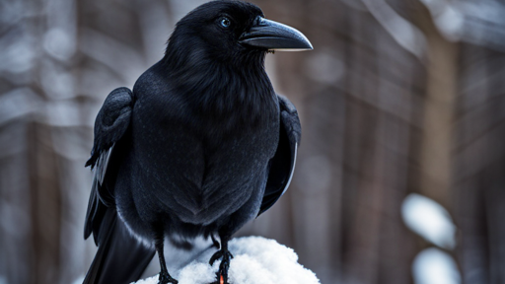
Thanks!

Slide 15
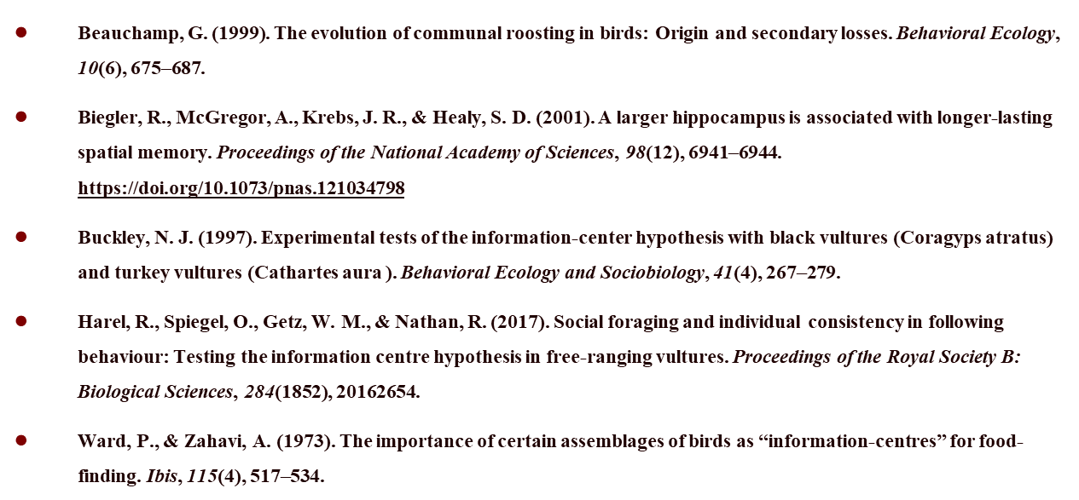
Literature review

