Slide 1

Selenium
Modulo 4a

Slide 2
Locators
CSS
Tag
attributes
XPATH
Absolute
Id
Descendant
Class
Comma
Universal
Siblings
Children
Relative
Text
Attribute
Siblings
Children
Functions

Slide 3
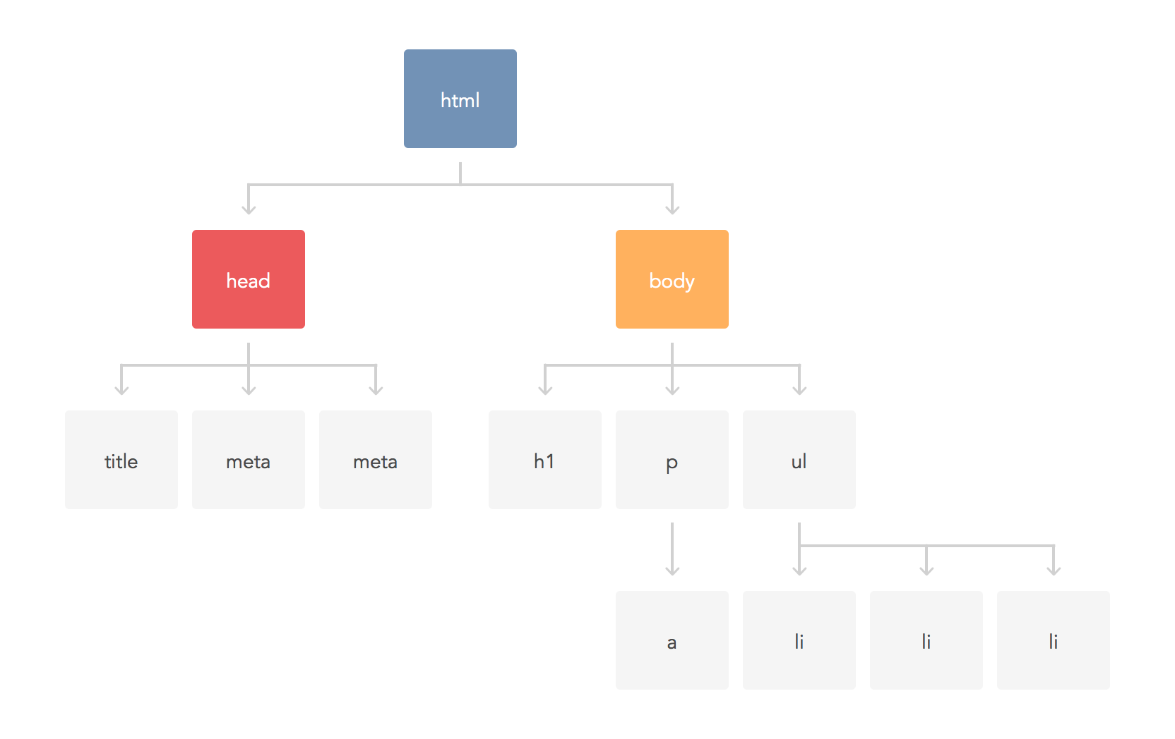
DOM (Document Object Model)
Notes:
xpath absoluto xpath relativo
/html/body/h1 //h1
/html/body/p/a //a
/html/body/ul/li //li[1]
//fulano[ contains(text(), ‘algun texto’ ) ]

Slide 4
WebElements (Elementos HTML)
<h1>Hello World!</h1>
<button>Click me!</button>
<span>8,678</span>
Notes:
//h1[ text() = ‘Hello World!’ ]
//button[ text() = ‘Click me!’ ]
//span[ text()=’8,678’ ]

Slide 5
Atributos HTML
<span class="badge-item-love-count">8,678</span>
ATTRIBUTO
<a class="logo257" href="http://9gag.com" onclick="GAG.GA.track('NavigationBar');">9GAG</a>
ATTRIBUTOS
Notes:
//span[ @class = ‘badge-item-love-count’ ]
//a[ @class = ‘logo’ ]
//a[ @href = ‘http://9gag.com’ ]
contains() => //a[ contains( text() , ‘GAG’) ] => //a[ contains( @class, ‘logo’ ) ]
starts-with() => //a [starts-with( text(), ‘9’ )] ⇒ //a[ starts-with(@class, ‘logo’ )]

Slide 6

CSS Selectors
Language used to describe element style
Dictates how elements are displayed
Elements used:
Tags,
Ids
Classes
Attributes
Siblings,
etc

Slide 7
CSS by Tags
Selecciona elementos por su tipo (etiqueta)
<ul> <li><a class="current" href="/" title="Home">Home</a></li> <li><a href="/about" title="About">About</a></li> <li><a href="/contact" title="Contact">Contact</a></li> <li><a href="/songs" title="Songs">Songs</a></li> </ul>
Ex:
li
a

Slide 8
CSS by Tags
<section class="main content"> <form action="/foo" method="POST"> <label for="foo">Foo:</label> <input id="foo" name="foo" type="text"> <label for="bar">Bar:</label> <input id="bar" name="bar" type="password"> <button>Click Me!</button> </form> </section>Ex:
label
input

Slide 9
CSS by Id
Utiliza el id del element con el simbolo “#”
<section class="main content"> <form action="/foo" method="POST"> <label for="foo">Foo:</label> <input id="foo" name="foo" type="text"> <label for="bar">Bar:</label> <input id="bar" name="bar" type="password"> <button>Click Me!</button> </form> </section>
Ex:
#foo
#bar
input#foo

Slide 10
CSS by class
Utiliza clase del element con el simbolo “.”
<section> <div class="table"> <div class="bento"> <div class="apple"></div> </div> <div class="plate"> <div class="orange"></div> </div> </div> </section>
Ex:
.table
div.bento
div.plate

Slide 11
CSS by Class
<section> <div class="table"> <span class=”apple”>
</span> <div class="plate” id=“ceramic”> <span class=”apple"></div> </div> </div> </section>
Ex:
.apple
.plate

Slide 12
CSS by attribute value
Utiliza el valor o parte del valor de un atributo del element entre “[ ]”
<section class="main content"> <form action="/foo" method="POST"> <label for="foo">Foo:</label> <input id="foo" name="foo" type="text"> <label for="bar">Bar:</label> <input id="bar" name="bar" type="password"> <input type=“submit” value=“Click It”/> </form> </section>
Ex:
label[for=‘foo’]
[for=‘bar’]
[value*=‘Click’]

Slide 13
CSS by attribute value start or end with string
Utiliza el valor o parte del valor de un atributo del element entre “[ ]”
Utilizamos parte del valor con (^) y ($) si el valor comienza o termina con un substring
<section class="main content"> <form action="/foo" method="POST"> <label for="foo">Foo:</label> <input id="foo" name="foo" type="text"> <label for="bar">Bar:</label> <input id="bar" name="bar" type="password"> <input type=“submit” value=“Click It”/> </form> </section>
Ex:
[value^=‘Click’]
[value$=‘It’]

Slide 14
CSS by Descendant
Utiliza tags de la jerarquia del element separadas por espacios
<section> <div class="table"> <div class="bento"> <div class="apple"></div> </div> <div class="plate"> <div class="orange"></div> </div> </div> </section>
Ex:
section div.table
div.table div.bento
div.plate div.orange

Slide 15
CSS combinados, descendentes, class, id, etc.
<section> <div class="table"> <div class="bento"> <span class=”orange"></span> </div> <div class="plate” id=“ceramic”> <div class="orange"></div> </div> </div> </section>
Ex:
section div.table
div.table div.bento
div#ceramic div.orange

Slide 16
CSS combinados por comas
Utiliza el id del element con el simbolo “#”
<section class="main content"> <form action="/foo" method="POST"> <label for="foo">Foo:</label> <input id="foo" name="foo" type="text"> <label for="bar">Bar:</label> <input id="bar" name="bar" type="password"> <button>Click Me!</button> </form> </section>
Ex:
label, input
input, button

Slide 17
CSS siblings
Los elementos al mismo nivel son hermanos
Se puede seleccionar uno solo (+) o varios (~)
<section class="main content"> <form action="/foo" method="POST"> <label for="foo">Foo:</label> <input id="foo" name="foo" type="text"> <label for="bar">Bar:</label> <input id="bar" name="bar" type="password"> <button>Click Me!</button> </form> </section>
Ex:
label[for=“foo”] + input
label[for=“foo”] ~ input

