Slide 1

POLLCAST
Python-based Poll Application
Group members:
Ahila
Indhupriya
Kavya
Manjima
Sandra

Slide 2
CONTENT
INTRODUCTION
AIM & SCOPE
FEATURES
TECHNOLOGIES USED
USER INTERFACE
CONCLUSION

Slide 3
INTRODUCTION
Overview: System serves as an interactive platform for users to cast their votes on various options, making decision-making more democratic and inclusive.
Importance of Polling: Polling is a crucial process in gathering opinions and making informed decisions in various sectors, including business, education, and community engagement.

Slide 4
AIM
To develop an easy-to-use Python-based polling application.
Allow users to vote securely and view real-time results, ensuring transparency and efficiency in the polling process
SCOPE
Create a user-friendly interface for voting.
Implement functionality for result tracking and data storage using text files.
Enable poll resetting for new voting sessions, ensuring flexibility in usage

Slide 5

FEATURES
User-friendly Interface:
Intuitive design for seamless interaction.
Real-time Voting:
Instant updates to results upon voting.
Data Persistence:
Results saved in a text file, ensuring data integrity across sessions.
Reset Functionality:
Easily reset poll results to start a new voting round.

Slide 6
TECHNOLOGIES USED
Programming Language: Python
Framework: Streamlit
Facilitates rapid development of web applications.
Storage Solution: Text files
Simple file handling for saving and loading poll results.

Slide 7
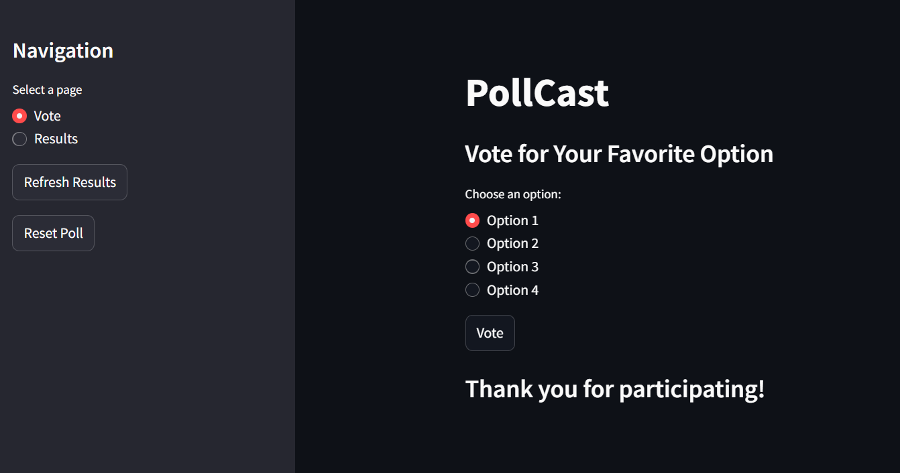
USER INTERFACE
Voting Page:
Users can select options and submit their votes.

Slide 8
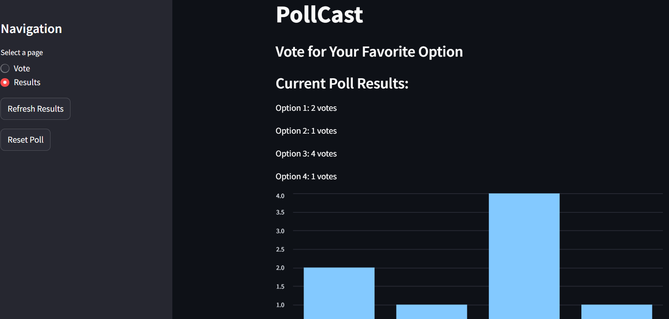
Results Page:
Displays current voting results in real-time.

Slide 9
CONCLUSION
Recap:
This Python-based polling application successfully facilitates easy voting and efficient result tracking.
Benefits:
Enhances participation and transparency in decision-making processes.

