Slide 1

JAVA TRIVIA QUIZ
By Olga H., Sandra J. and Dana M.

Slide 2
What is pseudocode?
Pseudocode (pronounced SOO-doh-kohd)
a detailed yet readable description of what a computer program or algorithm must do, expressed in a formally-styled natural language rather than in a programming language.
Catching errors at the pseudocode stage is less costly than catching them later in the development process.
https://whatis.techtarget.com/definition/pseudocode

Slide 3
Pseudocode
INTRO
“Hi, do you want to play Java Trivia? Yes/No”
Scanner
If Yes, start, If No - “Have a nice day!” Quit
WHILE
GAME - Question “?” – Scanner
A, b, c, d Check input!
If (..correct ) {score++;
System.out.println (“Great job! You earned 1 point”); }
Else if (wrong input ) { “Wrong input. Please choose a, b, c, d”
(returns to question) }
Else (wrong answer) {
“Wrong answer. Correct answer is- ………” }
“Continue? Y/N”
Scanner .ignoreCase
If (Yes) {continue}
Else if (No) {“Have a nice day!”} Quit
Else if (wrong input) {“Please chose Y/N”}
Else wrong answer;
Return score;
OUTRO:
0 – 3 correct: You’re just a Java beginner. Time to hit the books and do a bit more studying.
4-5 correct: You’re pretty solid in your Java history, but it might behoove you to pay a little more attention to the details.
6-7 correct: Nice! You know your stuff!
8 correct: You are a Java master.
“Start all over? Y/N” Scanner
If Yes, return to question 1
Else “Have a nice day!”
Quit

Slide 4
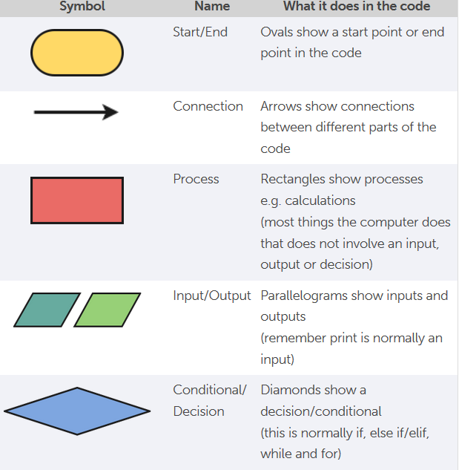
What is flowchart?
The purpose of a flow chart is
to provide people with a common language or
reference point when dealing with
a project or process.
A good plan:
creates a guide you can follow
helps you plan efficient structure
helps communicate to others what your code will do

Slide 5
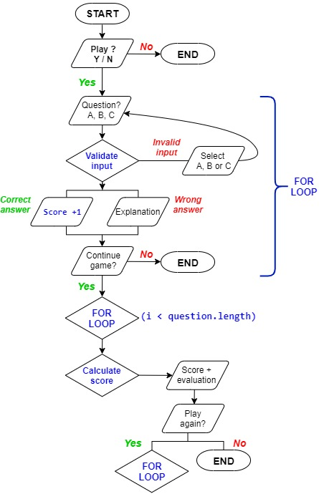

Flowchart using

Slide 6
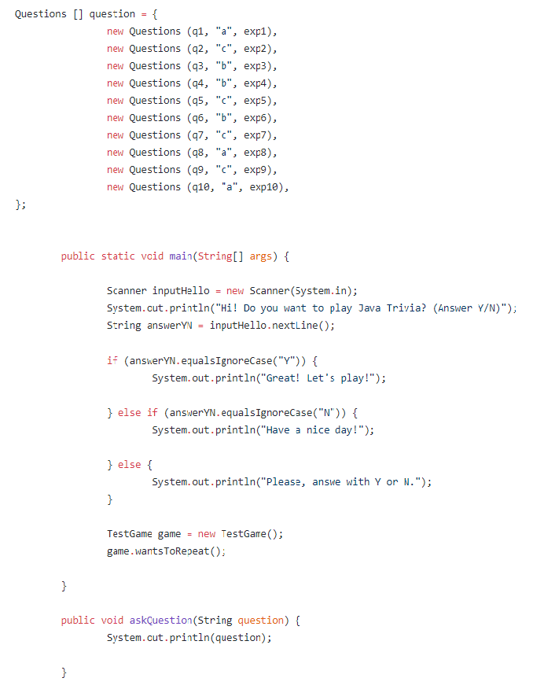
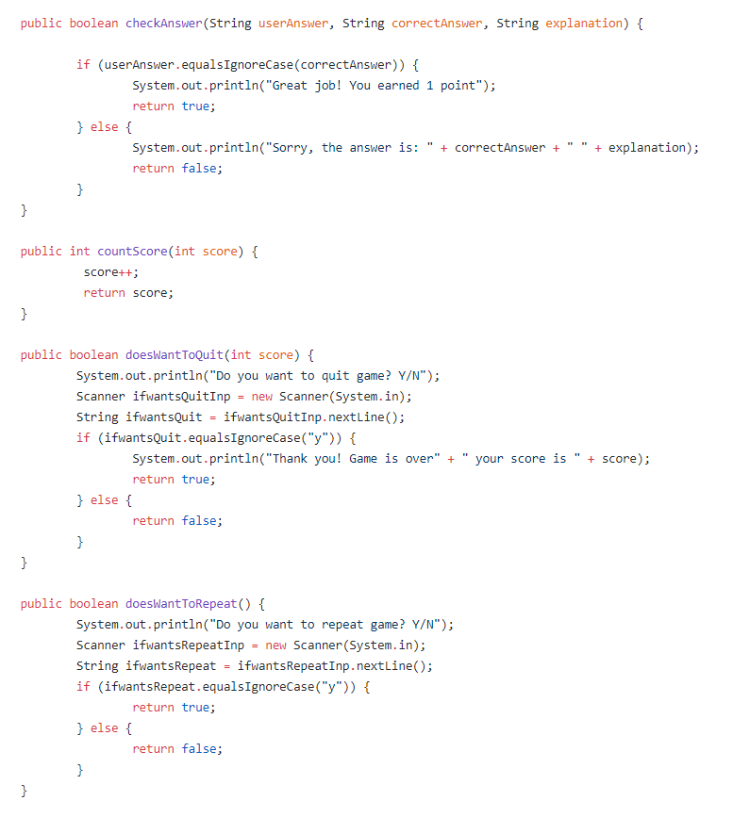

Slide 7
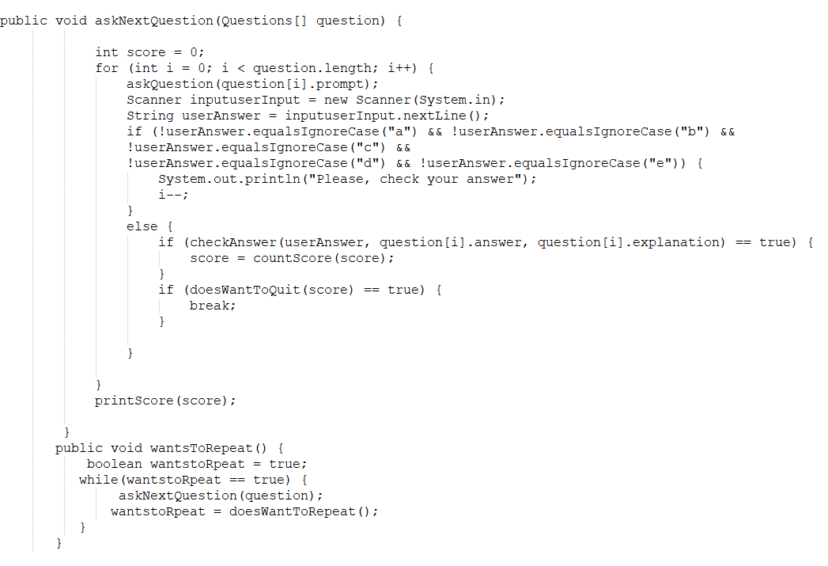

Slide 8
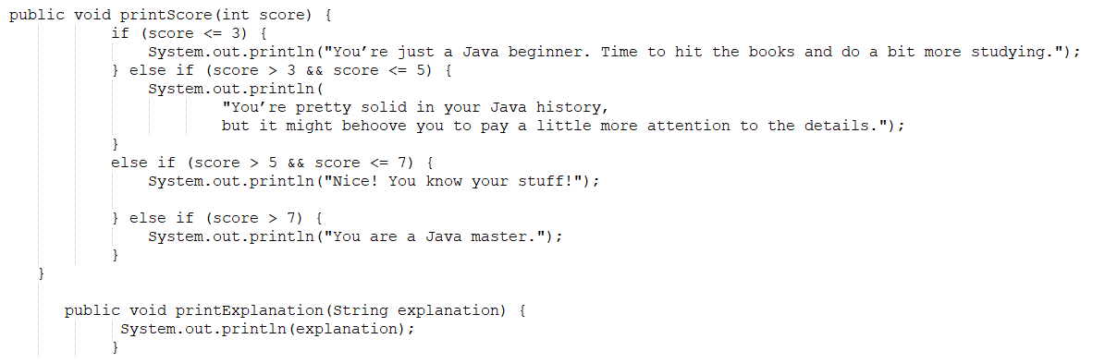

Slide 9
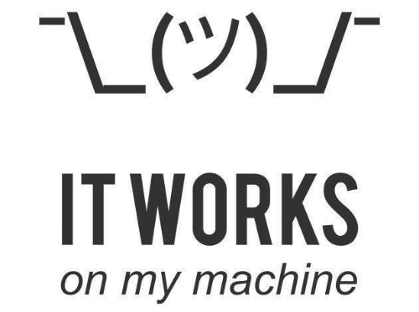
Thank you for your attention!

