Slide 1
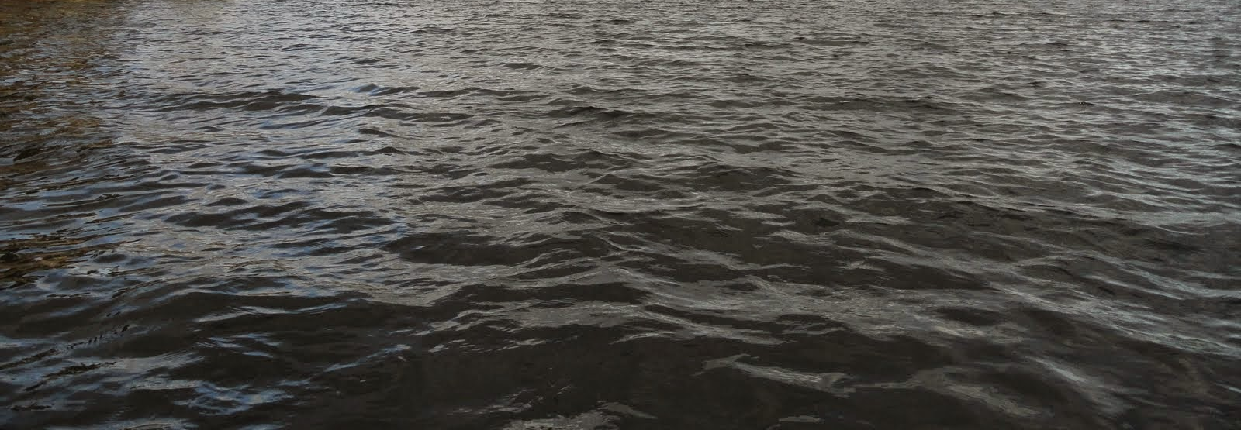

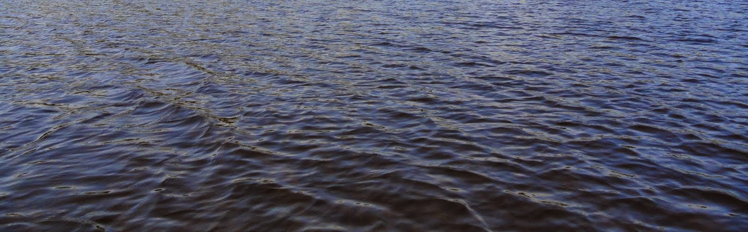
This Photo by Unknown Author is licensed under CC BY-SA

Slide 2
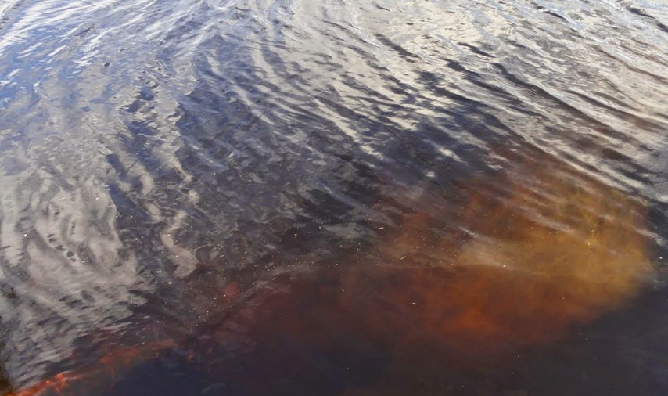
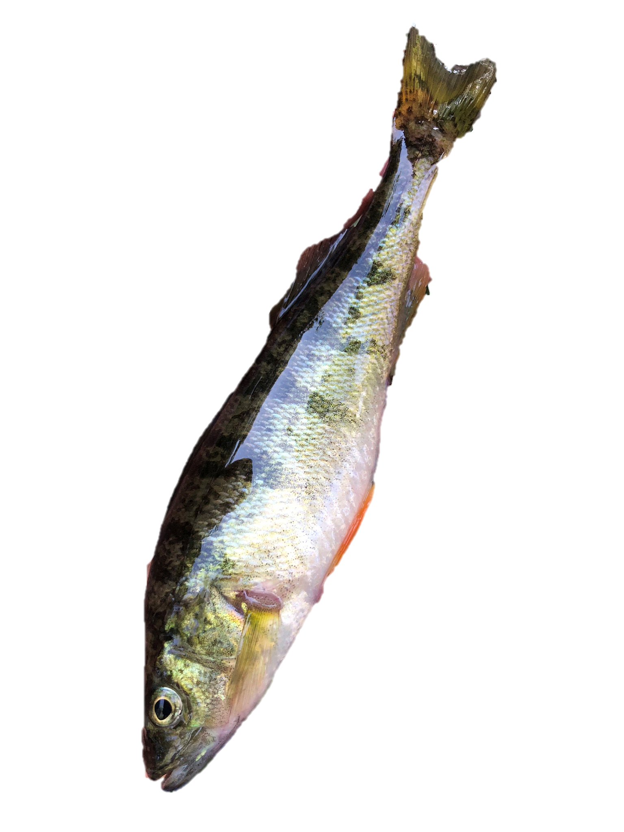

+ AgNP
2nd year
P
N
P
P
Ag
N

Slide 3

+ AgNP
2 years
P
N
P
P
Ag
N

Slide 4
