Slide 1

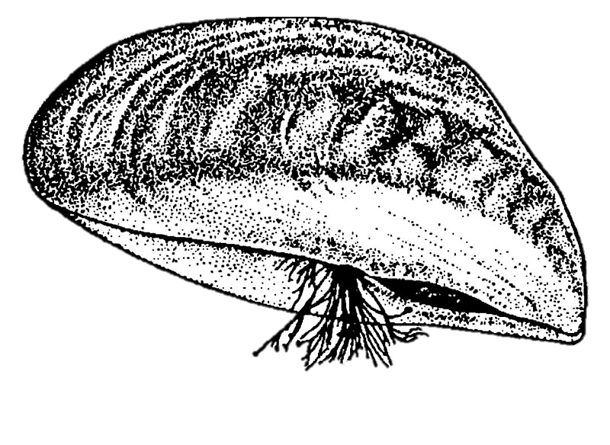

Remobilization: animal-mediated nutrient cycling
Loss: nutrient uptake, metabolized, and stored
Input: internal nutrient loads
Inputs: external nutrient loads
Outputs
Notes:
Food web load term: Nutrient load uptake – (nutrient ingestion by animal - (egestion + metabolism + nutrient storage (pool or sink) + excretion) =

Slide 2
Lake N and P retention and internal cycling
Consumers
Trophic transfer
Excretion and remineralized egestion
Primary producers
Metabolism
Uptake
External nutrient loads
Dissolved inorganic nutrients: recycled + translocated
Outputs
Temporary or long-term burial
Abiotic processes
Bioturbation + decomposition
Resource extraction + outflow
Temporary or long-term burial
Nutrient pool: sediments + biomass
Notes:
Bocaniov, Li et al, Wu et al for magnitude of arrows
External loads alone do not determine nutrient availability to primary producers; animal-mediated internal fluxes redistribute nutrients between pools and partially offset losses, thereby sustaining primary production.
the effective nutrient supply experienced by primary producers exceeds the external load because internally recycled P supplements external inputs.
Increased recycling → higher primary production,
Higher production → greater consumer biomass,
Greater consumer biomass → higher absolute excretion rates,
Which further elevates internal nutrient availability
External loads set the initial boundary condition, but internal cycling determines how long and how intensively those nutrients remain biologically available before they are permanently buried, exported, or otherwise rendered unavailable.
Framing this as “re-investing a portion of the inputs” is appropriate: nutrients that are mineralized or excreted return to the bioavailable pool and can support additional rounds of primary production without any new external inputs.
Thus, even though only 1 percent of the original external load is being recycled at this particular step, its functional importance is disproportionate, because that same 100 MTA can support multiple production–consumption cycles over time.

Slide 3
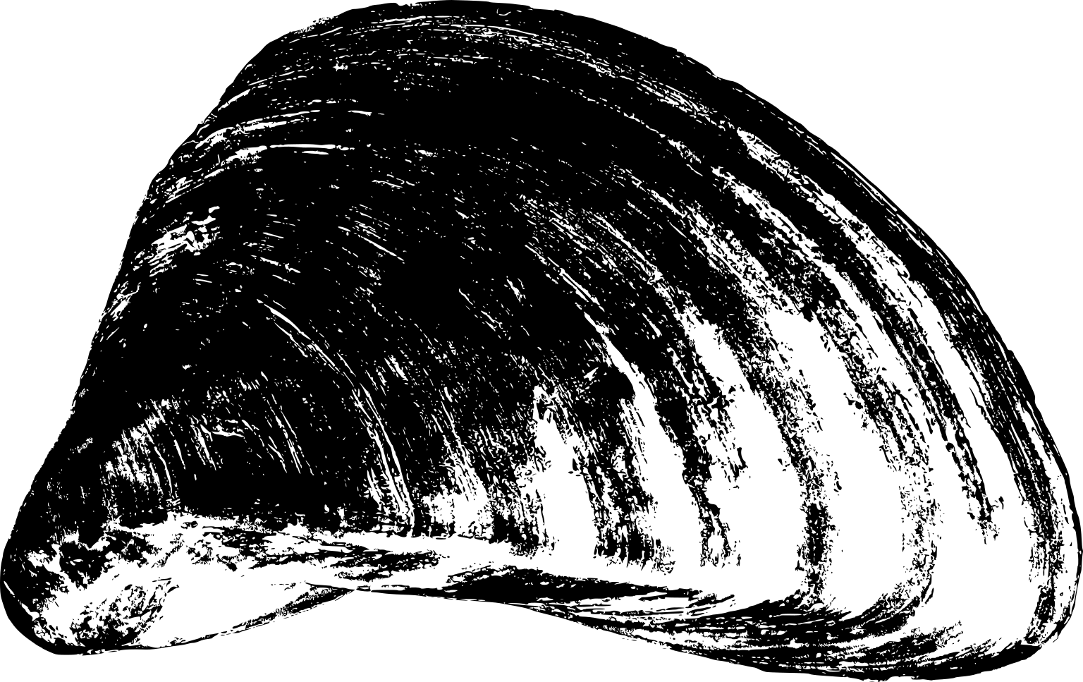

Lake N and P retention and internal cycling
Trophic transfer
Excretion + egestion
Metabolism
Uptake
External nutrient loads
Outflow
Outputs
Dissolved inorganic nutrients
Bioturbation + decomposition
Abiotic processes
Storage
Burial
Nutrient pool: sediments + biomass
Resource extraction + outflow
Notes:
Bocaniov, Li et al, Xu et al for magnitude of arrows
External loads alone do not determine nutrient availability to primary producers; animal-mediated internal fluxes redistribute nutrients between pools and partially offset losses, thereby sustaining primary production.
the effective nutrient supply experienced by primary producers exceeds the external load because internally recycled P supplements external inputs.
Increased recycling → higher primary production,
Higher production → greater consumer biomass,
Greater consumer biomass → higher absolute excretion rates,
Which further elevates internal nutrient availability
External loads set the initial boundary condition, but internal cycling determines how long and how intensively those nutrients remain biologically available before they are permanently buried, exported, or otherwise rendered unavailable.
Framing this as “re-investing a portion of the inputs” is appropriate: nutrients that are mineralized or excreted return to the bioavailable pool and can support additional rounds of primary production without any new external inputs.
Thus, even though only 1 percent of the original external load is being recycled at this particular step, its functional importance is disproportionate, because that same 100 MTA can support multiple production–consumption cycles over time.

