Slide 1
Category review: Chips
August 2026
Retail Analytics
Brand note: If client logo is not required, use alternate title page layout right click slide thumbnail > Layout > Title

Slide 2
Notes:
To view Privacy video explaining how important data privacy is to Quantium, please click here: https://www.youtube.com/watch?v=Zq1QDAkoRzU
or here Q:\Company Reference\Brand & Design\Brand videos\Q Privacy.mp4
At Quantium, we believe that data is the behavioural footprint of humanity and that it has to be treated with the utmost care and responsibility.
Histories, attitudes, indeed lives are stored within it in ways that aren’t always apparent – and that’s what makes its potential so powerful.
To work with it responsibly, sensitively, we set ourselves the highest data privacy protection and governance standards.
We have spent 17 years perfecting privacy-by-design and secure-by-design principles. Central to this is not holding any personally identifiable information about people –
we neither receive it, and put the necessary protections in place to be unable to decipher it.
Every aspect of handling data is safeguarded: from its de-identification, to its encryption – data security is paramount and of the highest grade.
We pride ourselves on gaining the trust of iconic organisations around the world through years of securely working with their data,
and in turn the trust that builds with their stakeholders.

Slide 3
Executive summary
01
Task 1
Mainstream Young & Midage Singles/Couples are chips' highest-value growth segment - a large, price-tolerant customer base that over-indexes on premium brands and larger pack sizes.
02
Task 2
2 of the 3 trial stores achieved a statistically significant sales uplift during the trial, driven by more customers visiting - not higher spend per visit - supporting a wider rollout of the new layout.

Slide 4
01
Category

Slide 5
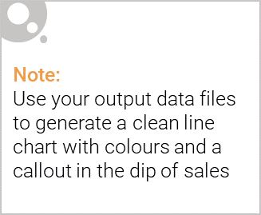
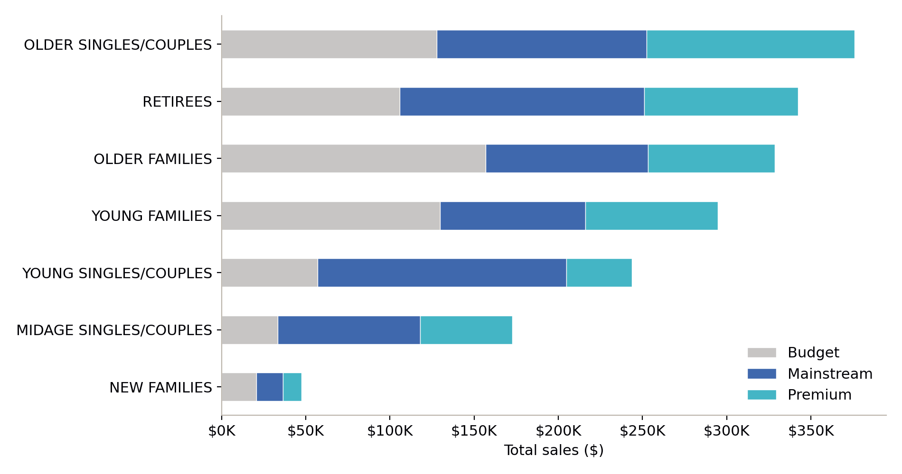
Sales are concentrated in five segments, led by Budget families and Mainstream young singles/couples
Older Families, Retirees, and Older Singles/Couples (all Budget or Mainstream) are the top 3 revenue segments.
Budget Older & Young Families drive sales through volume - about 9 units bought per customer, well above the category average.
Mainstream Young Singles/Couples drive sales through customer count: over 8,000 customers, the largest single segment.
New Families is the smallest segment by total sales across every affluence tier.

Slide 6

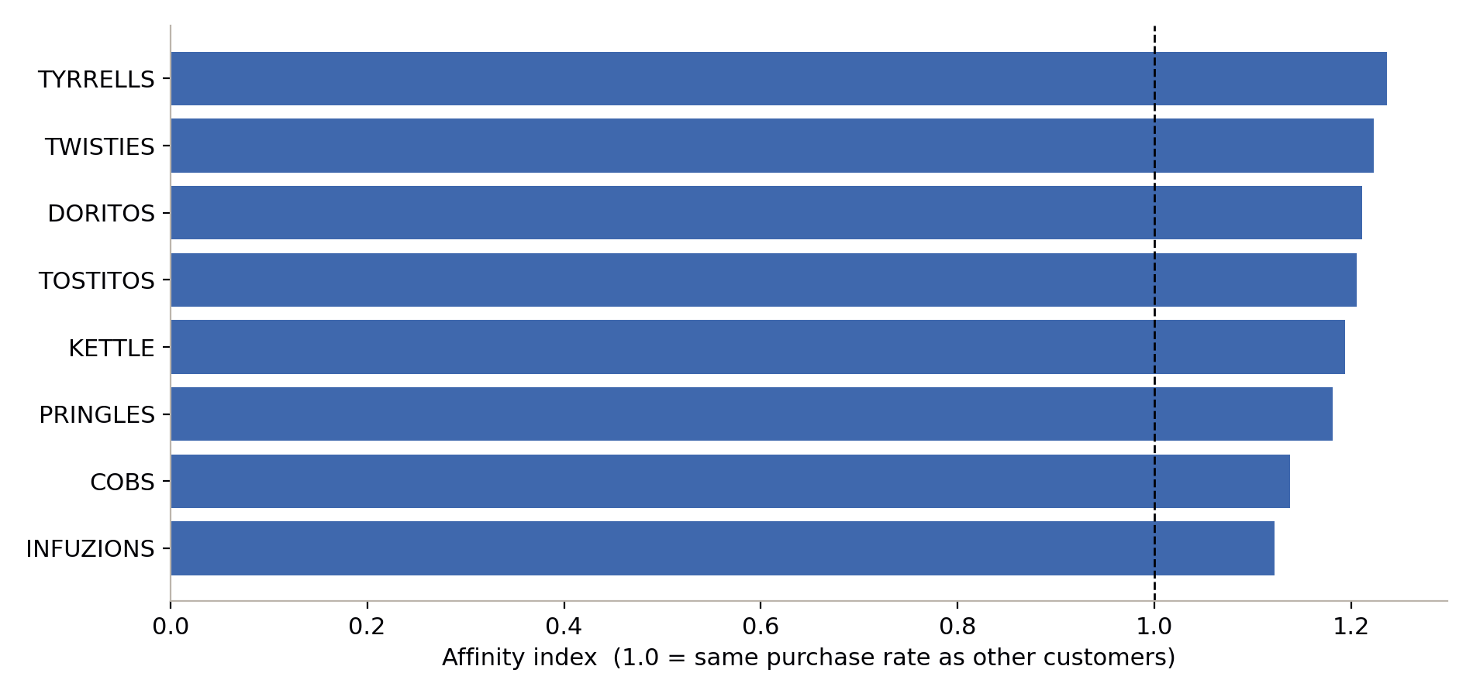
Mainstream Young & Midage Singles/Couples over-index on premium brands and larger packs
20-25% more likely than other customers to buy Tyrrells, Twisties, and Doritos - brands positioned at the premium end of the category.
Average pack size purchased is 178g vs. 175g across the rest of the customer base - a small but consistent lean toward larger packs.
This combination (willingness to pay + large customer base) makes this segment the clearest opportunity for premium-range and larger-pack promotion.

Slide 7
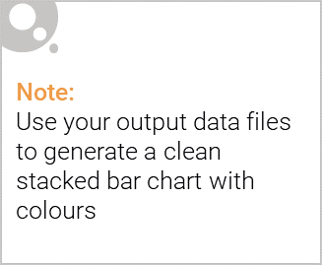
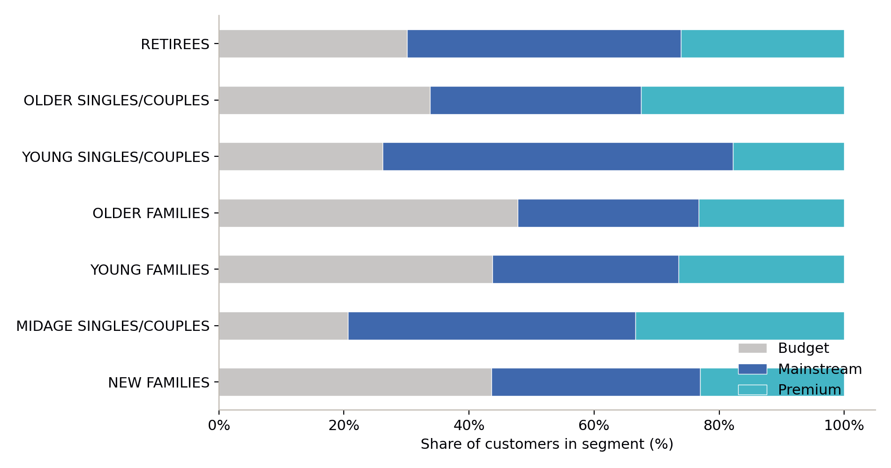
Budget and Mainstream customers each make up roughly a third of every life stage's customer base
No single life stage is dominated by one affluence tier - Budget, Mainstream, and Premium customers are present in similar proportions almost everywhere.
Young Singles/Couples is the exception - Mainstream customers are a clear majority, reinforcing it as a distinct, high-potential segment rather than an average one.

Slide 8
02
Trial store performance

Slide 9
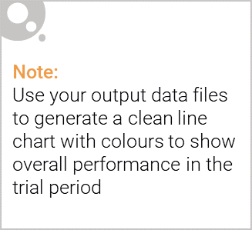
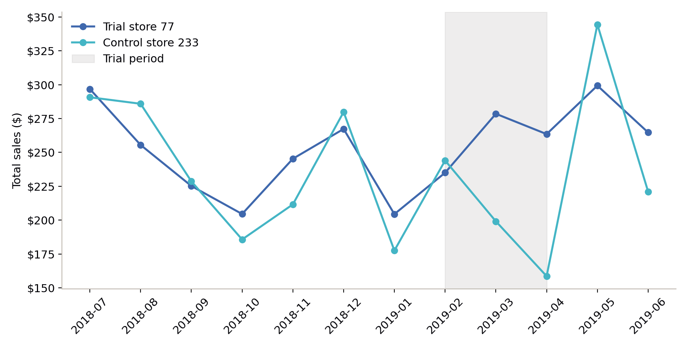
Control stores were matched on pre-trial sales and customer trends, not assumed by location
Each trial store was scored against every other complete-history store on pre-trial (Jul 2018-Jan 2019) sales and customer-count trends, combining trend shape (correlation) and scale (magnitude distance).
Store 77's best match (store 233, shown left) tracked it closely for 7 straight months before the trial began - a strong basis for comparison.
Match quality varied: stores 77 and 86 found strong matches (0.94-0.97); store 88's best match was weaker (0.80), which affects confidence in its result.

Slide 10
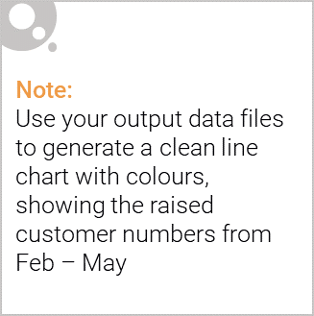
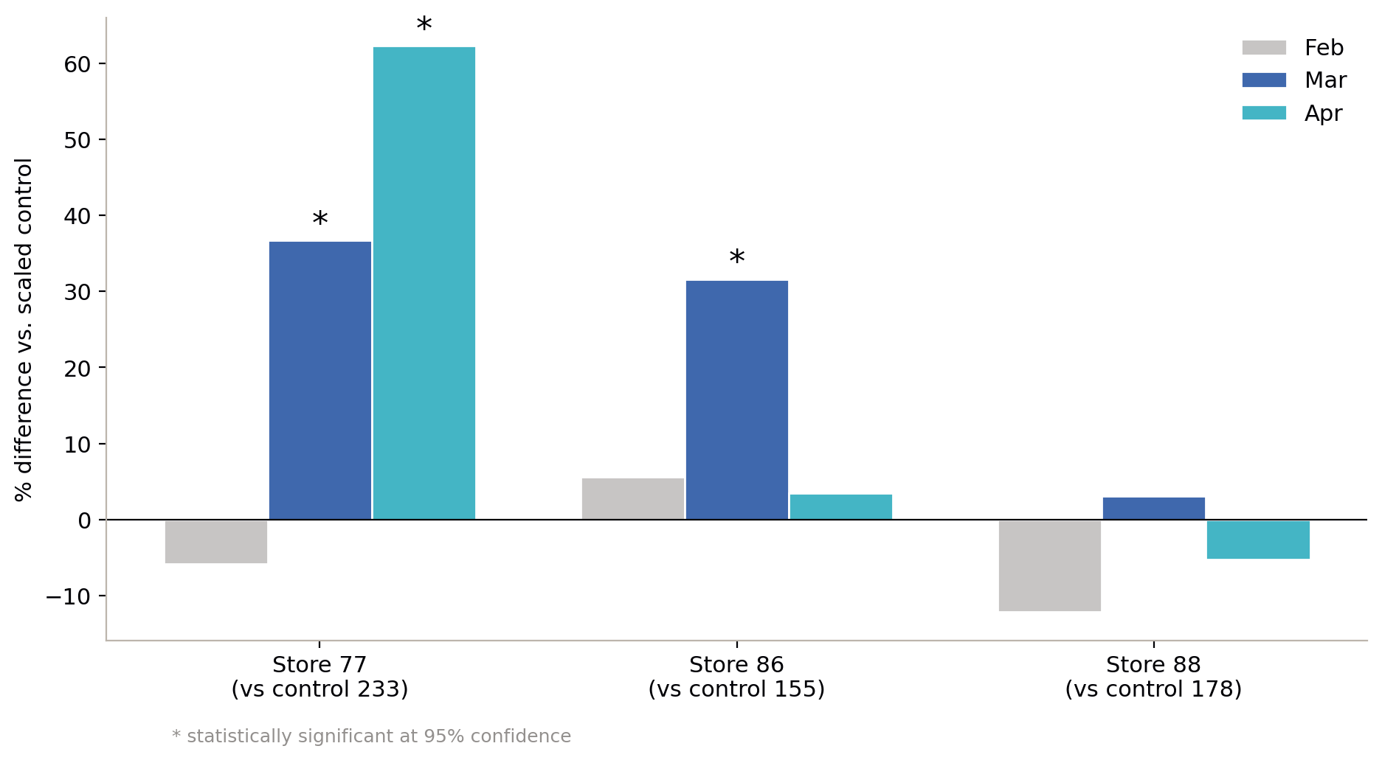
The trial layout drove a significant, customer-led sales uplift at 2 of 3 stores
Store 77: significant uplift in March (+37%) and April (+62%), driven by +23.5% more customers - not higher spend per visit.
Store 86: significant uplift in March (+32%) only; worth investigating why it didn't sustain through April.
Store 88: no month reached significance - but its control-store match was the weakest of the three, so this should read as inconclusive, not as a failed trial.
Recommendation: proceed toward a wider rollout, prioritising the layout elements common to stores 77 and 86, and re-test store 88 with a stronger control match.

