Slide 1

FarmerTrader
Cryptocurrency Trading Project
By Jingjing Guan, Suruo Wang
12.8.2018

Slide 2
1
Introduction
2
Technologies
Agenda
3
Considerations
CONTENTS
4
Database
5
Website
6
Challenges and Solutions
7
Live Demo

Slide 3

Introduction
Cryptocurrency Trading system
Buy and sell crypto
Track trading history and profit and loss
Jingjing did the back-end part created the database and python
Suruo did the front-end part HTML, CSS JavaScript and python

Slide 4




Technology

Slide 5
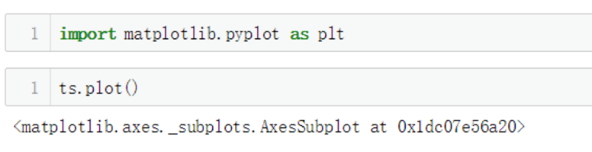
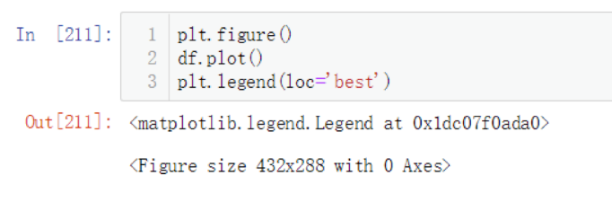
Considerations
How will we crate graphs?
How will we store the blotter and PL?
MySQL
What type of business rules should we implement so that the trader doesn’t cheat our system?
Check buying power
Check balance
Where will we get crypto price from?
Python library

Slide 6
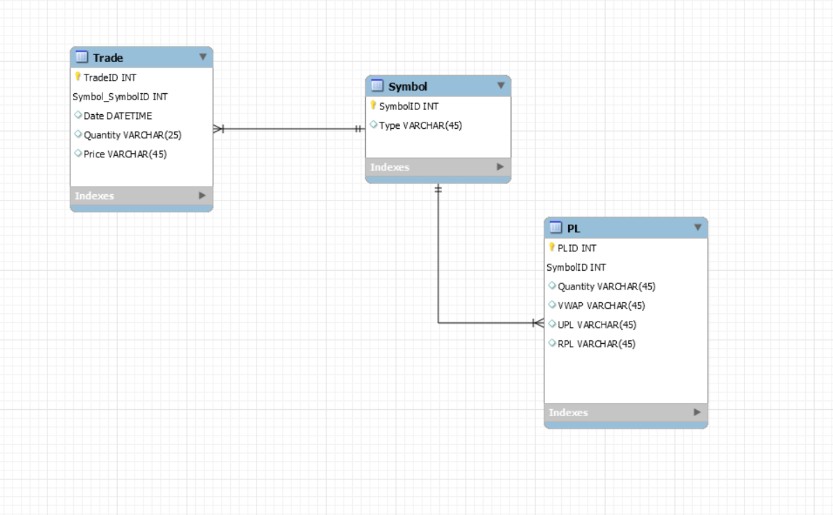

Database
3 Tables：Trade, Symbol, PL
Formulas:
Per Trade RPL= Price sold – VWAP
Per Asset URL = Market Price – VWAP
New VWAP= New-qty*price + Current-qty*VWAP
New-qty + Current-qty

Slide 7
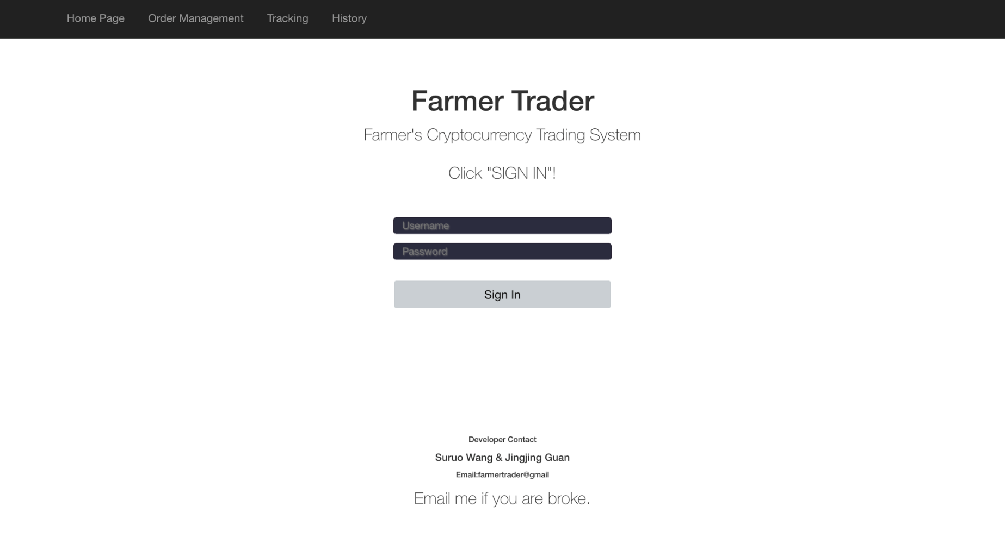
Website – Sign In Page

Slide 8
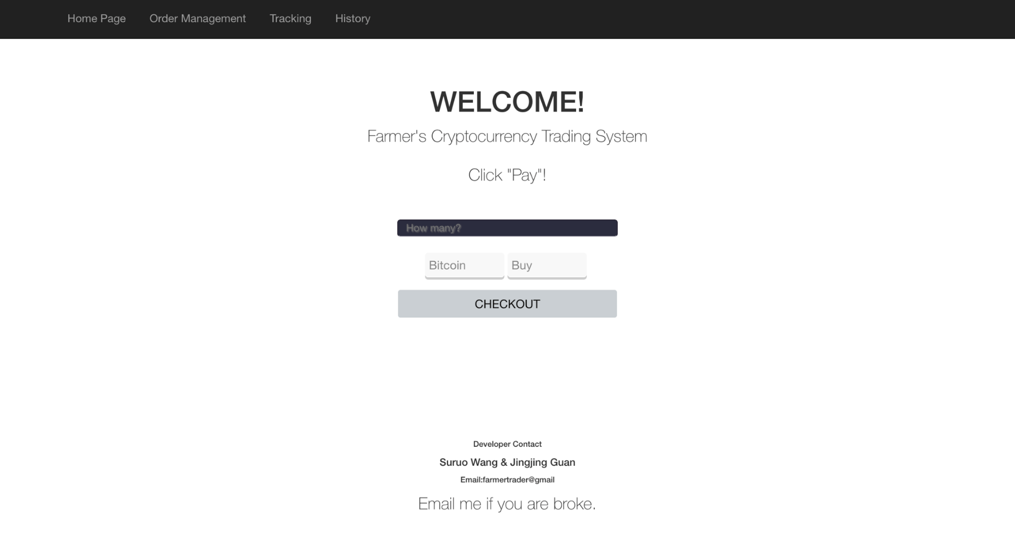
Website – Order Management Page

Slide 9
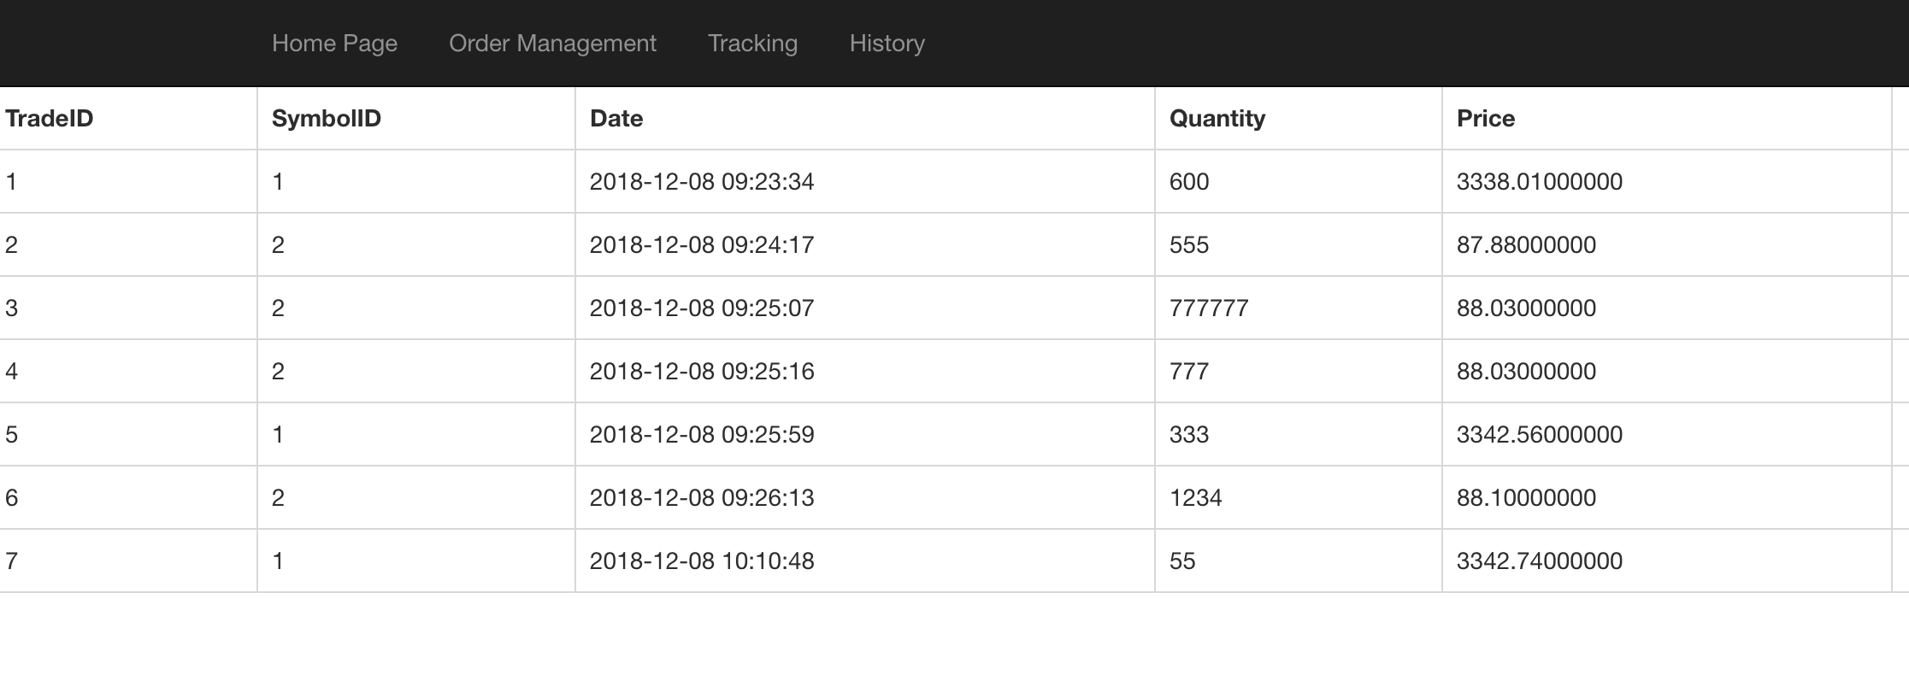
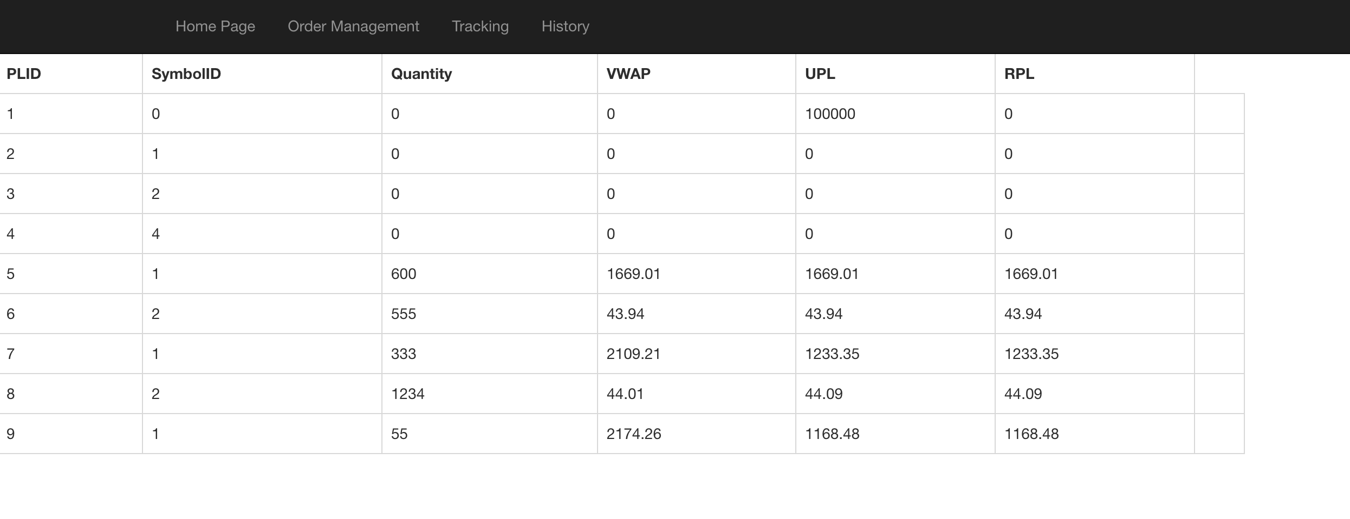
Website – Tracking &History

Slide 10
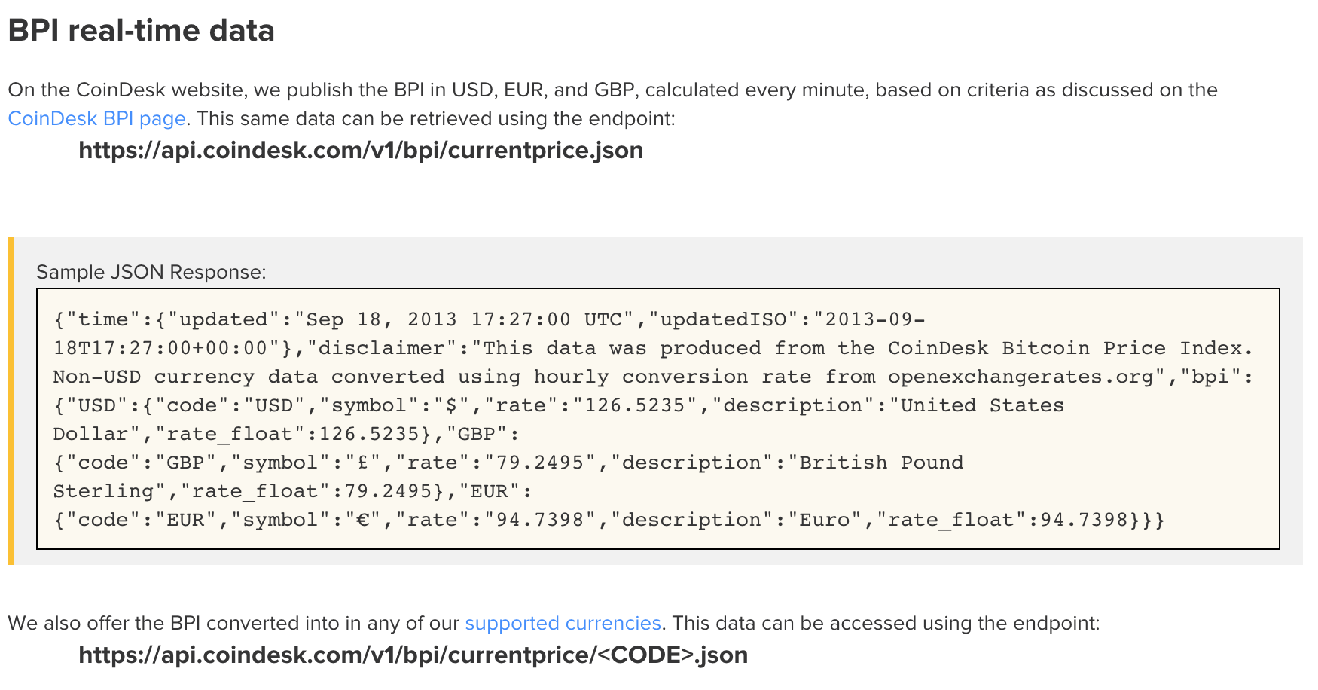
Challenges and Solutions
Identify different cryptos and calculated the VWAP in the same table
Cooler Coding time
Create Chart
Calculation
1
Show the real-time price for each Cryptos
Python Library - cbpro
API-BPI
2
Source of Crypto Price

Slide 11

Live Demo

Slide 12

Thank You!

