Slide 1
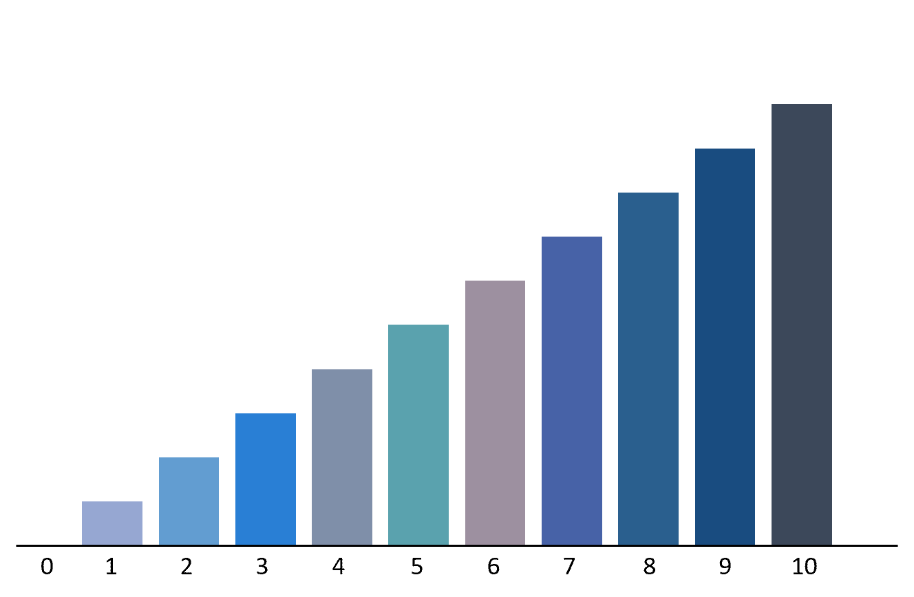


Tariffs Prediction Software
By: Sandro and Daksh

Slide 2
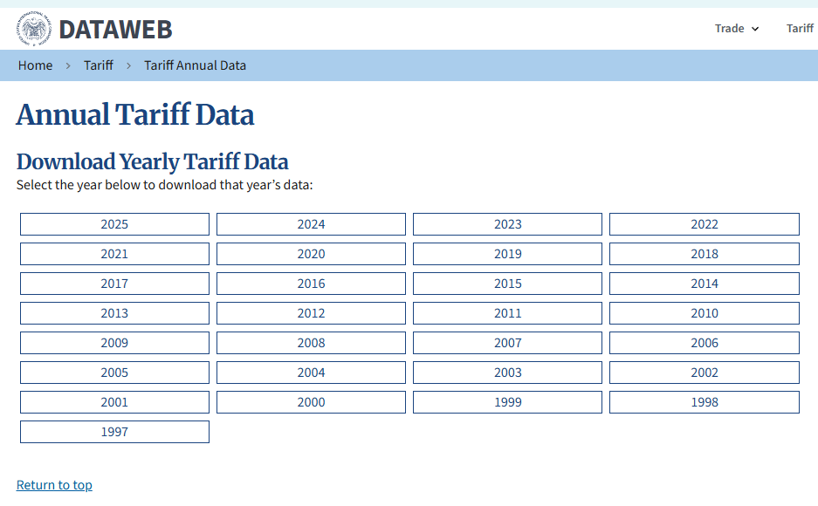

Data sources
https://dataweb.usitc.gov/tariff/annual

Slide 3
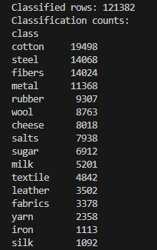
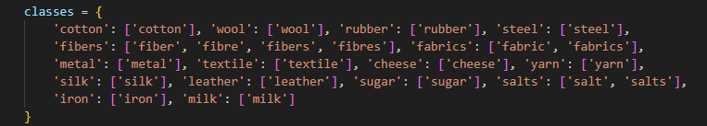
Data Preprocessing
Combining data from all years into one big CSV file
Cutting down from 1000’s of columns into less than 8 useful columns
Dropping rows with missing values
Using One-Hot encoding for categorical values such as mfn_rate_type_code
Removing Outliers - 99999+
Creating 10 classes based on the most frequent words in Tariff descriptions.

Slide 4
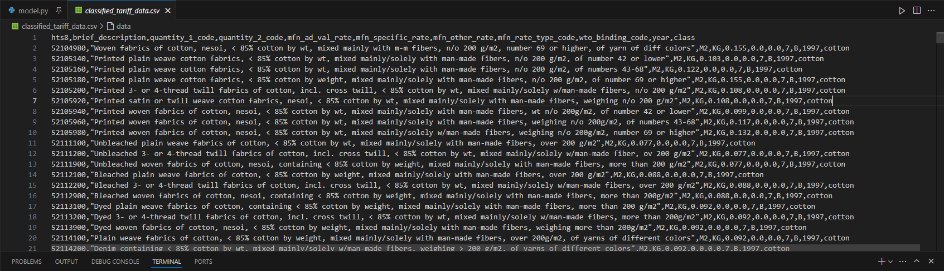
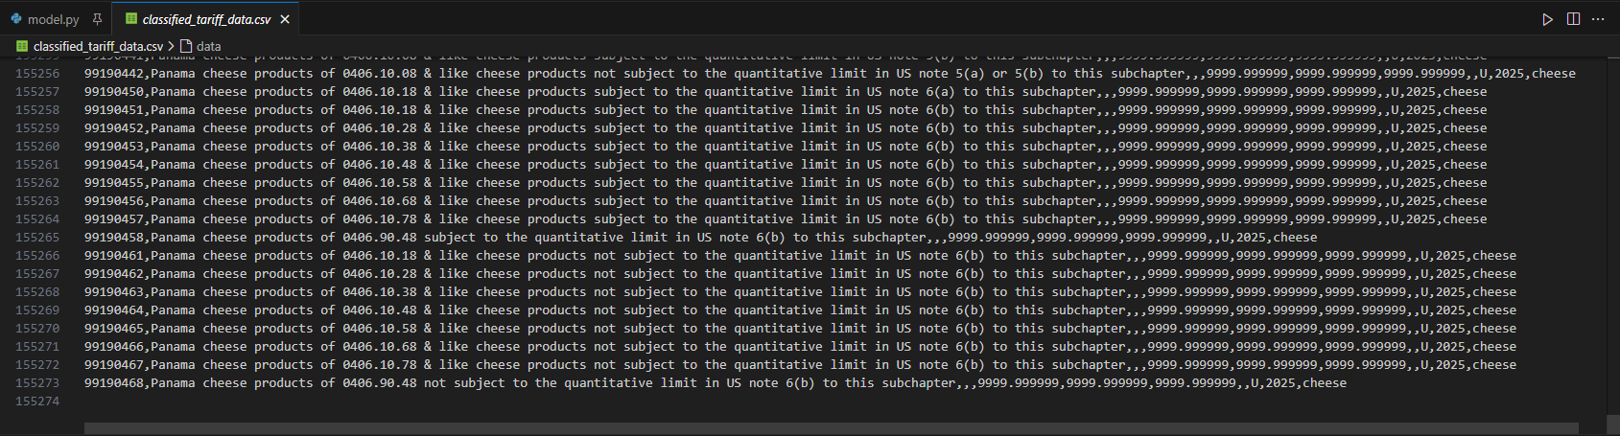

Slide 5
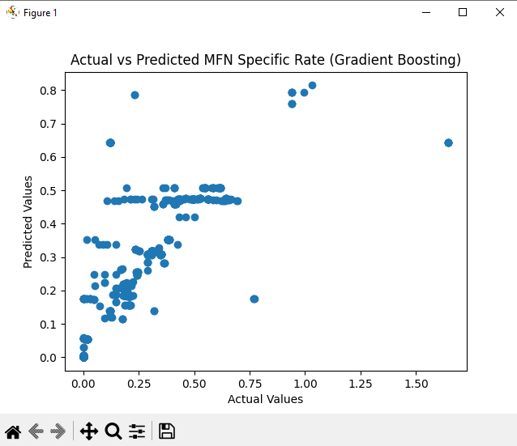
Model Development
Input to the model aka feature selection:
mfn_ad_val_rate: Percentage-based tariff rate
mfn_other_rate: Fixed duty or fee
mfn_rate_type_code: Type code for MFN rate
class: Product category (e.g., cotton, wool)
Output of the model:
mfn_specific_rate: Predicted fixed tariff rate per unit
Random Forest + Gradient Boost
80 / 20 split
Random Forest R-squared: 0.8198

Slide 6
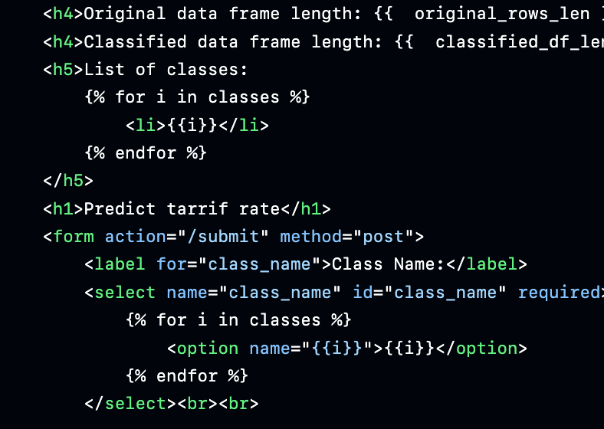

Web Demonstration!!!

Slide 7
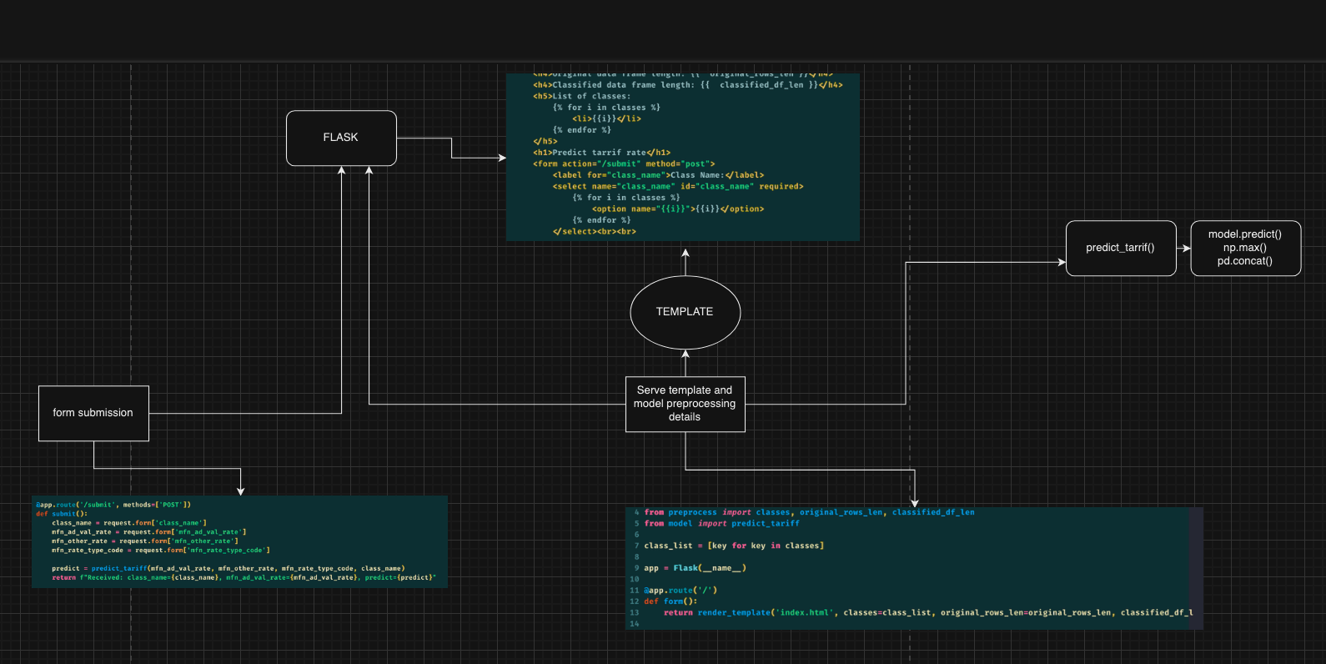
Code structure

Slide 8
Conclusion
Our dataset included various tariff-related features across key product classes; integrating a live data stream could improve model relevance and adaptability to real-time changes.
The final Gradient Boosting model achieved an R² score of 0.80, indicating strong predictive performance for MFN specific tariff rates.
Data preprocessing steps like filtering, encoding, and scaling played a major role in boosting model accuracy.
Future improvements could include testing additional models, tuning hyperparameters further, and expanding input features for better generalization.

