Slide 1
PRINCIPLES OF PROGRAMMING
International Black Sea University
Faculty of Business and Technology
Lecturer: Nika Narushvili
6th week

Slide 2
Agenda
Arrays
Accessing array elements
Arrays and loops
Multidimensional arrays
Strings
String functions

Slide 3
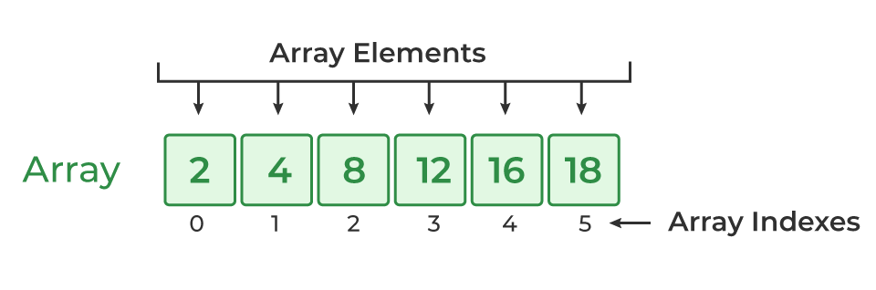
Arrays are data structures that store multiple values of the same data type
They allow us to group and access a collection of elements using a single variable name
Arrays have a fixed size, which is defined when declaring the array
Array elements are access using an index, starting at 0

Slide 4
Arrays in c++
Syntax for declaring arrays: data_type arrayName[size];
In C++ arrays use zero-based indexing, first element starts at 0, the second at 1, and so on
To access an array element, you use arrayName[index] syntax
You can use the syntax above to assign some value to an element inside the array, or to obtain it and use it for different purposes, such as arithmetic operations and printing

Slide 5
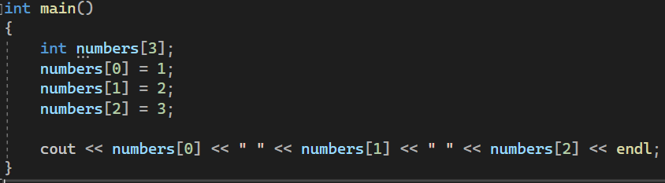
Notes:
#include <iostream>
using namespace std;
int main()
{
int numbers[3];
numbers[0] = 1;
numbers[1] = 2;
numbers[2] = 3;
cout << numbers[0] << " " << numbers[1] << " " << numbers[2] << endl;
}

Slide 6
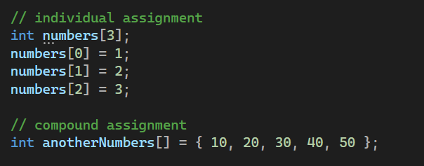
Array initialization
There are two methods of initializing an array
Individual element assignment: assign values to array elements one by one
Compound assignment: initialize the entire array with a list of values
Notes:
#include <iostream>
using namespace std;
int main()
{
// individual assignment
int numbers[3];
numbers[0] = 1;
numbers[1] = 2;
numbers[2] = 3;
// compound assignment
int anotherNumbers[] = {10, 20, 30, 40, 50}
}

Slide 7
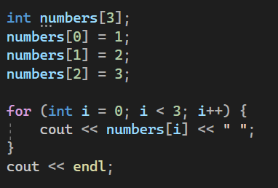
Arrays and loops
Arrays and loops work well together for processing multiple elements
Notes:
#include <iostream>
using namespace std;
int main()
{
int numbers[3];
numbers[0] = 1;
numbers[1] = 2;
numbers[2] = 3;
for (int i = 0; i < 3; i++) {
cout << numbers[i] << " ";
}
cout << endl;
}

Slide 8
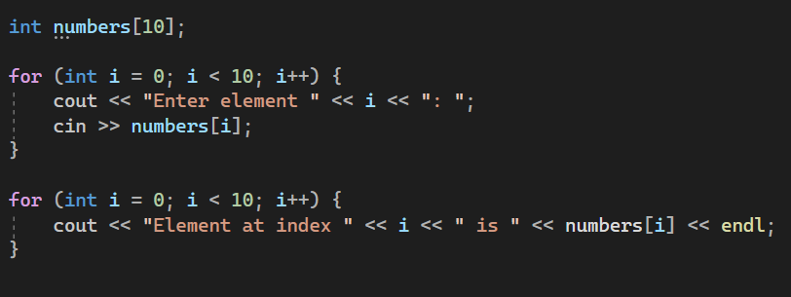
Input an array
With loops it’s possible to easily enter the array elements from input
Notes:
#include <iostream>
using namespace std;
int main()
{
int numbers[10];
for (int i = 0; i < 10; i++) {
cout << "Enter element " << i << ": ";
cin >> numbers[i];
}
for (int i = 0; i < 10; i++) {
cout << "Element at index " << i << " is " << numbers[i] << endl;
}
}

Slide 9
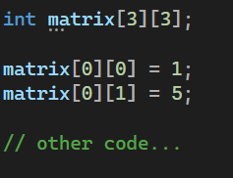
Array dimensions
There can be multi-dimensional arrays
In previous examples, we used a one-dimensional array
To define more than one dimension, we have to add [size] to the declaration of the array
To access an element, use [index1][index2] syntax
Notes:
#include <iostream>
using namespace std;
int main()
{
int matrix[3][3];
matrix[0][0] = 1;
matrix[0][1] = 5;
// other code...
}

Slide 10
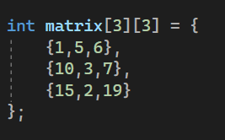
Compound multi dimensional array initialization

Slide 11
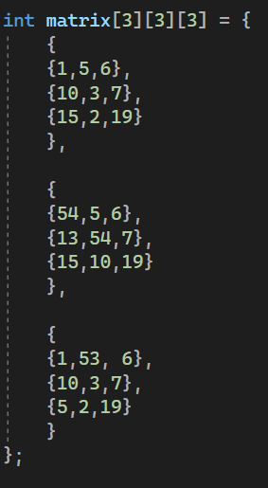
Arrays with more dimensions

Slide 12
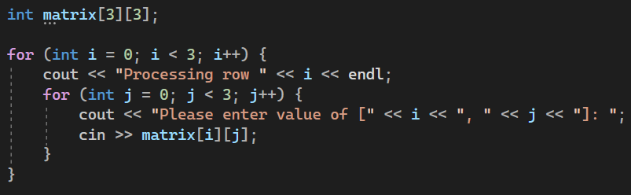
Nested loops and multi-dimensional arrays
To effectively process a multi-dimensional array, nested loops are required
Notes:
#include <iostream>
using namespace std;
int main()
{
int matrix[3][3];
for (int i = 0; i < 3; i++) {
cout << "Processing row " << i << endl;
for (int j = 0; j < 3; j++) {
cout << "Please enter value of [" << i << ", " << j << "]: ";
cin >> matrix[i][j];
}
}
}

Slide 13
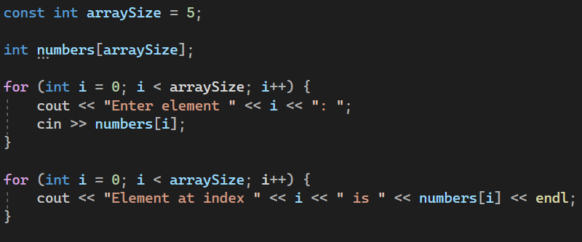
Symbolic array
Symbolic array definition refers to an array where we use symbolic constants to define array size instead of hardcoding a specific value every time
This approach offers more code readability and flexibility

Slide 14
Strings in c++
Strings in programming are sequences of characters, more commonly referred as information that holds some form of a text
String is a class in C++, we will talk about classes later but for now we can imagine them as more complex data types with different functions
Declaring a string variable is as easy as – string name = “Guy”;
The string class in C++ offers various functions to manipulate text

Slide 15
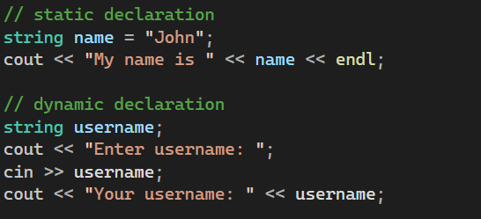
Strings can be declared statically and dynamically
Notes:
#include <iostream>
using namespace std;
int main()
{
// static declaration
string name = "John";
cout << "My name is " << name << endl;
// dynamic declaration
string username;
cout << "Enter username: ";
cin >> username;
cout << "Your username: " << username;
}

Slide 16
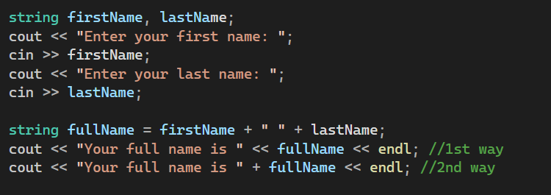
String operations
You can concatenate (add one to another) strings using the + operator
Notes:
#include <iostream>
using namespace std;
int main()
{
string firstName, lastName;
cout << "Enter your first name: ";
cin >> firstName;
cout << "Enter your last name: ";
cin >> lastName;
string fullName = firstName + " " + lastName;
cout << "Your full name is " << fullName << endl; //1st way
cout << "Your full name is " + fullName << endl; //2nd way
}

Slide 17
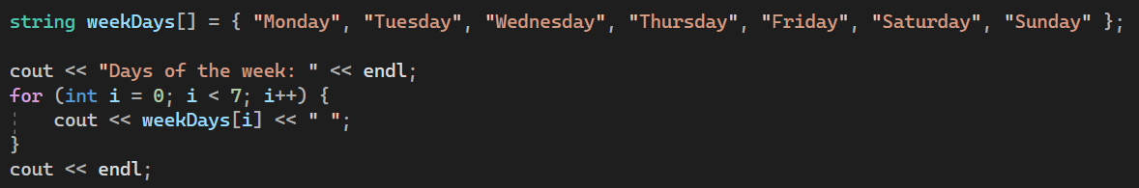
String arrays
You can define an array of strings like any other array
Notes:
#include <iostream>
using namespace std;
int main()
{
string weekDays[] = { "Monday", "Tuesday", "Wednesday", "Thursday", "Friday", "Saturday", "Sunday" };
cout << "Days of the week: " << endl;
for (int i = 0; i < 7; i++) {
cout << weekDays[i] << " ";
}
cout << endl;
}

Slide 18
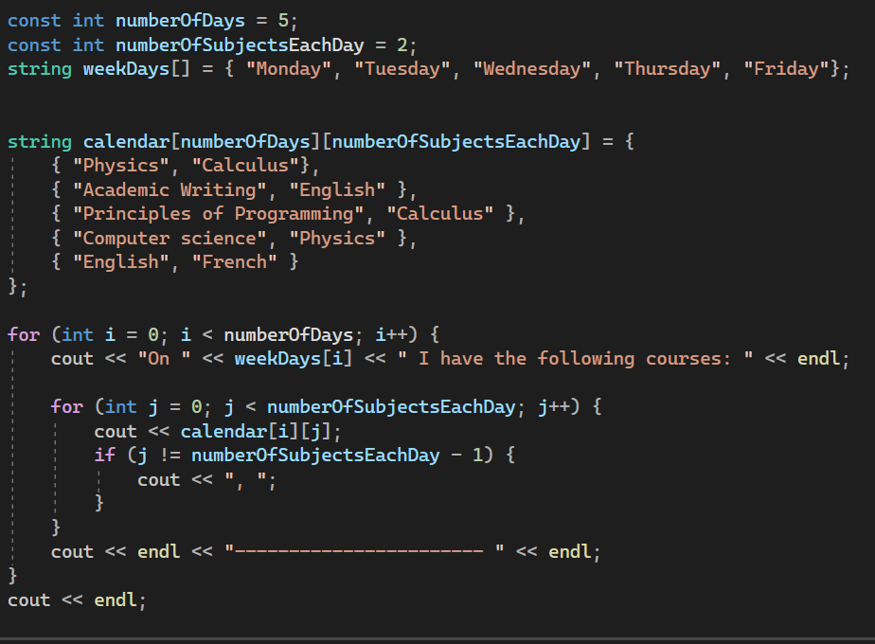
Multi-dimensional string arrays are also possible
Notes:
#include <iostream>
using namespace std;
int main()
{
const int numberOfDays = 5;
const int numberOfSubjectsEachDay = 2;
string weekDays[] = { "Monday", "Tuesday", "Wednesday", "Thursday", "Friday"};
string calendar[numberOfDays][numberOfSubjectsEachDay] = {
{ "Physics", "Calculus"},
{ "Academic Writing", "English" },
{ "Principles of Programming", "Calculus" },
{ "Computer science", "Physics" },
{ "English", "French" }
};
for (int i = 0; i < numberOfDays; i++) {
cout << "On " << weekDays[i] << " I have the following courses: " << endl;
for (int j = 0; j < numberOfSubjectsEachDay; j++) {
cout << calendar[i][j];
if (j != numberOfSubjectsEachDay - 1) {
cout << ", ";
}
}
cout << endl << "----------------------- " << endl;
}
cout << endl;
}

Slide 19
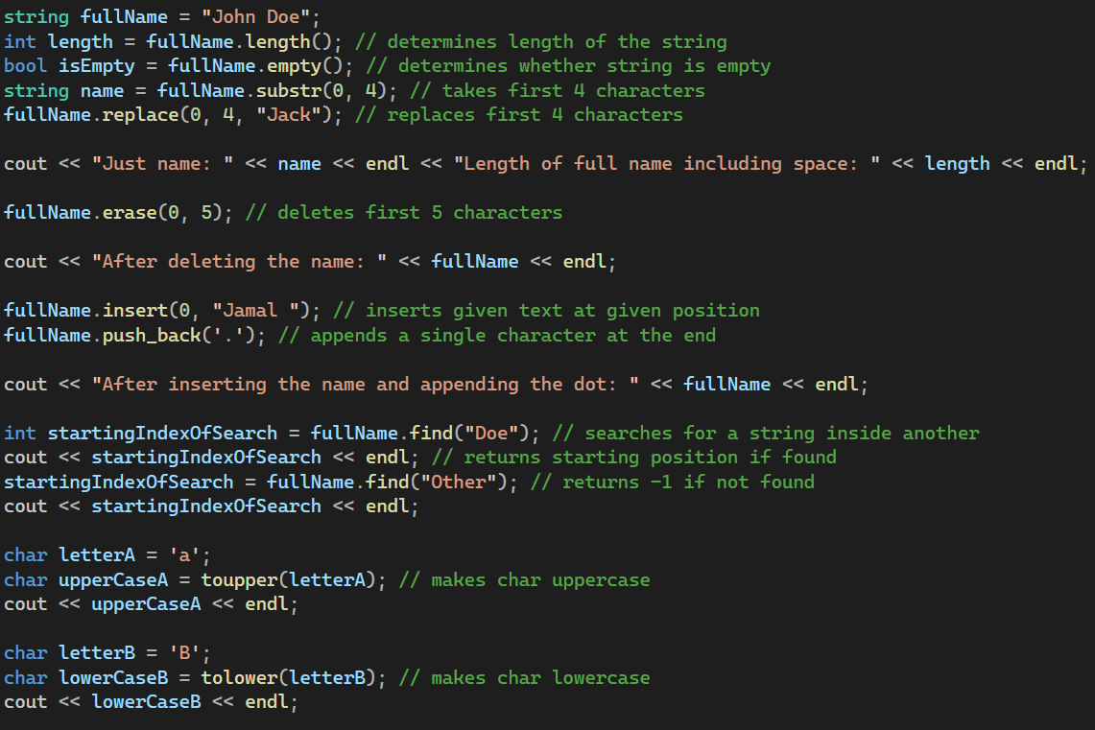
Useful string and char functions
Notes:
#include <iostream>
using namespace std;
int main()
{
string fullName = "John Doe";
int length = fullName.length(); // determines length of the string
bool isEmpty = fullName.empty(); // determines whether string is empty
string name = fullName.substr(0, 4); // takes first 4 characters
fullName.replace(0, 4, "Jack"); // replaces first 4 characters
cout << "Just name: " << name << endl << "Length of full name including space: " << length << endl;
fullName.erase(0, 5); // deletes first 5 characters
cout << "After deleting the name: " << fullName << endl;
fullName.insert(0, "Jamal "); // inserts given text at given position
fullName.push_back('.'); // appends a single character at the end
cout << "After inserting the name and appending the dot: " << fullName << endl;
int startingIndexOfSearch = fullName.find("Doe"); // searches for a string inside another
cout << startingIndexOfSearch << endl; // returns starting position if found
startingIndexOfSearch = fullName.find("Other"); // returns -1 if not found
cout << startingIndexOfSearch << endl;
char letterA = 'a';
char upperCaseA = toupper(letterA); // makes char uppercase
cout << upperCaseA << endl;
char letterB = 'B';
char lowerCaseB = tolower(letterB); // makes char lowercase
cout << lowerCaseB << endl;
}

Slide 20
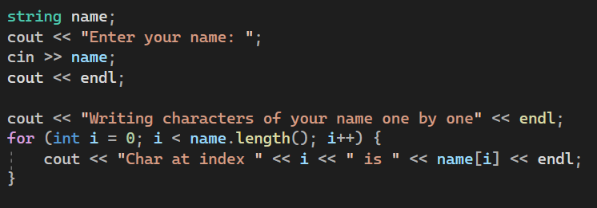
Strings as arrays
You can treat strings as arrays of char data types
Notes:
#include <iostream>
using namespace std;
int main()
{
string name;
cout << "Enter your name: ";
cin >> name;
cout << endl;
cout << "Writing characters of your name one by one" << endl << endl;
for (int i = 0; i < name.length(); i++) {
cout << "Char at index " << i << " is " << name[i] << endl;
}
}

Slide 21
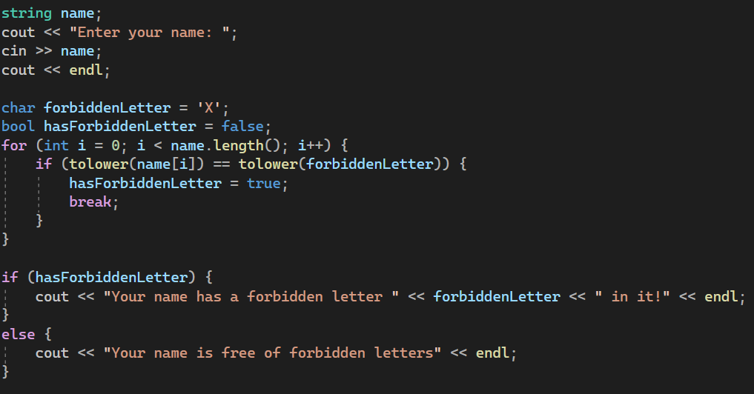
Notes:
#include <iostream>
using namespace std;
int main()
{
string name;
cout << "Enter your name: ";
cin >> name;
cout << endl;
char forbiddenLetter = 'X';
bool hasForbiddenLetter = false;
for (int i = 0; i < name.length(); i++) {
if (name[i] == forbiddenLetter) {
hasForbiddenLetter = true;
break;
}
}
if (hasForbiddenLetter) {
cout << "Your name has a forbidden letter " << forbiddenLetter << " in it!" << endl;
} else {
cout << "Your name is free of forbidden letters" << endl;
}
}

Slide 22
Practical work 1
Create an array with a size of your choice and data type of your choice
Let user enter the elements of the array
After receiving the inputs, print the content of the array in reverse

Slide 23
Practical work 2
Declare two 4x4 matrices named matrixA and matrixB of type double (or float)
Let the user enter their values
Perform a + operation on A and B matrices, save the result into another array and output it
Adding two matrices is just adding values of cells, so if A[0,1] = 2 and B[0,1] = 5, then C[0,1] = 2 + 5 = 7, where C is the resulting matrix

Slide 24
Practical work 3
Create an array of 10 strings
Ask the user to enter the values of each of the strings
Then ask the user to enter a text (minimum 3 characters) that they would like to search for
Go through the array of your strings, write any string that contains the search text

