Slide 1
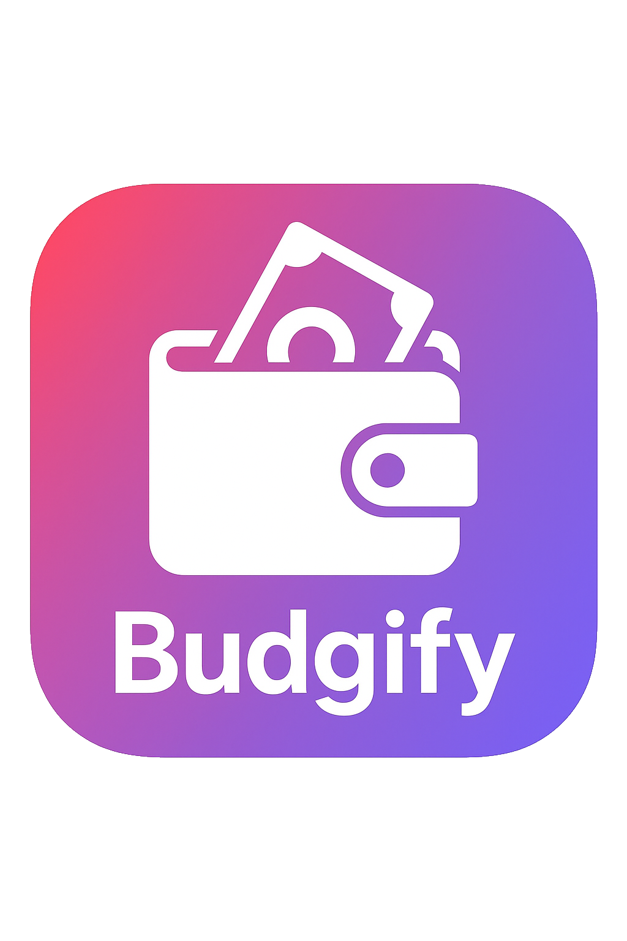
Your personal finance manager
Alessandro Catalano
Alessandro Rocchi
Onorio Iacobelli
Human-Computer Interaction
A.Y. 2024/2025

Slide 2
Introduction
Budgify is an app that helps you track your expenses

Slide 3
Application scenario

Slide 4
Personas and scenarios
ALEX JAMESON
Alex is an ambitious and forward-thinking university student, constantly striving for independence. He’s disciplined in his studies and works part-time, but struggles with self-control when it comes to impulsive spending. Deep down, Alex is motivated by the desire to prove to himself and others that he can achieve major life goals on his own. He values freedom and sees owning a car as a symbol of personal success and responsibility.
Scenario
Alex dreams of buying his first car but feels overwhelmed trying to balance his school workload, part-time job, and unpredictable spending habits. When he starts using ”Budgify”, it becomes more than just a budgeting tool, it’s his personal financial coach.
He sets a specific saving goal for his car, breaking it down into manageable monthly targets. Seeing his progress visually keeps him motivated and focused.
Alex becomes more aware of his habitual takeout expenses. Recognizing the impact, he starts meal-prepping, not only saving money but also improving his health and self-discipline.
He also gains a stronger sense of control and confidence in hisfinancial decisions, ultimately purchasing his car without compromising his long-term security.

Slide 5
Personas and scenarios
JAMES CARTER
James is a practical and resilient individual in his late 30s who thrives on stability. When he loses his job, his initial reaction is anxiety, bordering on hopelessness. Internally, he struggles with self-worth and the fear of losing control. However, James is also adaptive and willing to rebuild. He’s detail-oriented and appreciates clarity when faced with uncertainty.
Scenario
After being unexpectedly laid off, James feels lost and unsure of how long he can stay afloat. He turns to ”Budgify” to regain a sense of direction and clarity during this uncertain time.
”Budgify” helps James analyze his emergency fund and sets a realistic timeline for how long his current savings will last. This calms his anxiety and lets him focus strategically on his next steps.
As he begins freelancing, James uses ”Budgify” to categorize different income sources, track tax-related expenses, and manage invoices. This organization helps him treat freelancing as a viable and structured career path.
He rebuilds his confidence and navigates unemployment with purpose, eventually stabilizing his finances and redefining his professional future.

Slide 6
Personas and scenarios
MARGARET ”MAGGIE” THOMPSON
Maggie is a lively, optimistic retiree with a zest for life. She’s careful with moneybut believes in enjoying the fruits of her lifelong labor. Internally, she’s driven bythe need to feel independent and self-sufficient, even in her golden years. She’scurious, enjoys planning, and takes pride in managing her finances herself ratherthan relying on her children.
Scenario
With a long-anticipated cruise around the Mediterranean on the horizon, Maggie wants to enjoy herself without falling into careless spending. She downloads ”Budgify” to help her prepare for the trip.
Maggie uses ”Budgify” to create a personalized trip budget, dividing expenses into categories like travel, lodging, excursions, and on-board spending. The app gives her peace of mind by projecting her affordability.
During the trip, ”Budgify” tracks her spending in real time, sending gentle alerts when she’s nearing her limits. This empowers her to make informed choices—buying meaningful souvenirs while skipping unnecessary extras.
Maggie enjoys her cruise worry-free, proud of having full control over her finances, and returns home with wonderful memories, not debt.

Slide 7
User analysis - interviews
The feedback from the interviews with our users can be synthesized into:
Simplicity and Ease of Use: many current applications are perceived as ”too confusing”, ”overcomplicated” or having a cluttered interface
Intuitiveness: users want an app that is intuitive from the start, allowing for quick and easy use and visualization
Engagement: many users focus on personal goals, wanting to track their progress towards them and to receive rewards for reaching them

Slide 8
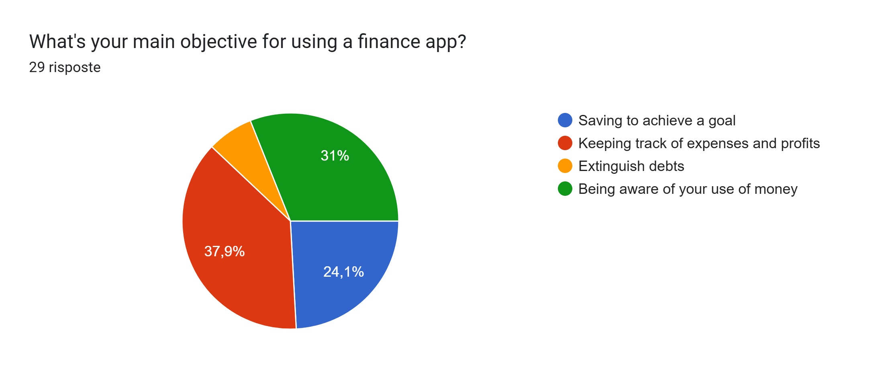
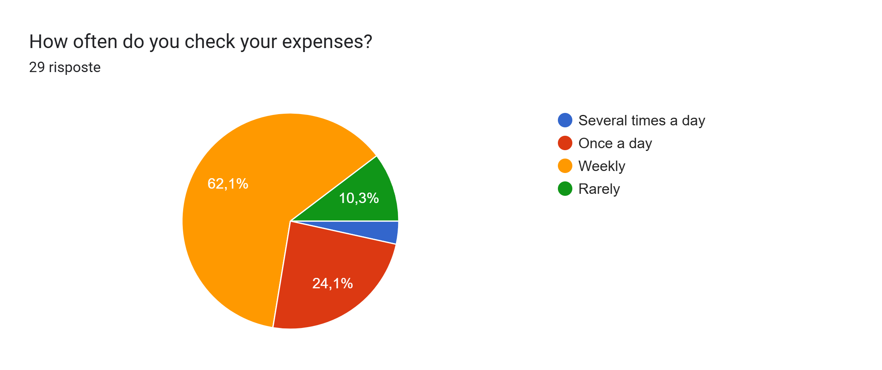
User analysis - questionnaires
We administered a questionnaire to our potential users. Here are some of the insights we gained from it.
Users want to keep track of their expenses in order to be aware of their use of money
They also like to keep track of goals and debts
Many users tend to check expenses on a weekly basis
From this, we were able to get an idea of the general use of the app.

Slide 9
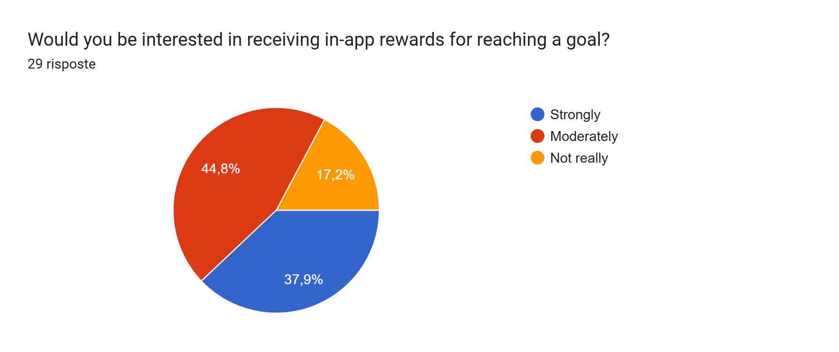
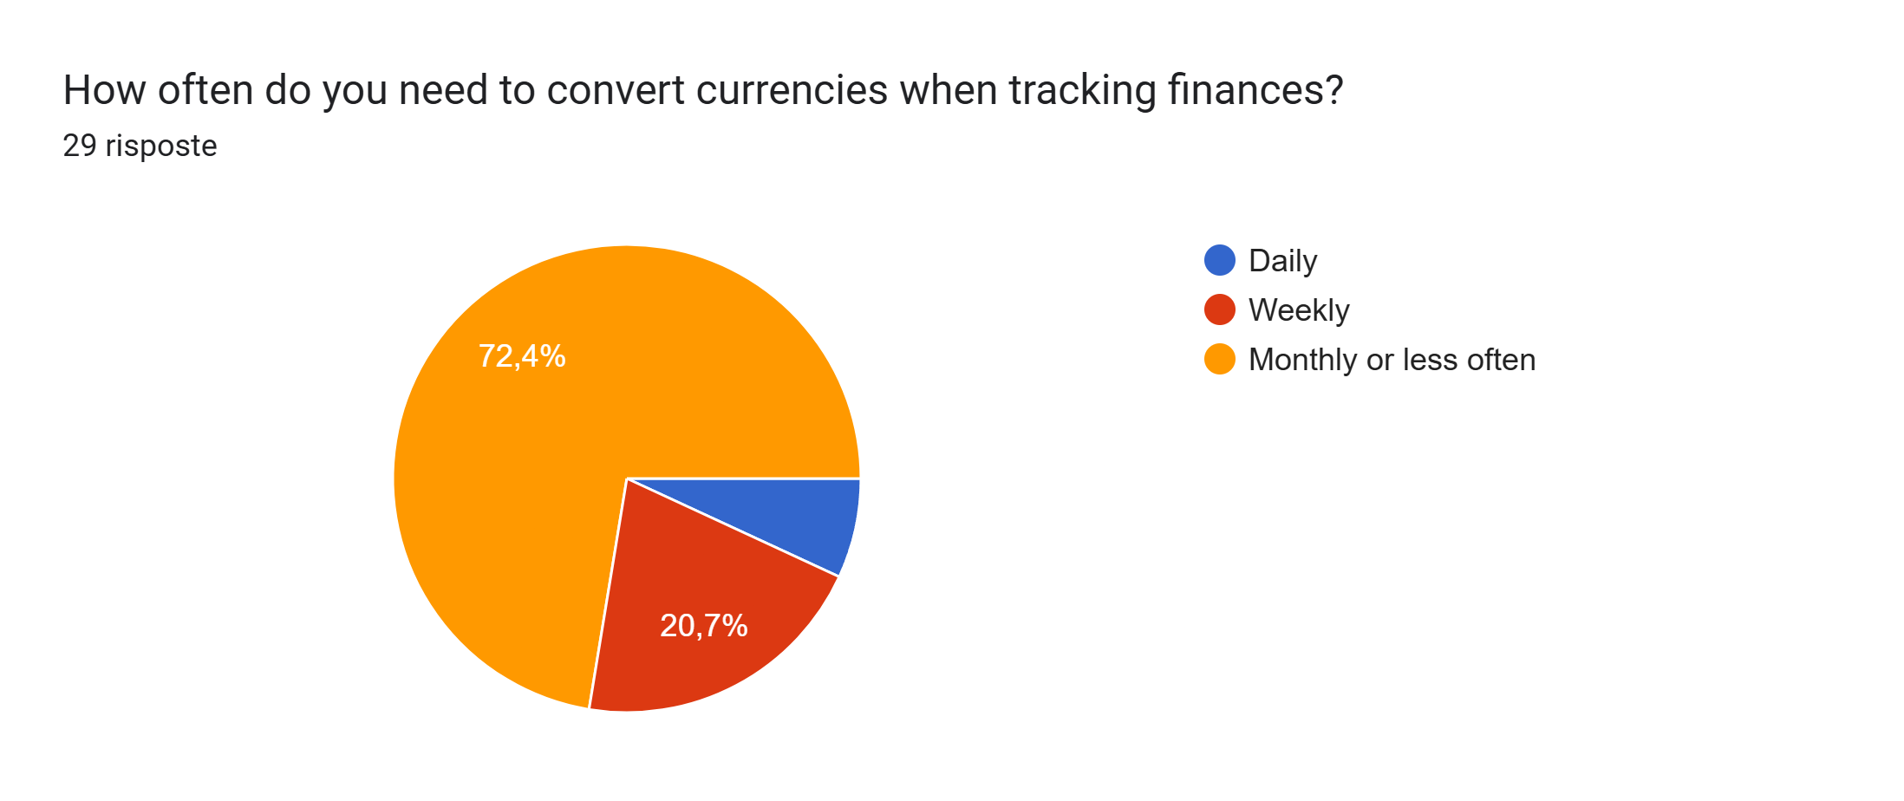
User analysis - questionnaires
Through the questionnaire we were also able to decide which features to develop depending on the preference of the users. We noticed that
Users like receiving in-app rewards for reaching set goals
They do not need to convert currencies often
Because of this, we decided to implement a leveling system with rewards in our app and we abandoned the idea of inserting a currency conversion feature.

Slide 10



Competitor analysis
From the results of the questionnaires and by looking at the most popular finance apps we were able to find some apps that users currently utilize to track their expenses. We’ve compared the features offered by said apps with the ones offered by Budgify
App | Expense tracking | Categories | Loans | Charts | Reward system | Secure access
Budgify
Budget e finanze
Splitwise
Money manager
1Money
PRO
LIMITED

Slide 11
Hierarchical task analysis
0: Buy and item and record the expense
Plan 0: In order 1,2,3,4
Plan 2: In order 2.1,2.2,(2.3 or 2.4)
1: Decide what to buy
2: Find a shop
3: Buy the item
Plan 3: 3.1 or 3.2
4: Register the transaction
Plan 4: One between 4.1,4.2,4.3
Then 4.4
2.1: Look for shops that sell the item
2.2: Choose a shop
2.3: Go to the physical store
2.4: Visit the online shop
3.1: Pay with cash
3.2: Pay with card
4.1: Use a budgeting tool
4.2: Use an app
4.3: Write the transaction down
4.4: Write the transaction details

Slide 12
Hierarchical task analysis
0: Set an objective and buy the related item
Plan 0: In order 1,2,3 Then, if no, do 4 Then do 5
Plan 2: In order 2.1,2.2
Plan 4: Do 4.1,4.2,4.3 until money is enough
1: Choose what you want to save for
2: Set an objective
3: Check if you can afford the item
4: Save money
5: Buy the item
Plan 2.2: 2.2.1 or 2.2.2
Plan 3.1:
3.1.1 and/or 3.1.2
Plan 3.2:
3.2.1 or 3.2.2
2.1: Identify the price of the item
2.2: Record the details of the item
3.1: Check if you have enough money
3.2: Check if you have any debts
Plan 4.3:
4.3.1 or 4.3.2
4.1: Cut down on expenses
4.2: Put aside earnings
4.3: Keep track of saved money
2.2.1: Use an app
2.2.2: Write them down
3.1.1: Check your cash
3.1.2: Check your bank account
3.2.1: Check with an app
3.2.2: Check a list
4.3.1: Use an app
4.3.2: Write it down

Slide 13
Hierarchical task analysis
0: Extinguish a debt
Plan 0: In order 1,2 Then, if no, do 3 Then do 4
Plan 1: In order 2.1,2.2
Plan 2: In order 2.1,2.2
Plan 3: Do 3.1,3.2,3.3 until money is enough
Plan 4: 4.1 or 4.2
1: Identidy the debt
2: Check if you can repay the debt
3: Save money
4: Repay the sum
Plan 1.1: 1.1.1 or 1.1.2
Plan 2.1:
2.1.1 and/or 3.1.2
Plan 2.2:
2.2.1 or 2.2.2
1.1: Check your debts list
1.2: Find the debt
2.1: Check if you have enough money
2.2: Check if you have any debts
4.1: Set up an appointment
4.2: Pay with bank account
3.1: Cut down on expenses
3.2: Put aside earnings
3.3: Keep track of saved money
4.1.1 Pay with cash
1.1.1: Check an app
1.1.2: Check a physical list
Plan 3.3:
3.3.1 or 3.3.2
2.1.1: Check your cash
2.1.2: Check your bank account
2.2.1: Check with an app
2.2.2: Check a list
3.3.1: Use an app
3.3.2: Write it down

Slide 14
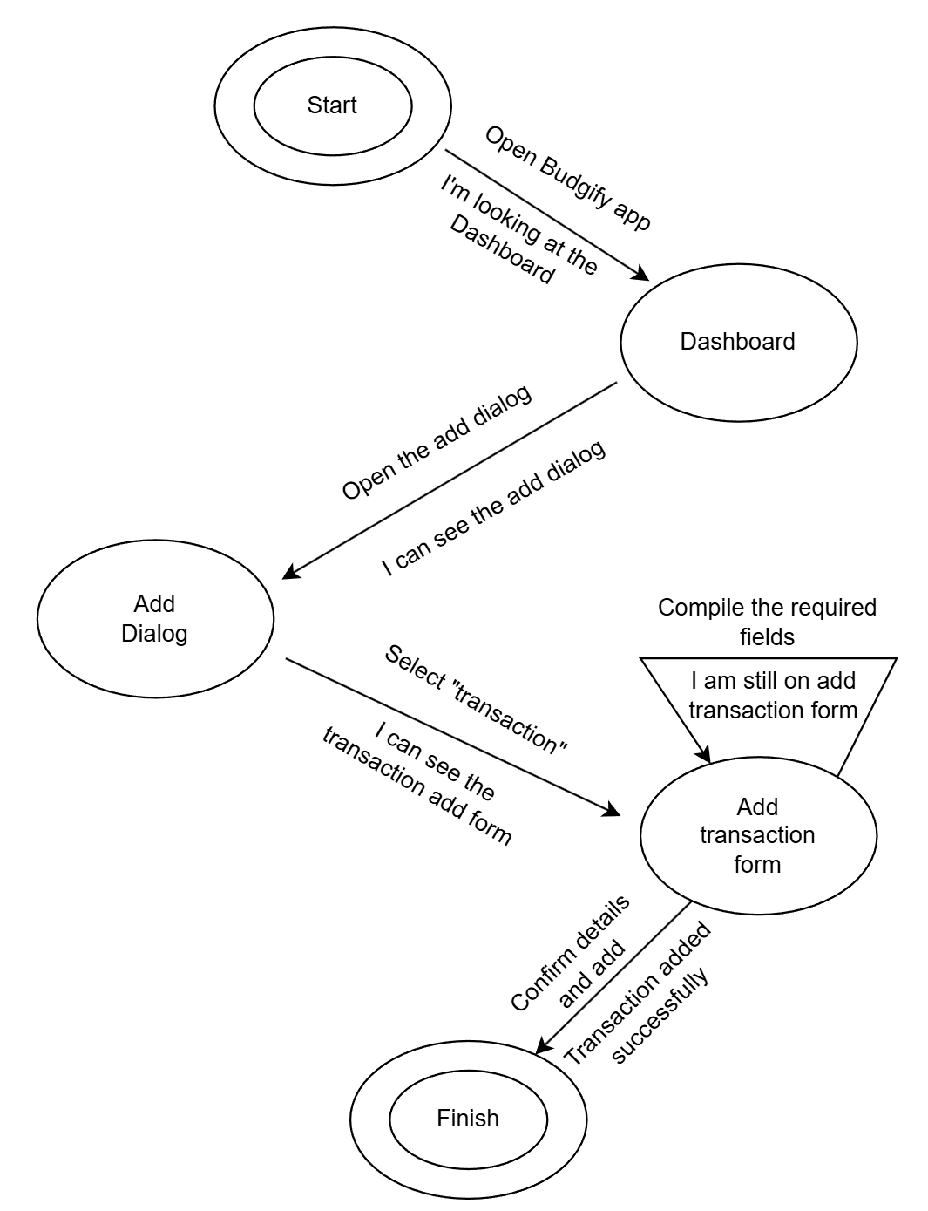
State transition networks
This is the STN related to the “Buy and item and record the expense “ HTA

Slide 15
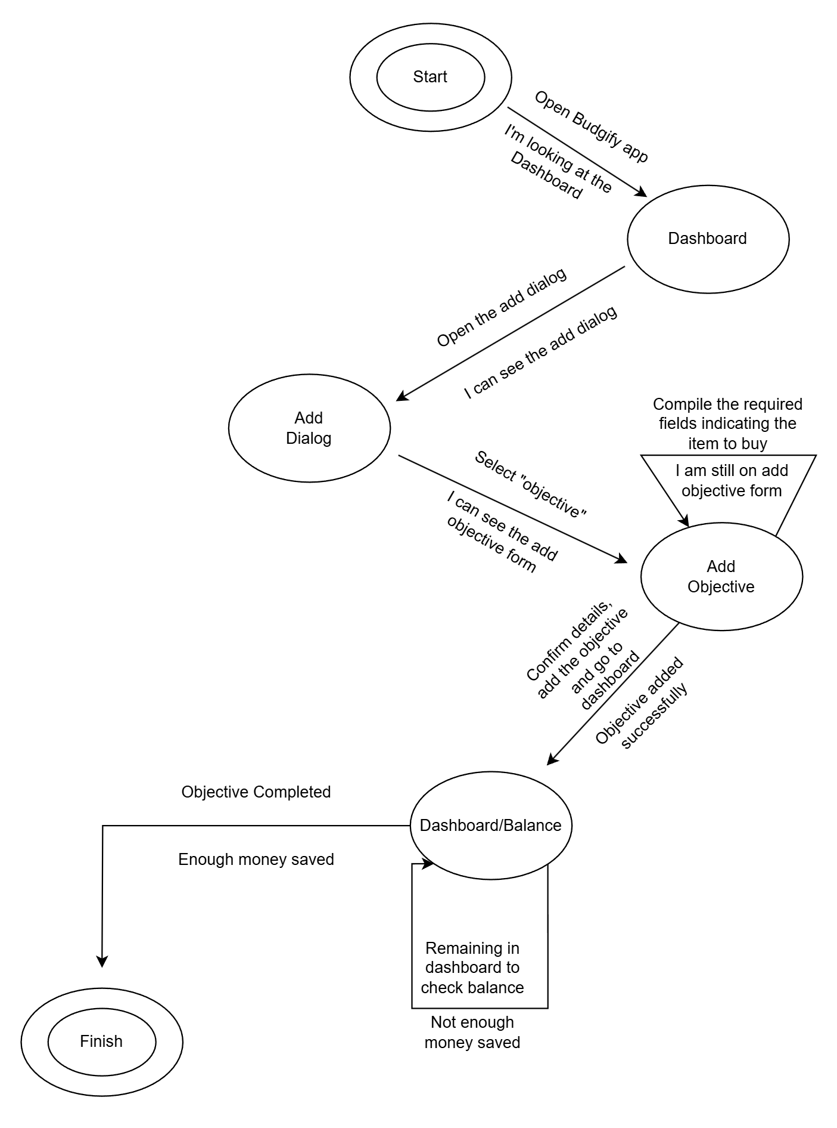
State transition networks
This is the STN related to the “Set an objective and buy the related item“ HTA

Slide 16
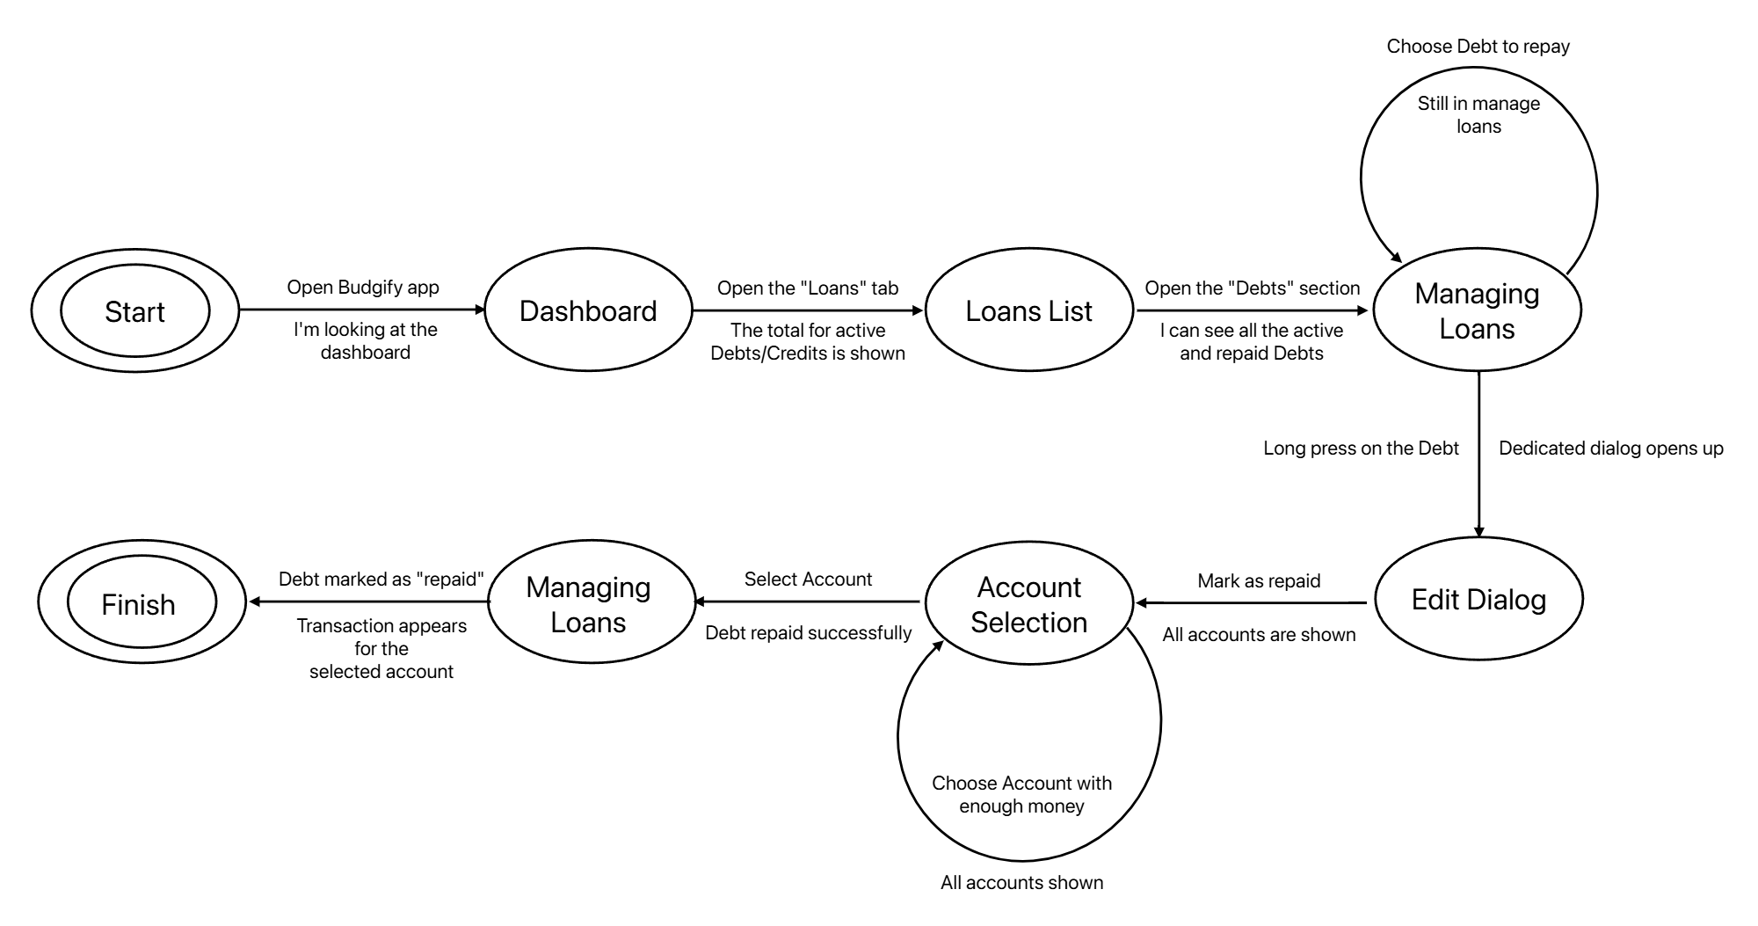
State transition networks
This is the STN related to the “Extinguish a debt“ HTA

Slide 17
Conclusion analysis
In conclusion, the analysis indicates a clear user need for a comprehensive and goal-oriented financial tool. The main features to include are:
Rewarding objectives
Debts and credits handling
Listing of transactions
Handling of multiple accounts
Clear visualization of data

Slide 18
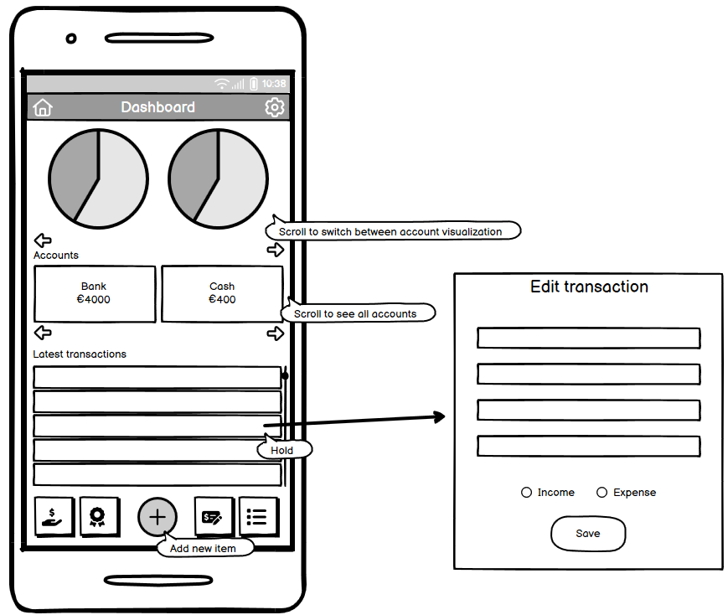
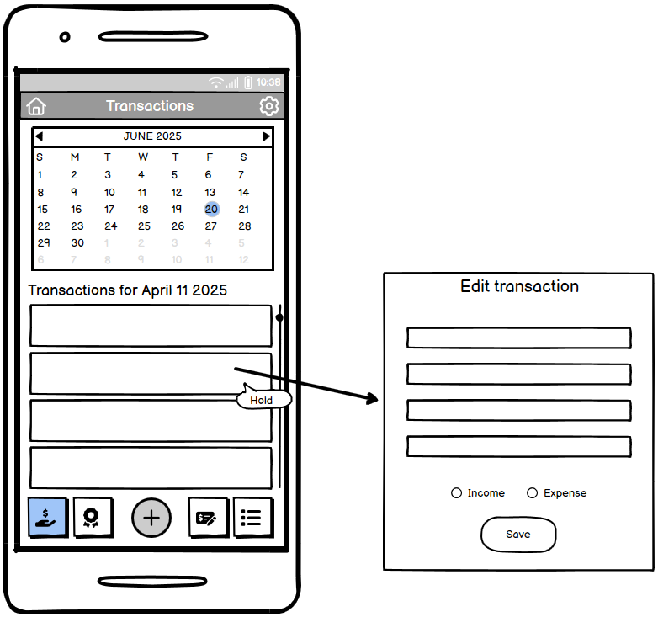
Prototype 0 - mockups
For our first prototype, we realized some mockups of the different screens to be realized in the application. Here are some of them.
Dashboard
Transactions screen

Slide 19
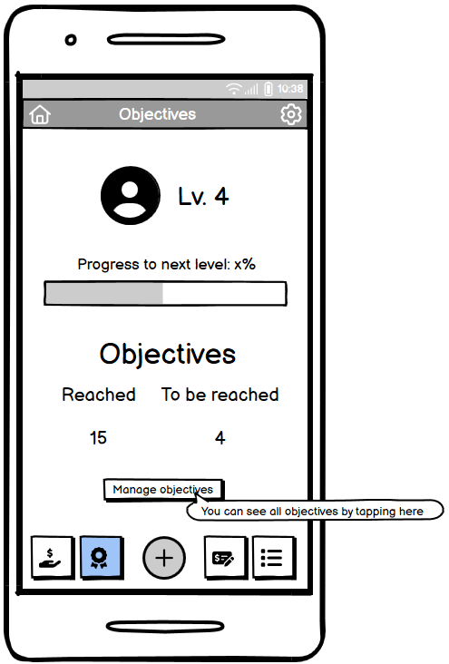
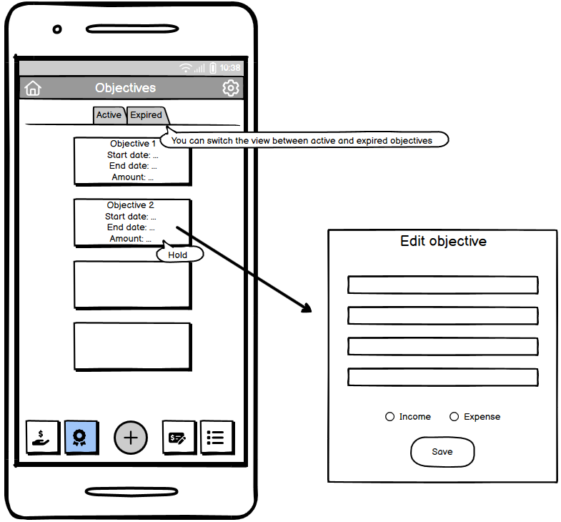
Prototype 0 - mockups
Objectives screen
Objectives management screen

Slide 20
EXPERT EVALUATION - HEURISTIC EVALUATION
We asked an expert to conduct heuristic evaluation on our prototype 0. Here are some of the more severe issues surfaced from the results.
Frame | Heuristic violated | Severity | Description / Comment
Transactions | Match between system and real word | 4 | Days with transactions lack clear visual cues, such as dots or highlights. Users must click randomly to find transactions, which does not meet real-world expectations of calendar design.
Categories | User Control and Freedom | 4 | No visible options to edit or delete existing categories. Users cannot modify incorrect category names or remove unused categories, which severely limits their control over the financial organization system.

Slide 21
EXPERT EVALUATION - HEURISTIC EVALUATION
Frame | Heuristic violated | Severity | Description / Comment
Transactions | Help Users Recognize, Diagnose, and Recover from Errors | 3 | Selecting a date with no transactions must show an empty list with a feedback (e.g., "No transactions on this day"). Otherwise, users may assume a technical error.
All Interfaces | Help & Documentation | 3 | There is a lack of contextual help and onboarding for first-time users.

Slide 22
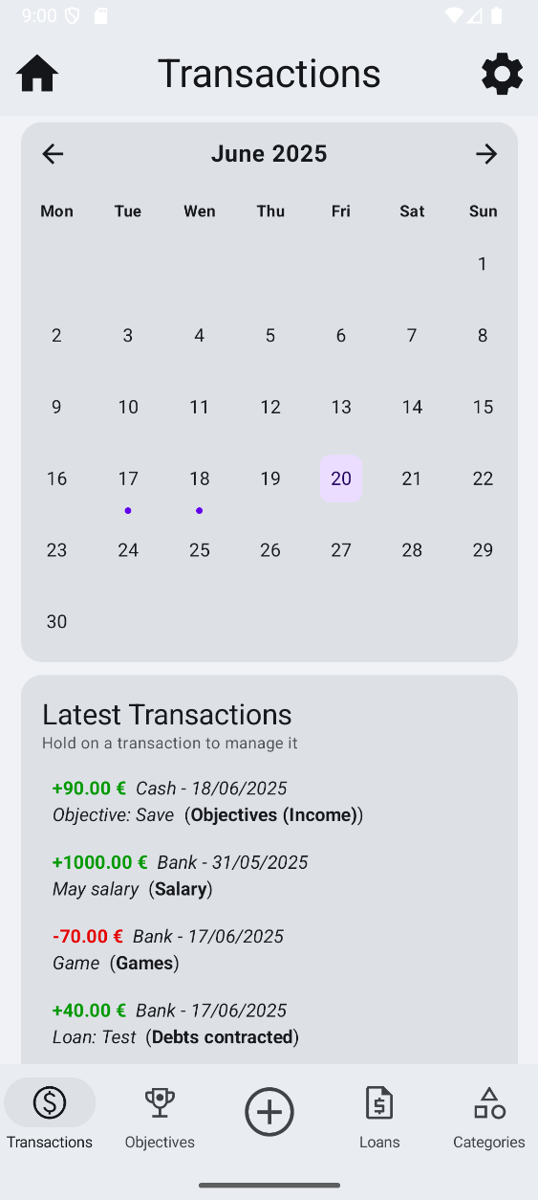
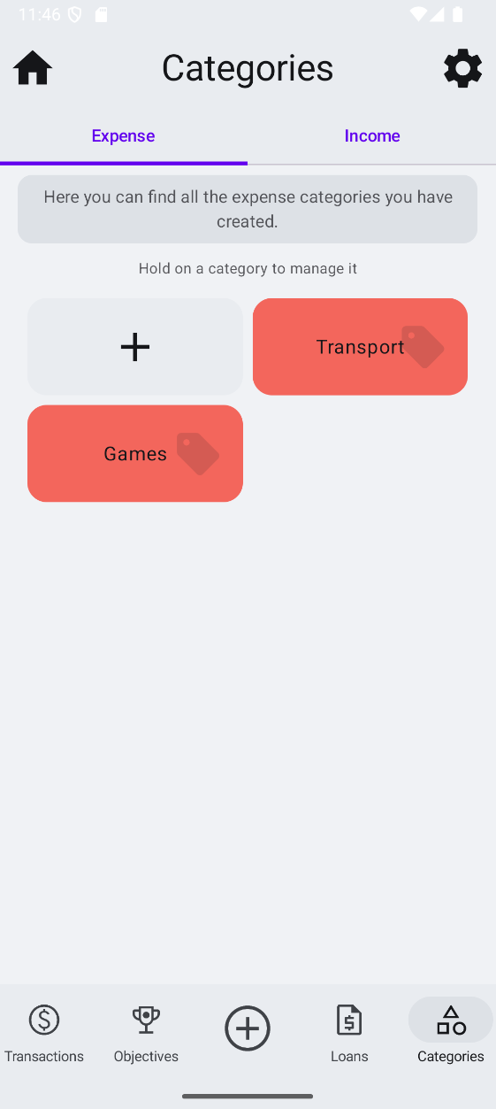
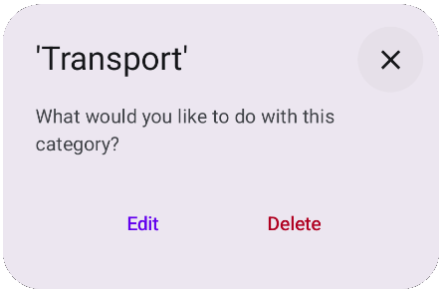
EXPERT EVALUATION - HEURISTIC EVALUATION
All the issues were promptly fixed. Here are the final screens related to the previously shown issues, with the implemented fixes. In particular:
The transcations screen now features an indication on the days that contain transactions
Categories can be edited an deleted and it is clearily stated how to do so

Slide 23
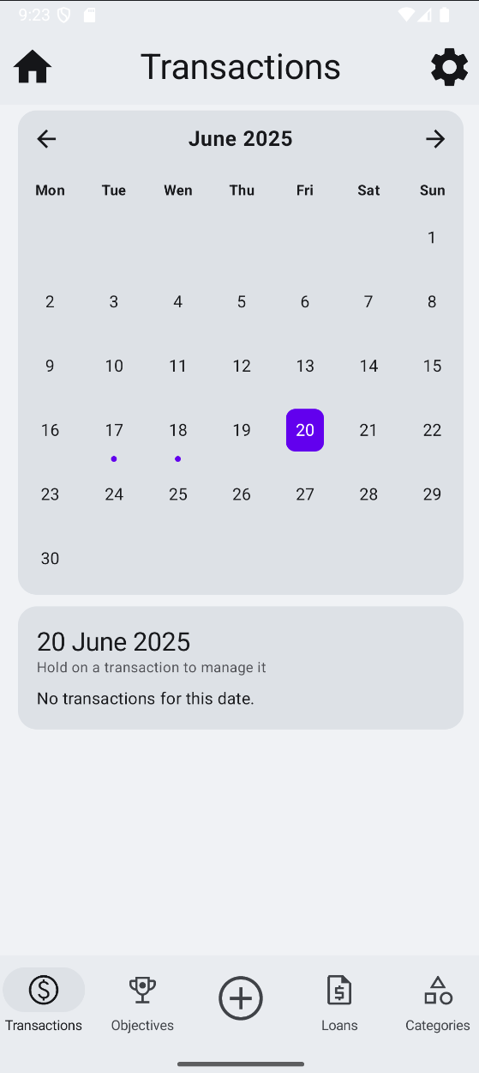
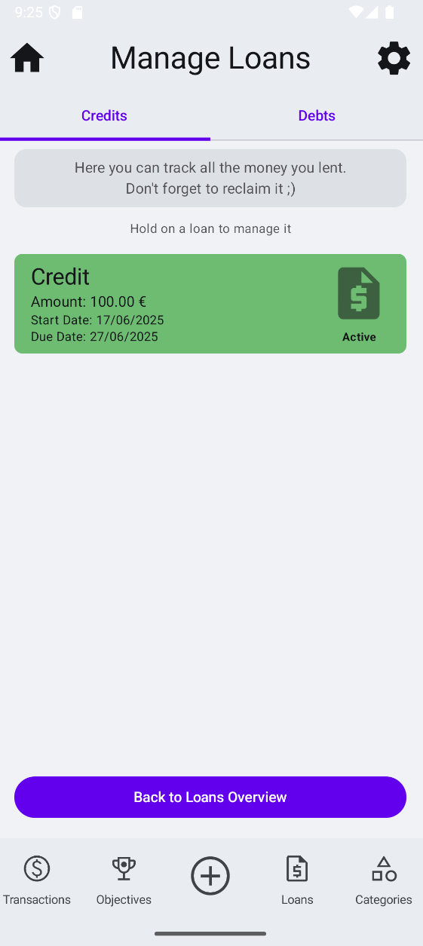
EXPERT EVALUATION - HEURISTIC EVALUATION
When selecting a day with no transactions, a message is displayed
In several interfaces, there is now a message the informs the user of the functionality of said interface; this should help first-time users

Slide 24
USER EVALUATION – think aloud

Slide 25
USER EVALUATION – controlled experiment

Slide 26
Final realization

Slide 27
Future work
Add more types of reward

