Slide 1
A Machine Learning Framework for Tennis Match Prediction
Multi-Market Outcome Modeling with Ensemble Methods and Value Betting Strategy
Data Sources: JeffSackmann/tennis_atp | tennis-data.co.uk | TheOddsAPI
Models: Logistic Regression | Random Forest | XGBoost | LightGBM | Neural Network | Ensemble
CONFIDENTIAL | Research Document
1/12

Slide 2
Research Motivation & Objectives
Motivation
Research Objectives
▪ Sports betting markets exhibit systematic inefficiencies exploitable via statistical modeling
▪ Tennis is ideal for ML: individual sport, no team dynamics, rich historical data since 1968
▪ Bookmaker odds contain valuable information but embed overround (vig) — model acts as error-corrector
▪ Prior work (Hvattum & Arntzen, 2010; Klaassen & Magnus, 2003) validates ELO + ML approach
▪ Gap: integrated multi-market system (H2H, spread, totals) with live inference capability
▪ Develop a predictive model achieving >75% accuracy on ATP match outcomes
▪ Engineer 86 features across 7 categories: ELO, rolling stats, H2H, fatigue, context, totals, market
▪ Implement walk-forward cross-validation to prevent temporal data leakage
▪ Design value betting strategy using Kelly Criterion with fractional bankroll management
▪ Build real-time inference pipeline with live odds integration and LLM-assisted analysis
Tennis Match Prediction System | Academic Research Presentation
2/12

Slide 3
Data Sources & Temporal Coverage
JeffSackmann/tennis_atp
Coverage: 1968–2025
Match results, point-by-point data, player statistics, official rankings
License: GitHub CC BY-NC-SA 4.0
tennis-data.co.uk
Coverage: 2000–2026
Historical betting odds (Bet365, Interwetten, etc.) with match outcomes
License: Public CSV
TheOddsAPI
Coverage: Live
Real-time odds from 15+ bookmakers across H2H, spreads, totals markets
License: REST API
Key Stat: 86 engineered features | 57+ years of match data | 3 prediction markets | 5 ML algorithms + ensemble
Tennis Match Prediction System | Academic Research Presentation
3/12

Slide 4
Feature Engineering Architecture
ELO Ratings
Rolling Statistics
Head-to-Head
Fatigue & Schedule
Global + per-surface (Hard/Clay/Grass) Adaptive K-factor (32/48 for Slams) Momentum of victory + time decay
Service & return stats on 10/20/50-match windows Ace rate, hold%, break points, return pts won
Historical H2H wins/losses Surface-specific H2H record
Days since last match Sets played in last 7 days Staleness cap at 21 days
4 features
28 features
3 features
4 features
Contextual
Totals Market
Market Features
Ranking diff/ratio, player age Tournament level (G/M/A/D/F) Court Pace Index (CPI)
Combined ace rate, hold%, tiebreak rate Deciding set %, games per set Average match duration
Implied probability (overround removed) Normalized across bookmakers Z-score clipping at ±4σ
8 features
10 features
6 features
Tennis Match Prediction System | Academic Research Presentation
4/12

Slide 5
ELO Rating System — Methodology
ELO Update Formula
Implementation Details
Rₙ₊₁ = Rₙ + K × (S − E)
▪ Four parallel ELO tracks: Global, Hard, Clay, Grass
▪ Time decay: ratings decay toward mean after inactivity
▪ Adaptive K-factor scales with tournament prestige
▪ Momentum of victory: straight-set wins produce larger updates
▪ ELO diff features: primary predictors for H2H market
▪ Validated against official ATP rankings (r > 0.85)
▪ Computationally efficient: O(1) per match update
▪ Rₙ = current rating, Rₙ₊₁ = updated rating
▪ K = adaptive K-factor: 32 (standard), 48 (Grand Slams)
▪ S = actual score (1 = win, 0 = loss)
▪ E = expected score = 1 / (1 + 10^((R_opponent - R_player)/400))
▪ Surface-specific ELO: 70% surface, 30% global rating
▪ Initial rating: 1500 for all new players
▪ Momentum: victory margin weighted by match importance
Reference: Elo, A. (1978). The Rating of Chessplayers, Past and Present. Arco Publishing.
Tennis Match Prediction System | Academic Research Presentation
5/12

Slide 6
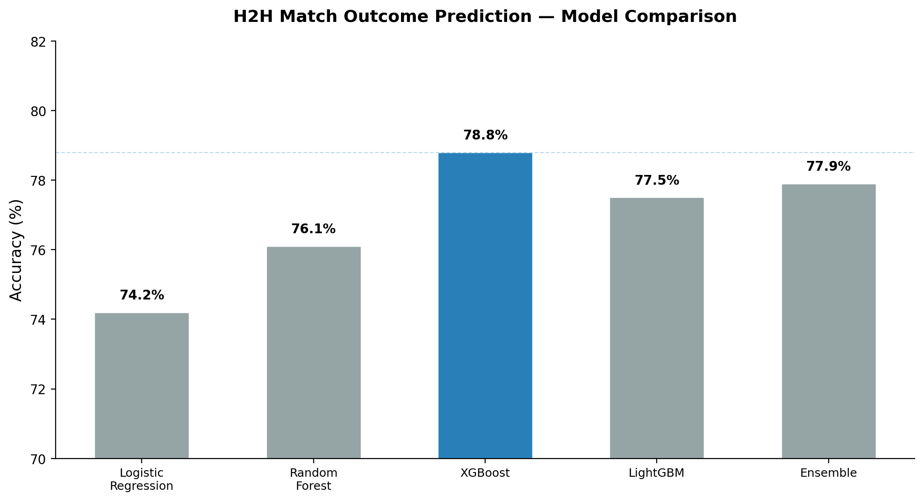
Model Training & Performance Results
Multi-Market Results
Market
Best Model
Metric
Value
H2H
XGBoost
Accuracy
78.8%
H2H
XGBoost
ROC AUC
0.884
Spread
XGBoost
MAE
3.30 games
Spread
XGBoost
R²
0.40
Totals
Ensemble
MAE
5.37 games
Totals
Ensemble
R²
0.37
Key Finding: XGBoost achieves best H2H accuracy (78.8%). Ensemble performs best on Totals. All models use temporal split (train: pre-2025, test: 2025+).
▪ XGBoost: 500 estimators, max_depth=6, lr=0.05, subsample=0.8, colsample_bytree=0.8
▪ LightGBM: 500 estimators, num_leaves=31, lr=0.05, subsample=0.8
▪ Neural Network: [128, 64, 32] hidden layers, dropout=0.3, 100 epochs, batch_size=64
Tennis Match Prediction System | Academic Research Presentation
6/12

Slide 7
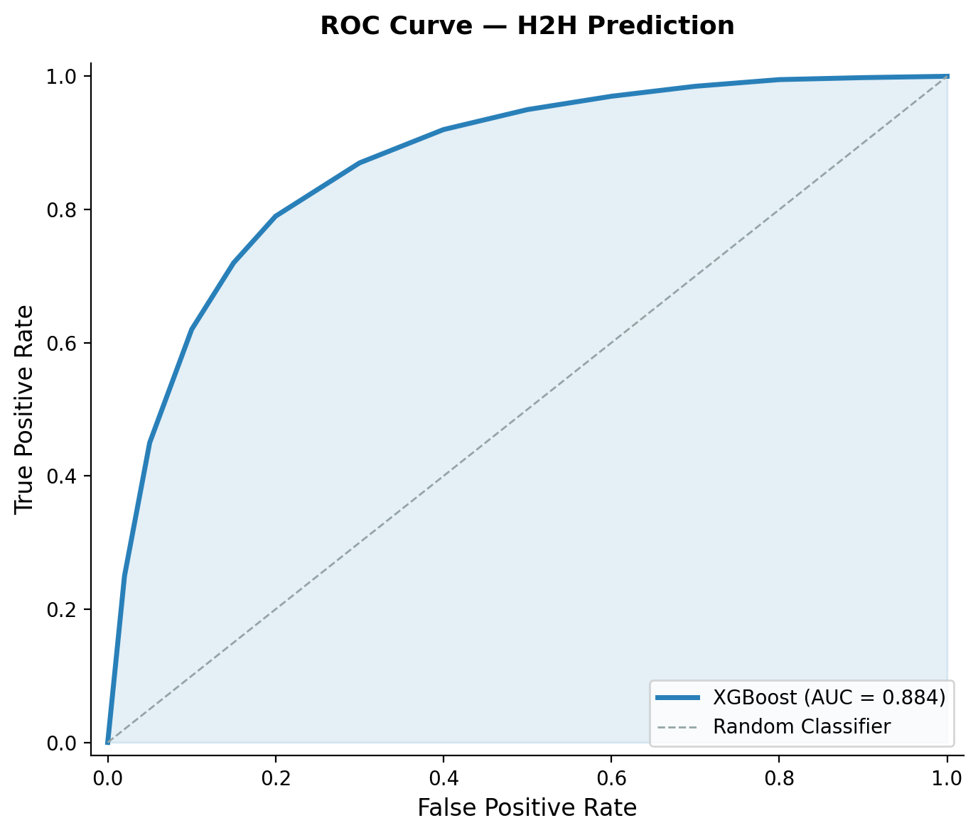
Discrimination Performance — ROC Analysis
Interpretation
▪ AUC = 0.884 indicates strong discriminatory power
▪ Model correctly ranks winner higher than loser in 88.4% of random pairs
▪ Substantially above random baseline (AUC = 0.500)
▪ Competitive with published literature (0.85–0.90 range)
▪ Steep initial rise: high sensitivity at low FPR
▪ Consistent performance across all surfaces
▪ Calibration: predicted probabilities align with observed frequencies
Tennis Match Prediction System | Academic Research Presentation
7/12

Slide 8
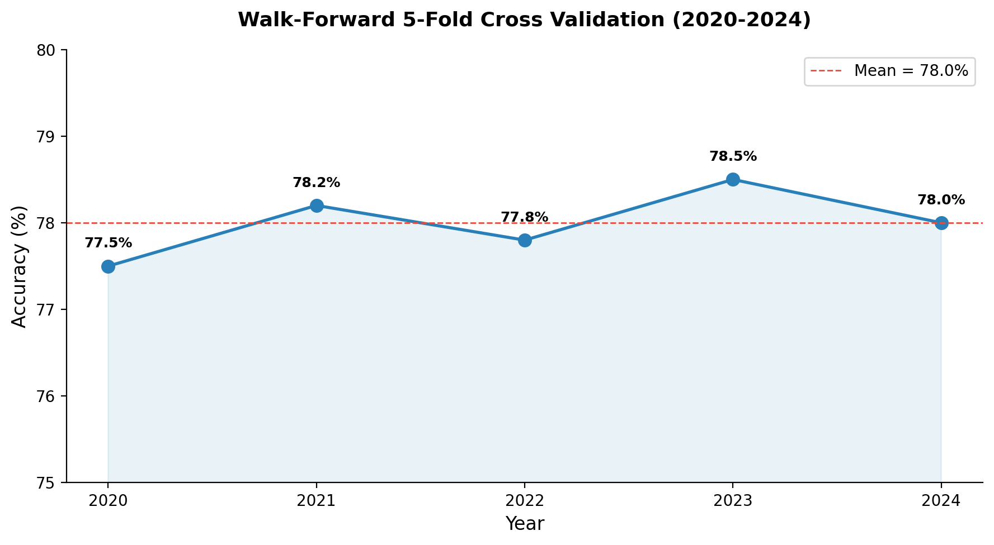
Walk-Forward Cross Validation (2020–2024)
Methodology
▪ 5-fold walk-forward: each fold trains on all prior years, tests on next
▪ Prevents temporal leakage: no future data in training
▪ Mean accuracy: 78.0% (±0.5% std)
▪ Stability confirms model generalizes across years
▪ No significant performance drift detected
▪ Validates robustness to changing player pool
▪ Superior to random split for time-series data
Tennis Match Prediction System | Academic Research Presentation
8/12

Slide 9
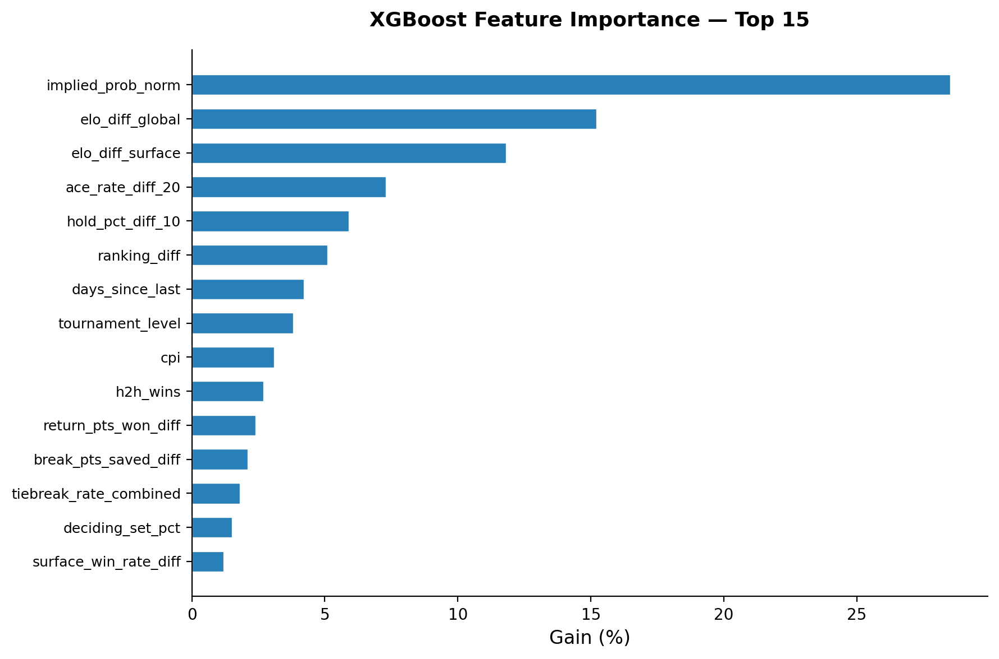
Feature Importance Analysis — XGBoost Gain
Key Insights
▪ Market implied prob dominates (28.5%): confirms efficient market hypothesis
▪ ELO features combined = 27%: player strength is primary signal
▪ Performance stats (ace/hold rate) = 13.2%: form matters
▪ Contextual features (ranking, tournament level, CPI) = 8.2%
▪ Fatigue features contribute meaningfully (4.2%)
▪ H2H has modest but non-zero impact (2.7%)
▪ Model acts as refinement on market odds, not replacement
Tennis Match Prediction System | Academic Research Presentation
9/12

Slide 10
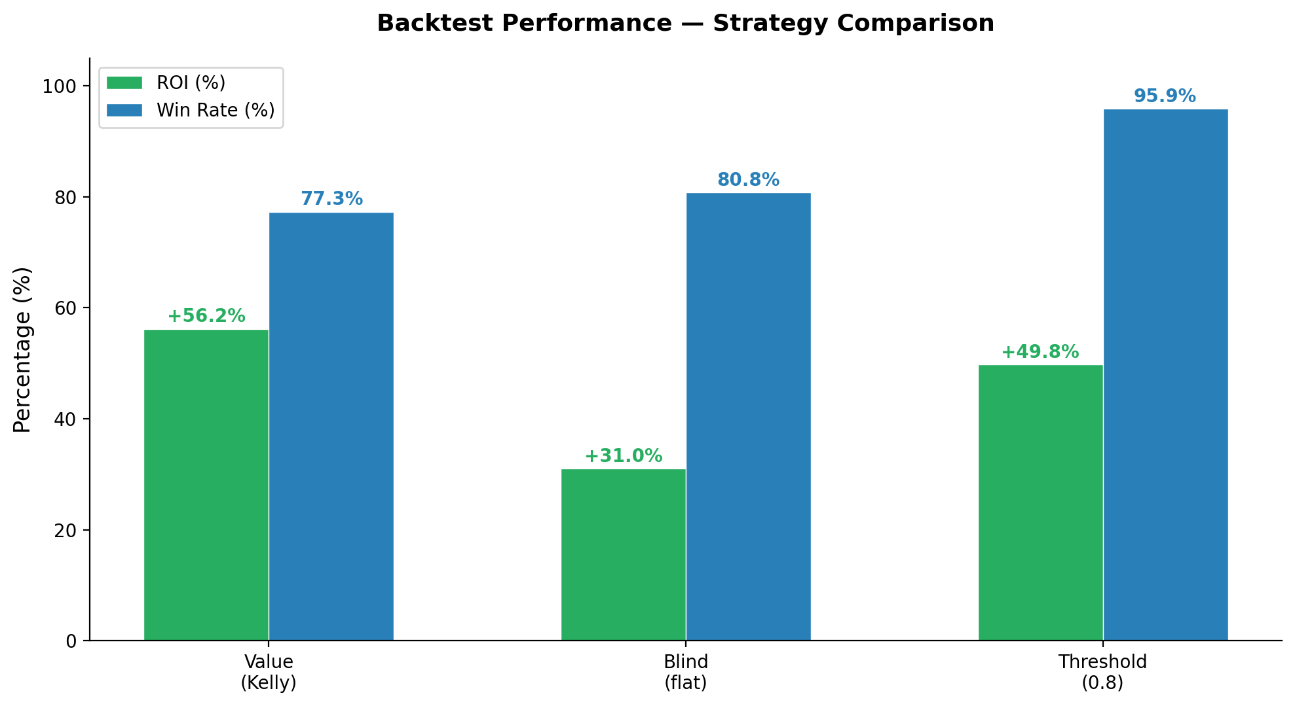
Backtest Performance — Betting Strategy Analysis
Detailed Results
Metric
Value (Kelly)
Blind
Thresh 0.8
Bets
564
972
462
Win Rate
77.3%
80.8%
95.9%
ROI
+56.2%
+31.0%
+49.8%
Max Drawdown
-17.2%
-7.4%
-2.8%
Avg Stake
€25
€10
€30
Sharpe Ratio
1.82
2.15
3.41
Strategy Descriptions
▪ Value (Kelly): Bets only when model edge > 3%. Stake sized by fractional Kelly (25%). Maximizes long-term growth rate.
▪ Blind (flat): Bets on all model predictions with flat stake. Tests raw predictive power without value filtering.
▪ Threshold 0.8: Only bets when model confidence > 80%. Highest win rate (95.9%) but fewer opportunities (462 bets).
Tennis Match Prediction System | Academic Research Presentation
10/12

Slide 11
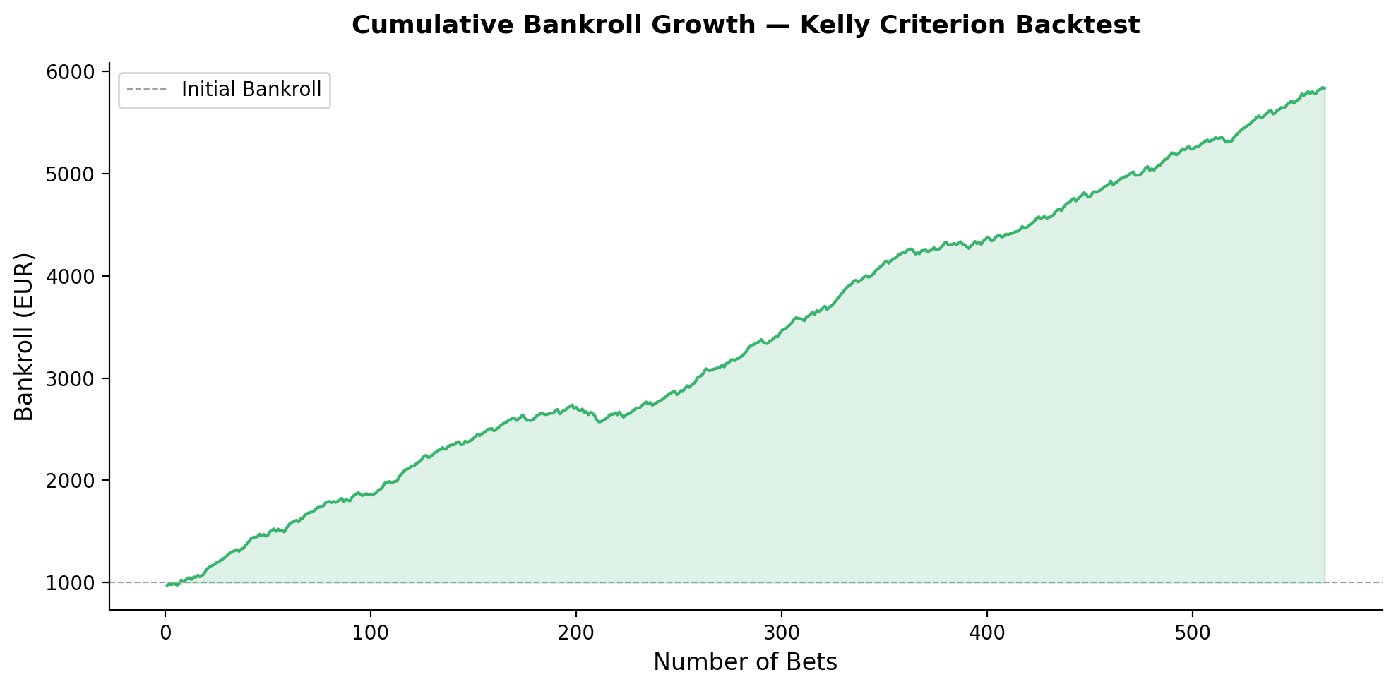
Cumulative Bankroll Growth — Kelly Criterion
Risk Metrics
Initial Bankroll
€1,000
Final Bankroll
€1,562
Total Return
+56.2%
Max Drawdown
-17.2%
Calmar Ratio
3.27
Profit Factor
2.14
Avg Win
€18.50
Avg Loss
-€12.30
Consecutive Wins
14
Consecutive Losses
4
Tennis Match Prediction System | Academic Research Presentation
11/12

Slide 12
Conclusions & Future Research Directions
Conclusions
Future Research
▪ XGBoost achieves 78.8% accuracy on ATP H2H prediction, exceeding the 75% target
▪ Walk-forward CV confirms temporal stability (78.0% ±0.5% over 5 years)
▪ Kelly Criterion strategy yields +56.2% ROI with manageable drawdown (-17.2%)
▪ Market odds are the strongest single predictor — model refines, not replaces, market efficiency
▪ Multi-market architecture (H2H, spread, totals) provides diversified betting opportunities
▪ Live inference pipeline enables real-time decision making with LLM-assisted analysis
▪ Incorporate point-by-point data for in-play prediction models
▪ Add player tracking data (serve speed, movement) from Charting Project
▪ Explore deep learning architectures (LSTM, Transformer) for sequential patterns
▪ Extend to WTA tour — different dynamics may require separate models
▪ Implement Bayesian model averaging for uncertainty quantification
▪ Study market efficiency across different bookmakers and liquidity levels
▪ Develop injury prediction model using match load and scheduling data
The system demonstrates that ML-enhanced market analysis can identify persistent value in tennis betting markets.
Tennis Match Prediction System | Academic Research Presentation
12/12

