Slide 1

AI & Radio Astronomy
By: Thomas Merle, Tanya Ahn, Sungbin Park, Rémi Doguet and Marleen Jonker.
Notes:
Marleen
Introduction: Today we will present our ideas about the AI project applied to Radio Astronomy. We have started researching machine learning algorithms a bit and we have implanted one with a dataset about stars and planets. But we will tell you more about that later on.

Slide 2
The team
Marleen JONKER, The Netherlands
Sungbin PARK, Republic of Korea
Thomas MERLE, France
Rémi DOGUET, France
Tanya AHN, Republic of Korea
Notes:
Marleen
Background of AI

Slide 3
Our goal
To figure out whether a star has at least one Exoplanet in orbit by using ML.
Build a neural network to find pattern of exoplanet.
Notes:
We want to train a machine learning algorithm that can predict if a star has at least one exoplanet in orbit.
Marleen
Our is to To figure out whether a star has at least one Exoplanet in orbit by using ML. Build a neural network to find pattern of exoplanet. We also have exces to some devices like de movidius stick, which we can use for the neural network.

Slide 4
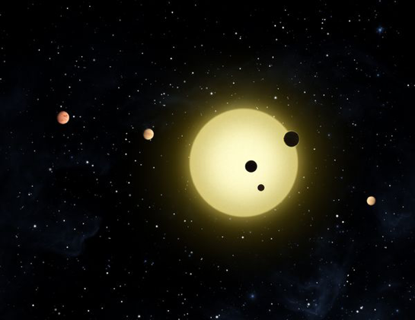
What is an exoplanet?
Planets that orbit around other stars
Scientists search for exoplanets by looking at the effects these planets have on the stars they orbit
Notes:
Tanya
All of the planets in our solar system orbit around the Sun.
So exoplanet has some potential possibilities that there might be some other creatures in the planet or possible for humans to live in there.
----okay then how can we find Earth-like planets in other solar systems?
Exoplanets are very hard to see directly with telescopes since they are hidden by the bright glare of the stars they orbit.
So they came up with the other idea, which is to search exoplanet by looking at the effects that these planets have on the stars.

Slide 5
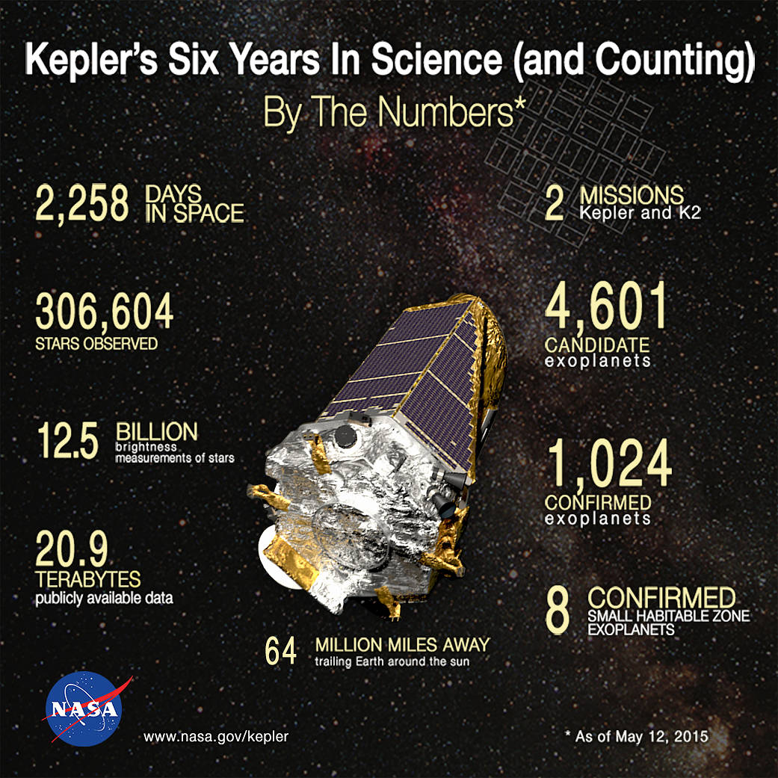
NASA’s mission to search for the exoplanets : Kepler
Satellite-telescope designed to search for exoplanets.
It focuses on one area for 80 days to gather data.
Kepler measure change in light intensity.
Notes:
Tanya
Kepler is very sensitive to changes in flux (light intensity). Periodically, data are beamed down to Earth and after a bit of de-noising, they are open-sourced via the Mikulski Archive.
Kepler detected exoplanets using something called transit method.
When a planet passes in front of its star, it’s called a transit.
As the planet transits in front of the star, it blocks out a little bit of the star's light.
which means, a star will look a little less bright when the planet passes infront of it.
So by collecting the datas of brightness of the stars as time passes, they can observe whether the transit is currently going on.

Slide 6
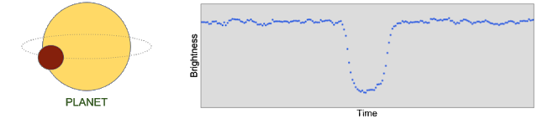
NASA’s mission to search for the exoplanets : Kepler
Notes:
Kepler detected exoplanets using something called transit method.
When a planet passes in front of its star, it’s called a transit.
As the planet transits in front of the star, it blocks out a little bit of the star's light.
which means, a star will look a little less bright when the planet passes infront of it.
So by collecting the datas of brightness of the stars as time passes, they can observe whether the transit is currently going on.

Slide 7
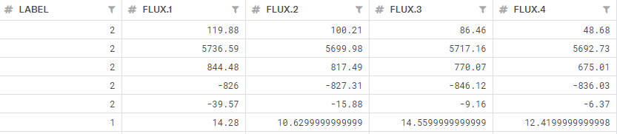
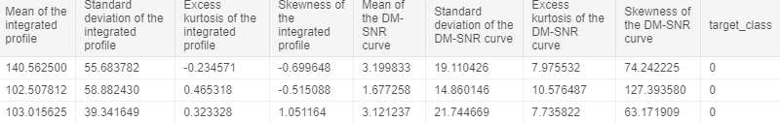
DataSet
Exoplanet dataset
Pulsar dataset
Notes:
Exoplanet dataset: We want to train a machine learning algorithm that can predict if a star has at least one exoplanet in orbit.
Pulsar dataset: Just for showing our first choice
Thomas

Slide 8
Traning set : 5087 rows or observations
Test set : 570 rows or observations.
3198 columns or features.
Column 1 is the label vector. Columns 2 - 3198 are the flux values over time.
37 confirmed exoplanet-stars and 5050 non-exoplanet-stars in training set.
Notes:
Thomas

Slide 9
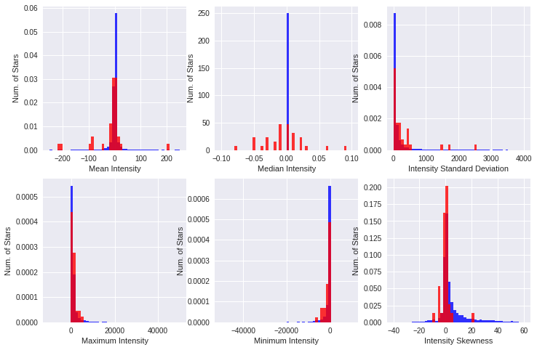
Visualization of Data
- Red : an exoplanet star
- Blue : a non-exoplanet-star.
Notes:
Tanya
whether it’s suitable for ML

Slide 10
Technical Information
Using Tensorflow 1.1x with Keras
Using Jupyter notebook
Using dataset from Kaggle
Create virtual Environment through Anaconda - for using Tensorflow
Base OS is Windows 10
Supervised learning neural network
Use devices such as Jetson Nano developer kit, Movidius or Coral for deep learning environment
Notes:
Thomas

