Slide 1
Linear Regression-Multiple Variable

Slide 2
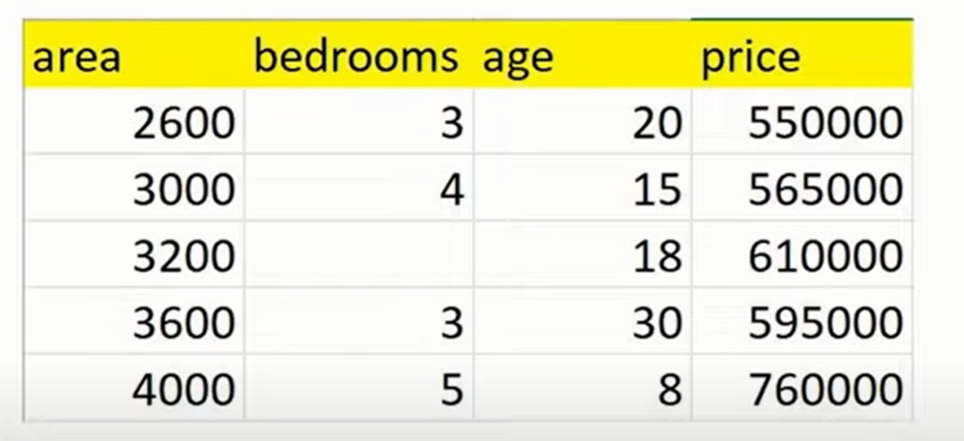
Home Prices In Finland

Slide 3
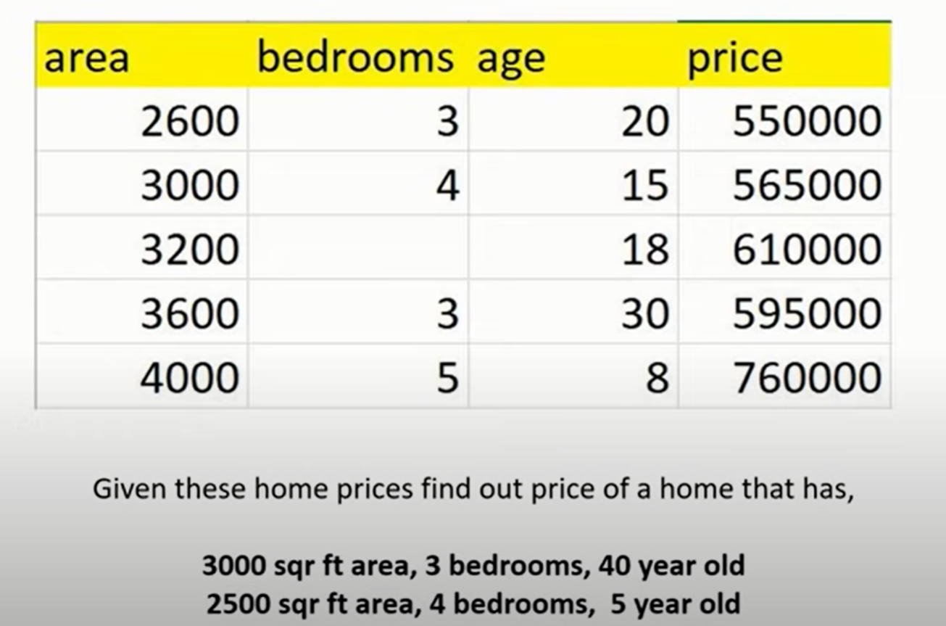
Estimate Home Prices

Slide 4
Linear Regression Model

Slide 5
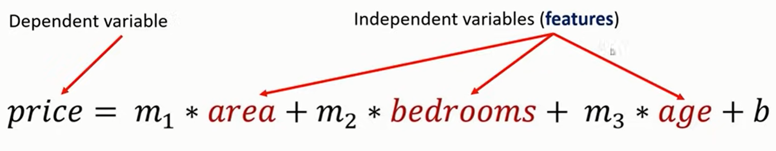
Linear Regression Model

Slide 6
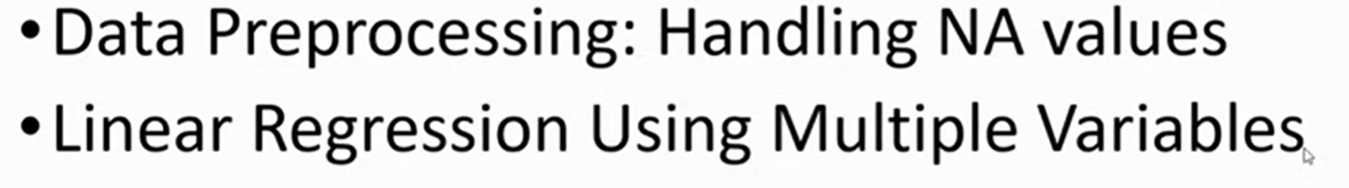
Topics

Slide 7
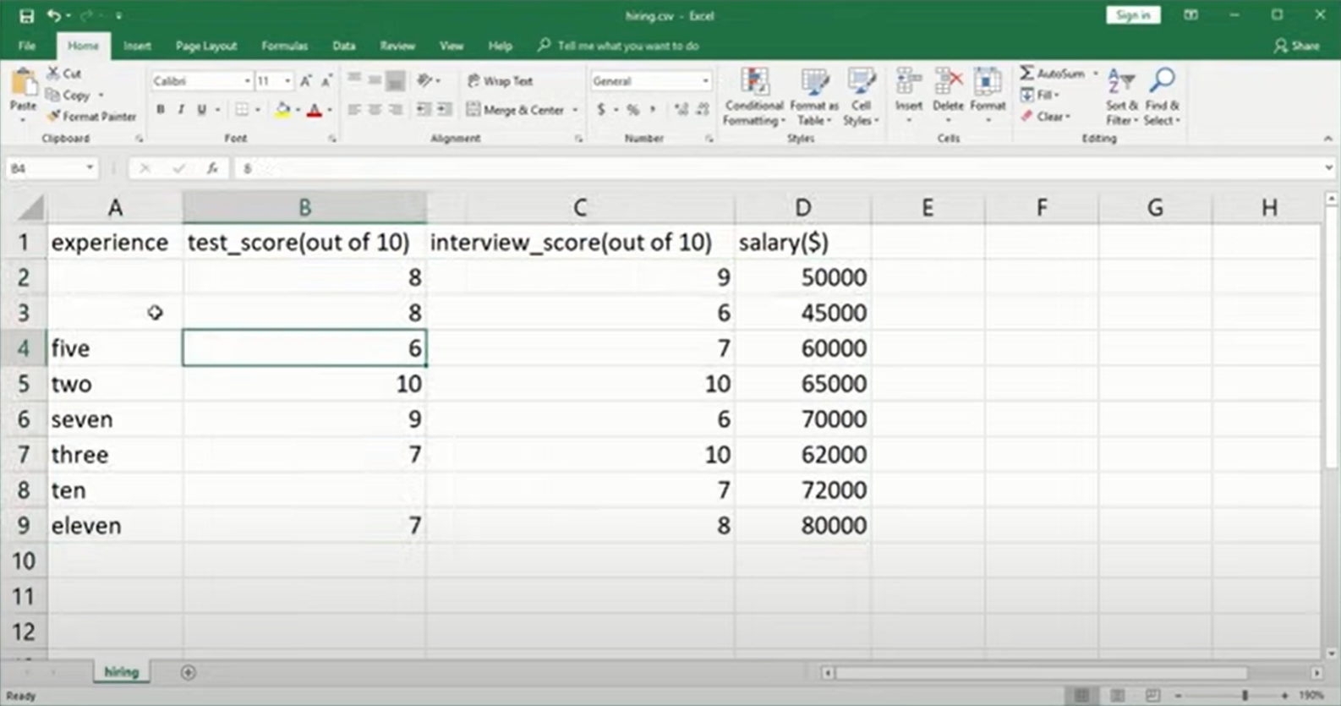
More Data Processing

Slide 8
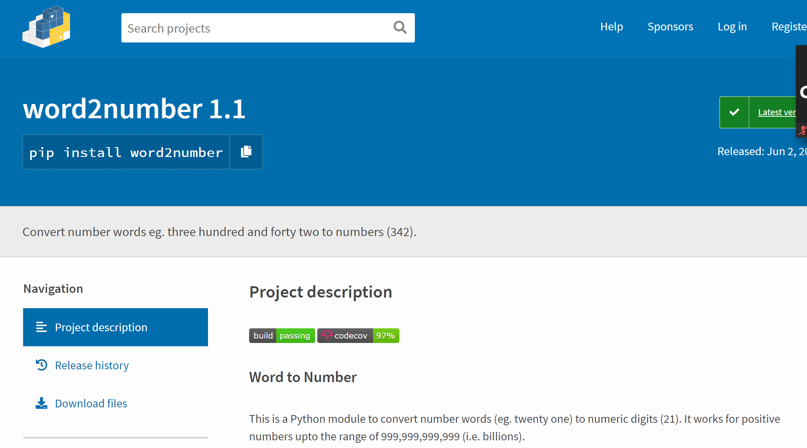
Python Word to Number

Slide 9

Exercise

