Slide 1
Linear Regression-Single Variable

Slide 2
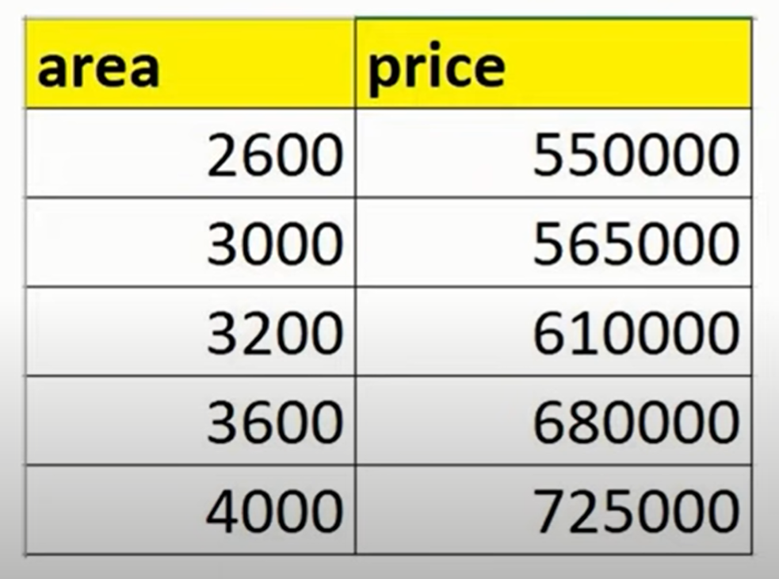
Home Prices In Finland

Slide 3
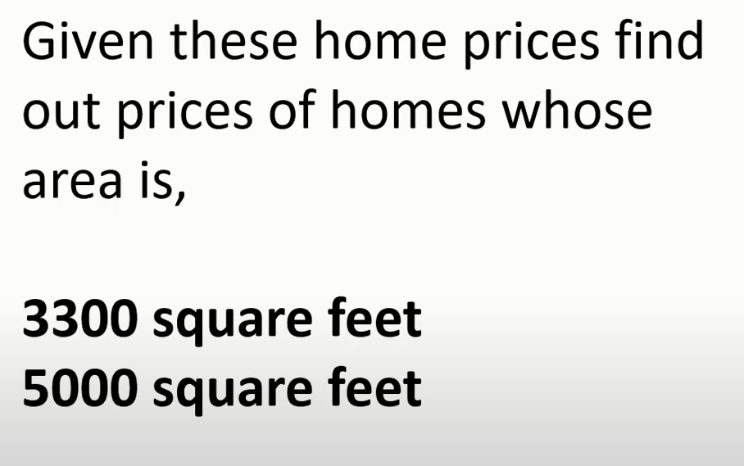
Estimate Home Prices

Slide 4
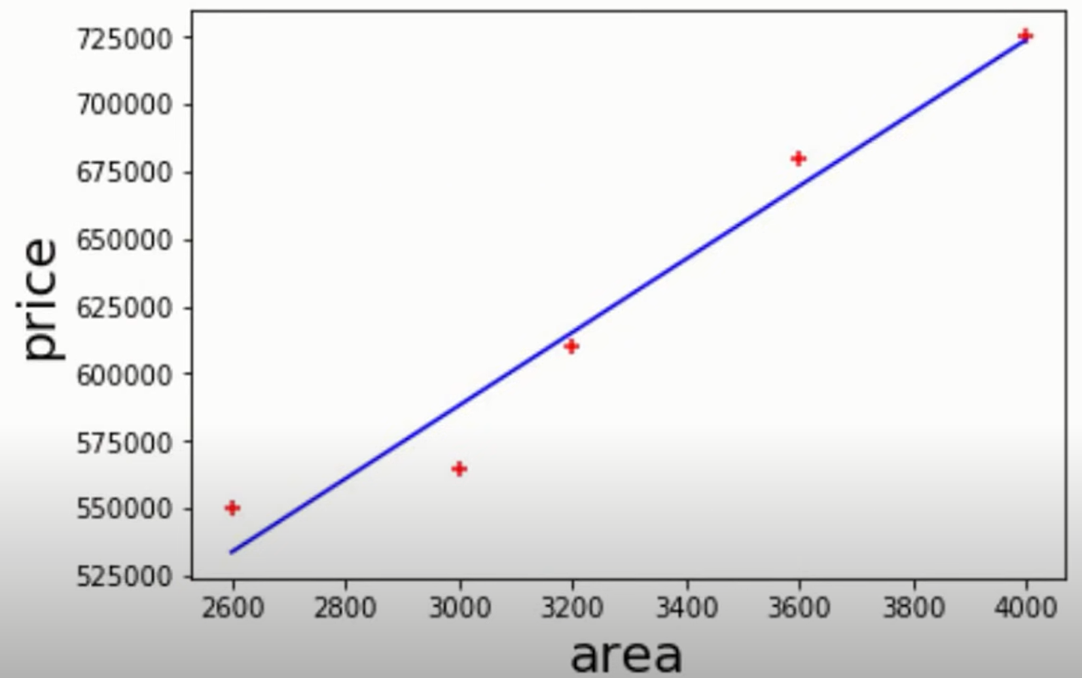
Estimate Home Prices

Slide 5
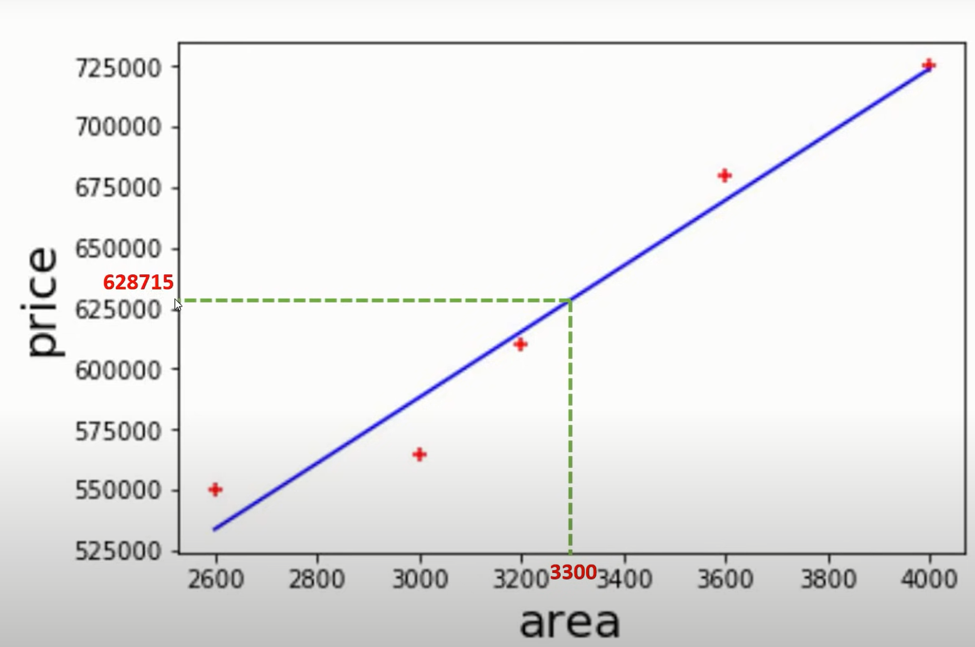
Estimate Home Prices

Slide 6
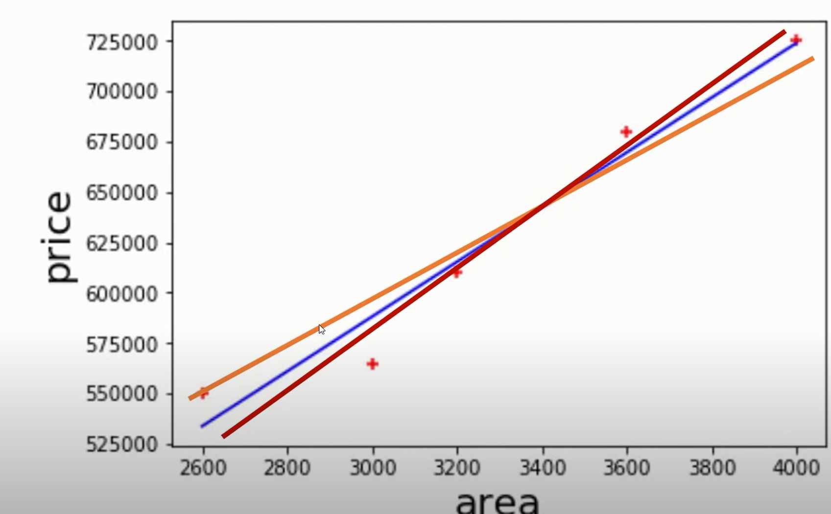
Estimate Home Prices

Slide 7
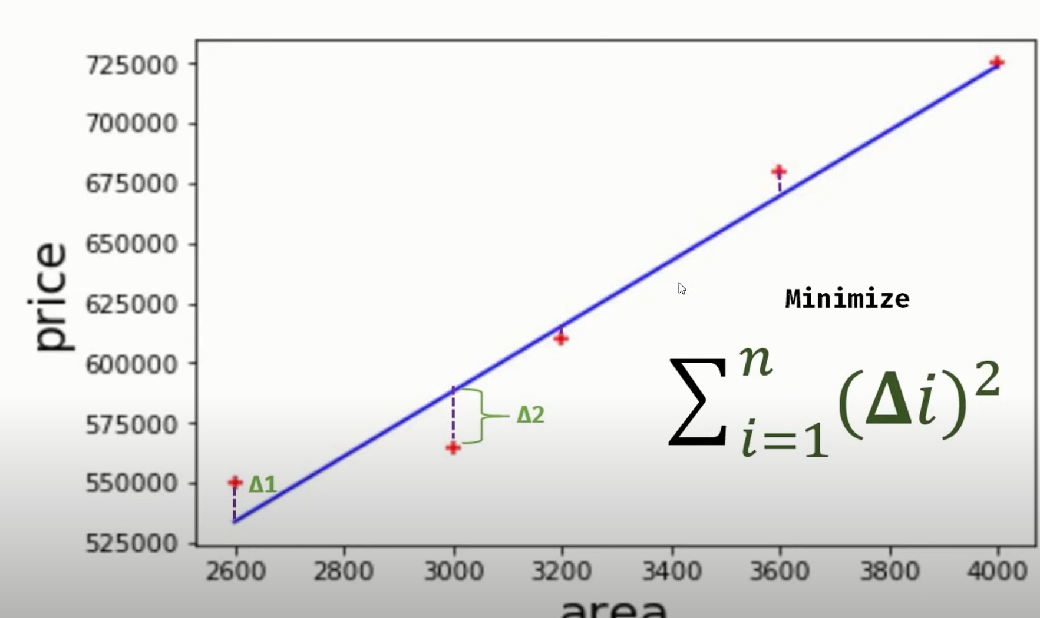
Estimate Home Prices

Slide 8
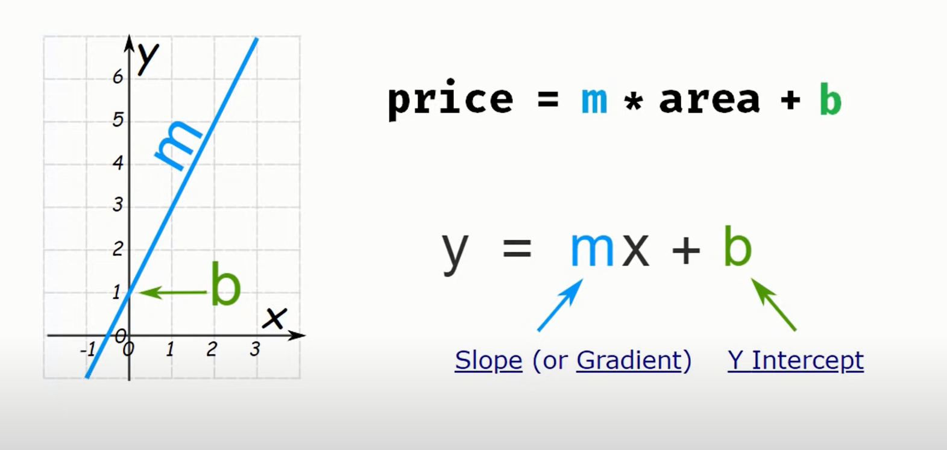
Estimate Home Prices

Slide 9
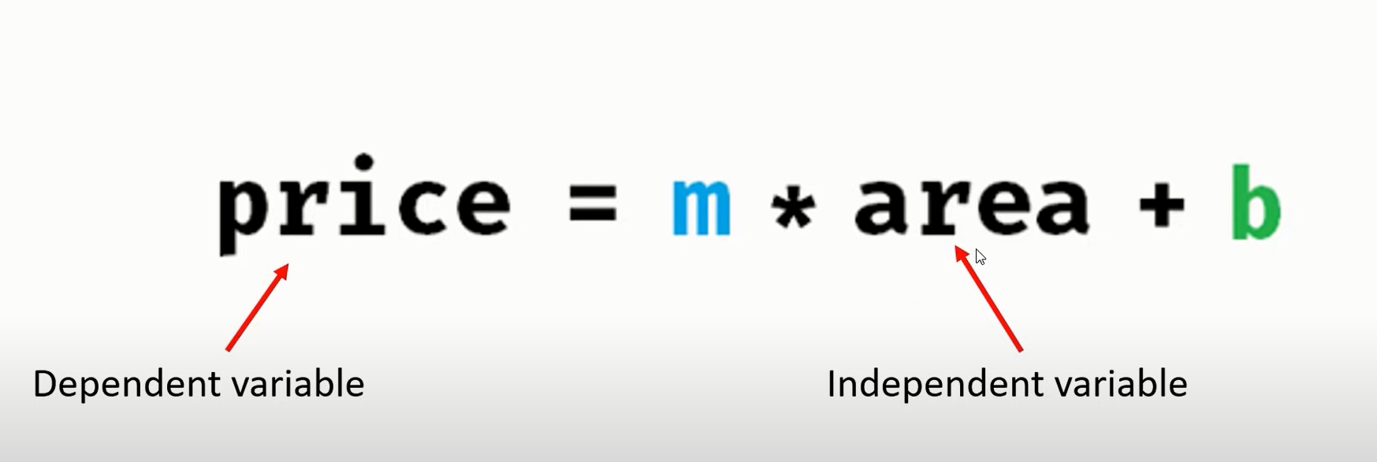
Estimate Home Prices

