Slide 1
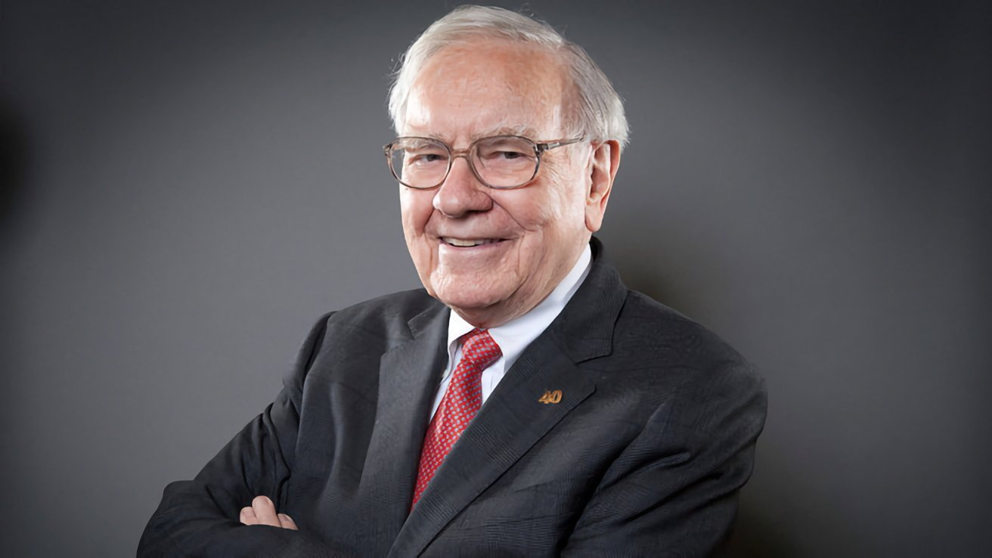
„Risk comes from not knowing what you are doing” - Warren buffett

Slide 2


„Portfopal – a web tool for investment portfolio management and stock market analysis
Proposed by SANDU TOZLOVANU

Slide 3
How to find a valuable stock?
Stock screening tool
P
O
R
T
F
O
P
A
L
How to know the real value of a stock?
Stock profiling tool
How to properly manage the stocks I already own?
Portfolio performance tracker

Slide 4
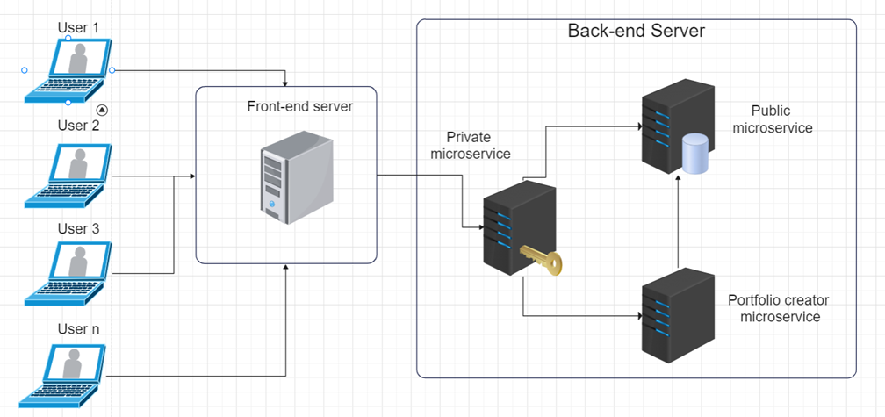
Application architecture

Slide 5
Thank you for your attention!

