Slide 1
Anti spoof face detector
Final year project

Slide 2
Problem statement
Biometrics are all around us.
It is something we are. According to (Ross, Nandakumar and Jane, 2006).
The most frequent methodologies of authentication are, face, fingerprint, iris and voice according to (Ross et al., 2006)
Face authentication which is a very popular biometric authentication can still be spoofed.
Photographic material
Video material
3d model of the user’s face

Slide 3
Project Objectives
1. Detect faces
2. Detect face changes
3. Detect eye changes
4. Detect spoof attack

Slide 4
Solution outline
1. Detect Faces
Made use of computer vision, haar cascades and open cv
2. Detect Face Changes
Was not able to detect head movement but was able to detect a life sign which is a smile using haar cascade
3. Detect Eye Changes
Detect eye blinks
4. Detect spoof
Detect spoof using the 3 goals achieved above
BIGGEST CHALLENGE
Was the eye blink.

Slide 5
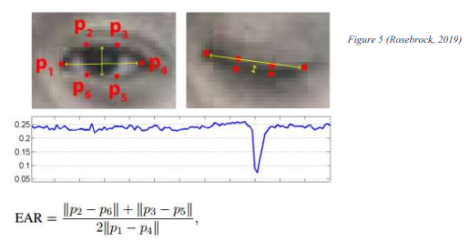
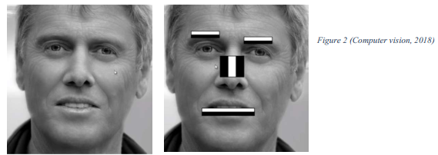
Research and findings
Haar features
Learned how the haar cascades worked and how the computer detects faces
Eye blink detection using EYE ASPECT RATIO
Found that localization of the face is required in order to do this
Found in my research that the distance between the horizontal and vertical lengths of the eye can be calculated to identify an eye blink

Slide 6
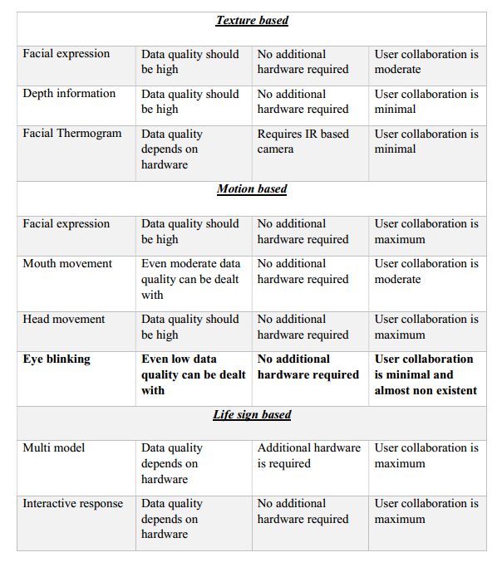
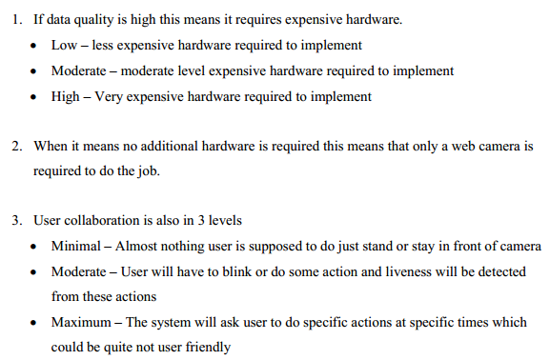
Analysis

Slide 7
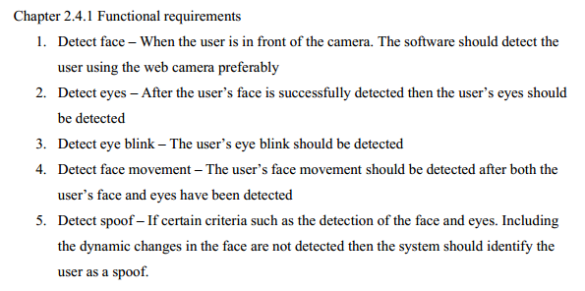
Requirement specification

Slide 8
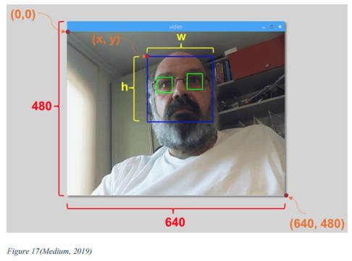
Choice of development
Detect face – used open cv, and haar cascades to detect the face
Detect eyes – After detecting the face another haar cascade was used to detect eyes
Detect eye blink – After detecting the landmark points of the face the distance between the points of the eye can be calculated to get the value of the EYE ASPECT RATIO. EAR > 0 if EAR = 0 this is an eye blink
Detect face movement – Used a haar cascade to detect a smile
Detect spoof – above mentioned features were used to detect spoof

Slide 9
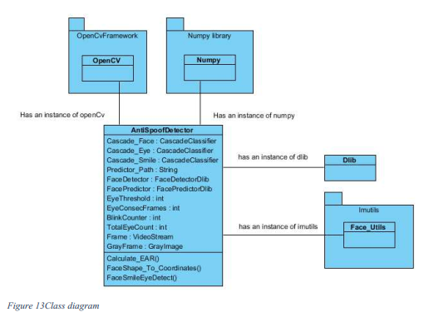
design

Slide 10
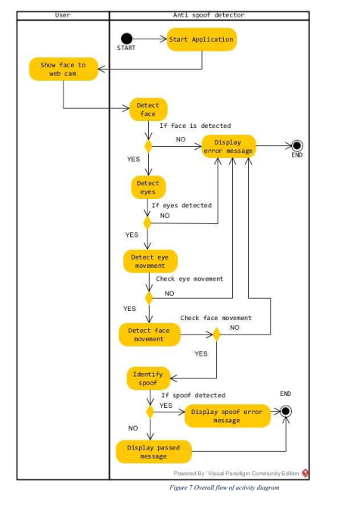
Overall flow

Slide 11
implementation
My contribution to this report is that I used multiple technologies using haar cascades and eye aspect ratio to learn and combine these technologies to detecting a spoof.

Slide 12
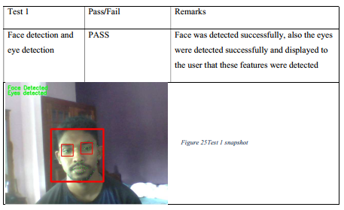
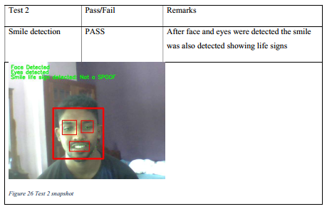
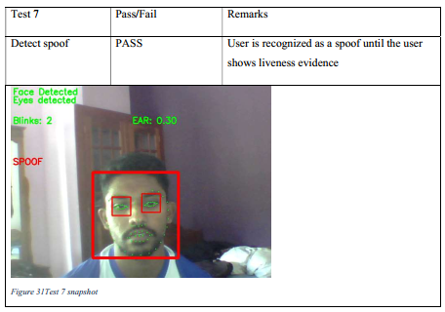
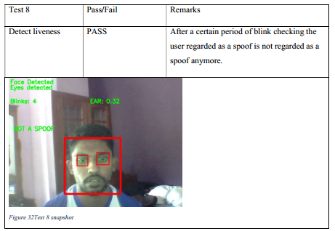
Test strategy
Testing had to be done for the main functional requirements to see if these were functioning properly. Test strategy involved certain functional tests with a pass and fail criteria along with evidence

Slide 13
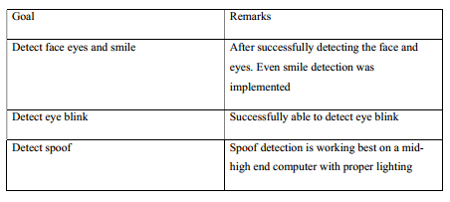
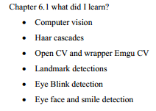
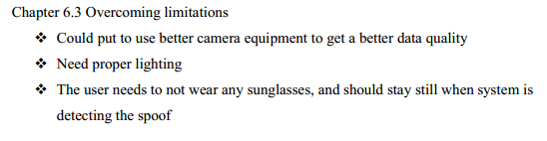

Critical appraisal

