Slide 1

Telco Value Added Service Predictor
By R.M.S.K. Chamodani
W1802124 / 20200090
Supervised By
Dr. Alroy Mascrenghe

Slide 2
Agenda
Background
Previous Work
Research Gap & Contribution
Algorithm Selection
System Architecture
Technology Selection
Demo
Testing
Limitations & Enhancements
Conclusion
Skills & Problems

Slide 3
Background
Mobile telecommunication industry in Sri Lanka
VAS (Value Added Services)
Why VAS Prediction?

Slide 4
Past Studies
Citation | Brief | Algorithms | Improvements | Limitations
(Vahidi Farashah et al., 2021) | Analytics model for TelecoVAS customers’ basket clustering using ensemble learning | Combines the X-Means algorithm, the ensemble learning system, and the N-List structure | Achieved around 97.6% accuracy. | Model requires long computation time.
(Szymkowiak et al., 2018) | Apply market basket analysis to official statistical data | An Apriori algorithm | Model has an optimal accuracy in classification | This research suggests a complex model
(Srivastava et al., 2018) | Improved market basket analysis with utility mining | Implement a Bi-phase algorithm | High speed | Model has a low accuracy
(Seyedan and Mafakheri, 2020) | Predictive big data analytics for supply chain demand forecasting | KNN, Regression Analysis, Support Vector Machine | Model has high classification accuracy | In this project a complex model is suggested
(Kurniawan et al., 2017) | Market basket analysis to identify customer behaviors by way of transaction data | Used associative and data mining techniques | Model has fast execution time | Model has a low accuracy

Slide 5
Research Gap
No recent researches have been conducted specifically considering subscribers in Sri Lankan domain
Only one past study has focused on VAS service prediction (Vahidi Farashah et al., 2021)
Comprehensiveness of the used datasets
Ensemble techniques such as Stacking, Bagging and Boosting were never used for VAS prediction

Slide 6
Research Aim
The aim of this research project is to design, develop and test an accurate, efficient model to select customers for a VAS in mobile telecommunication industry.

Slide 7
Research Contribution
Present a high accurate VAS prediction model
Prove that a number of machine learning models can be used to accurately address the VAS prediction research problem and that ensemble learners are more appropriate for the task.

Slide 8
Algorithm Selection
Traditional
Naive Bayes
K-Nearest Neighbour
Logistic Regression
Random Forest
Ensemble
Bagging CART
XG Boosting
Stacking ( KNN, NB, CART)

Slide 9
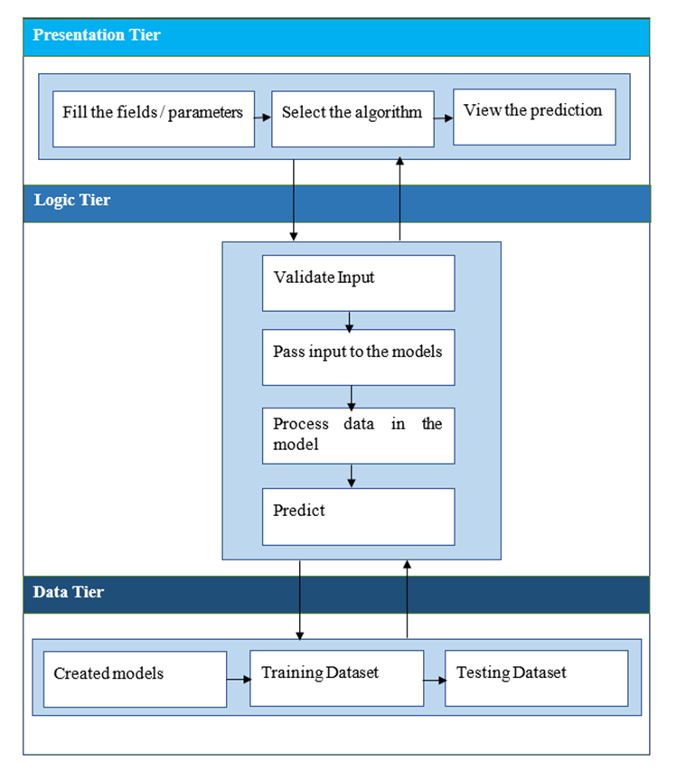
System Architecture

Slide 10
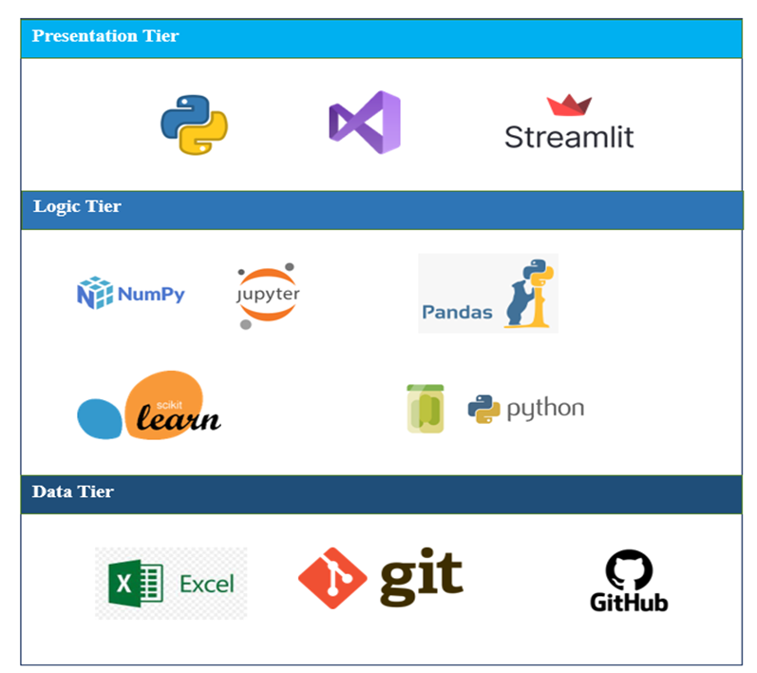
Technology Selection

Slide 11
Demo

Slide 12
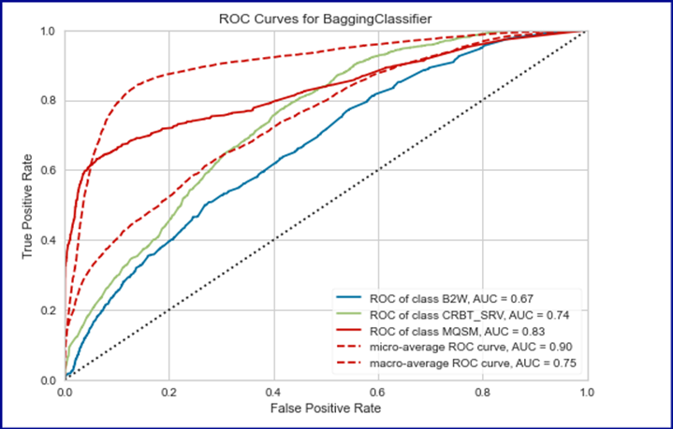
Testing
Algorithm | Accuracy
KNN | 72.31%
NB | 74.23%
Logistic Regression | 76.48%
Random Forest | 75.18%
Stacking | 73.70%
Bagged CART | 82.97%
XGBoost | 82.84%
AUC ROC Curve

Slide 13
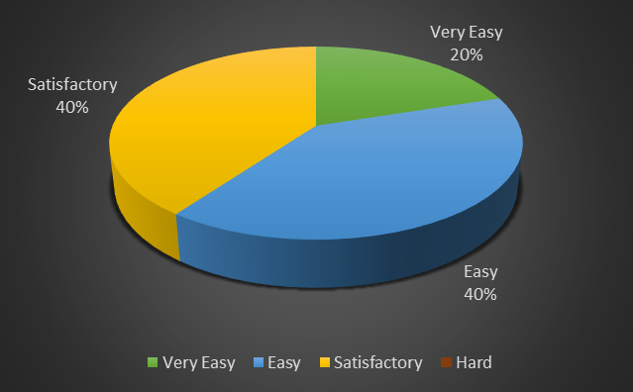
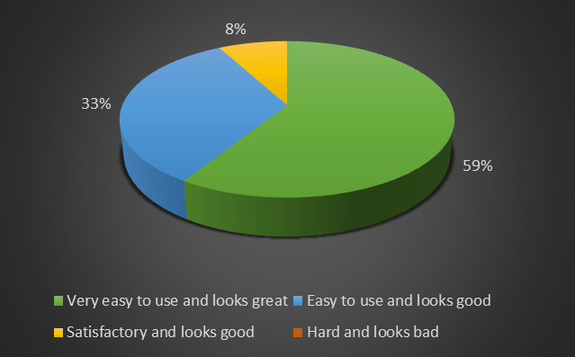
Evaluation
Difficulty of the system
Evaluators
Group | Position
Beginner developers | Undergraduate Student
Domain Experts | Software Architect
 | Tech Lead - Big Data & data Science
Technical experts | Senior Software Engineer
 | Senior Software Engineer
GUI of the application

Slide 14
Limitations & Enhancements
Limitations
Only one dataset which is collected from a Sri Lankan company has been used for testing and evaluation. If we can test the model with a dataset from another company, it will be more accurate
Models were trained and tested on a single machine
Enhancements
Encourage more learning styles
Implement a reporting component for the system
Use a large dataset to improve the performance of models

Slide 15
Skills and Problems
New skills acquired
Existing skills that used
Problems and challenges faced
Contribution to body of knowledge

Slide 16
Conclusion
The VAS prediction can be accurately done by using ensemble learners more than traditional machine learning algorithms

Slide 17
References
Kurniawan, F., Umayah, B., Hammad, J., Nugroho, S.M.S., Hariadi, M., 2017. Market Basket Analysis to Identify Customer Behaviours by Way of Transaction Data. Knowl. Eng. Data Sci. 1, 20. https://doi.org/10.17977/um018v1i12018p20-25
Seyedan, M., Mafakheri, F., 2020. Predictive big data analytics for supply chain demand forecasting: methods, applications, and research opportunities. J. Big Data 7, 53. https://doi.org/10.1186/s40537-020-00329-2
Srivastava, N., Stuti, Gupta, K., Baliyan, N., 2018. Improved Market Basket Analysis with Utility Mining (SSRN Scholarly Paper No. 3170300). Social Science Research Network, Rochester, NY. https://doi.org/10.2139/ssrn.3170300
Szymkowiak, M., Klimanek, T., Józefowski, T., 2018. APPLYING MARKET BASKET ANALYSIS TO OFFICIAL STATISTICAL DATA. ECONOMETRICS 22, 39–57. https://doi.org/10.15611/eada.2018.1.03
Vahidi Farashah, M., Etebarian, A., Azmi, R., Ebrahimzadeh Dastjerdi, R., 2021. An analytics model for TelecoVAS customers’ basket clustering using ensemble learning approach. J. Big Data 8, 36. https://doi.org/10.1186/s40537-021-00421-1

Slide 18
Thank You

