Slide 1

Tree_App Database Project
TreeApp is a not-for-profit social startup that wants to accelerate reforestation by using technology.
They are developing an app, where anyone can register and upload pictures of the trees they have planted, with other information such as description, date, geo location etc.
Additionally, the users will get points based on the number of trees they plant and a number of years they look after them, and Badges (displayed on their profile) based on their achievements.

Slide 2
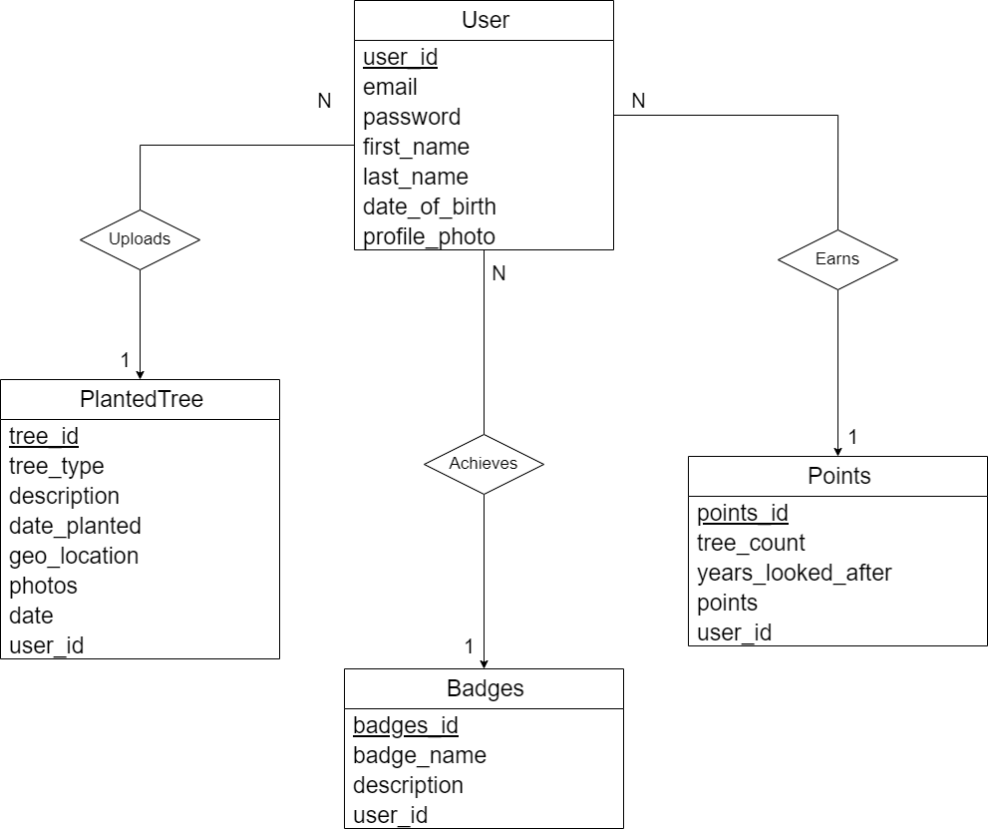
ER Diagram of tree_app
4 entities
User
Planted Tree
Points
Badges
Assumptions:
A user can plant multiple trees, but each tree has only one user.
A user can earn multiple points, but each point is related to only one user.
A user can earn multiple badges, but each badge is associated with only one user

Slide 3
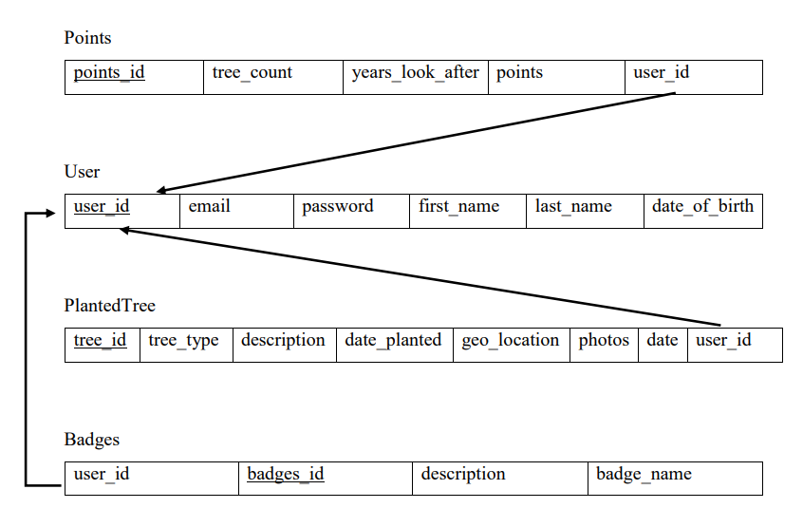
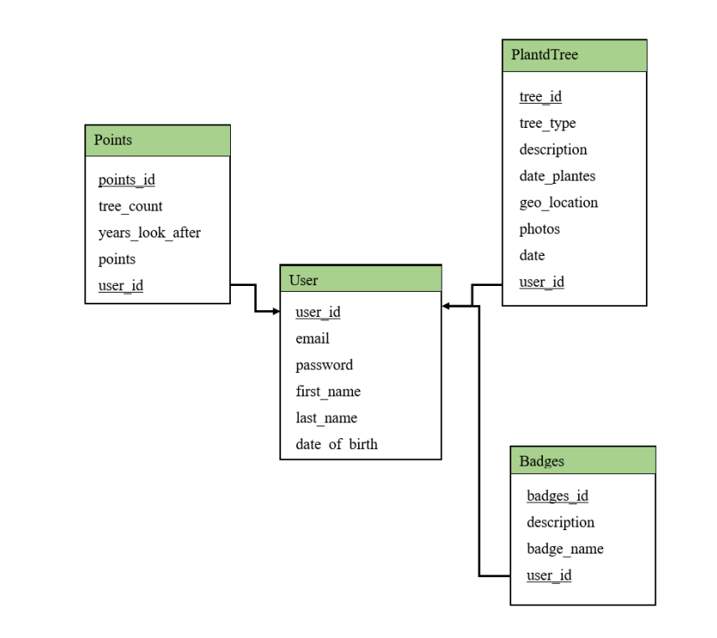
Schema Diagram of tree_app

Slide 4
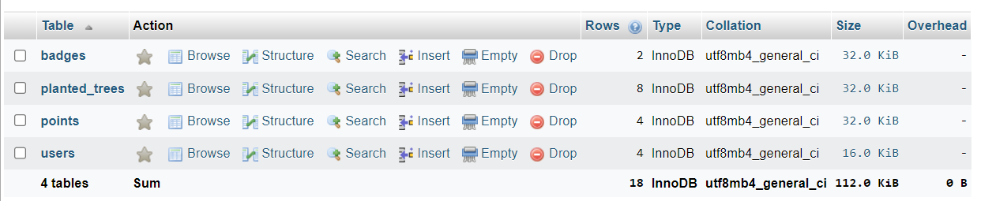
SQL database structure of tree_app
4 tables for 4 entities as:
users
planted_trees
points
badges

Slide 5
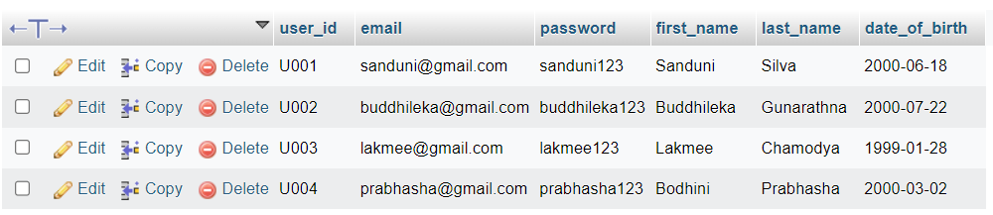
users table
SQL query to create users table:
Sample SQL query to insert values to users table:
CREATE TABLE users (
user_id VARCHAR(255) PRIMARY KEY,
email VARCHAR(255),
password VARCHAR(255),
first_name VARCHAR(255),
last_name VARCHAR(255),
date_of_birth DATE,
);
INSERT INTO users (user_id, email, password, first_name, last_name, date_of_birth, profile_photo) VALUES
(U001, ‘Sanduni@gmail.com', ‘sanduni123', ‘Sanduni', ‘Silva', ‘2000-06-18’),
(U002, ‘buddhileka@gmail.com', ‘buddhileka123', ‘Buddhileka', ‘Gunarathna', ‘2000-07-22);

Slide 6
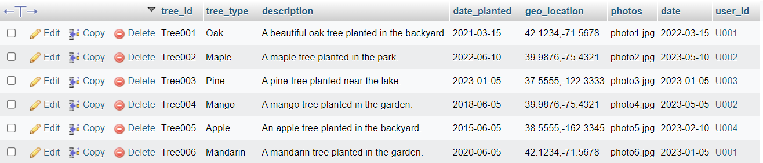
planted_trees table
SQL query to create planted_trees table:
Sample SQL query to insert values to planted_trees table:
CREATE TABLE planted_trees (
tree_id VARCHAR(255) PRIMARY KEY,
tree_type VARCHAR(255),
description TEXT,
date_planted DATE,
geo_location VARCHAR(255),
photos VARCHAR(255), date DATE, user_id VARCHAR(255, FOREIGN KEY (user_id) REFERENCES users(user_id) );
INSERT INTO planted_trees (tree_id, tree_type, description, date_planted, geo_location, photos, date, user_id) VALUES
(Tree001, 'Oak', 'A beautiful oak tree planted in the backyard.', '2021-03-15', '42.1234,-71.5678', 'photo1.jpg', '2021-03-15’, U001),
(Tree002, 'Maple', 'A maple tree planted in the park.', '2022-06-10', '39.9876,-75.4321', 'photo2.jpg', '2022-06-10’, U002);

Slide 7
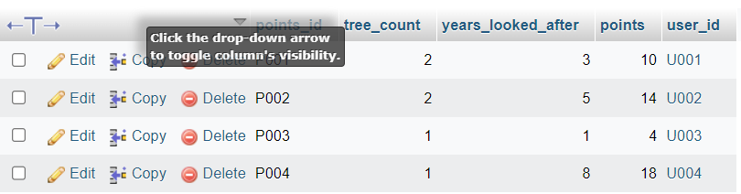
points table
SQL query to create points table:
Sample SQL query to insert values to points table:
CREATE TABLE points (
points_id VARCHAR(255) PRIMARY KEY,
tree_count INT,
years_looked_after INT,
points INT,
user_id VARCHAR(255, FOREIGN KEY (user_id) REFERENCES users(user_id) );
INSERT INTO points (points_id, tree_count, years_looked_after, points, user_id) VALUES
(P001, 2, 3, 10, U001),
(P002, 2, 5, 14, U002),
(P003, 1, 1, 4, U003)
(P004, 1, 8, 18, U004);

Slide 8
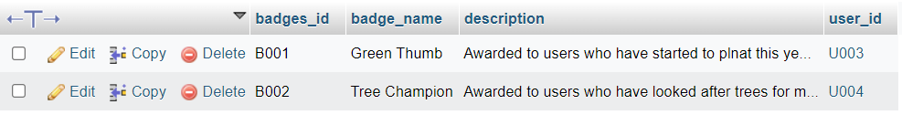
badges table
SQL query to create badges table:
Sample SQL query to insert values to badges table:
CREATE TABLE badges (
badges_id VARCHAR(255) PRIMARY KEY, badge_name VARCHAR(255), description TEXT,
user_id VARCHAR(255, FOREIGN KEY (user_id) REFERENCES users(user_id) );
INSERT INTO badges (badges_id, badge_name, description, user_id) VALUES
(B001, ‘Green Thumb', 'Awarded to user who have started to plant this year.’, U003),
(B002, ‘Tree Champion’, 'Awarded to user who have looked after trees for 8 or more years.’, U004);

Slide 9
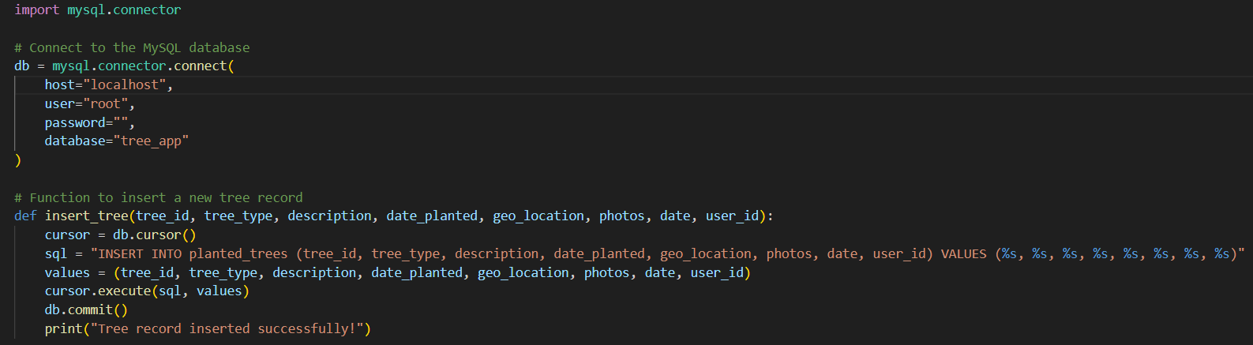
Python: Functionality to insert a tree
Code:
Updated database:

Slide 10
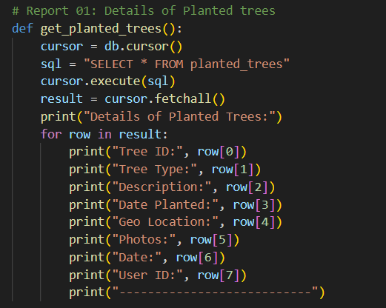
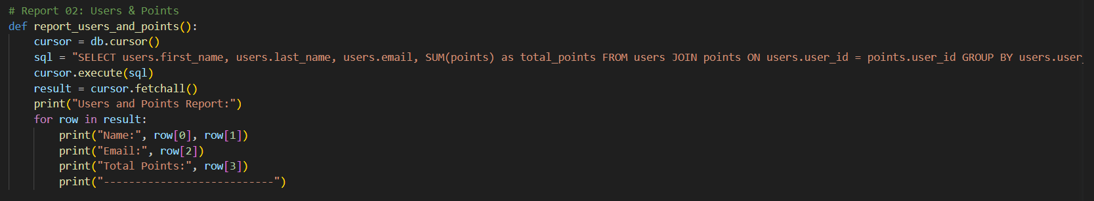
Python: Functionality to generate 2 reports
Report 01: Details of Planted Trees
Report 02: Users & Points

Slide 11
END

